Slide 1
Piping Task

Slide 2
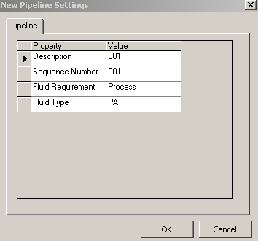
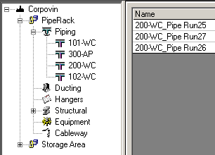
Pipeline
  Is a high-level grouping of Pipe Runs that is created in System and Spec Task environment.

Slide 3
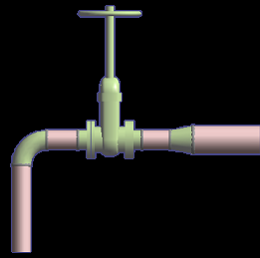
Pipe Run
  A pipe run identifies one or more path features that share a common pipe specification, flow direction, size, temperature, pressure, etc…
  One or more pipe runs make up a pipeline.
Pipe Run 1
Pipe Run 2
6” NPD
4” NPD

Slide 4
Features
  Define the geometry path of the pipe run and your design intent that occur along the path.
  When you route a pipe run, you place features.
Run Change Feature
Turn Feature
Straight Feature
Along Leg Feature
End Feature

Slide 5
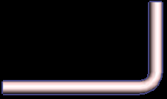
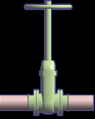
Parts
  Are the physical components generated by the feature.
Straight Feature
Along Leg Feature
Parts:
- Mating Flanges
- Gate Valve
- Gaskets/Bolts/Nuts
Part: Pipe
Turn Feature
Straight Feature

Slide 6
Port
  Is the actual connection point for the part.
Port 1
Port 2

Slide 7
Path leg
  Is a section of a pipe run maintaining one general direction between turns, branches and end.
Path leg 2
Path leg 1

Slide 8
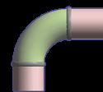
Connections
  Provide the connectivity model between ports of different components, nozzles and pipes (welded, bolted, etc...)
Straight Feature
Leg 1
Turn Feature
Generated parts
Pipe
Elbow
Port1
Port1
Port2
Leg 2
C
Port2
Weld
C
Port1
Straight Feature
Weld
Port2
Pipe

Slide 9
Piping Hierarchy
  - Piping System System and Spec Task
  - Pipeline System
  - Pipe Run
  - Features
    - Parts/Components
    - Ports
    - Connections

Slide 10
Route Pipe Command
        Start routing a Pipe Run from
        - a nozzle/component port
        - a point in space
        - an existing pipe run

Slide 11
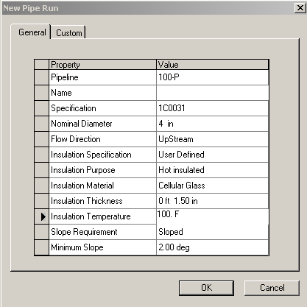
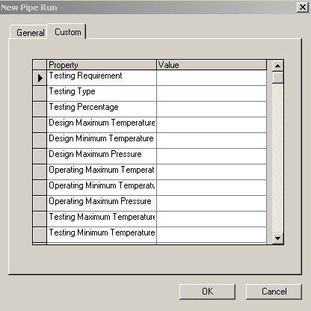
Pipe Run Dialog Box
  Define the Pipe Run properties

Slide 12

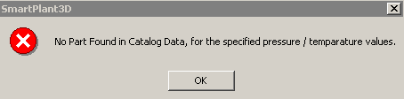
Route Pipe Command
  Wall thickness calculations require Temperature and Pressure values
Trigger wall thickness calculations
Notes:
.

Slide 13
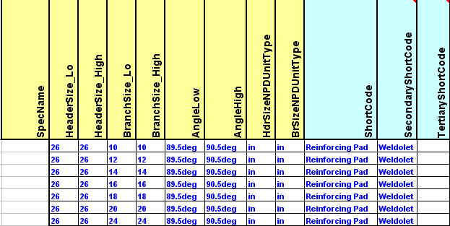
Route Pipe Command
  Branch reinforcement calculations require Temperature and Pressure values
Pick the Strongest short code
Notes:
.

Slide 14
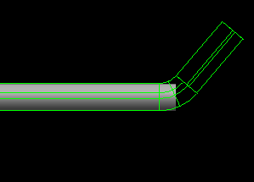
Route Pipe Command
  Designation of commodity options while routing
Commodity option for turn
Commodity option for straight
Angle control
Notes:
.

Slide 15
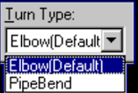
Turn Type Option
  Displays the type of turn (Default, Elbow, Pipe Bend, or Miter).
  Default turn type: the system selects the type of turn as defined in the Ref Data (Default Change of Direction)
SP3D Piping can check pipe bends as they are modeled to ensure that they have adequate lengths for fabrication on an allocated bending machine.

Slide 16
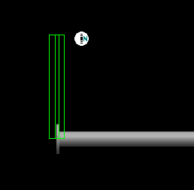
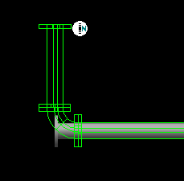
Route Pipe Command
  Route command should only compute the turn part on commit or (on-going)
  Use Shift + F keys to toggle the compute modes
Do not compute the turn part
Compute the turn part
Notes:
.

Slide 17

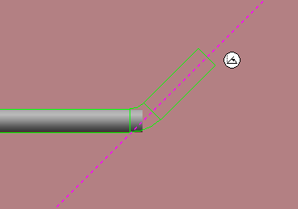

Length Control Tool
  Enter or select a length for the current route path.
  - Length Lock: Lock or unlock the length field.
  - By Default: dynamically displays the current
  length of the pipe run from a turn point or a
  starting point.
  - contains the last 10 values entered by the user.

Slide 18
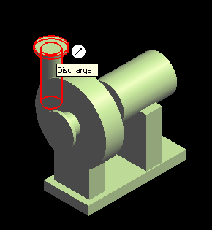
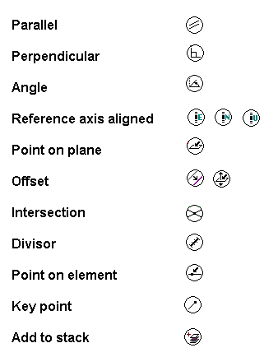
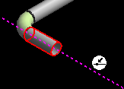
SmartSketch

Slide 19
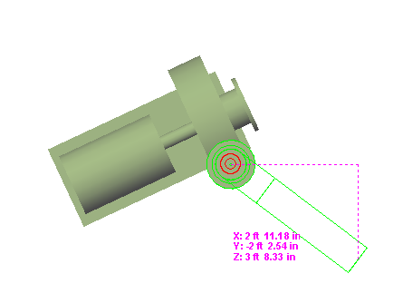
Route Pipe Run with PinPoint
  PinPoint provides coordinate inputs to the route command.
  x,y,z coordinates are relative to Target Point.
  Relative Tracking Mode.

Slide 20


Angle Control Tool
  Enter or select an angle for the current route path.
  - Angle Lock: Lock or unlock the Angle field.
  - By Default: Dynamic readout of the current
  bend angle as defined by the cursor.
  - The angle field can only be 0 or 90 deg if the working plane
  is set to NO Plane.

Slide 21
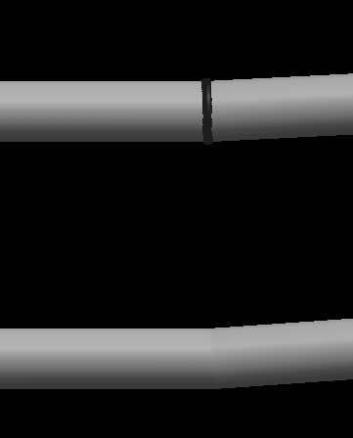
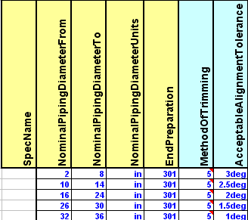
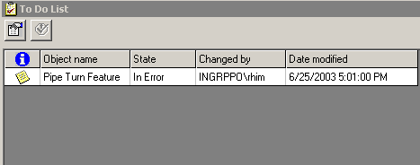
Route Pipe Command
  Port flexibility to allow connection of non-aligned objects
2.9 deg
4 deg
Notes:
.

Slide 22
Pipe Run Smart Step Ribbon Bar
  Angle lock in Route command should remain locked until manually unlocked
  Working plane should be set to plan plane when sloped run is created
  Compute offset of piping from duct and cableway routes
Working Plane Control
Angle Lock
Offset Control
Notes:
.

Slide 23

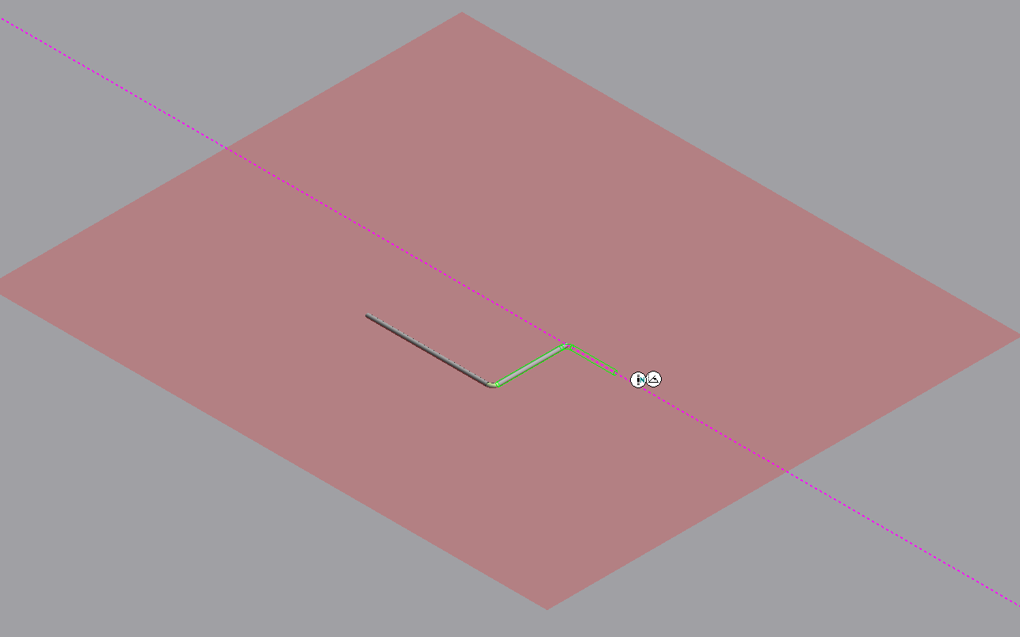
Working Plane Control Tool
  Constrains the route path to a specific plane.
  Ctrl + Keyboard
  1 - Plane Plane
  2 - Elevation Plane
  3 - Section Plane
  4 - Plane by Turn/Branch
  5 - Plane by Three Points
  6 - No Plane
Route plane

Slide 24
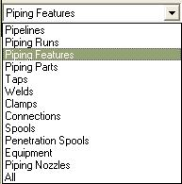
Pipe Select Command
Provides specific filters:
  Workspace Explorer (set the filter to all and key in the string in the field to find an object).
  Tools > Select by Filter

Slide 25
Delete a Pipeline
  Deleting a pipeline deletes all pipe runs, features, and parts associated with that pipeline.

Slide 26
Delete a Pipe Run
  Deleting the run deletes all features (and thereby all parts) belonging to the run.
  The software attempts to maintain the design integrity of the model by adjusting all previously connected features.

Slide 27
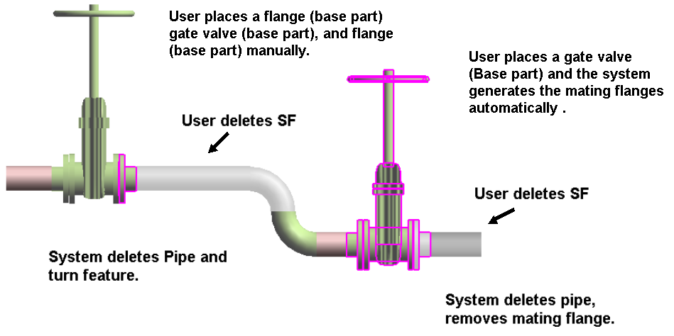
Delete Straight Features
Example:

Slide 28
  LAB – 1
  LAB – 2
  LAB – 3
  LAB – 4

Slide 29
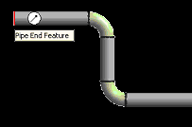
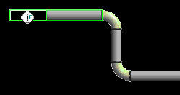
Run To or From End Features or Nozzle
  When you select an end feature during the creation of a pipe run, the Route Pipe command joins the run with the end feature and inherits the properties of the run that the end feature belongs to.

Slide 30
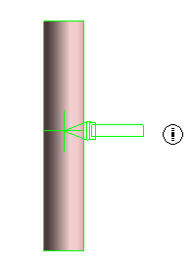
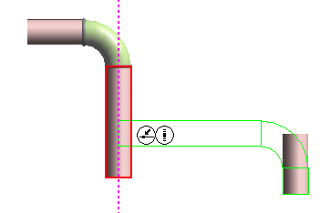
Routing To or From a Straight Feature
  Use the Route Pipe command
  Branch on Pipe Run
  Intersect to Branch

Slide 31
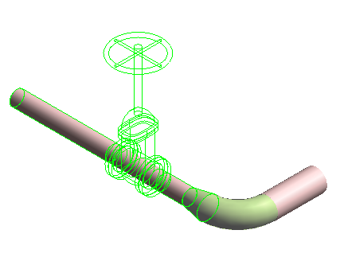
Insert Component
  Insert command inserts a component interactively.
  In-line components (Valves, Tees, Reducers); Change of direction (Elbows, Miters, Bends); End Components (caps and plugs); Strainers (Y-strainers, Basket Strainers) etc…

Slide 32
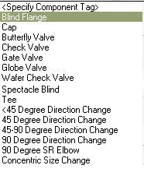
Insert Component Ribbon Bar
Comp Rotation
Select Feature/EF or Nozzle
Select Component Type
Display the Pipe Run
Insertion Point
Toggle Ports
End the command
Display Component Tag
Specifies a port to be the insertion point
Displays a list of available component

Slide 33



Insert Component
Reference Position option:
The system should slide the component along the path so that the select position (example: Origin) is located at the insertion point.
Flip option: port 1
Reference position: port 1
Reference position: origin
Reference position: port 2 or port 3

Slide 34


Insert Component
Flip option:
Toggles through the ports available for the component being inserted. As each port is toggled, the component is oriented so that the selected port is aligned along the axis of the leg on which it is being inserted.
Reference position: port 1
Flip option: port 1
Flip option: port 2
Flip option: port 3

Slide 35
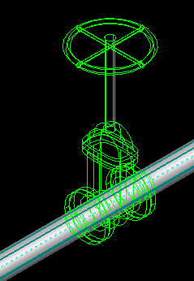
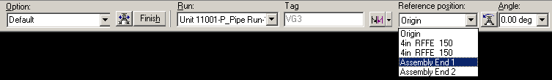
Insert Component
  Mating part ports / end terminus available in the Ref Position list.
Mating Ports

Slide 36
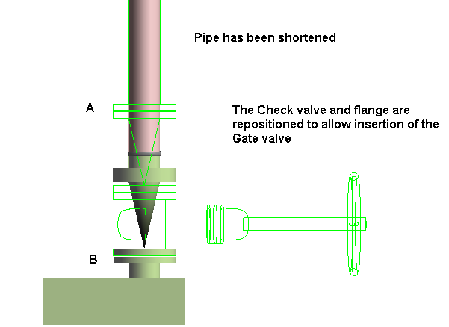
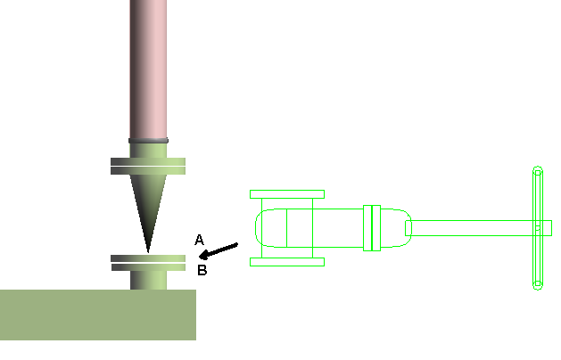
Insert Component
  Insertion of a new component at an equipment nozzle
  Example:
  Since a suitable straight feature exists on the leg, the check valve and its connecting flange are repositioned and the gate valve is inserted.

Slide 37
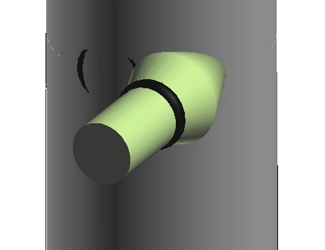
Insert Non-Radial Branching
  Supported using either the Insert Component command or the Route Pipe command.
  Possible to create tangential branches with reinforcing welds, reinforcement pads, or non-radial weldolets.

Slide 38
  LAB – 5
  LAB – 6
  LAB – 7
  LAB – 8
  LAB – 8A

Slide 39
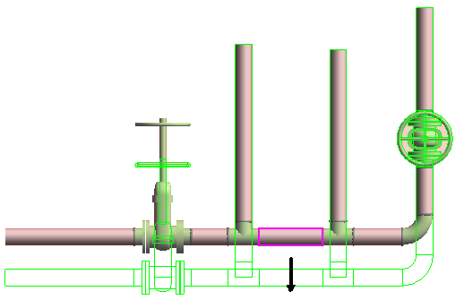
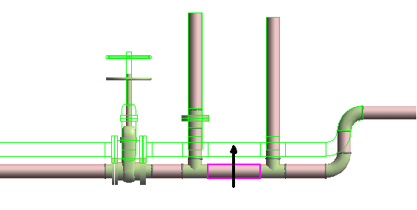
Edit Straight Features
  Moving a SF moves the entire leg to which the feature is connected.
  The move direction is always perpendicular to the axis of the SF.
  A branch feature (BF) connected to the moved leg maintains its original angle.
  Movement stops when parts on the associated leg overlap, or when they overlap with adjacent parts on connected legs.

Slide 40
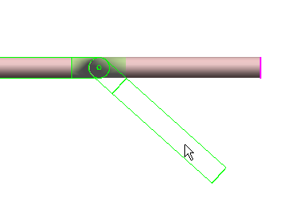
Edit End Features
  Moving the end feature by key in the length

Slide 41
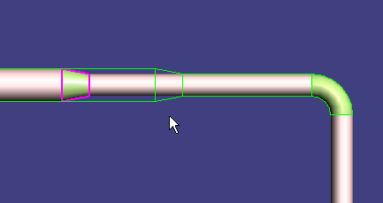
Edit Run Change Features
  You can move the RCF along the associated straight feature. As you move the feature, the RCF appears in dynamic mode.

Slide 42

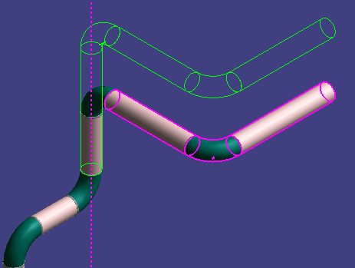
Editing Features
  Shift – Select Command
Move selected legs
- Point along tool

Slide 43
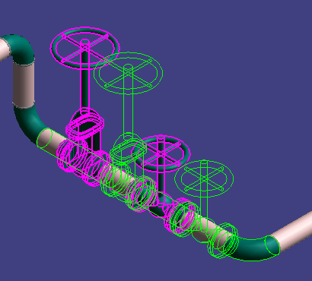
Editing Features
  Shift – Select Command
Move along the leg the selected items

Slide 44
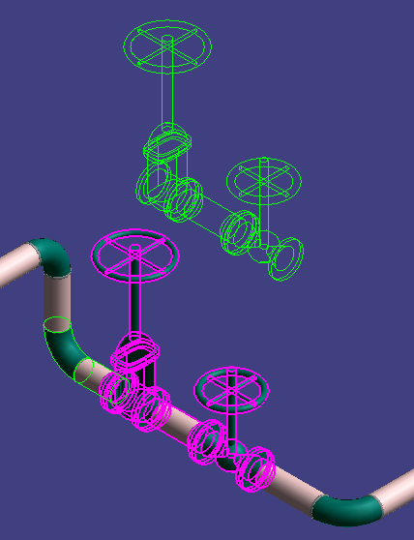
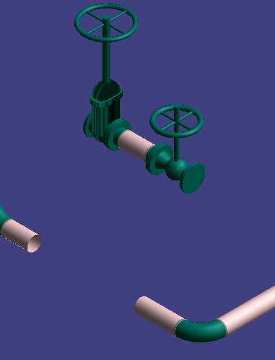
Editing Features
  Shift – Select Command
Turn off the moving along the leg

Slide 45
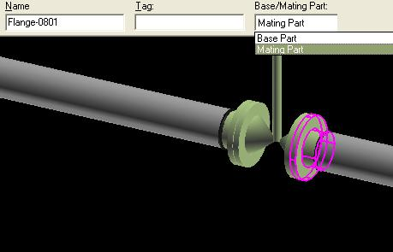
Modification
Mating parts can be changed to base parts using either the ribbon or the property page.
Mating Parts: Depend of a parent component for placement, i.e. if parent valve is deleted, mating flange is also removed.
Base Parts: Independent from mating component, i.e. if connecting valve is deleted, flange remains.

Slide 46
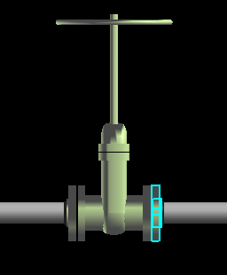
Modification
  SP3D will allow the user to specify a commodity option for the base part being inserted or modified. During modification, the user is able to change the option code for mating parts.
Notes:
In case of NoPartsFound error client should display a warning message and commit the change.

Slide 47
Modification
  Elegant solution to branch/turn angle modification if component is not valid
  For Trimmable Elbows (eg 2-45 deg) if the angle is changed to any value in this range , the component is retained. Other than this range the solver replace the component with the suitable part (I.e default).
  For NonTrimmable any change in angle will replace the part with the best suitable one.

Slide 48
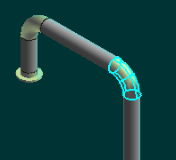
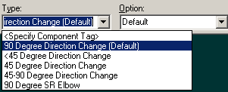
Modification
  Operator may replace item with another of same type
  Presentation of only one short code for a particular item.
  If a component has been generated automatically by the solver, the user sees two entries in the Type list for that object: one with a "Default" suffix signifying that this part is rule generated and one without the suffix.
Notes:
.

Slide 49

Modification
  New Enhancement in V4
  Ability to rotate components after insertion
Dynamic
Key-In

Slide 50
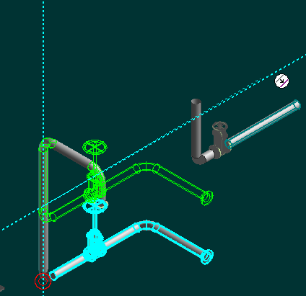
Modification
  Offset field on multiple edit ribbon bar

Slide 51
Modification
  New Enhancement in V4
  Copy/Paste commands are available
  Mirror Copy command is available
  Creation of a connection (geometry permitting) when multiple objects are moved and placed on another object

Slide 52
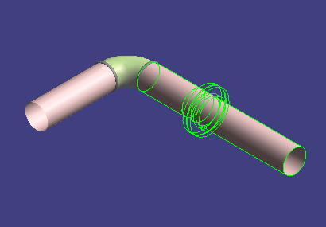
Insert Split Command
  The Insert Split command cuts a straight pipe and connects the parts by a weld joint or a takedown joint.

Slide 53

Insert Split Ribbon Bar
Feature Break
Display the type of split
Insertion Point
Takedown joint
Display the Pipe Run
Displays a list of available option items for the split
Select Feature
Welded Joint

Slide 54

Attribute Break
  The Insert Split command can also be used to create a feature break. This makes it possible to stop heat-tracing, insulation, or a surface coating at an arbitrary location along the pipe instead of at a weld or other break in the line.

Slide 55




Attribute Break
  Edit Pipe Run properties during modeling to create an attribute break.
  When the run properties are changed, the corresponding feature properties are automatically changed as well.
  When NPD is changed, reducers are selected from the spec to satisfy the NS change.

Slide 56
Edit Properties Command
  Edit Pipe Run properties.
  Features inherit the
  common properties of
  the run by default.

Slide 57

Edit Properties Command
  Flow Direction
  Downstream is the direction from the start to the end of the run
Bi-directional, Upstream, Downstream, No flow, Undefined

Slide 58

Edit Properties Command
  Insulation

Slide 59

Edit Properties Command
  Edit Pipe Run properties
  Relation Tab displays all the relationships defined for the selected pipe run.

Slide 60

Properties Pages
  Pipe cut lengths to reflect lining & weld gap

Slide 61

Properties Pages
  Ability to insert notes on higher level objects such as pipelines and runs
Notes:
.

Slide 62

Properties Pages
  Connections Tab is added for pipe parts
Notes:
.

Slide 63



Properties Pages
  Management of commodity overrides
  (Base Part Name)
Enable - 10
Disable - 5
Notes:
.

Slide 64


Properties Pages
  Schedule/Thickness override options
Disable - 5
Enable - 10
Notes:
.

Slide 65


Properties Pages
  Right clicking on piperun or feature brings up menu when in Route Pipe environment

Slide 66



Route Pipe Run Using the Offset Value
  Offset Control Tool
  If the reference object is a planar surface or linear element, the offset distance is measured from the surface or line to the indicated reference plane on the pipe being routed. Five offset reference are available.
  An offset SmartSketch point is found on either side of the referenced plane or linear element.
North

Slide 67

Route Pipe Run using the offset value
  How the Solver finds the offset:

Slide 68



Insert Component by its Engineering Tag
The engineering tag will be available on the P&ID, and may be used to select a piping commodity from the Piping Specification.

Slide 69
Instrument & Piping Specialty Placement
We have two types of piping specialty/instrument Parts:
1. Stock item: Stock items represent those piping items that are purchased from a manufacturer’s catalog, where no real engineering is required other than selecting the correct size, material, etc.
2. Custom-engineered item: custom engineered items are built items according to the process.

Slide 70

Instrument & Piping Specialty Placement
Placing piping specialty/instruments

Slide 71
  LAB – 9
  LAB – 10
  LAB – 11

Slide 72


Sloped Pipe
  Slope format
Notes:
.

Slide 73

Sloped Pipe
Specify Slope on New Run Properties page

Slide 74


Sloped Pipe
Specify Slope Direction
Turn Slope Lock On/Off

Slide 75


Sloped Pipe
  Modification of the “Slope” value will graphically change the slope of a run.

Slide 76

Route Flanged Pipe
  Two sample flanged piping specifications:
  - 1C0100
  - 1C0101
  Purchase length setting controls placement of flanged ends at fixed intervals for long runs.
Notes:
.

Slide 77



Instruments
  Placement of Instrument Items On the Fly

Slide 78


Instruments
  Placement of Instrument Items On the Fly: User is able to provide item dims.

Slide 79
  LAB – 12
  LAB – 12A
  LAB – 13
  LAB – 14

Slide 80

Insert Tap
  Use this command when in need to tap a drain, vent, or instrument connection. Used to place taps on all piping components; elbows, tees, caps, valves, pipes, and so forth; except for mating parts.

Slide 81



Specialty Items
  Placement of Specialty Items On the Fly

Slide 82

Specialty Items
  Placement of Specialty Items On the Fly

Slide 83

Route Using Spherical Coordinates
  Relative Tracking Mode

Slide 84
  LAB – 15
  LAB – 15A
  LAB – 16
  LAB – 17

Slide 85


Route Pipe by Cardinal Points
Route a pipe by the top, sides, bottom, or invert elevation of the pipe instead of the pipe centerline.
Routing by invert elevation is supported for use in modeling underground piping.

Slide 86



Spools
Generation of Spools
  Generate Spools

Slide 87



Spools
Generation of Spools
  Create Penetration Spools

Slide 88
Spools
Naming of Spools
Spooling options always default to those defined in the Catalog with interactive setting changes persisting for the current session only.

Slide 89

Spools
Breaks at unions by system
Breaks at user defined control points

Slide 90
Sequence Objects
  Renames objects in the selected pipeline, pipe run, or spool such that the names are in order. You can select to sequence the objects based on flow direction or topology.

Slide 91


TEF and Routing From P&ID
  Users can import SmartPlant P&ID pipeline and component data into the 3D active data.

Slide 92
  LAB – 18
  LAB – 19
  LAB – 20
  LAB – 21
  LAB – 22

Slide 93


Materials Reports
  Users can easily extract materials lists for review from their modeled pipelines.

Slide 94

Pipe Supports
  Hangers and Supports Task provides an integrated supports environment.

Slide 95


Interactive Clash Detection
  System can check new piping for interferences with same and other displayed disciplines as user works.

Slide 96
  LAB – 23
  LAB – 24
  LAB – 25

