Slide 1

SP3D Basic Training
“I’m going to cure YOU from the old CAD blues”
Rick

Slide 2





SP3D Basics Online Training Intro
FIRST TIMERS! ONE-TIME ONLY: Click here to install Camtasia video TSCC Codec
OLD TIMERS!
SEE WHAT’S NEW
FIRST TIMERS!!
CLICK BUTTON TO START INTRODUCTION VIDEO
NOTE: First time users should read through all the slides before proceeding to the lessons menus.

Slide 3
Key Concepts
Single Database
CAD Neutral
Catalog-Driven
Work-share Capable
Designer Lessons Menu
  Note: These lessons were designed as an introduction to the basics to get you started with SP3D. More in-depth learning can be made available through your friendly CAE department
Catalog Lessons Menu

Slide 4

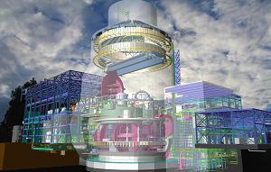
Single Database
20th Century design software architecture:
  Intelligent data stored in relational database
  Graphic data stored in CAD files
21st Century design software architecture:
  Graphics and intelligent data stored in the same relational database system
Model
Database
3D CAD
3D CAD
3D CAD
Model
Database

Slide 5
CAD Neutral
SP3D does not require installation of a separate CAD engine to support graphics
SP3D can output drawings and 3D graphics to popular CAD formats

Slide 6
Catalog Driven
Piping, cable tray, conduit, structural items must all be defined first in the reference catalog database before they can be placed in the 3D model
Equipment items can be fully predefined per vendor drawings in the reference database, imported from 3rd party 3D applications, or modeled with primitive shapes

Slide 7
Work-Share Capable
Multiple offices can contribute to the 3D model
Integration happens by database servers at multiple offices synchronizing with each other automatically and regularly

Slide 8
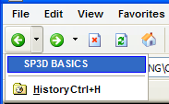

Designer Courses Menu
SELECT A LESSON TO BEGIN
IMPORTANT: Allow “active content” if prompted by the web browser
Simply use the browser’s “Back” button to navigate back to this page…
Common Applications
Equipment Modeling
Shaw Equipment Parametrics
Piping Modeling
Electrical Modeling
Grids and Coordinate Systems
Structural Modeling
Pipe Supports
Orthographic Drawings
Isometric Drawings

Slide 9

Reference Data Course Menu
SELECT A LESSON TO BEGIN
IMPORTANT: Allow “active content” if prompted by the web browser
Simply use the browser’s “Back” button to navigate back to this page…
Equipment Reference Data
Piping Reference Data
ISOGEN Administration I
NOTE: These lessons require prior training in
-Common Apps.
-Equipment Modeling
-Piping Modeling

