Slide 1


Slide 2

SP3D Electrical Modeling Task

Slide 3

Overview
The Electrical task provides a workspace for distributed cableway system 3D design and routing
The Electrical task uses point-by-point route design and inserts cableway and cable tray components during design
Also, the task includes placement of conduit
A run of tray/conduit includes straight features; along-leg features such as branches, transitions, and reducers; turn features; and end features
Placement of features is spec-dependent: Users can only place items that were previously defined in the reference data catalog
After completing cable tray design and route conduit, you then route cables through existing cable trays/conduit and define their properties. Cables are implied items and are not permanently displayed in 3D
As the cable trays are modified, cable lengths are automatically adjusted. When new cables are added to trays, the fill of the cable tray or conduit is calculated

Slide 4
Terms to Know
These terms describe the different tray and conduit components that you work with during a session with the software:
▪ A feature is a high-level component that composes part of a run in the model. An example is a tee. You are free to move the feature at any time during the design process
▪ A turn feature is a high-level component that composes part of a run in the model. The turn feature represents a change in direction for the cableway or conduit run
▪ An end feature is a high-level component that represents either end of the cableway or conduit run
▪ A straight feature is a high- level component that represents a straight section of cableway or conduit
▪ A transition feature is a high- level component that represents a change of cross section of the cableway
▪ A parent feature is a high-level component that represents a feature with an additional feature. An example is an insulated straight feature

Slide 5
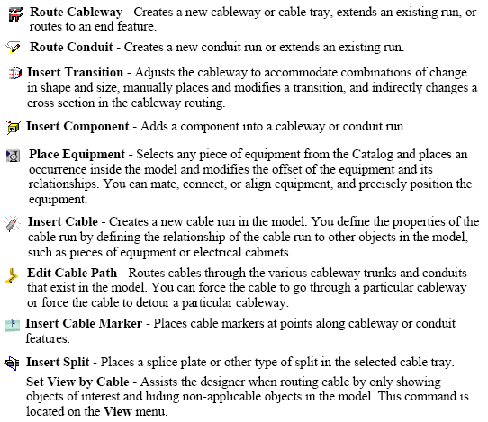
Electrical Task Commands

Slide 6
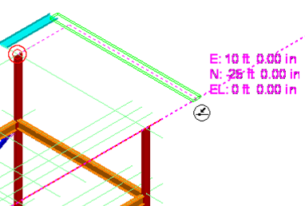

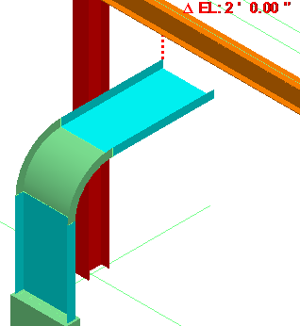

Routing Cableway
Basic Start (Click to see video)
Length and Direction
Pinpoint
  Rectangular Coordinates
  Spherical Coordinates
  Relative Tracking (Delta increments from end pt.)
SmartSketch
From/To End Features
From/To Equipment Ports
From/To Branch
Offset Route
Labs: 1-9
(Click to open Labs URL)

Slide 7
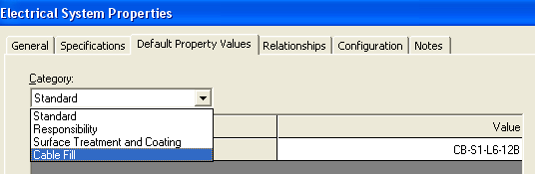
Default Run Properties
Ability to set Default Run Attributes at System Level
  User can set default cableway attributes at the parent Electrical system level. These attributes are inherited by all child Cableways and used by Cable auto route command
Lab: 13

Slide 8
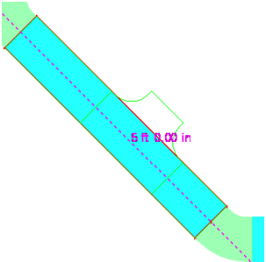
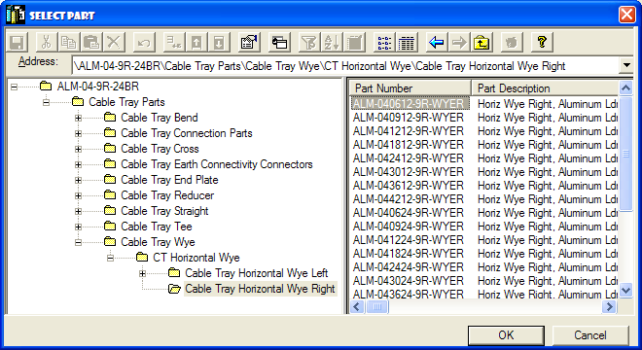
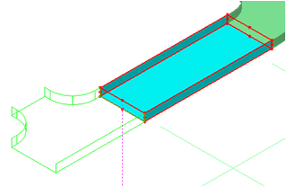
Cableway Insert Component
Parts can be inserted manually along straight runs
Parts can be inserted at cableway ends
Lab: 10

Slide 9
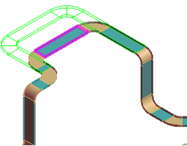
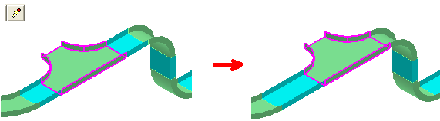
Cableway Editing
Cableway runs editing
Parts editing
Lab: 12

Slide 10
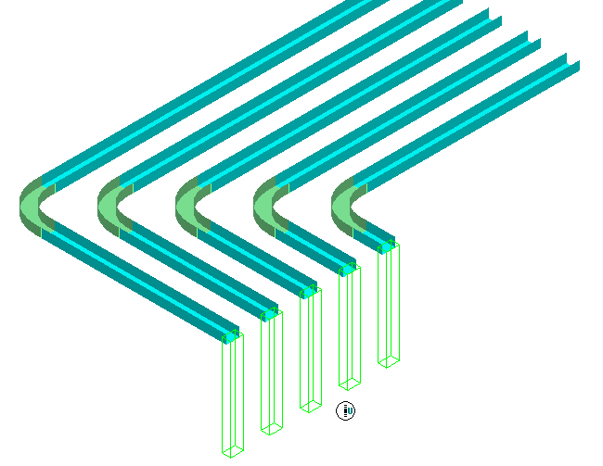
Multiple Cableway Routing
Ability to Route Multiple Cableways
  User can route multiple cableways at the same time. User routes the Master Run and can have slave runs to Left and right
  or Up and down
  Once routed, the runs will function as independent systems with no relationships created between them
Labs: 14-15

Slide 11
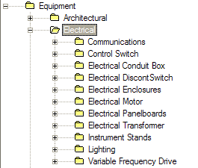
Electrical Equipment
Various electrical equipment items are available without need for switching to Equipment Modeling Task
Custom electrical equipment items can be added to the library
Electrical equipment items can have constraint relationships to other items, e.g. a light fixture can have a connect relationship with an existing structural column, such that if the column is relocated, the fixture will attempt to relocate with it
Labs: 19-20

Slide 12
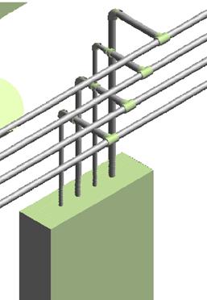
Conduit Routing
Same routing tools as Cableway’s:
Length and Direction
Pinpoint
  Rectangular Coordinates
  Spherical Coordinates
  Relative Tracking (Delta increments from end pt.)
SmartSketch
From/To End Features
From/To Equipment Ports
From/To Branch
Alternate Route and Insert Component
Lab: 21

Slide 13
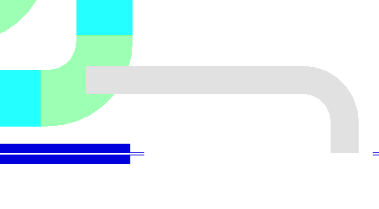
No-Part Cableway Space Reservation
Ability to Route Cableway from No-part specs (e.g. spec0)
  Cableway can be branched along the center line of cableway turn. Cableway can be branched horizontally, vertically and slantingly
  Cables can be routed through this branch without disconnection
  This functionality is used when routing cableways as space reservation without parts (zero-spec cableway)
Labs: 11, 23

Slide 14
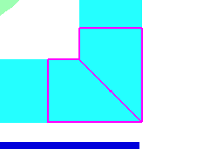
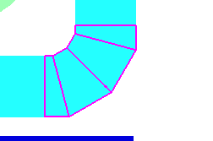
Mitered Bends
Ability to model one cut Miter
Able to model multi cut miters
Lab: 24

Slide 15
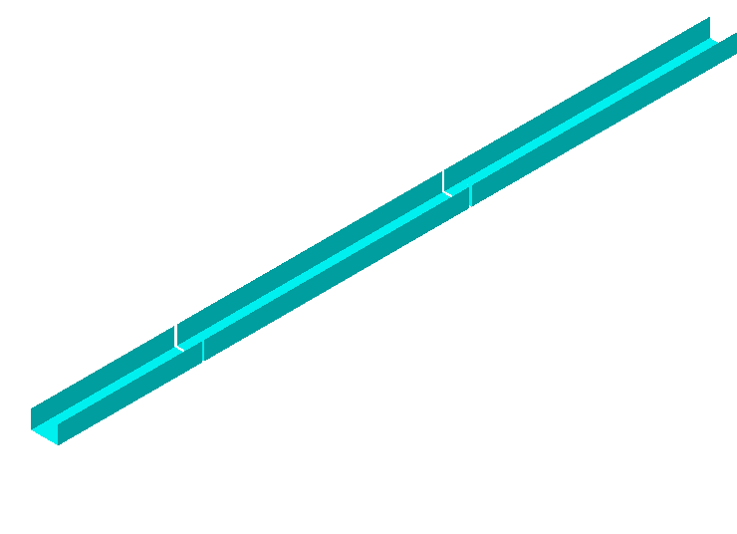
Cable Tray Splits
Option to insert Cable Tray Splits
  User can insert splits/gaps on Cableways
  Option to Specify Gap
  Option to insert Single or
  Multiple Splits
Lab: 25

Slide 16
Cable Routing
In the Electrical task, you can create cables and then route those cables through existing conduit and cableway. The software provides the following features:
Create cable and assign properties
Ability to Create Parallel Cables
Ability to automatically route cables on the shortest path from start point to end point. Uses set of rules to find the nearest cableways
Editable cable routes including the ability to define where cables enter and exit cable tray
Insert cable markers and generate a report of the cable route by marker name
Cables are implied items that are not permanently displayed in 3D, but can be selected and seen as single line graphics
Labs: 26-29

Slide 17
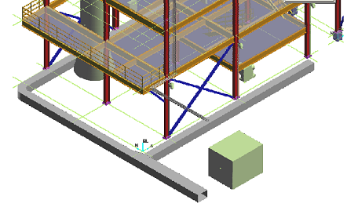
Duct Banks Routing
Reserves space without spec-driven parts.
Same routing tools as Cableway’s:
Length and Direction
Pinpoint
  Rectangular Coordinates
  Spherical Coordinates
  Relative Tracking (Delta increments from end pt.)
SmartSketch
From/To End Features
From/To Branch
Lab: 30

