Slide 2
SP3D Electrical Reference Data

Slide 3
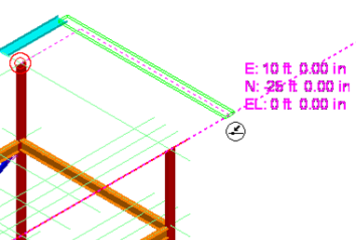

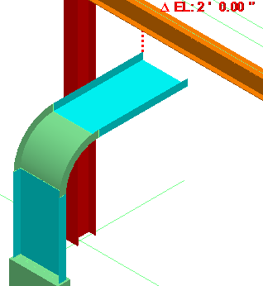

Routing Cableway
Basic Start (Click to see video)
Length and Direction
Pinpoint
  Rectangular Coordinates
  Spherical Coordinates
  Relative Tracking (Delta increments from end pt.)
SmartSketch
From/To End Features
From/To Equipment Ports
From/To Branch
Offset Route
Labs: 1-9
(Click to open Labs URL)

Slide 4
Electrical Reference Data
Six Separate Tasks:
  Cableway Reference Data
  Duct Bank Reference Data
  Cable Tray Reference Data
  Conduit Reference Data
  Cable Reference Data
  Electrical Symbols

Slide 5
Cableway Reference Data
Cableways do not have any physical parts; they are used in the 3D model to reserve space for cable trays and cable. The reserved space allows interference checking along the route. That is, if any other object is in the same space, a clash results which can be resolved in the modeling phase.
0-spec cableways allow the user to reserve this space without physical parts actually being assembled for this path at the site

Slide 6
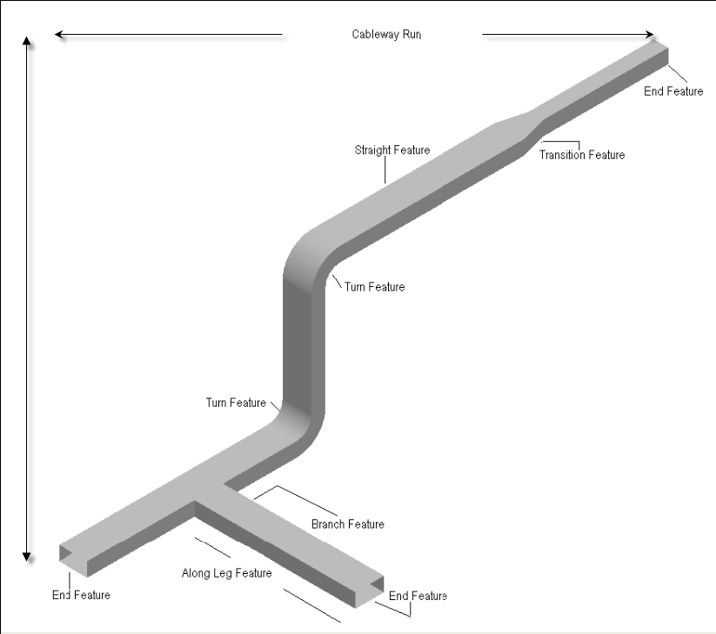
This illustration shows a cableway system and some of its features.

Slide 7
Duct bank Reference Data
A duct bank is the concrete-encased underground container used for laying conduits for electric and telephone lines, as well as other utilities. In general, two or more conduits routed side-by-side create a bank
The software allows you to route both the casing and its conduits simultaneously—customizing each conduit, as necessary.
you can map connectivity from a conduit in one duct bank to a conduit in another duct bank at a pull pit or manhole junction
Duct banks are generally sloped to drain off condensation

Slide 8
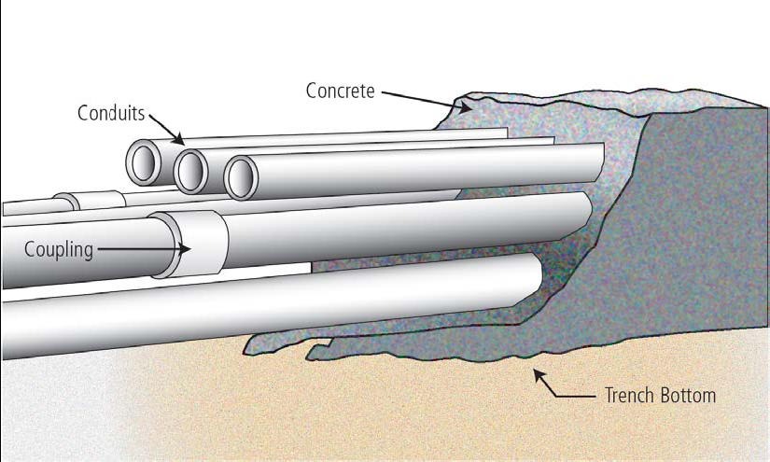
Duct bank Reference Data
A duct bank system consists of the following:
  Duct banks entering the ground
  Duct banks exchanging cables at pull pits or manholes
  Duct banks emerging from the ground

Slide 9
Cable Tray Reference Data
A cable tray is a physical unit that supports and routes cable.
A cable tray run is a connected series of features that normally have the same specification. All cable tray features belong to a cable tray run. That is, they do not stand alone but are connected to the cable tray run.
When you are routing cable tray, the software automatically selects the specific parts for the features based on the tray specification of the run from the reference data
As the cable trays are modified, cable lengths are automatically adjusted. When new cables are added, the fill of the cable tray or conduit is calculated

Slide 10
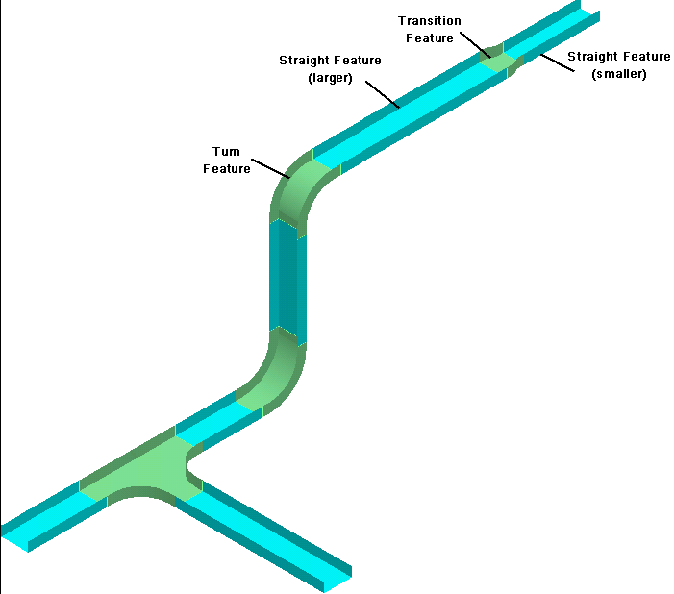
This illustration shows a cable tray system and some of its features.

Slide 11
Conduit Reference Data
Conduits are the hollow tubing used to house and protect cables
A conduit run is a connected series of features that normally have the same specification.
A conduit run includes straight features; along-leg features such as branches, transitions, and reducers; turn features; and end features.
You can think of features as logical collections of parts driven by the specification.
Conduit parts are the physical components that compose a conduit feature. Part size and properties depend on the specification.

Slide 12
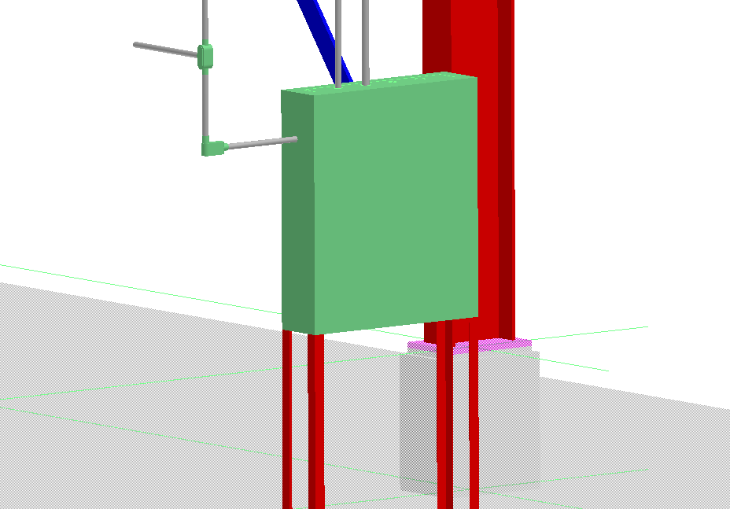
Sample conduit runs and conduit features

Slide 13
Cable Reference Data
The Electrical Task has rules for determining the amount of cable that can be placed in a cable tray or conduit. The delivered implementation is driven by NEC rules but they are customizable
The Catalog allows users to customize the cable definitions for selection by users modeling tray or conduit

Slide 14
Electrical Symbols
Symbols are the programs that create 3D graphic items
Electrical Symbols can be custom-made using Visual Basic or .NET
Symbol graphics development is outside the scope of this training
In this course, the spec writer will learn how to implement a new symbol as part of a specification. Intergraph delivered symbols will be used

