Slide 1


Isometric Management
Out of the Box Isometric Extractions
    Enter SmartPlant 3D and switch to Drawings and Reports task
    Right click on plant SP3DTrain, select New.. to create a Folder
    Rename the new folder to: ISOS
    Right click on ISOS, select New.. to create a Drawing By Query Manager from the General tab
    Rename the resulting Drawing By Query Manager folder to Unit01
    Right click Unit01 and select Setup..
    Under Filter select More.. and pick Training Filters>U01
    Under Packages Select More.. and pick Iso Pipeline then OK
    Right click Unit01 and select Run Query

Slide 2
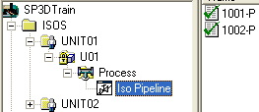
Isometric Management
Out of the Box Isometric Extractions (cont)
    Expand the tree structure created and right click Iso Pipeline to launch Create Drawings
    Right click iso 1001-P and select Update Now
    Once the green check appears, double click drawing 1001-P to review content or
    Right click drawing 1001-P and select View Extraction Data.. To review log, pcf and drawing files
    Repeat procedure to create drawings by query for Unit02 (U02) on a separate folder under ‘ISOS’

