Slide 1


Slide 2

SP3D Composed Drawings
Nov, 2007

Slide 3

Overview
Composed drawings are orthographic drawings created in a 3D task such as Common, Equipment, Electrical, etc.
Composed drawings are flexible, allowing you to have views that are managed by a drawing region and associate the views to 3D volumes and other views
You can create a composed drawing component in the Drawings and Reports task but you create the drawings associated with it in 3D tasks such as Common, Equipment, Electrical, etc.
In future versions of SP3D, switching between tasks will be minimized
NOTE: Upcoming slides will contain avi video of the solutions to the labs as contained in file “SHAW SP3D COMPOSED DWG Labs-Workflow.pdf”

Slide 4
Overall Workflow
Create a folder in the Drawings and Reports task
Define Layout styles
Define a Composed Drawing component
Go to Space Management task to define volume(s) to associate with drawing view(s)
Go to a 3D task such as Common and use the Tools > New Drawing command to create new composed drawings
Create Snapshot volumes as needed
Define views in 2D Drawing Editor
Link views to volumes or snapshots
Go to Drawings and Reports to update the drawing and perform additional editing

Slide 5
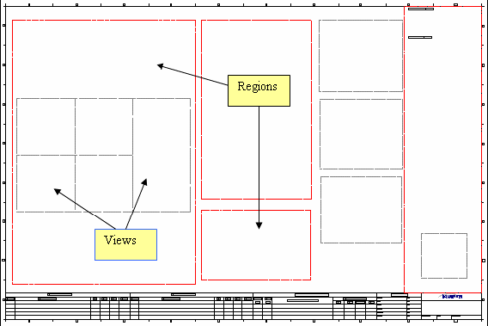
Drawing Regions and Drawing Views
A region is a container that manages drawing views
The layout style associated with the region dictates the order and placement of the managed drawing views
Drawing views are associated with objects, volumes, or other drawing views
You can create a drawing view outside a region, but this makes the drawing view an "unmanaged view", meaning the properties of the region do not impact the drawing view
The layout style dictates the order and placement of the managed drawing views

Slide 6
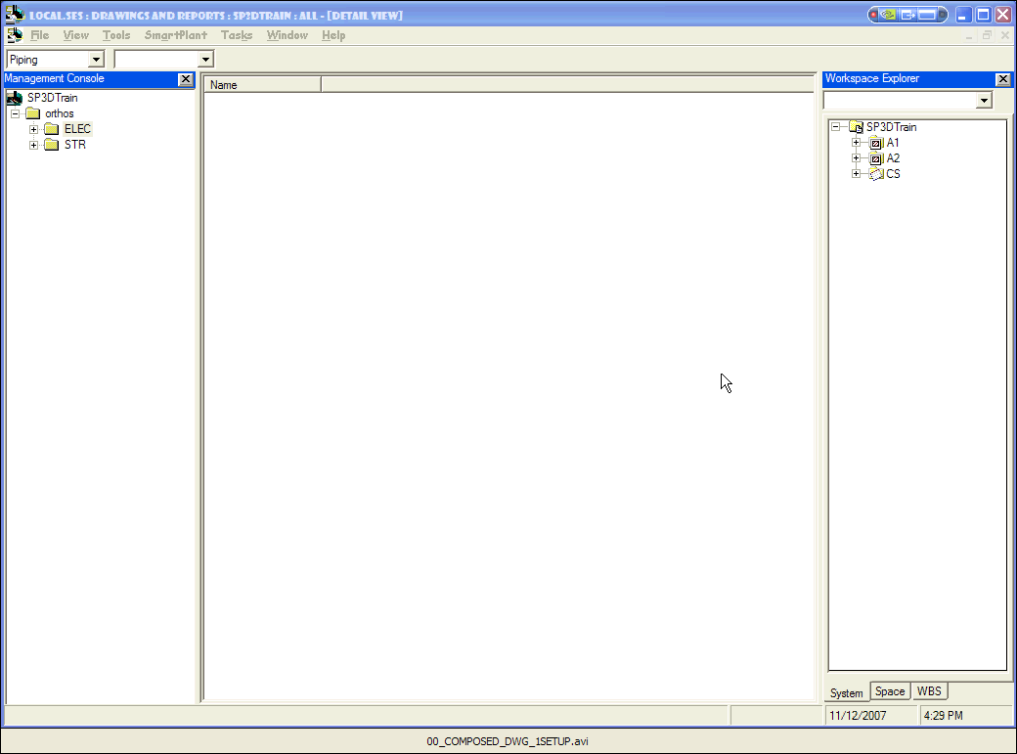
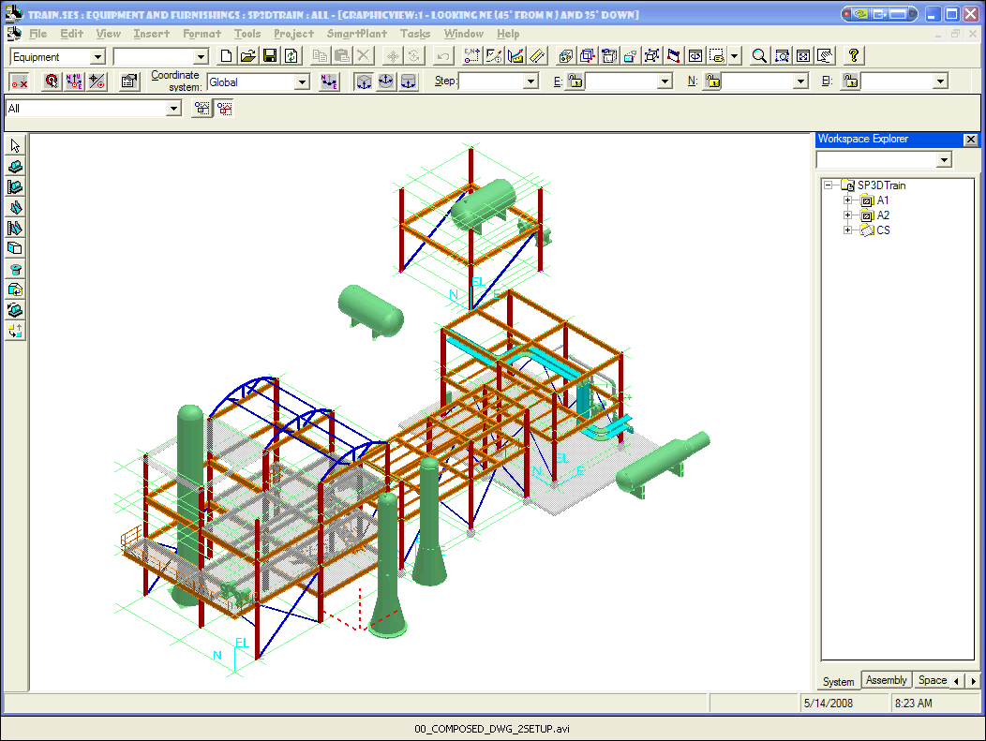
Volume Preparation
Composed Drawings can be created using Drawing Volumes, Space Volumes and Snapshots
Users can “recycle” and re-use volumes previously created for old Volume Drawings
Users can create new volumes specific to their composed drawings
Click on the images to launch video clip demos of volume preparation. If clip is cut short, start again and use the slider bar to move the demo forward

Slide 7
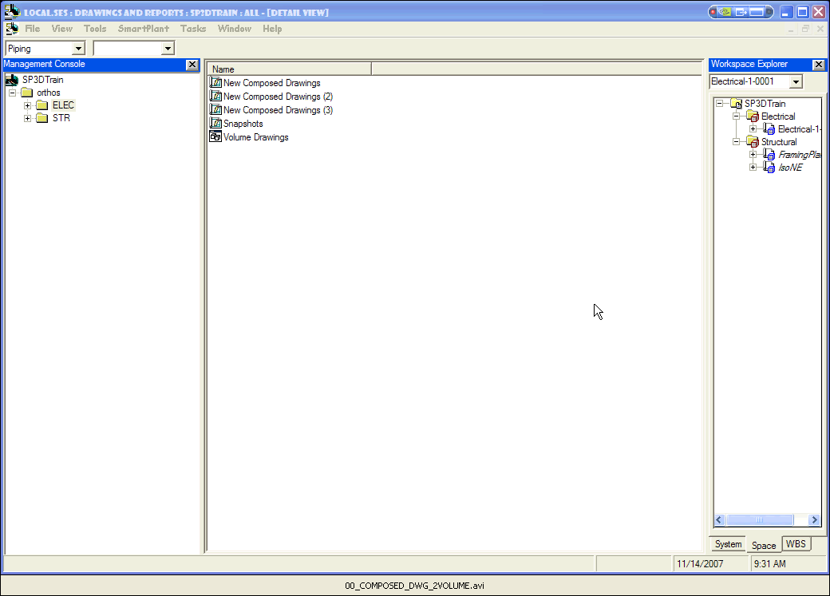
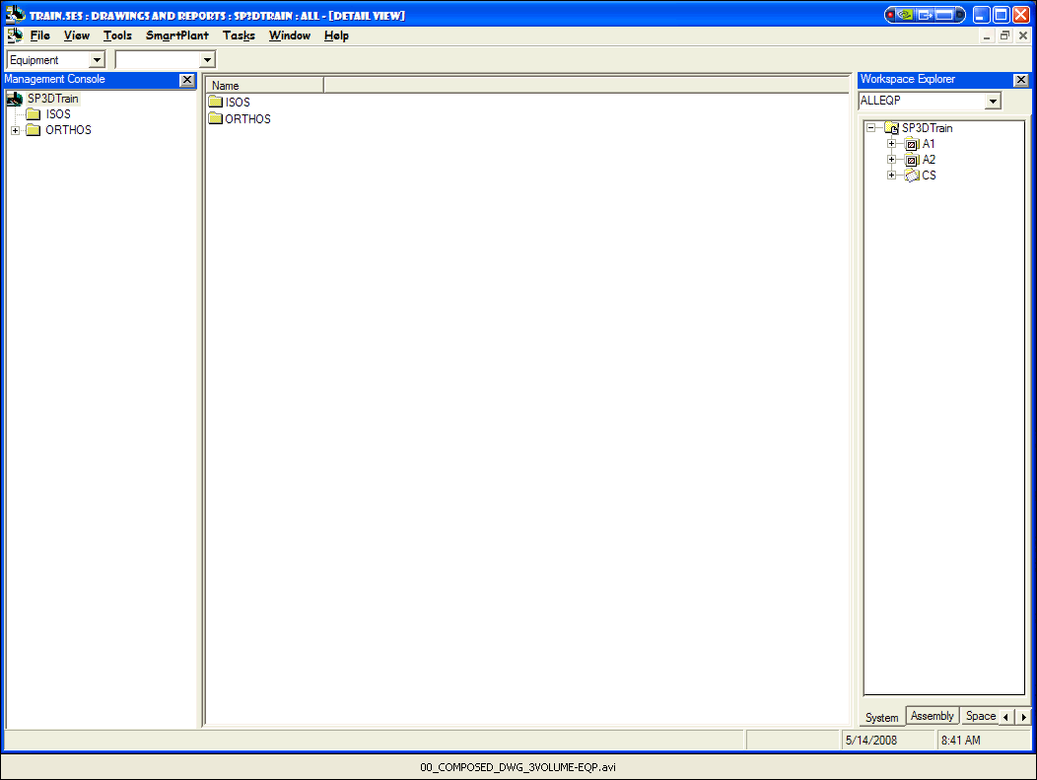
…by Volume Workflow
Define drawing component (parent)
Define “New Drawing” layout, border settings
Define Regions/Views in 2D (incl style and scale)
Associate 2D view(s) to volume(s) in 3D
Update drawing to populate views
Edit drawing to add labels, reports etc.

Slide 8
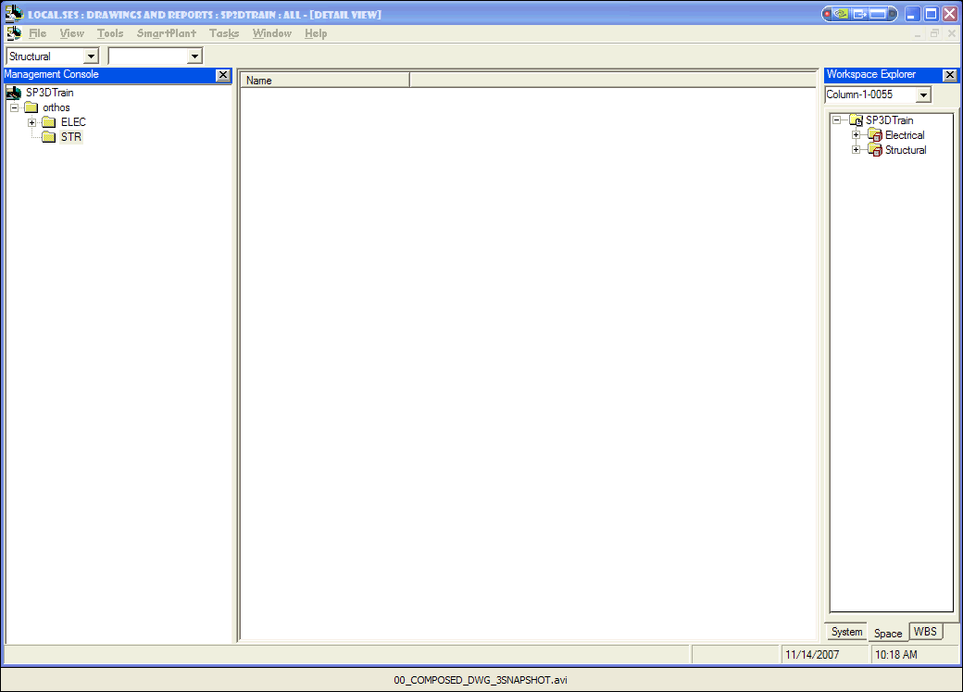
…by Snapshot Workflow
Snapshots are on-the-fly volumes that give the user added flexibility
Snapshot volumes are hidden by default upon creation so that there are no graphic volume boxes to deal with
Snapshots “know” their style settings by the time they’re imported into the drawing

Slide 9
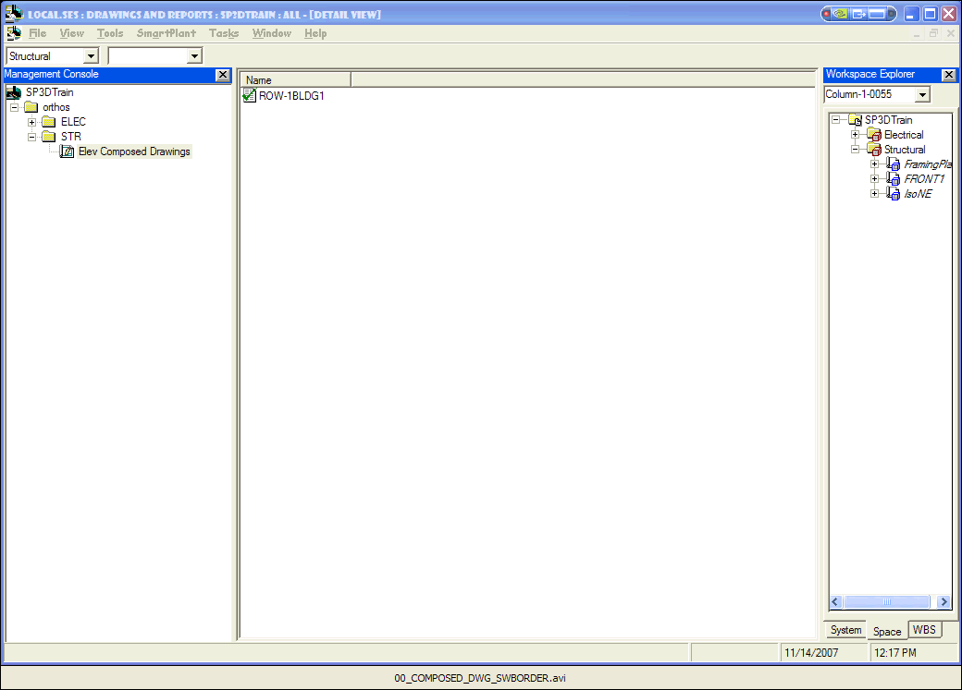
Switch Border Command
Allows you to switch the border template associated with the composed drawing documents selected in the Detail View
This command is available on the shortcut (right-click) menu when you select a composed drawing document
You need to update the drawings to regenerate them with the new border template file

Slide 10
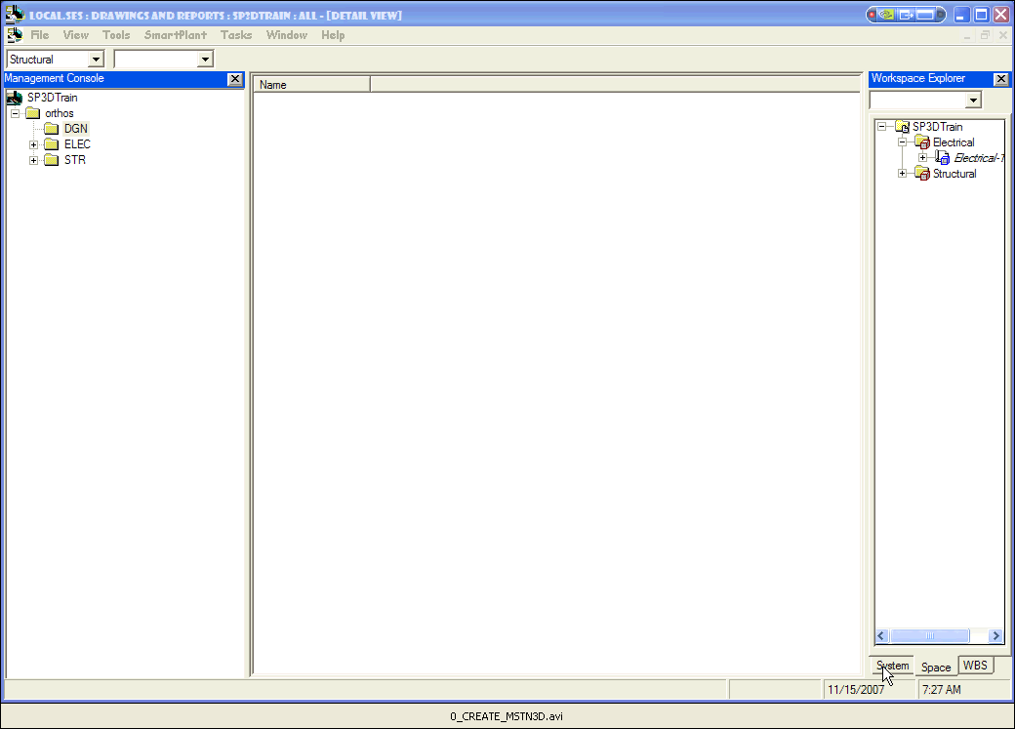
Bonus: Export to Mstn 3D
Drawings and Reports task includes a utility to export 3D model graphics to a Microstation 3D file
Workflow is similar to that of a composed drawing, taking advantage of volumes to define how much from the model to export

