Slide 1
What’s New in Drawings for v7

Slide 2
New Enhancements for v2007.0 - Overview
Orthographic Drawings:
  Optimizations
    Manual Dimensions
    Moved Border to the Background Sheet
    Deleting drawing doesn’t delete volume
    Visual ID of open drawing views to volume used
    Resizing volumes for snapshot
    Drawings By Query (SM Volumes)

Slide 3
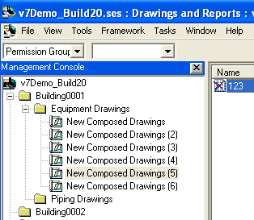

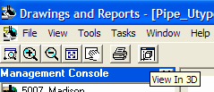


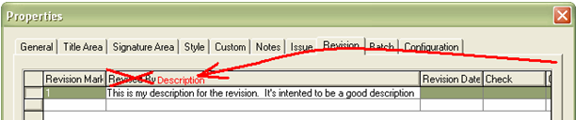
Usability/Clean-Up

Slide 4

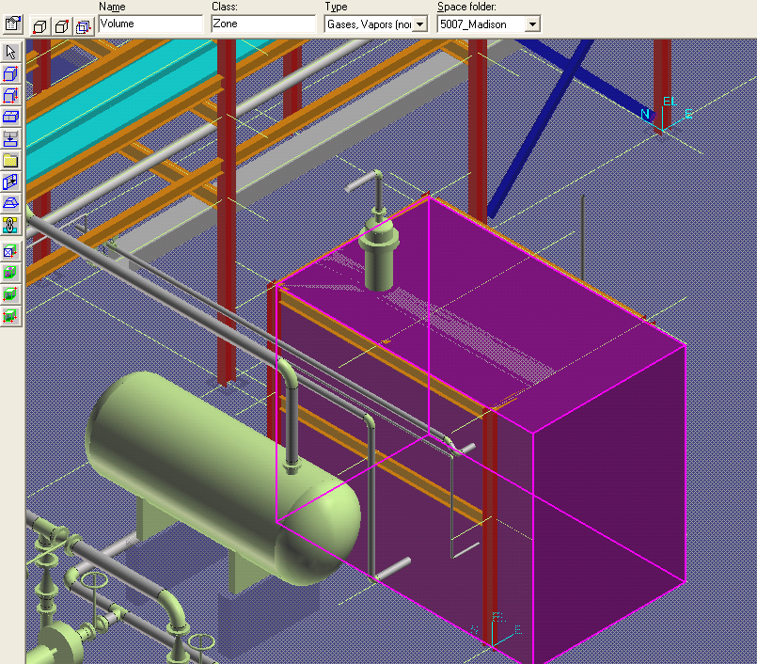
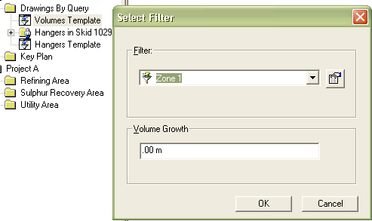
DBQ Using Volumes

Slide 5
New Enhancements for v2007.0 - Overview
Orthographic Drawings:
  New Functionality
    Batch (Print/Refresh and Manager)
    Replaced Snapshot with Composed
    Remembering Editor Settings
    Automatic Layering
    Find Documents to Publish
    Composed Drawings
    - managed views
    - unmanaged views
    Search Folders
    Switch Border command
    Predefine layouts for templates

Slide 6

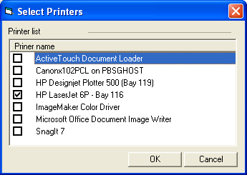
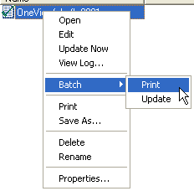
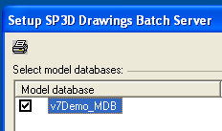

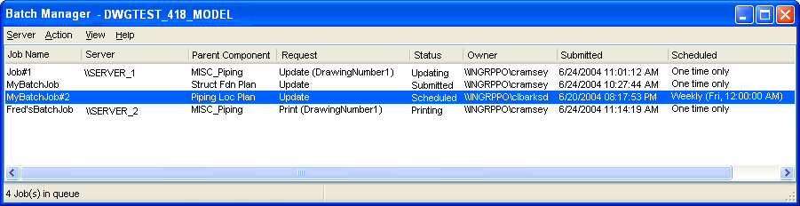
Batch

Slide 7

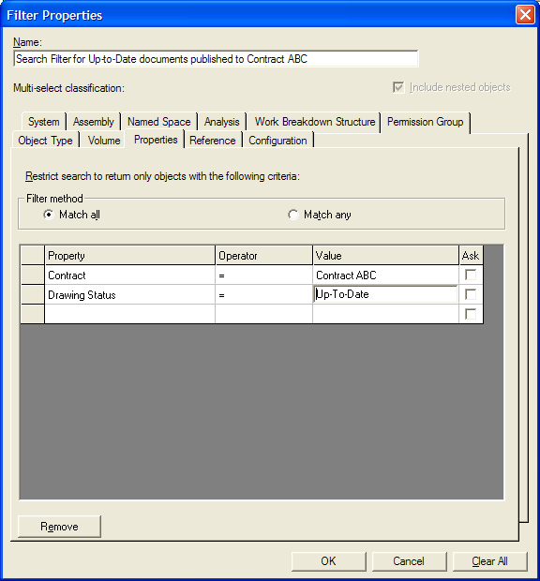
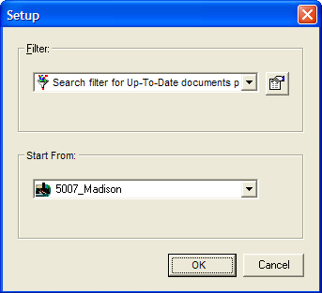
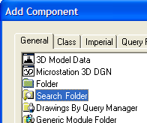
Search Folder

Slide 8

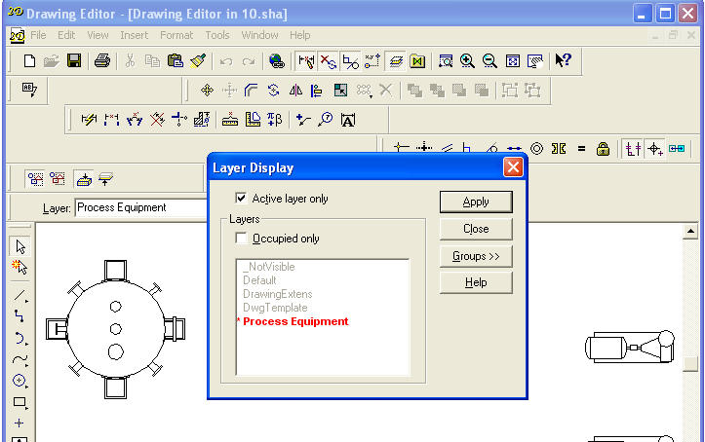
Automatic Layering

Slide 9

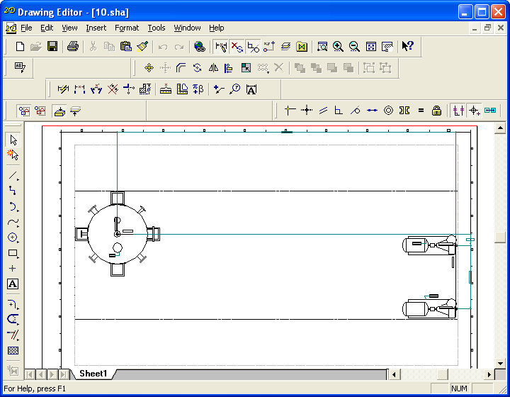
Remembering Editor Settings

Slide 10

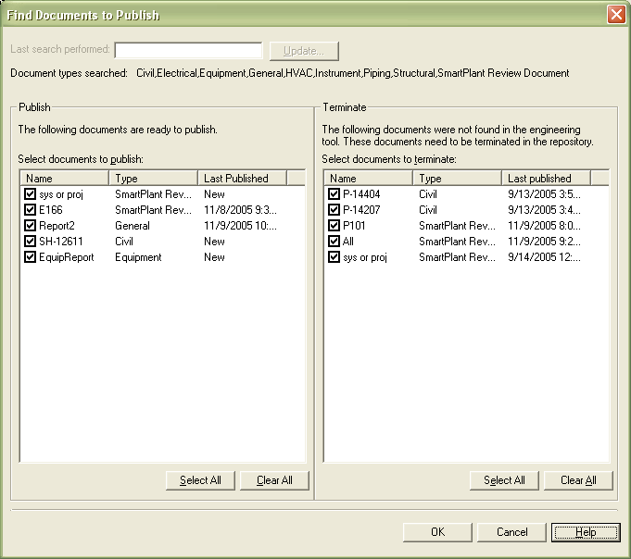
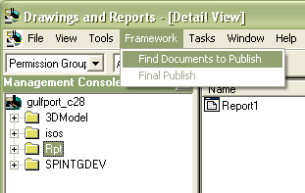
Find Documents to Publish
Notes:
Find Documents to publish finds documents that have newer revisions that what has been published and documents that have been deleted.

Slide 11

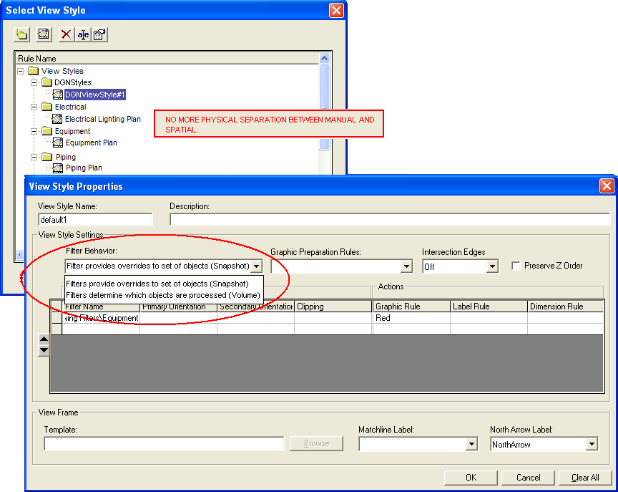
View Styles

Slide 12

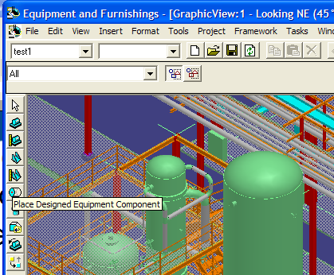
Content

Slide 13
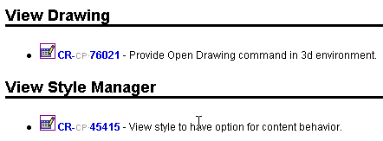



Composed Drawings
Notes:
All drawings eventually will be composable.

Slide 14
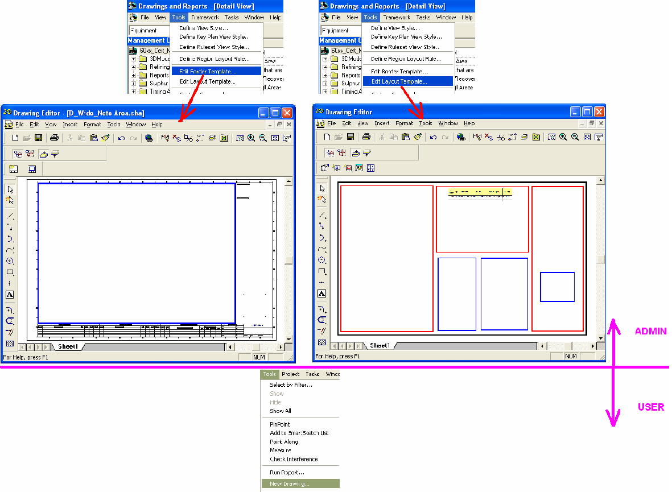
New Drawing Overview
The Border and Layout are both designed separately as an administrative task. “New Drawing” merges them together.
See Next Slide…

Slide 15
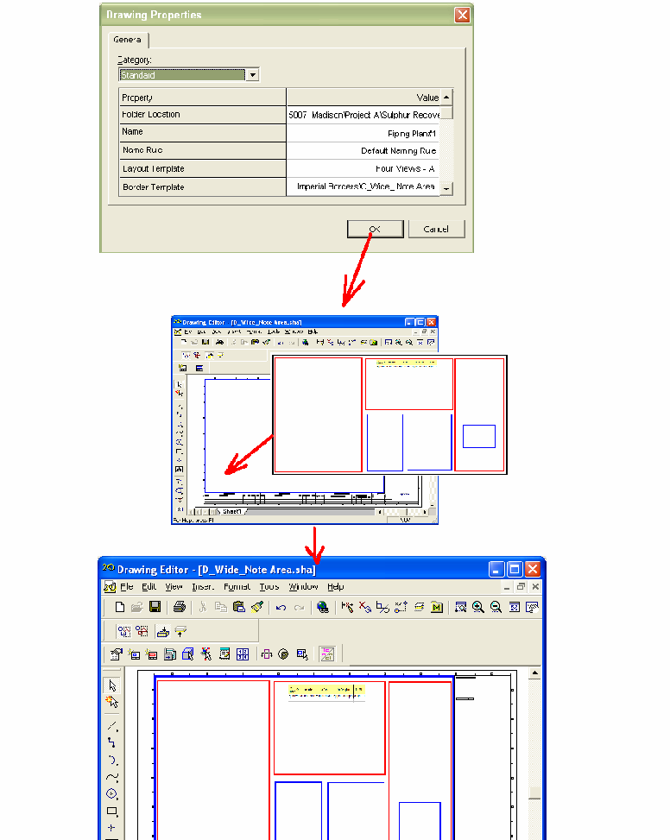
New Drawing Overview (Cont.)
Both of the files have a “Drawing Area (DA)”. The DA from the layout is stretched to match the DA from the border.
Since the layout allows you to choose a “family” of borders that are compatible, this will lead to easy border switch-out

Slide 16
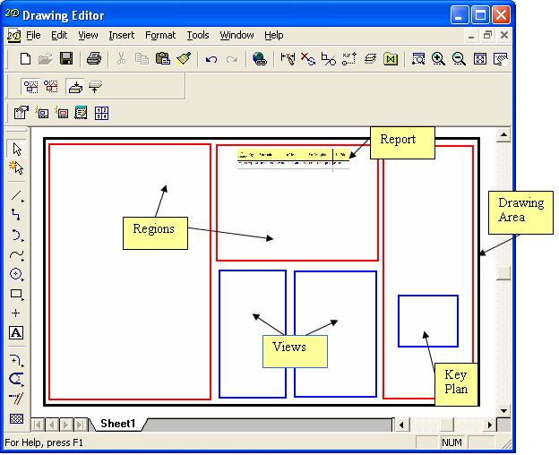
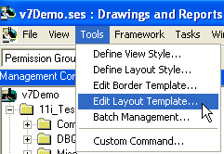
Edit Layout Template

Slide 17
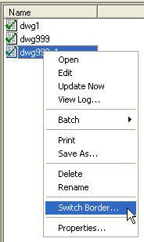
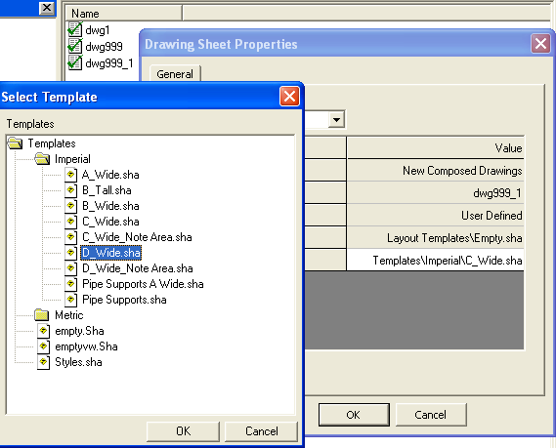
Switch Border Command

Slide 18
Miscellaneous Enhancements

Slide 19
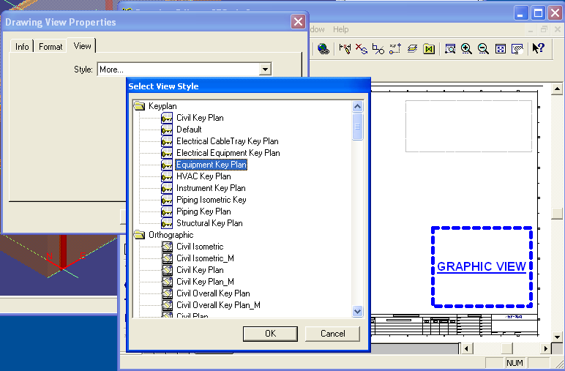
“Place View” is for views AND Key Plans (any Graphical View).
Selecting a Key Plan Style makes it a Key Plan View. Eventually we’ll have another node for “Intelliship” view styles. We thought this was going to happen in v7, but we found late that IS is going to skip v7 and go straight to v7.1.

Slide 20
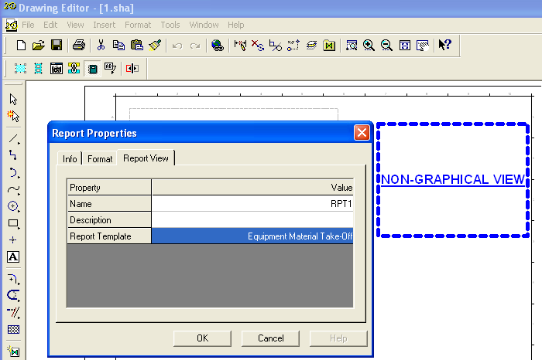
“Place Report” is for placing Non-Graphical Views.
This opens the door for future enhancements like one report being fed by multiple views and multiple reports all being fed by one view. For now, it’s still one-to-one.

Slide 21

Integrating the
Engineering
Enterprise…

