Slide 1


Slide 2

SP3D Piping Design Task

Slide 3

Prerequisites
3D Design
SP3D Common Apps training

Slide 4
Key Concepts
Pipeline
  Is a high-level grouping of Pipe Runs that is created in System and Spec Task environment
Pipe Run
  A pipe run identifies one or more path features that share a common pipe specification, flow direction, size, temperature, pressure, etc. One or more pipe runs make up a pipeline
Features
  Define the geometry path of the pipe run and your design intent that occur along the path. When you route a pipe run, you place features
Parts
  Are the physical components generated by the feature
Port
  Is the actual connection point for the part
Leg
  Is a section of a pipe run maintaining one general direction between turns, branches and end

Slide 5
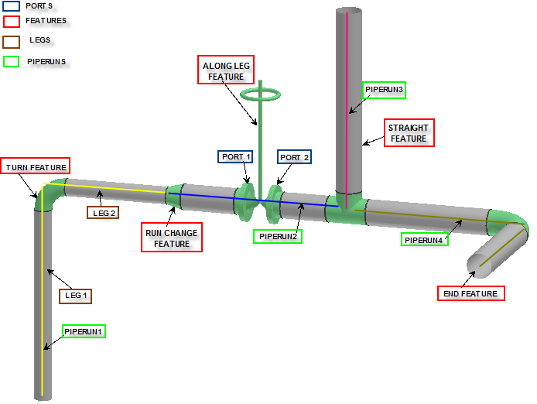
Sample Pipeline Elements

Slide 6


How to Get Started
Click to launch video
Starting the Piping Task
Defining defaults
Locating Equipment/Nozzle
Basic routing with Length Control
Saving a session
Labs: 1-3 (click=> to open labs’ URL)

Slide 7
How to Route Basic Piping
Routing using Angle Control, Length Control, and Plane Control tools
Routing using Pinpoint command
  Elevation offset
  Construct point with North and East offsets
Branching out of piperun
Branching into piperun
Routing from opposite ends
Starting route with fittings
Labs 4-7

Slide 8
How to Add Components
Inserting fittings
  Inline
  Branch
  Direction Change
  End
  Nipples
Inserting along leg features
Adjusting flow dependent features
Labs 8-10

Slide 9
How to Edit Properties
Editing piperun properties
Editing feature properties
Editing part properties
Lab 11

Slide 10
How to Route With Spherical Coordinates
Defining direction by angle
Defining distance and direction
Labs 12, 21

Slide 11
How to Insert Instrument Items
Inserting stock instruments
Inserting on-the-fly instruments
Inserting stock specialty items
Inserting on-the-fly specialty items
Lab 13

Slide 12
Advanced Routing I
Routing sloped piperuns
Inserting taps
  Tap points
  Elbowlets
Inserting splits
  Inserting weld
  Inserting take down joint
  Inserting attribute break
Labs 14,15, 18-20, 23

Slide 13
Advanced Routing II
Using offset command
  Offset by bottom of pipe
  Offset by top of pipe
Using cardinal points
Using local clash detection
Labs 22, 29

Slide 14
Misc Manipulations
Multi-Select
Delete
Move
Copy/Paste
Rotate
Mirror Copy
Fence
To-Do List

