Slide 2
SP3D Grids Task

Slide 3
Prerequisites
Common Apps training

Slide 4
Grids Task Concepts
Capabilities include:
Creates and manipulates coordinate systems, elevation planes, vertical grid planes, radial cylinders/planes, grid arcs, and grid lines
Coordinate systems provide a locating scheme when working in the model
The gridlines of a coordinate system represent the relative positioning requirements for a specific design purpose

Slide 5
Coordinate Systems
Available rectangular Cartesian coordinate systems
Available radial coordinate systems
Available combined radial and rectangular planes in a single coordinate system
There are two types of coordinate systems:
  Global coordinate system (rectangular Cartesian shape)
  Design coordinate system (can be either rectangular or radial)
The Global coordinate system origin is at (0,0,0) in the model. The positive Y-axis is used as the global North
Design Coordinate Systems (DCS) are always created in relation to the Global coordinate system
DCS may have a North rotated from true North
Objects in SP3D model must be placed within 10,000 meters (6.2 miles) of the Global coordinate system

Slide 6
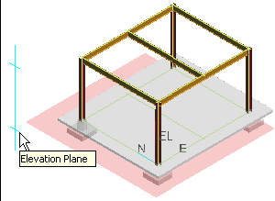
Elevation Planes
there are two types of planes: Elevation planes and grid planes
Elevation planes define the elevation or height of the grid line with respect to the origin of the coordinate system
Elevation planes are always
parallel to the N-E (x-y) plane
of the coordinate system

Slide 7
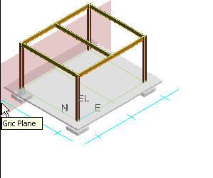
Grid Planes
Grid planes are used to define the location of grid lines in the model
Define the grid line location with respect to the X- or Y-axis of the coordinate system
Generally parallel to the X-Z or Y-Z plane of the coordinate system
can be placed rotated (sloped)
about the placement axis
A grid line is defined as the intersection
of the grid plane with the EL plane

Slide 8
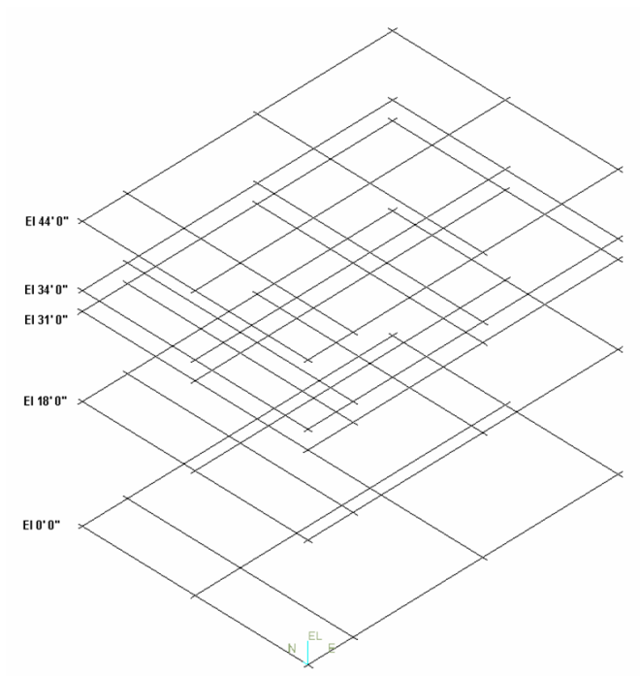
Grid Lines
Grid lines represent the intersection of an elevation plane and either a grid plane or a radial plane
Grid arcs represent the intersection of an elevation plane and a radial cylinder
You can create a filter to display
only the gridlines on specific
elevation planes. This makes the
workspace easier to work with.

Slide 9
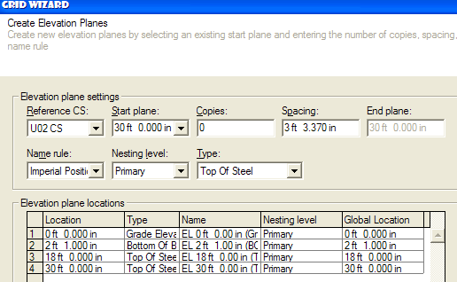
Grid Wizard Command
Defines coordinate systems, elevation planes, vertical grid planes, radial cylinders, and radial planes in a single process
Easy way to create a design coordinate system in the model, with the option of creating grid lines/grid arcs along the intersections with the elevation planes

Slide 10

Labs
Grids task labs: 1-6
Note that the labs include a link to a video clip with the lab being done by the instructor

