Slide 1
AGOL WebApp Builder
5 Basic Steps to Building an App
What you select will depend greatly on what you want the application to do. These are the basic steps to creating an application.
On the My Content tab of the content page, click Create, choose Web AppBuilder, and select 2D or 3D.
Open the item page for a map or scene, click Create Web App and choose Web AppBuilder.
Open a map in Map Viewer Classic, click the Share button, and click Create a Web App. In the window that opens, click the Web AppBuilder tab.

Slide 2
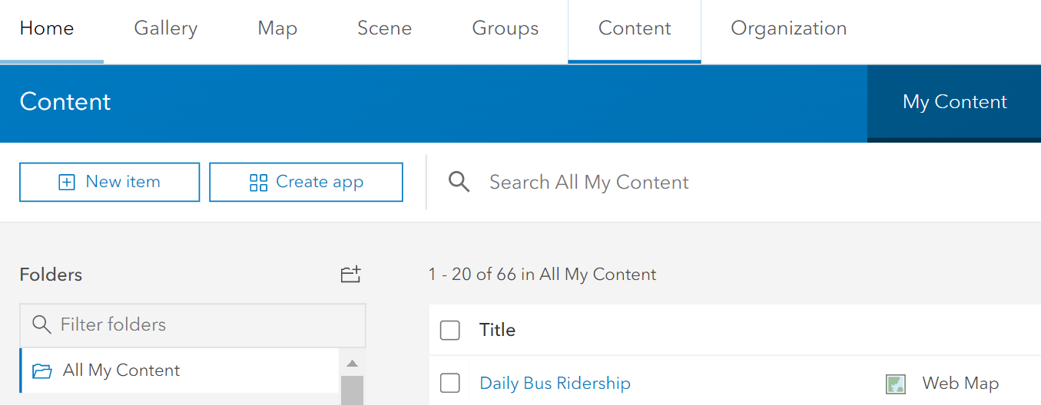
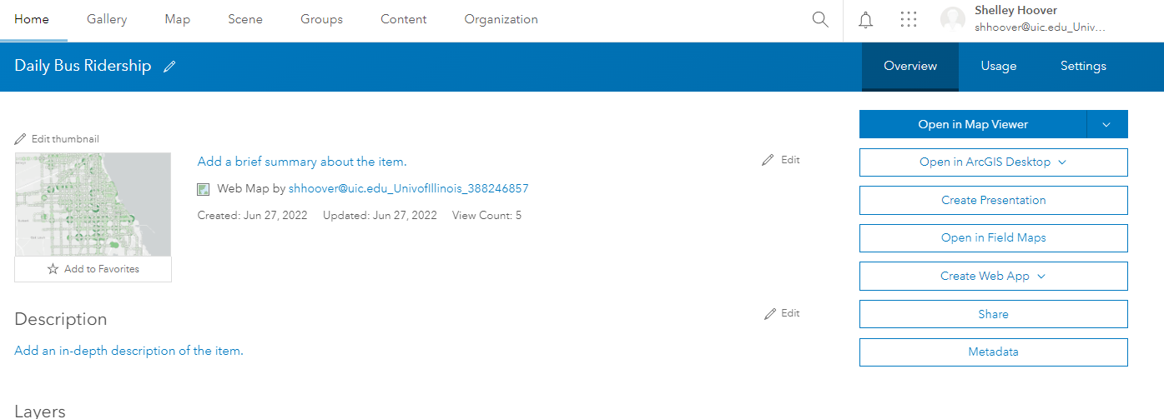
1. Create the App
Three options to initiate a web app:
Under your Content Page, click Create app, & Choose Web AppBuilder,
Open the item page for a map, click Create Web App and choose Web AppBuilder.
Open a map in Map Viewer Classic, click the Share button, and click Create a Web App. In the window that opens, click the Web AppBuilder tab.
1.
2.

Slide 3
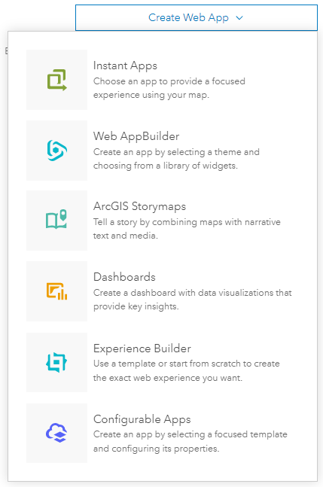
There are a lot of options, for the assignment use either Web App Builder or Configurable Apps. If you feel very motivated to do another version, let me know. The next set of instructions are for Web AppBuilder.

Slide 4
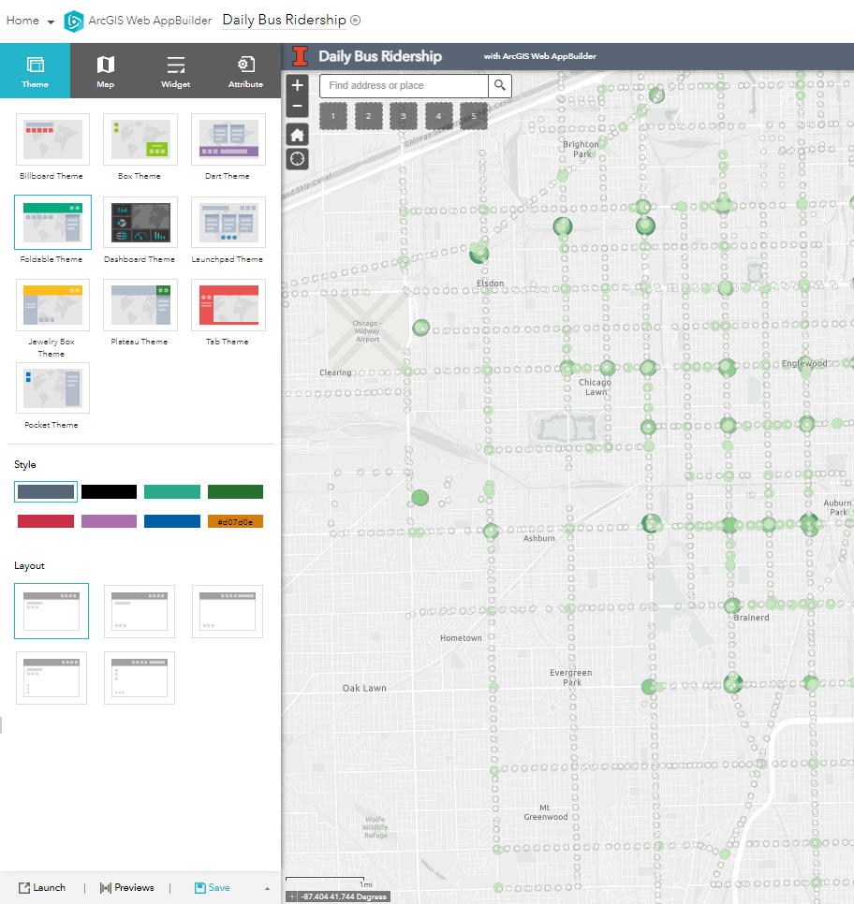
This is what your app looks like on load. To the left you have editing options for Theme, Map, Widget and Attributes. We will go over these one by one.
2. 3. 4. 5.

Slide 5
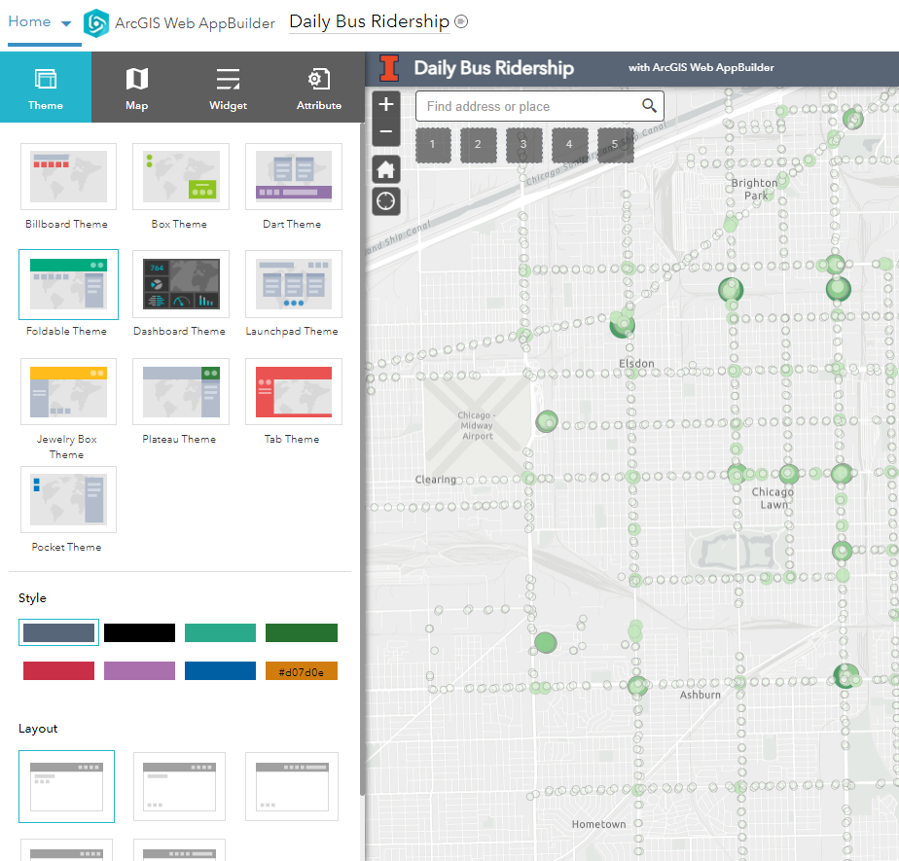
2. Select the Theme
Theme affects the look, layout, and basic functionality of your app. On this tab you can choose the Theme, Color Style, and Layout
List of themes: https://doc.arcgis.com/en/web-appbuilder/latest/create-apps/themes-tab.htm
Later we will add tools for the map viewer to use here
Note how the different themes organize the tools differently
Themes
Style/Color
Layout

Slide 6
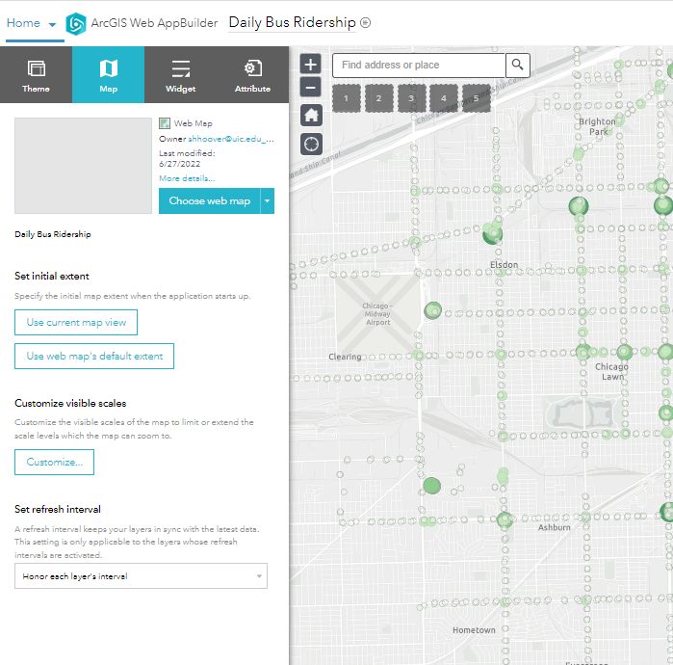
3. Edit your map
Make small edits to your map.
Change the web map if you’d like
You can change the map extent (amount zoomed in or out), or keep it the same as the web map (default)
If you would like to restrict zoom in/out ability you can here. Useful if you have A LOT of data.
You can change the refresh (but leave as the default unless you made edits to your map)

Slide 7
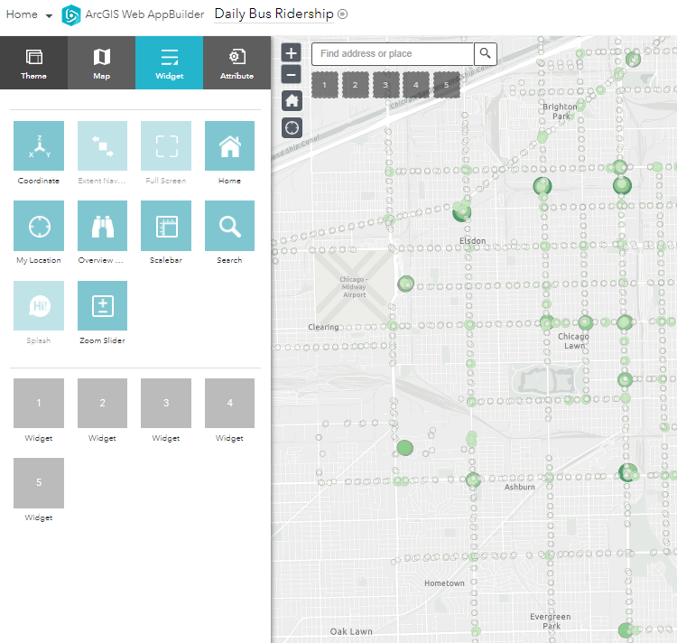
4. Select your widgets
Widgets are the backbone to WebApps. Each theme comes with certain preloaded widgets that you can turn on and off. These are called “On-panel widgets”
Note: some of the on-panel widgets are cut off in the screen shot.
Zoom in/out widget
On panel widgets:
Home Widget
Find me widget (location must be enabled)
Click the blue app to turn on/off. Grayed out means the app is turned off.
Off Panel Widgets

Slide 8
Off Panel Widgets are ones you select and will load in the gray boxes. There is a wide variety of widget functionality.
On panel widgets:
Select the gray box to pick the widget that will show in box 1.

Slide 9
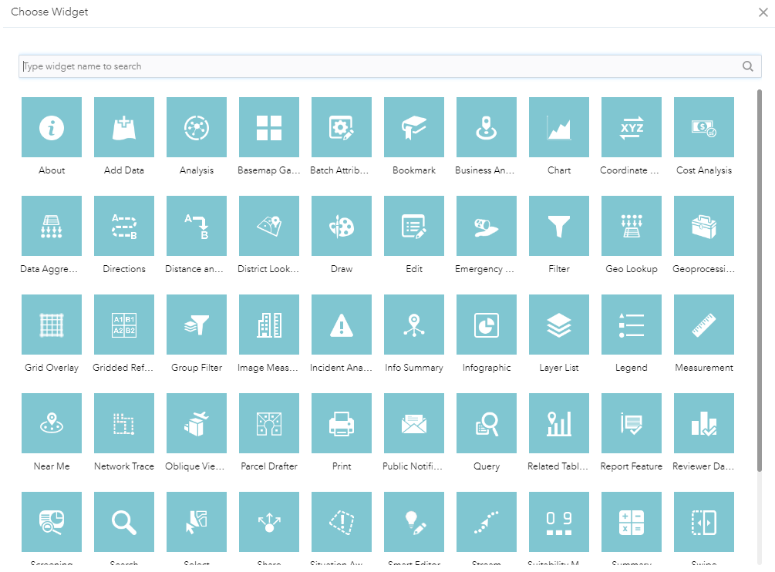
There are a lot of widgets:
Full list of widgets: https://doc.arcgis.com/en/web-appbuilder/latest/create-apps/widget-about.htm

Slide 10
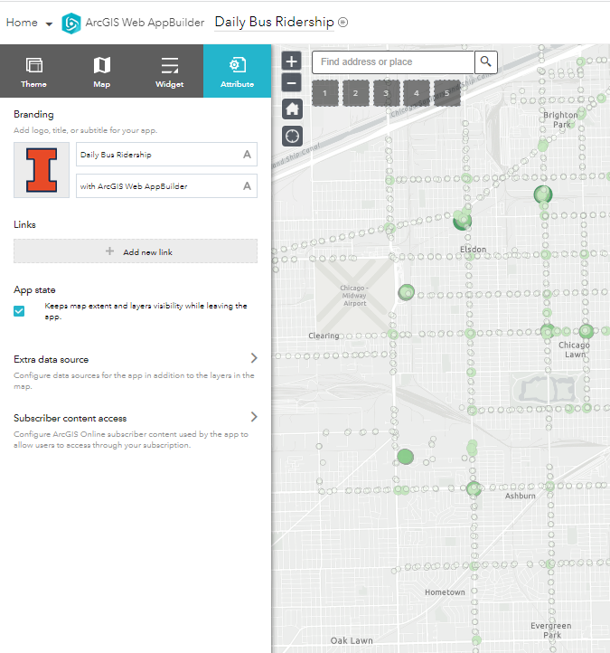
5. Add your credits/attributes
Widgets are the backbone to WebApps. Each theme comes with certain preloaded widgets that you can turn on and off. These are called “On-panel widgets”
Note: some of the on-panel widgets are cut off in the screen shot.
You can change/remove this. We don’t go to Urbana, so you should ☺
Change the subtitle
Add a link to an external site if you’d like

Slide 11
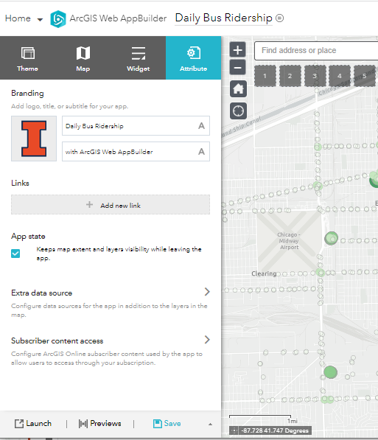
6. Finalize
Preview/Save/Launch your App.
Save often!
Saving does not launch the application though

Slide 12
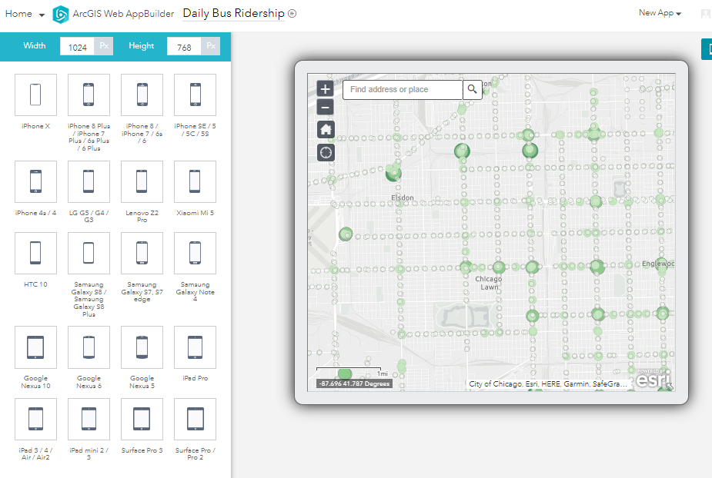
Preview allows you to view the application on a variety of devices:

Slide 13
Finally, after you have previewed, launch the application and you’re finished!

