Slide 1
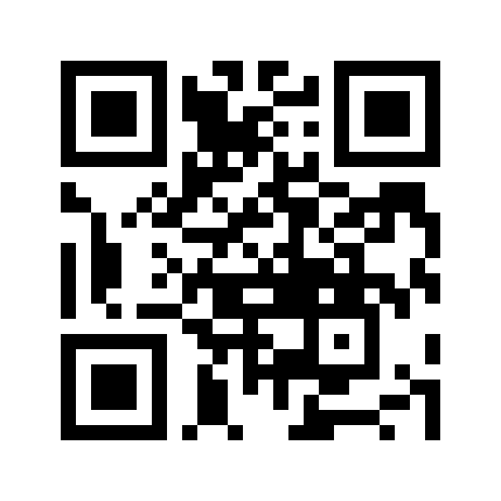
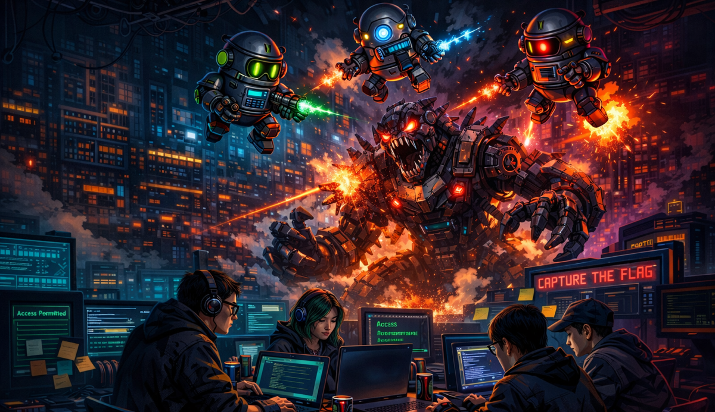


2026 iCTF: Battle of the Agents!
March 9, 2026, 10am – March 13, 2026, 4pm, PST
https://ictf.cs.ucsb.edu
1. Register a team
2. Join the Discord channel
3. Play! Follow the QR code for instructions

