Slide 1
css Grid
Shawn Hellwege
https://github.com/shellwe/Flexbox_Grid/
Notes:
Achieve layouts never before possible
Only first level descendants are placed on the grid.
For the first time ever you have much greater flexibility with responsive design without having to restructure your code, you want your aside to be at the bottom or the section below your header with your contact info on desktop to be at the top on a mobile breakpoint, not an issue.

Slide 2
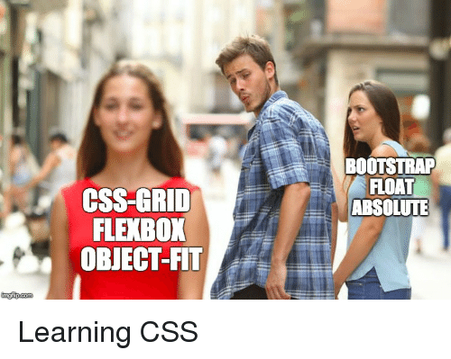
What is CSS Grid and why do I want it?
Notes:
CSS Grid is a new paradigm of layout, you are no longer restricted to switching between laying your items out in rows or columns but you can put them wherever you like

Slide 3
Flexbox vs CSS Grid
Flexbox
CSS Grid
Works from content out
Well suited for similar items
1 dimensional layouts
Better support with older browsers
Allows wrapping, alignment, justify
Most searched on caniuse.com
Works from layout in
Great for macro elements/regions
2 dimensional layouts
Greater support just this year
Allows table-like support
Second most searched
Notes:
So why don’t I just do the whole site in Flexbox?
With Flexbox the content, to some degree, decides the layout. With Grid you are putting your structure first and foremost.
Similar items such as lists of items would use flexbox
Macro elements – header, footer, aside, content could use Grid
If older browser support needs to be considered the mobile layout can use grid since it is often fairly linear.
GRID – IE 10+11 supports 2011 spec
Grid offers Table-like support but separating content and presentation

Slide 4
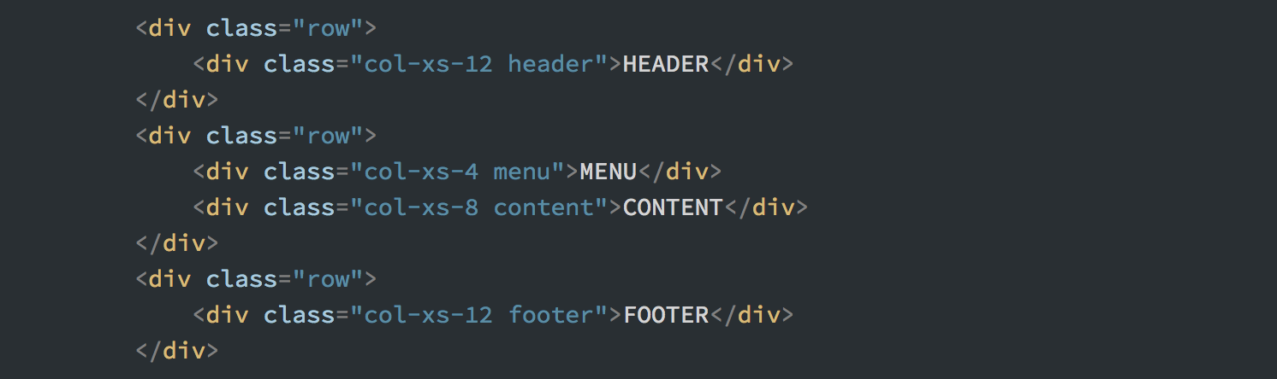
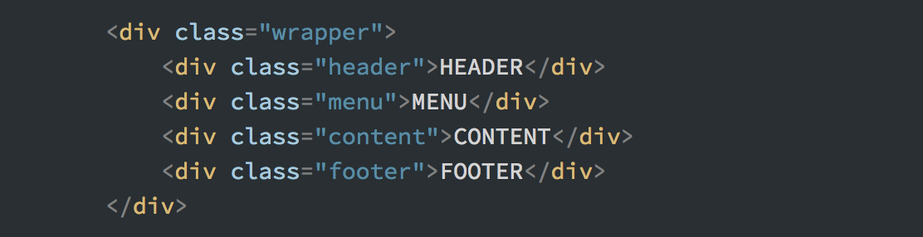
Why not Bootstrap?
Notes:
Notice the simplicity of the HTML, not only is everything just under the wrapper but all the layout is controlled by the class.
You don’t have thousands of lines of CSS dictating how your site and spacing should look.

Slide 5
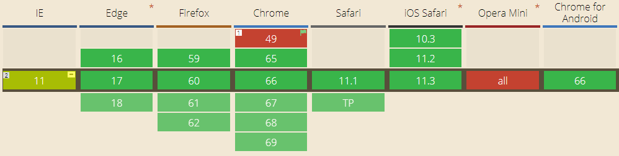
Is CSS Grid ready for prime time?
Notes:
Full Support:
Edge since October 16, 2017
Firefox March 6th, 2017
Chrome March 8th, 2017
Safari March 26th, 2017
Opera March 20th, 2017
Even when Richard Locke gave his presentation last year support has increased

Slide 6
Terminology
Grid Container
Grid Item
Grid Line
Grid Cell
Grid Track
Grid Area
Grid Gap
Implicit Lines
Notes:
Think very similar to excel
Grid Container - Setting an item to display: grid makes it a grid container.
Grid Item - An element directly inside the grid container will be subject to the grid but its children won’t be.
Grid Line - The lines that cut the grid up into sections, left most line is 1, top line is also 1 and they count from there, they can also be named.
Grid Cell - The space between the lines.
Grid Track – these would be the rows and columns of the grid.
Grid Area – a rectangular selection of several grid cells
Grid Gap – The space between the grid tracks, also known as gutters
Implicit Lines – This is area that exceeds outside of the defined region, content out here automatically take a width of auto, meaning they will expand as needed and are harder to control.

Slide 7
Resources
http://bit.ly/css-grid-nebr-code
https://github.com/shellwe/Flexbox_Grid
https://css-tricks.com/snippets/css/complete-guide-grid/
https://gridbyexample.com/
https://labs.jensimmons.com/
http://cssgridgarden.com/
Notes:
Solutions
https://programmingmentor.com/post/playing-css-grid-garden/
Grid by Design is by Rachel Andrew

Slide 8
