Slide 1
Multilevel Modeling
An Introduction

Slide 2
Roadmap
Why MLM?
Some technical features
What are things to consider when you run an MLM?
Running an MLM in R
Resources

Slide 3
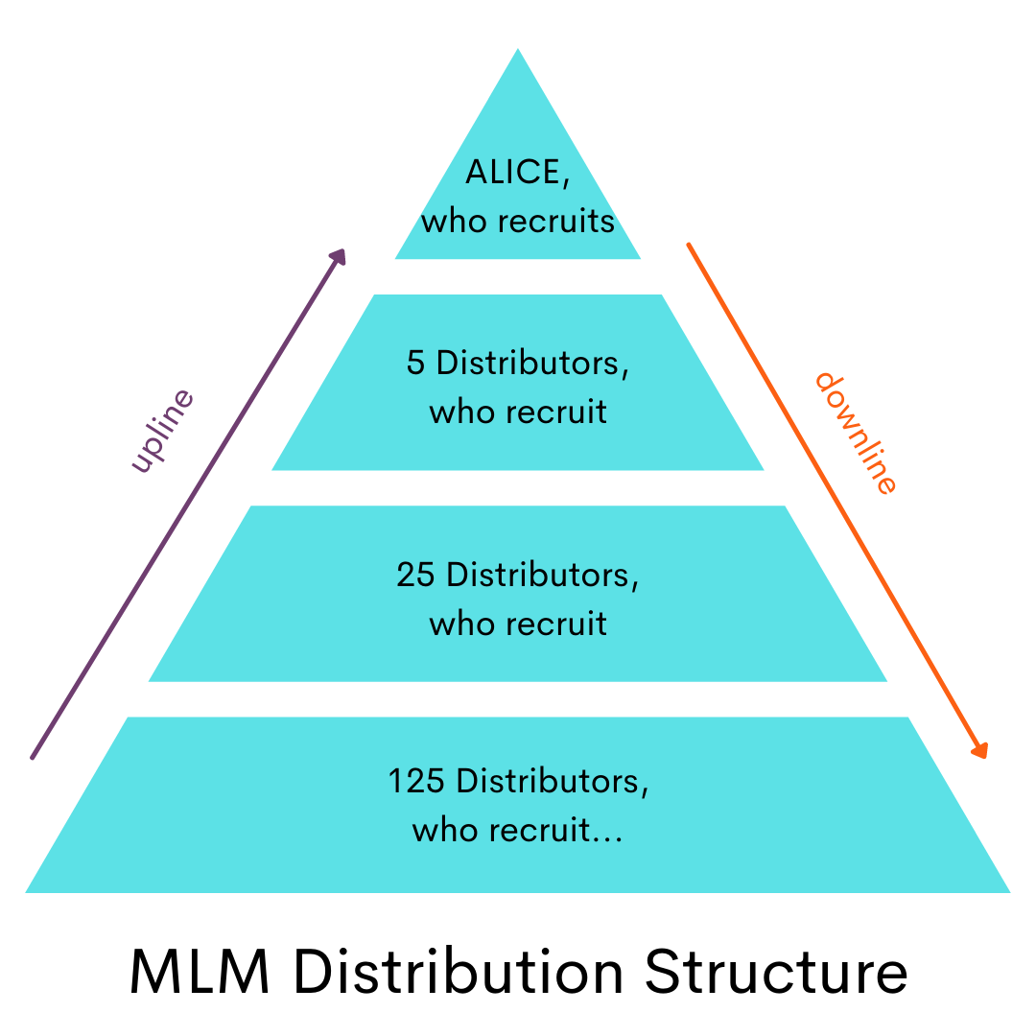
Many words for the same thing
Multilevel Modeling (not Multilevel Marketing)
Hierarchical Linear Modeling
Mixed Effects Modeling
…

Slide 4
Why MLM?

Slide 5

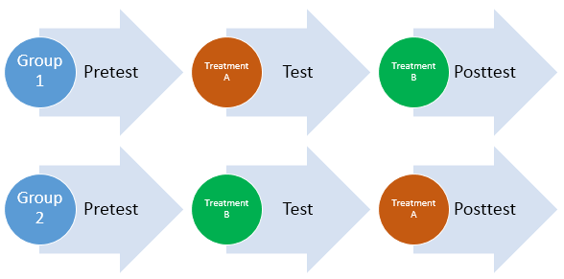

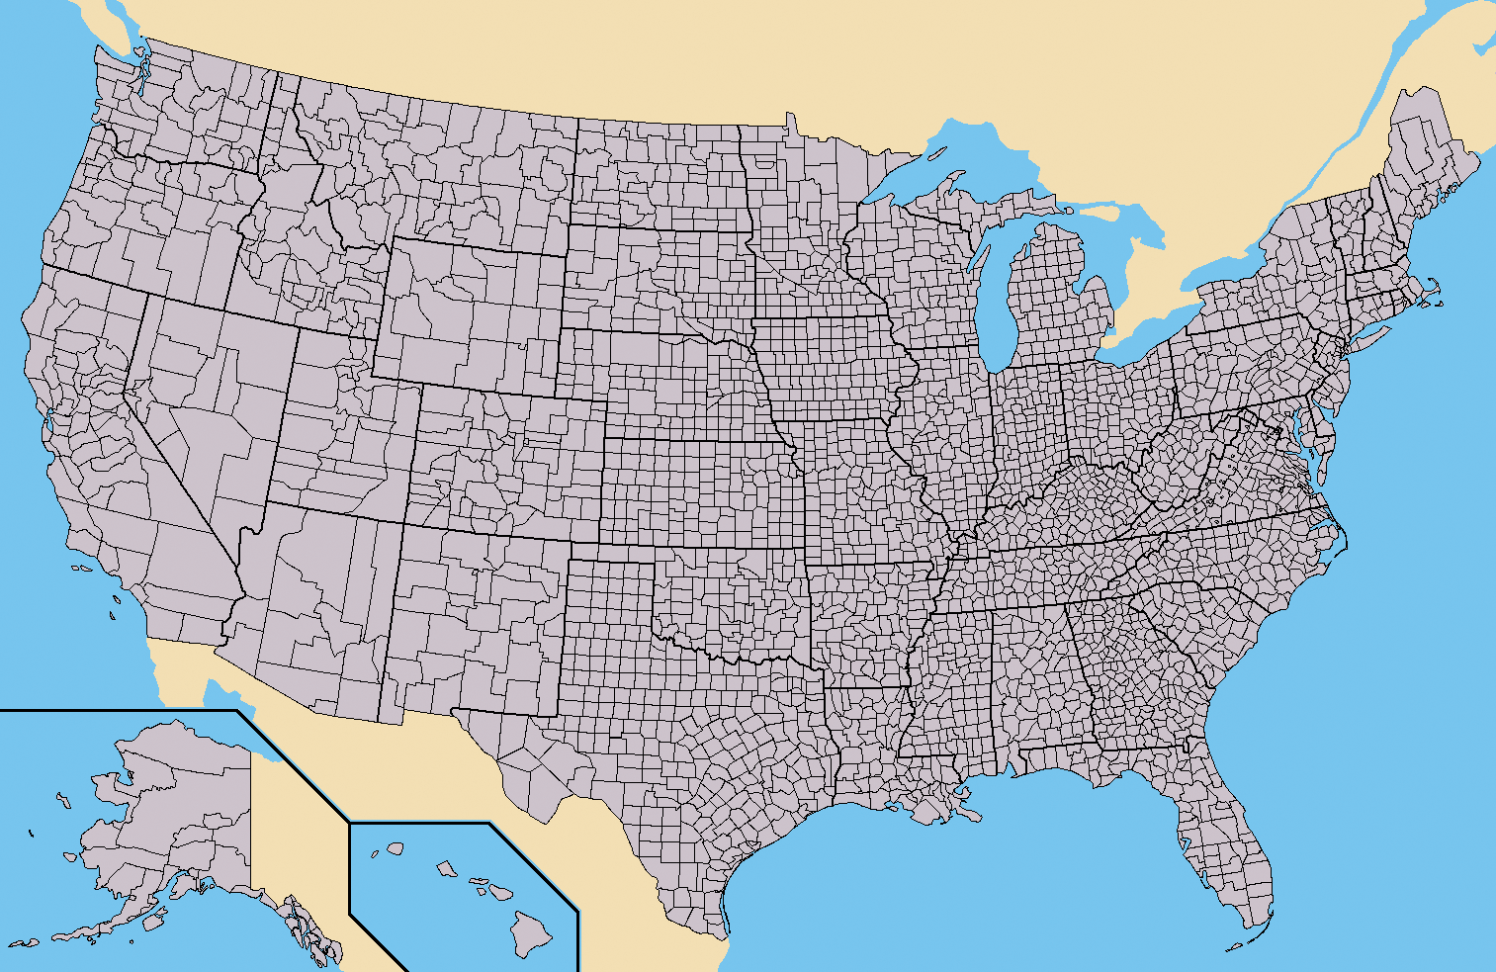
MLM helps when assumptions of independence are violated
Independence

Slide 6
Individual differences matter (Even if you are not a personality psychologist)
Example:
Does spending more time with friends predict higher well-being?
6 people in our study (terribly under-powered)
We ask them once every day for a week a) how much time they spent with their friends and b) how high they rate their well-being that day

Slide 7
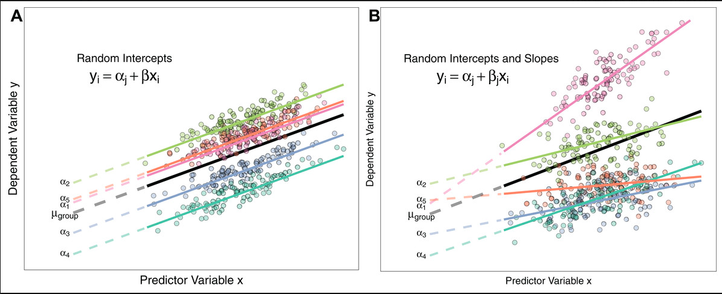
Individual differences matter (Even if you are not a personality psychologist)
Well-being
Time spent with Friends

Slide 8
Individual differences matter (Even if you are not a personality psychologist)
Well-being
Time spent with Friends

Slide 9
Individual differences matter (Even if you are not a personality psychologist)
Well-being
Time spent with Friends
Time spent with Friends

Slide 10
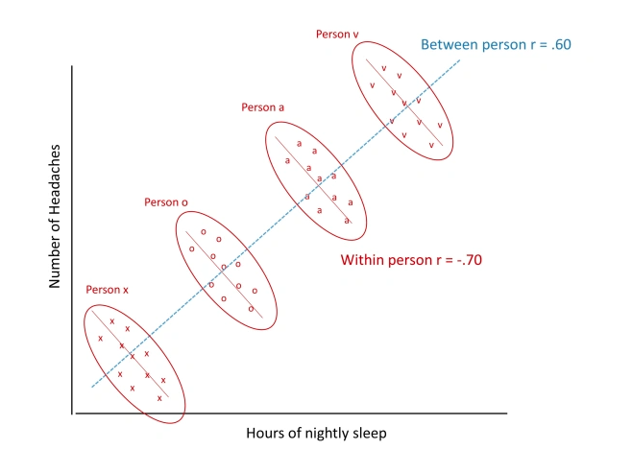
Between- and within-person effects matter
Typing Accuracy
Typing Speed

Slide 11
MLM beats RM-ANOVA
Simultaneous estimation of within and between effects
RM ANOVA uses listwise deletion
Participants or items with more missing cases have weaker influences on parameter estimates (i.e., the parameter estimates are precision weighted), and extreme values are “shrunk” toward the mean
Categorical and Continuous predictors possible in MLM
Can be adapted to continuous and categorical outcomes (GLMER)
dependent variable is continuous and the independent variables are categorical in ANOVA
Notes:
— Listwise deletion: any missing data will result in the person being deleted from analyses
(for more details on shrinkage, see Raudenbush & Bryk, 2002; Snijders & Bosker, 2012)

Slide 12
Technical Aspects

Slide 13
Maximum Likelihood
No ordinary least squares for MLM
Instead, we are using Maximum Likelihood Estimation

Slide 14
Pooling
Grouping variable is treated as coming from a population. All groups are alike (because they are from the same population), but different in their own way.
Because of this it is helpful to use information from other groups to help make predictions.
MLM is running a regression for each group. We want to pool as this leads to better predictions as we are not overfitting our data!

Slide 15
Important Considerations

Slide 16
Centering
Centering is very important for the interpretation of variables in MLM
What does 0 mean?
What do deviations from 0 mean? (important for within-person effects)

Slide 17
Centering
Grand-mean centering
Similar to what we have been doing in regression (subtracting the overall mean from each value)
Participant | Happiness_{ji}
Shelly | 2 | -1
Shelly | 3 | 0
Messi | 3 | 0
Messi | 4 | 1
Grand Mean of Happiness = 3

Slide 18
Centering
Group-mean centering (or Person-mean centering)
New! (subtracting the person (or group) mean from each value)
Participant | Happiness_{ji}
Shelly | 2 | -0.5
Shelly | 3 | 0.5
Messi | 3 | -0.5
Messi | 4 | 0.5
Shelly Mean of Happiness = 2.5
Messi Mean of Happiness= 3.5

Slide 19
Centering
Group-mean centering (or Person-mean centering)
New! (subtracting each value from the person (or group) mean)
Participant | Happiness_{ji}
Shelly | 2 | -0.5
Shelly | 3 | 0.5
Messi | 3 | -0.5
Messi | 4 | 0.5
When Shelly feels -.5 less happy than she
normally feels
When Messi feels -.5 less happy than he
normally feels
Shelly Mean of Happiness = 2.5
Messi Mean of Happiness= 3.5

Slide 20
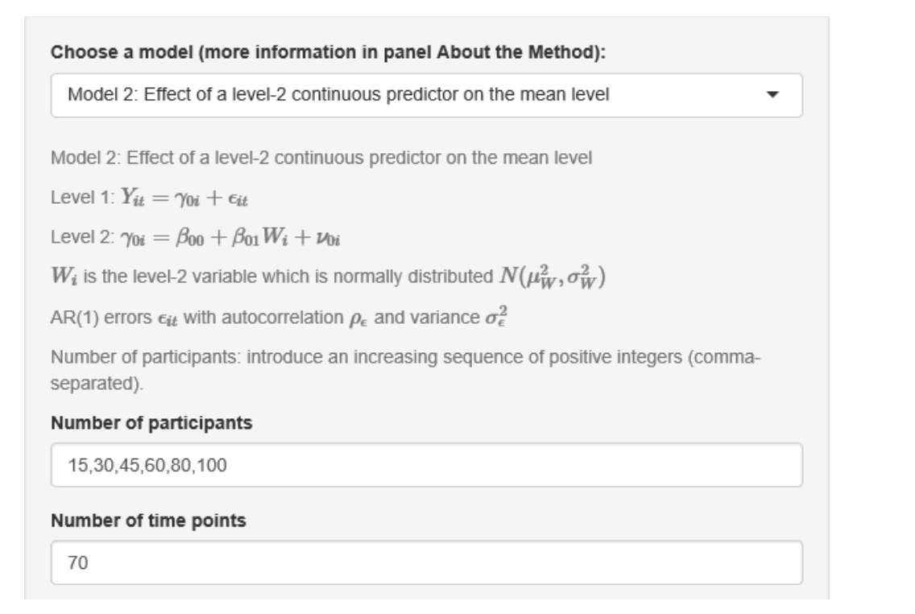
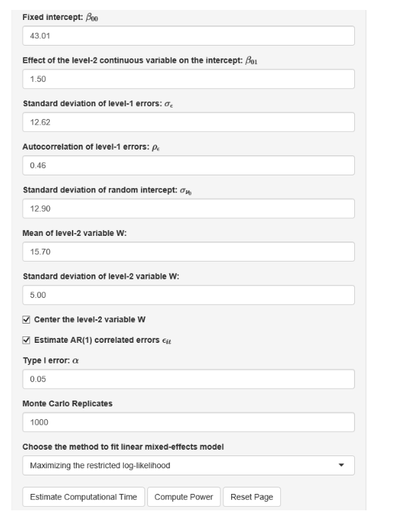
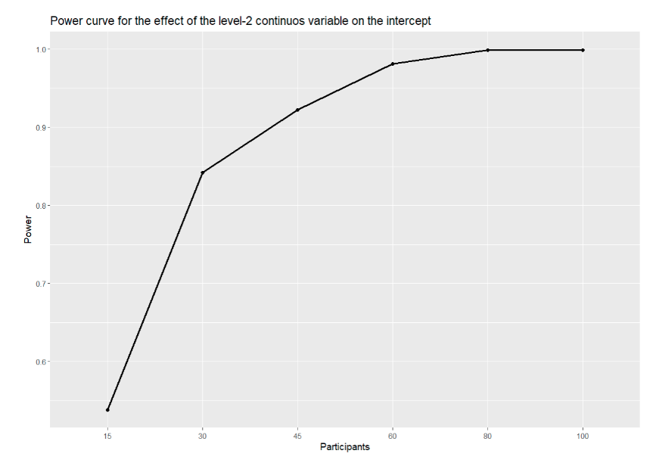
Power
PowerAnalysisIL Shiny App
Lafit, Ginette, Janne Adolf, Egon Dejonckheere, Inez Myin-Germeys, Wolfgang Viechtbauer, & Eva Ceulemans. (in press). Selection of the Number of Participants in Intensive Longitudinal Studies: A User-Friendly Shiny App and Tutorial for Performing Power Analysis in Multilevel Regression Models That Account for Temporal Dependencies. Advances in Methods and Practices in Psychological Science.

Slide 21
Preregistration
Be explicit about different parts of your model (researcher degrees of freedom!)
Random effects included? Which ones?
What happens if the models do not converge?
How are you centering your variables?

Slide 22
Reporting Standards
Subfield dependent
Focus on fixed effects (like for a regression)
Highlight random effects
Random effect correlations
Report model fit - model comparisons

Slide 23
Running MLMs in R

Slide 24
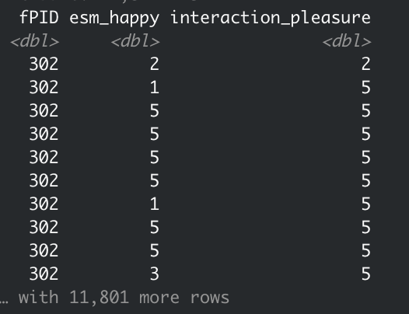
Our data
60 times for each person
Notes:
Scale 1-7
At the time of the prompt I felt happy
When was your most recent interaction….
Scale 1-5
How much pleasure did you experience during this interaction?

Slide 25
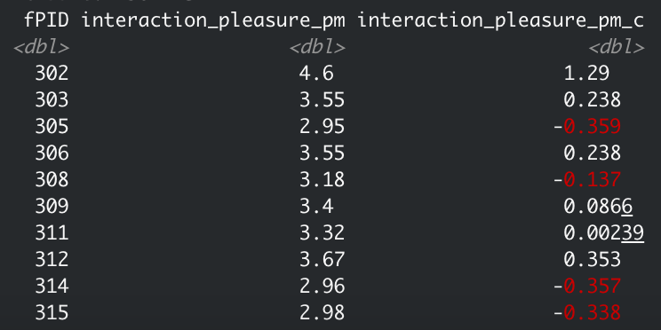
Centering - Getting Person Means
Notes:
Grand mean is 3.313401
We are centering the predictors but NOT the outcome

Slide 26
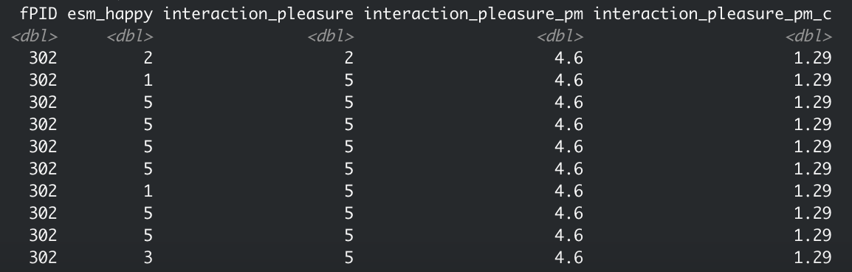
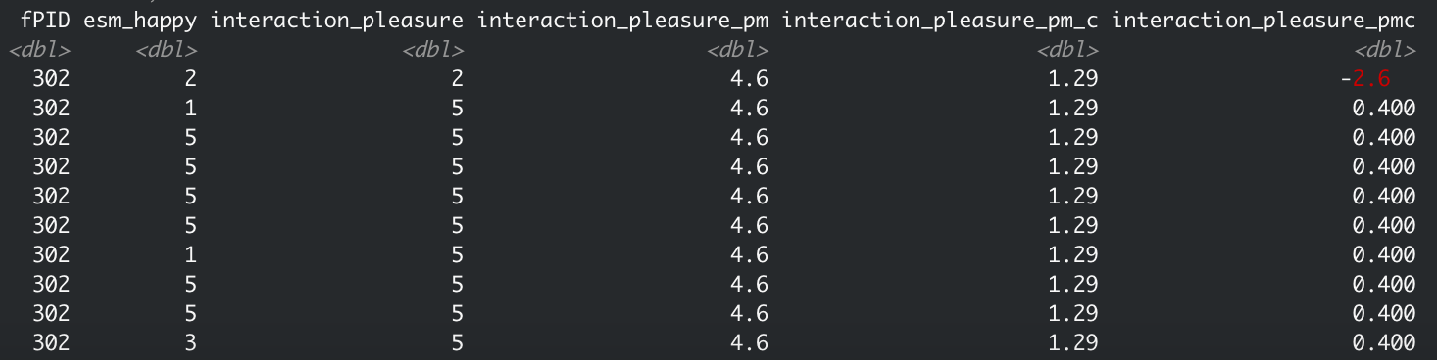
Centering - Getting Person-Mean-Centered Variables
Notes:
0 of pm_c = MEAN OF SAMPLE -- deviations from average person
0 of pmc = mean of person -- deviations from own average

Slide 27
Running the MLM with a Random Intercept
Notes:
Lets walk through each component of this model
Using lme4

Slide 28
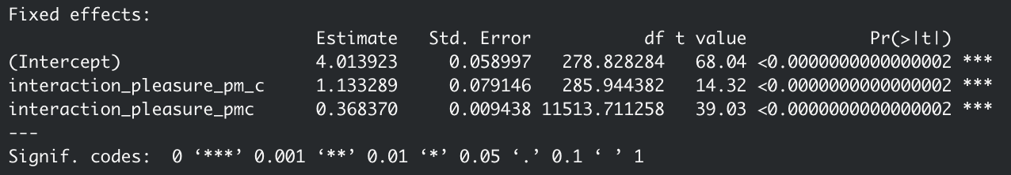
Running the MLM with a Random Intercept
Notes:
Outcome = happiness
Predictor = social interaction enjoyment
Each person that is 1 unit higher in average interaction enjoyment is experiencing 1.13 higher happiness
When people are 1 unit higher than their OWN average in interaction enjoyment they are experiencing .36 more happiness
We can find SMALLER within person effects (have more data!)

Slide 29
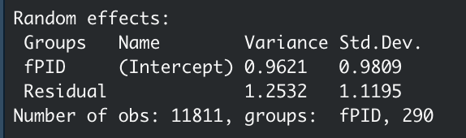
Running the MLM with a Random Intercept
An individual whose Intercept is one SD above
the Mean would be almost 1 unit higher in happiness
Notes:
Each of these random intercepts and slopes has an associated variance (and standard deviation) estimate, which tells you the extent to which response times for particular stimuli and participants varied around the fixed intercept and slope

Slide 30
Running the MLM with Random Intercept and Slope

Slide 31
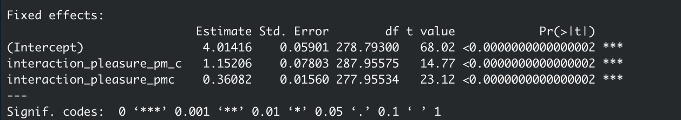
Running the MLM with Random Intercept and Slope
Notes:
For practice reasons - let’s interpret again

Slide 32
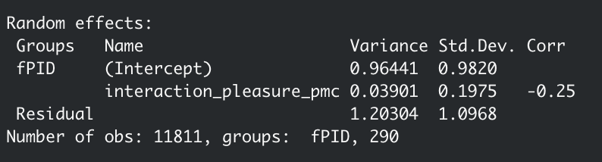
Running the MLM with Random Intercept and Slope
An individual whose Intercept is one SD above
the Mean would be almost 1 unit higher in happiness
AND
An individual whose Slope is one SD above the Mean
would have a slope of ~.56

Slide 33
Running the MLM with Random Intercept and Slope
People who have higher mean levels of happiness when
they experience average pleasure during a social interaction
show a lower association between interaction pleasure
and happiness

Slide 34
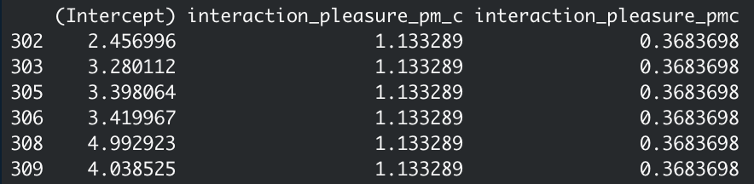
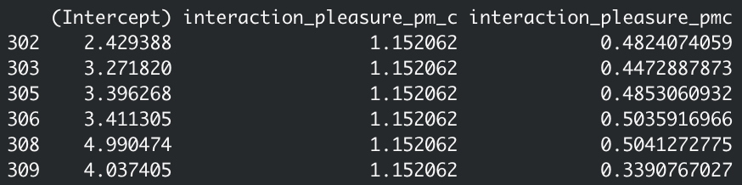
What do the individual estimates look like for these models?

Slide 35
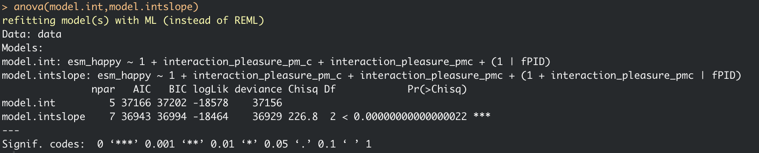
Should we include a random slope?
Let’s compare the models we just ran and see which one provides more information!
Yes! Including the random slope results in a better model (significant Chi-Square test, lower BIC)
Notes:
Likelihood ratio tests

Slide 36
Convergence Issues
Estimation issues can occur when we are trying the model to do a lot with little information (e.g., too many random slopes, too little variance)
Adjusting the optimizer can help

Slide 37
Other ways of running MLMs in R
Glmer
For non-continuous outcomes (e.g., binary outcomes)
Nlme
Precursor to lmer, can do some things lmer cannot do like modifying covariance structure
Brms (Bayesian MLM)
Can predict variance parameter and run multivariate models more easily

Slide 38
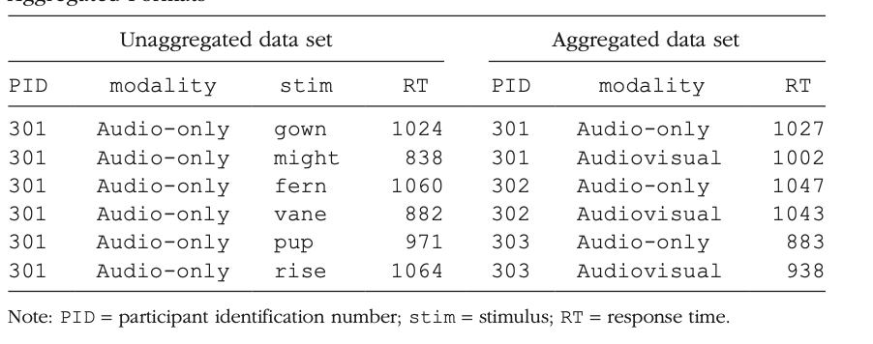
Example: MLM in Experimental Settings

Slide 39
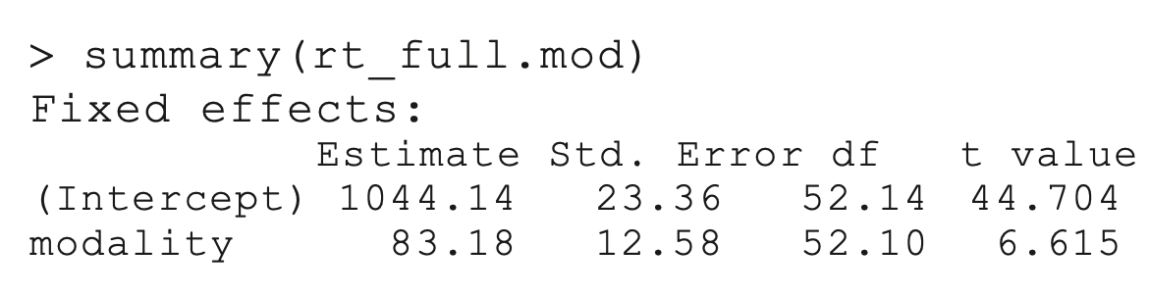
Example: MLM in Experimental Settings
rt_full.mod <- lmer(RT ~ 1 + modality + (1 + modality|PID) + (1 + modality|stim), data = rt_data)
Response time predicted by modality (audiovisual, audio only). Random intercepts and slopes added for both participants and stimulus
Notes:
Violet Brown example
Cross classified model (different nesting factors)
The example data I provide (see https://osf.io/ v6qag/), which we will work with later in this Tutorial, come from a within-subjects speech-perception study in which each of 53 participants was presented with 553 isolated words, some in the auditory modality alone (audio-only condition) and some with an accompanying video of the talker (audiovisual condition). Participants listened to and repeated these isolated words aloud while simultaneously performing an unrelated response time task in the tactile modality (classifying the length of pulses that coincided with the presentation of each word as short, medium, or long). The response time data are based on data from a previous experiment of mine (Brown & Strand, 2019; complete data set available at https://osf.io/86zdp/), but the response times them- selves have been modified for pedagogical purposes (i.e., to illustrate particular issues that you may encoun- ter when analyzing data with mixed-effects models). The accuracy data have not been modified, but variables have been removed for simplicity.

Slide 40
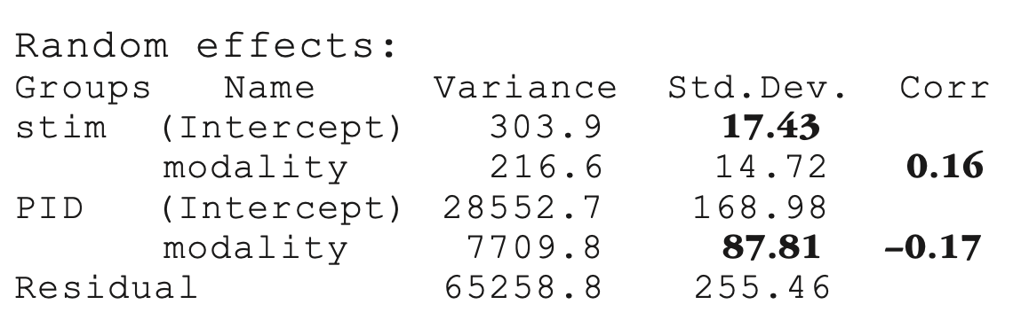
Example: MLM in Experimental Settings
SD for by- item random intercepts (in boldface in the output above) indicates that response times for particular items varied around the average intercept of 1,044 ms by about 17 ms.
Similarly, the standard deviation for by-participant random slopes (in boldface in the output above) indicates that participants’ estimated slopes varied around the average slope of 83 ms by about 88 ms.

Slide 41
Resources
Violet Brown’s amazing paper for an application to experimental settings
Brown, V. A. (2021). An introduction to linear mixed-effects modeling in R. Advances in Methods and Practices in Psychological Science, 4(1)
Take classes
Hierarchical Linear Modeling (Mike Strube)
Applied Longitudinal Data Analysis (Josh Jackson)
APA Advanced Training Institute Longitudinal Modeling
APA Methods lectures
CenterStat (classes for free sometimes)
Notes:
Violet Brown -- Cross classified model (two random intercepts -- Useful for experimental conditions)

Slide 42
Resources
Books
Longitudinal Analysis: Modeling within person fluctuation and change - Lesa Hoffman
Multilevel Analysis: An Introduction to Basic and Advanced Multilevel Modeling - Tom Snijders and Roel Bosker

