Slide 1
GPA
Parent SES

Slide 2
GPA
Peer Relations
b
Parent SES
a

Slide 3
GPA
Peer Relations
Parent SES
b
a
c

Slide 4
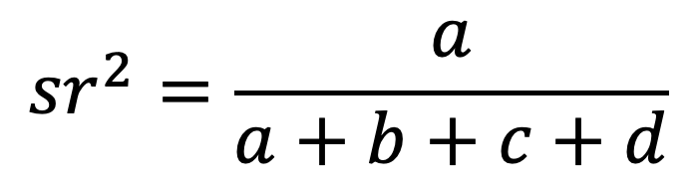
$${sr}^{2}=\frac{a}{a+b+c+d}$$
GPA
d
Peer Relations
Parent SES
b
a
c

Slide 5
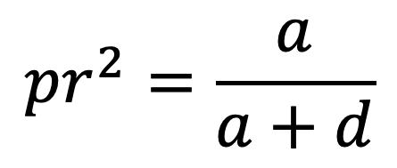
$${sr}^{2}=\frac{a}{a+b+c+d}$$
GPA
d
$${pr}^{2}=\frac{a}{a+d}$$
Peer Relations
Parent SES
b
a
c

Slide 6
GPA
d
Parent SES
b
a
c

Slide 7



$$R_{Y.12}^{2}=b_{Y1.2}^{∗}r_{Y1}+b_{Y2.1}^{∗}r_{Y2}$$
$$R_{Y.12}^{2}=r_{Y1}r_{Y1}+r_{Y2}r_{Y2}$$
Y
$$R_{Y.12}^{2}=r_{Y1}^{2}+r_{Y2}^{2}$$
X₁
b
X₂
a

Slide 8
$$R_{Y.12}^{2}=b_{Y1.2}^{∗}r_{Y1}+b_{Y2.1}^{∗}r_{Y2}$$
Y
X₁
b
X₂
a
c

Slide 9
Y
X₄
X₁
X₂
X₃

