Slide 1
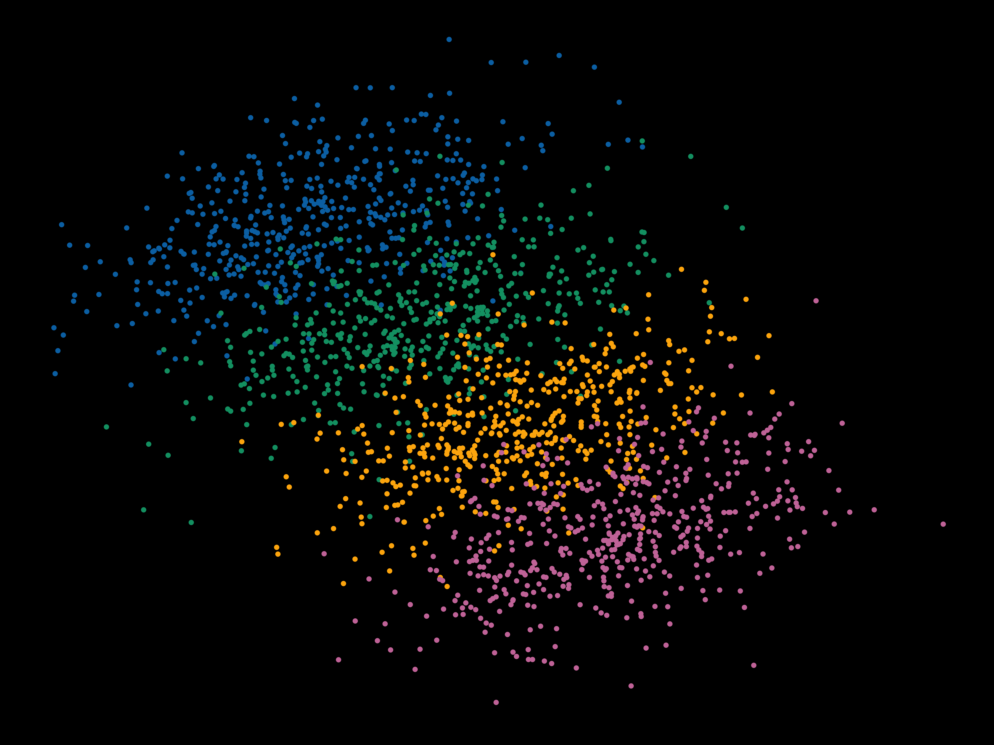
Multilevel Modeling Day 2
Violet Brown

Slide 2
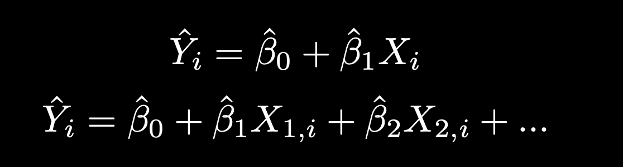
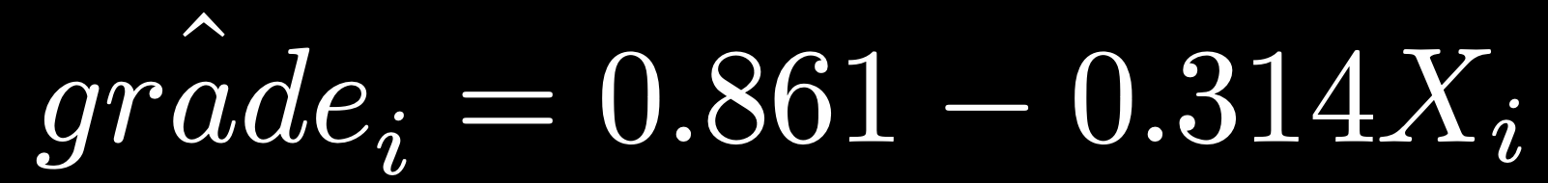
Standard regression equation:
> grade.mod <- lm(grade ~ skipped_class, data = grade_data)
> summary(grade.mod)
Coefficients:
Estimate Std. Error t value Pr(>|t|)
(Intercept) 0.86103 0.01900 45.322 < 2e-16 ***
skipped_class -0.31402 0.04514 -6.956 1.05e-10 ***

Slide 3
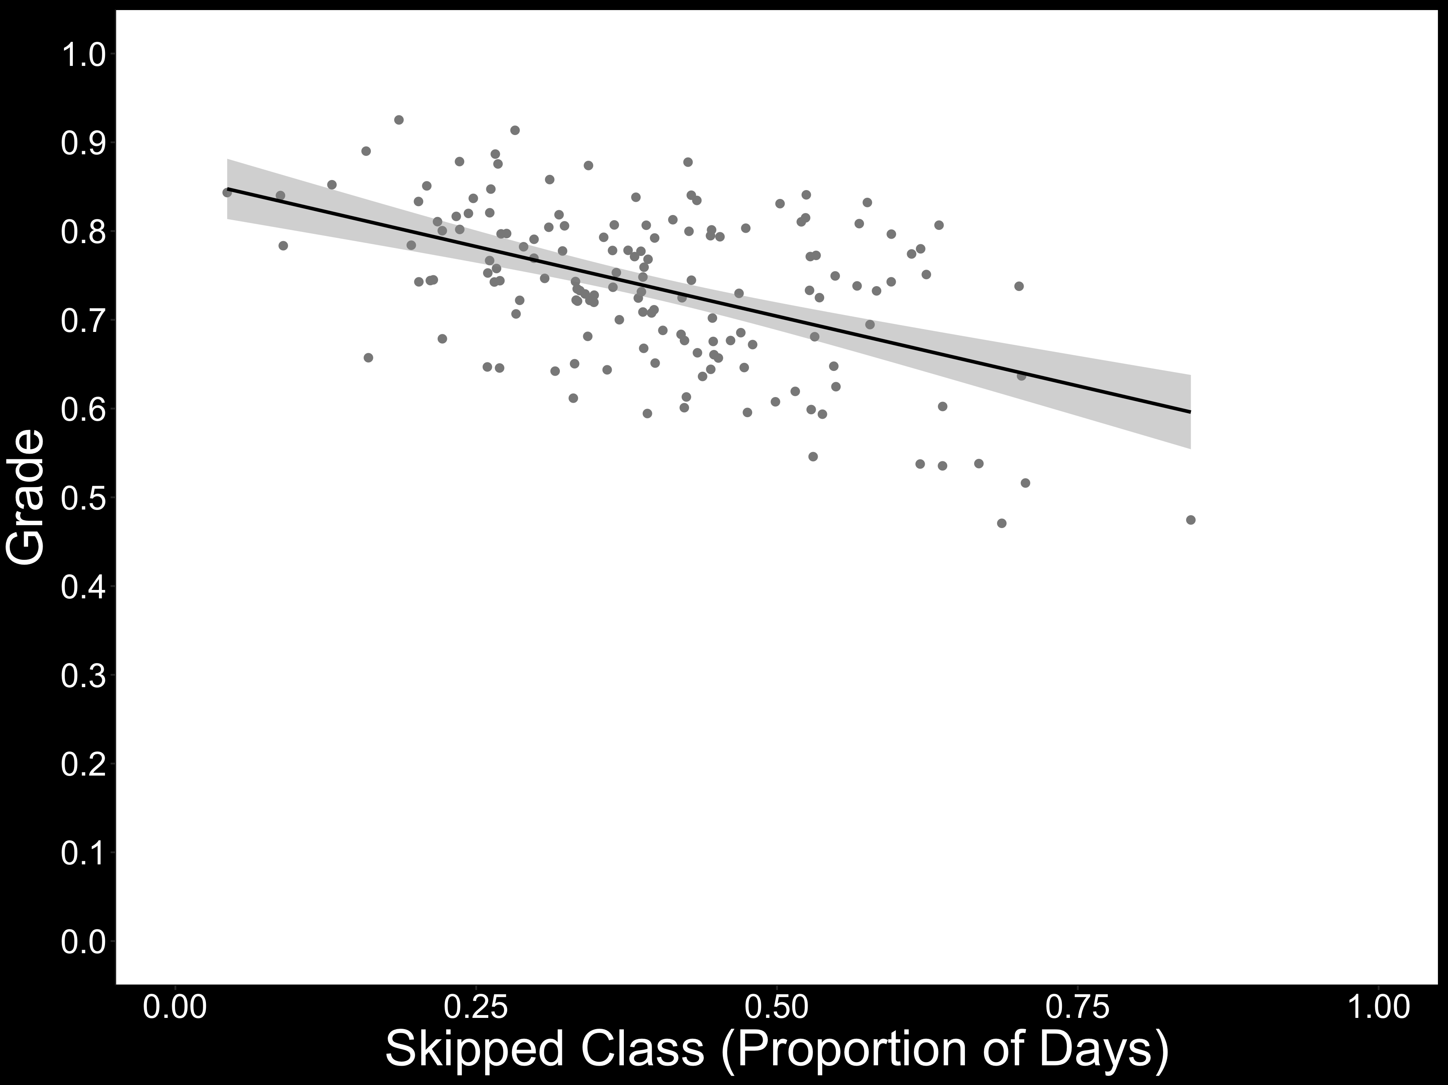
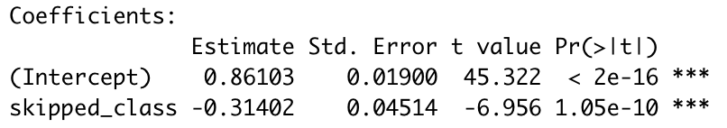

Slide 4
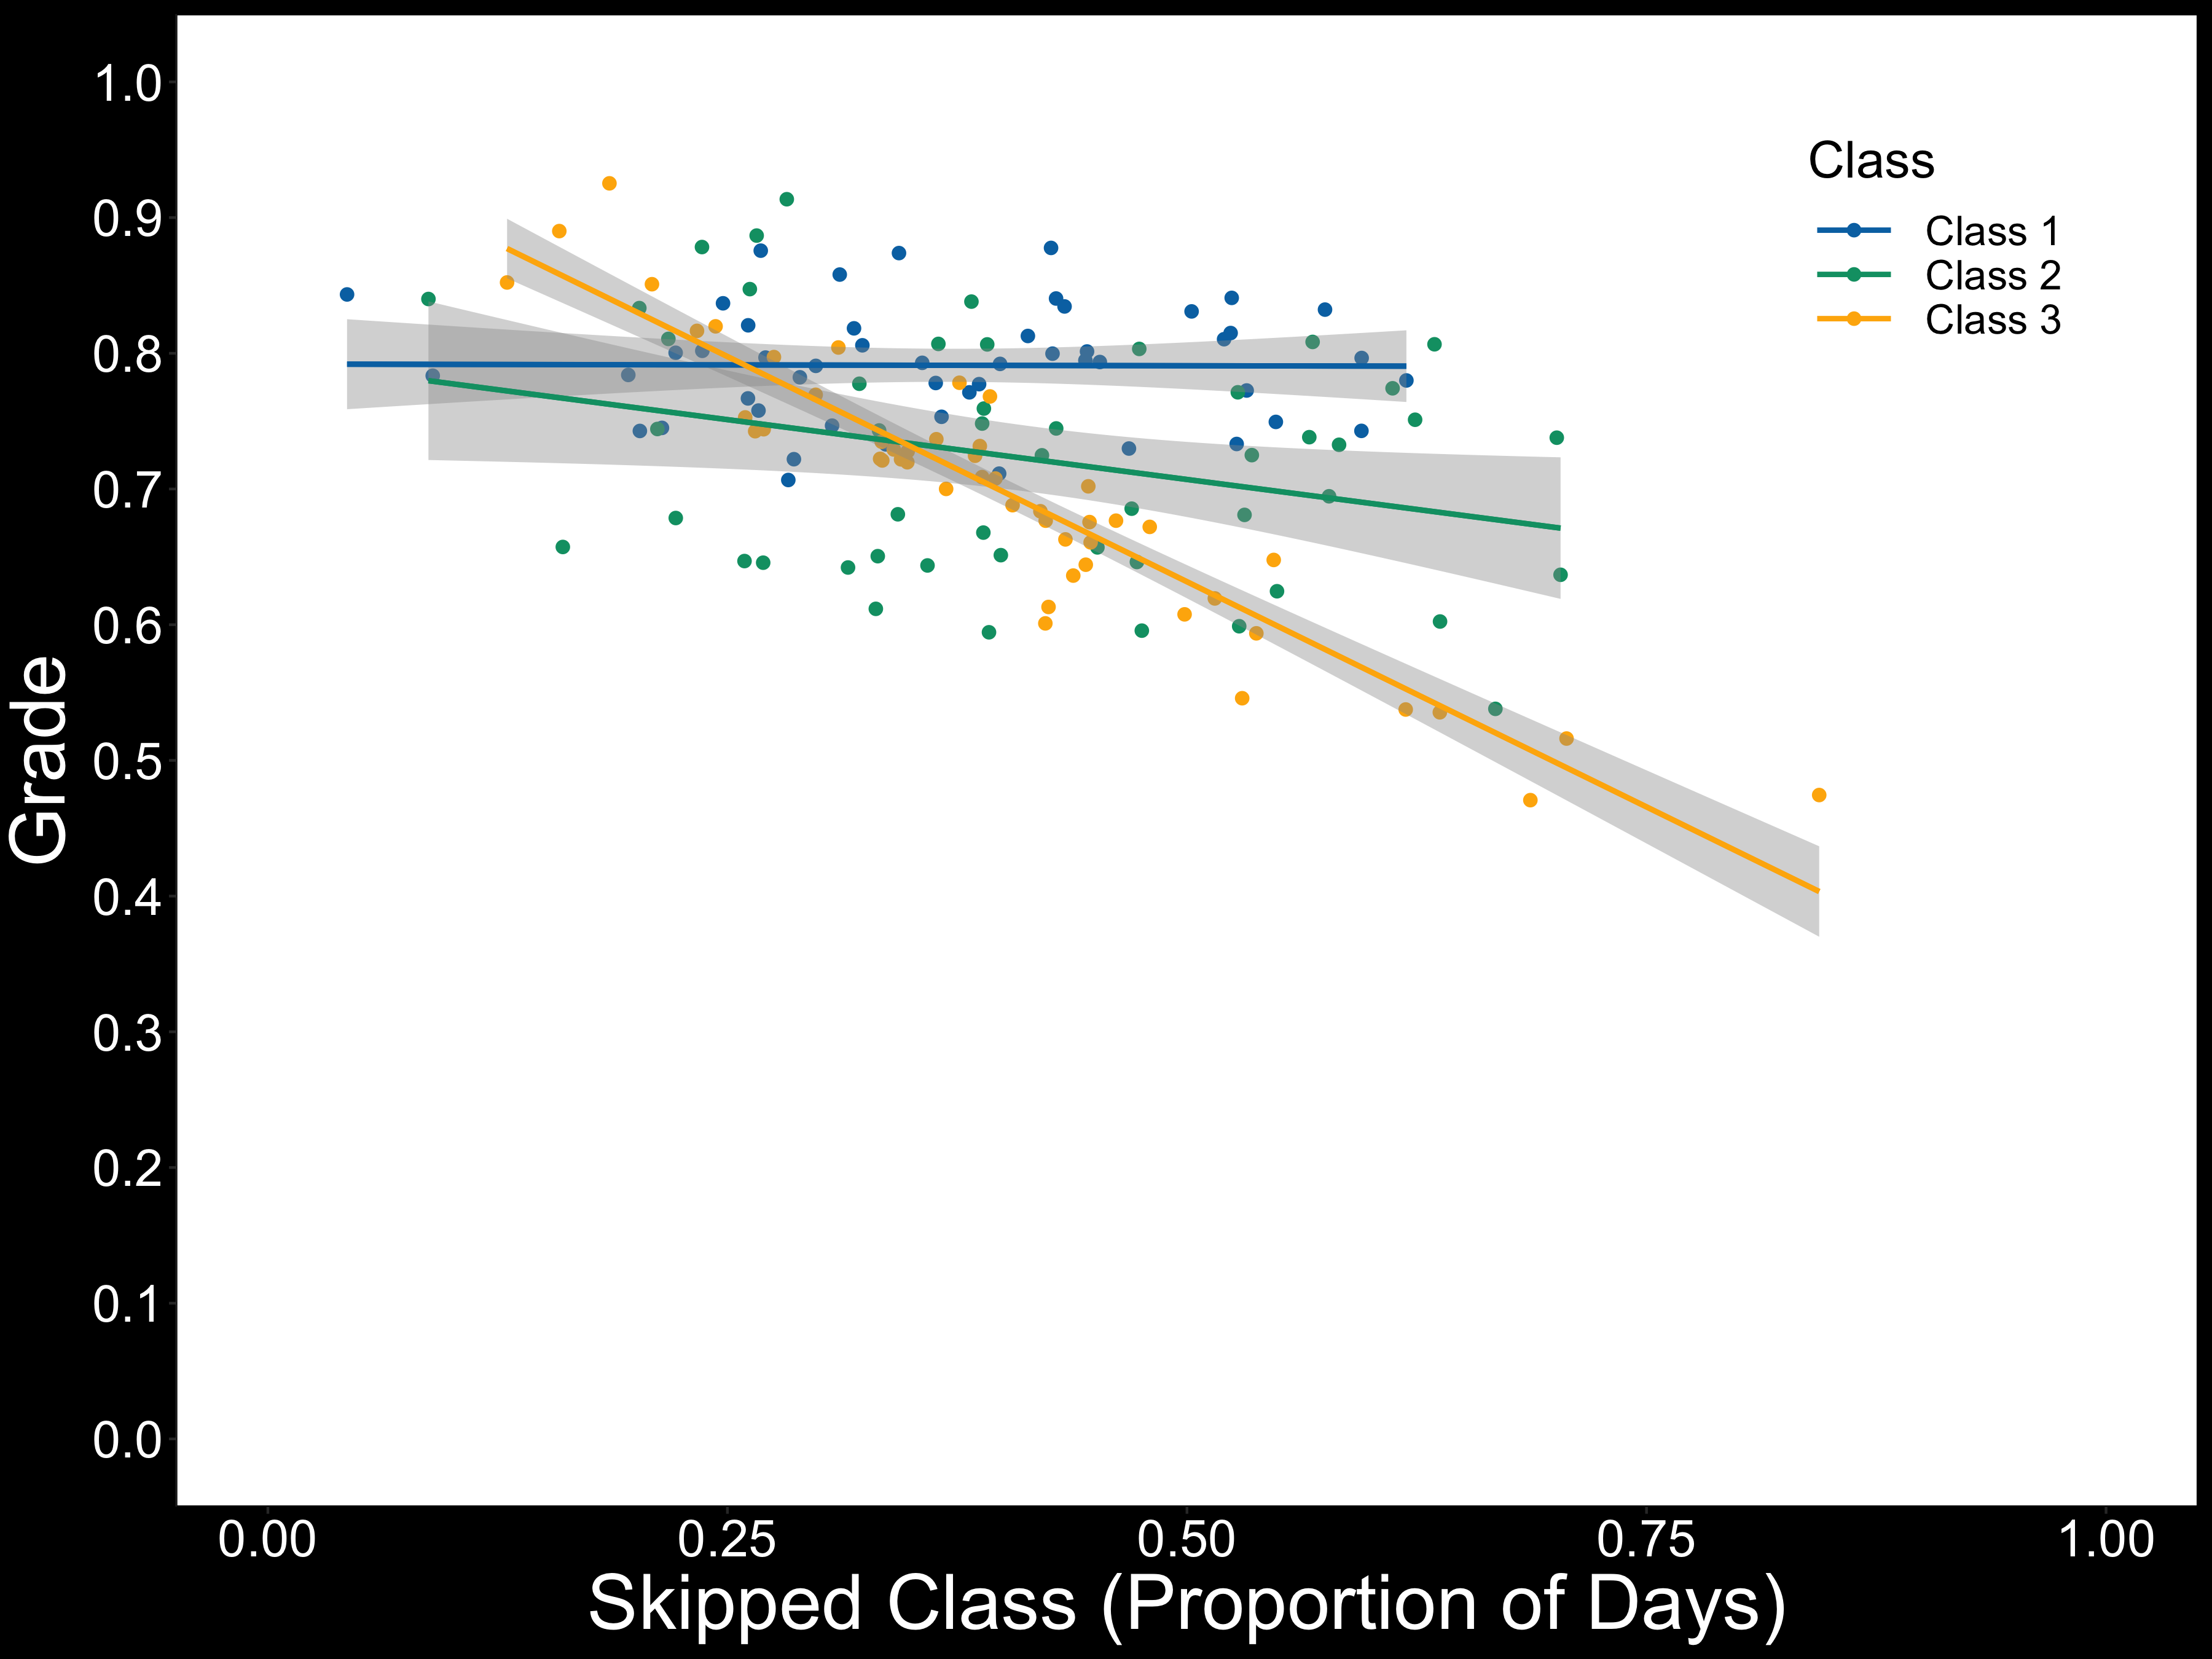

Slide 5
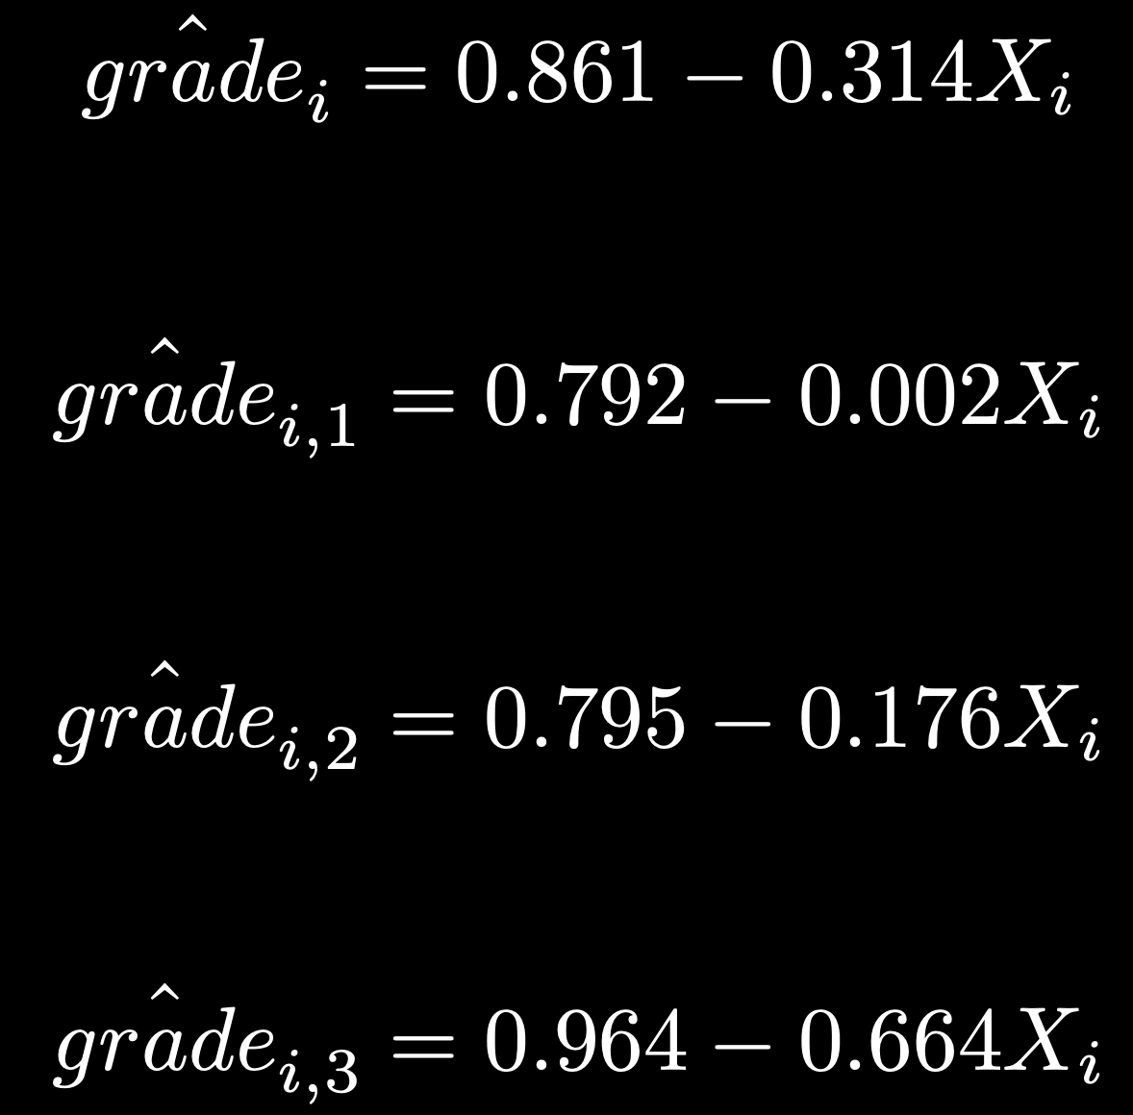
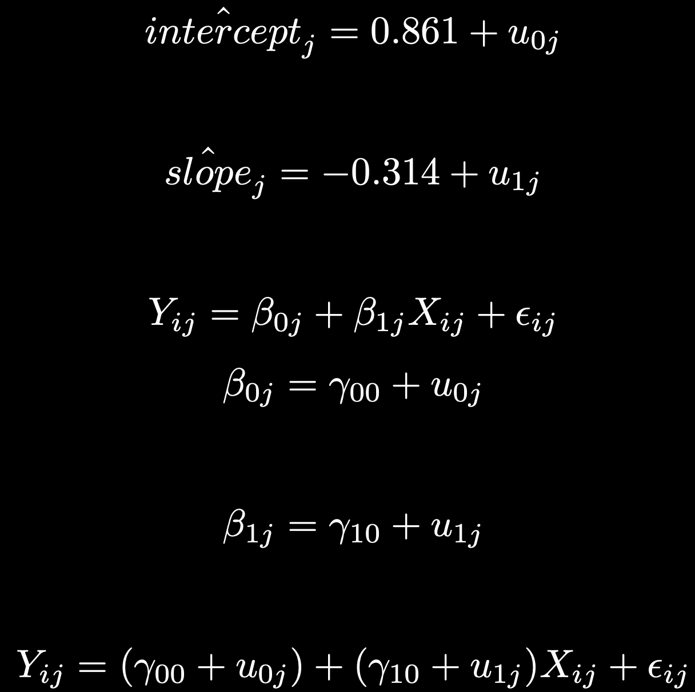
Multilevel model
Level 1
Level 2

Slide 6
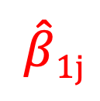
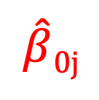
Multilevel model
Intercept
Slope
$\hat{β}$_{0j}
$$\hat{β}1j$$

Slide 7
Multilevel model
Intercept
Slope
$\hat{β}$_{0j}
$$\hat{β}1j$$

Slide 8
Multilevel model
Fixed effects
Random effects
Intercept
Slope
$\hat{β}$_{0j}
$$\hat{β}1j$$

Slide 9
Multilevel model
Class 1
Class 3

Slide 10
Multilevel model
Class 1
Class 3
 | 𝛥 Intercept | 𝛥 Slope
Class 1 | -0.069 | 0.312
Class 3 | 0.103 | -0.350

Slide 11
Multilevel model
Intercept
Slope
$\hat{β}$_{0j}
$$\hat{β}1j$$

Slide 12
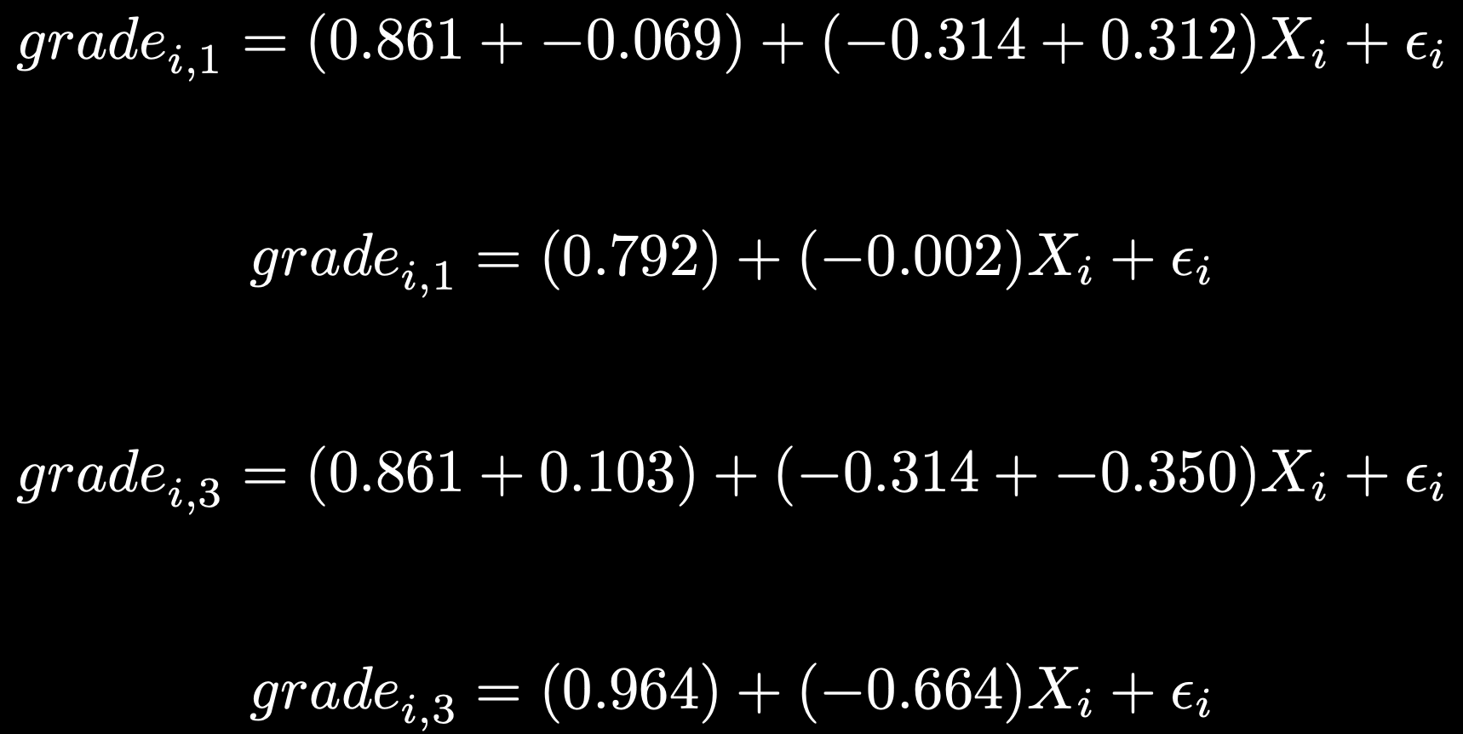
Multilevel model
 | 𝛥 Intercept | 𝛥 Slope
Class 1 | -0.069 | 0.312
Class 3 | 0.103 | -0.350

Slide 13
Multilevel model
 | 𝛥 Intercept | 𝛥 Slope
Class 1 | -0.069 | 0.312
Class 3 | 0.103 | -0.350

Slide 14
Multilevel model
Level 1
Level 2

Slide 15
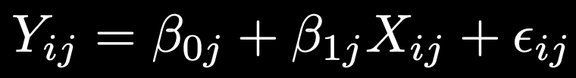

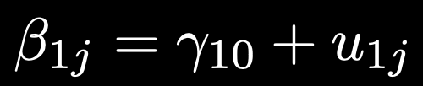
Multilevel model
Level 1
Level 2

Slide 16
Multilevel model
Level 1
Level 2

Slide 17
Multilevel model
Level 1
Level 2

Slide 18
Multilevel model
Level 1
Random effects
Fixed effects
Level 2

Slide 19
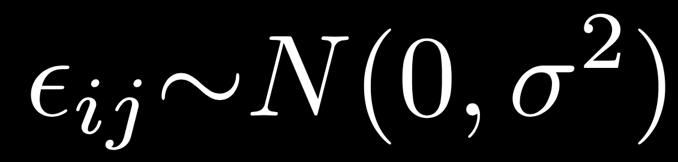

Some notes
Level 1 random effects (residuals), $εij$, vary within level 2 units
Constant across level 2 units
Level 1 coefficients ($β0j ,$ $β1j$) are constant within level 2 units but vary across level 2 units

Slide 20
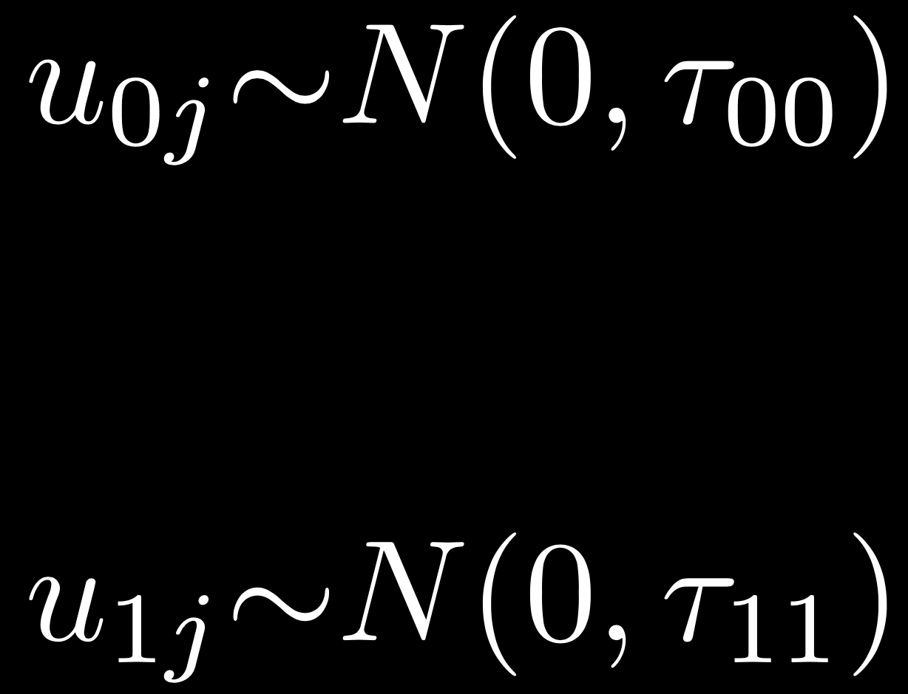

Some notes
Level 2 random effects/residuals (u_{0j}, u_{1j}) vary across level 2 units
u_{0j} , u_{1j} can be correlated! But are uncorrelated with $εij$
Tau matrix, $Τ$, contains variance and covariance for random effects

Slide 21
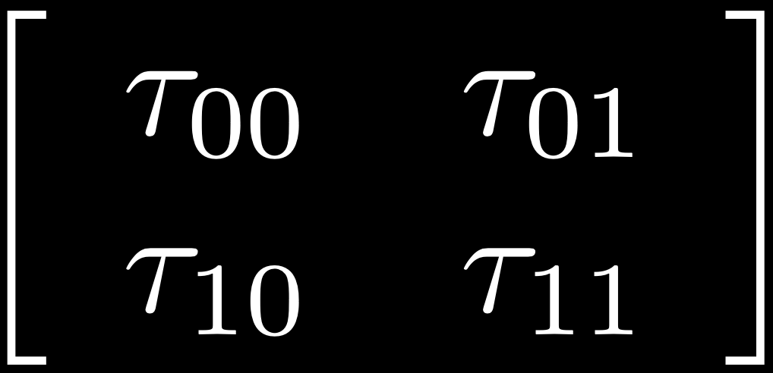
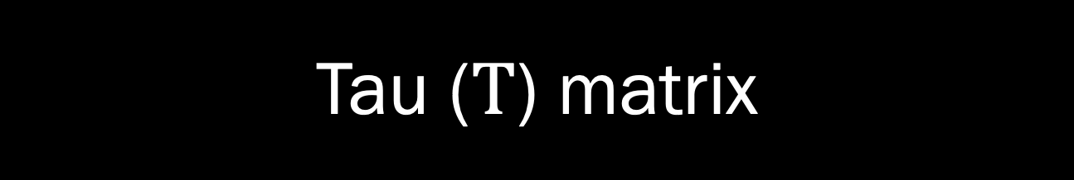
Tau ($Τ$) matrix
covariance between u_{0j} , u_{1j}
variance of u_{0j}
variance of u_{1j}

Slide 22

Some notes
Level 2 coefficients ($γ00$ , $γ10$) are constant across level 2 units
Fixed effects!

Slide 23
Implementation in R
> install.packages("lme4")
> library(lme4)
Fixed effect: proportion of classes skipped
Random effects:
by-class random intercepts
by-class random slopes for proportion of classes skipped

Slide 24
Implementation in R
> lmer(grade ~ 1 + skipped_class +
(1 + skipped_class|Class),
data = grade_data)

Slide 25
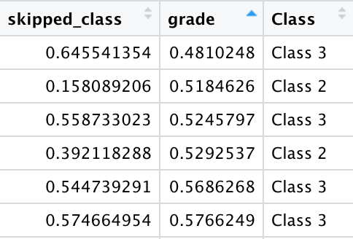
Implementation in R
> lmer(grade ~ 1 + skipped_class +
(1 + skipped_class|Class),
data = grade_data)

Slide 26
Implementation in R
Fixed effects:
Estimate Std. Error t value
(Intercept) 0.84229 0.05101 16.512
skipped_class -0.25669 0.17380 -1.477

Slide 27
Implementation in R
Fixed effects:
Estimate Std. Error t value
(Intercept) 0.84229 0.05101 16.512
skipped_class -0.25669 0.17380 -1.477
Random effects:
Groups Name Variance Std.Dev. Corr
Class (Intercept) 0.007011 0.08373
skipped_class 0.086015 0.29328 -0.91
Residual 0.004751 0.06893
lmer(grade ~ skipped_class +
(1 + skipped_class|Class) +
data = grade_data)

Slide 28
Implementation in R
Fixed effects:
Estimate Std. Error t value
(Intercept) 0.84229 0.05101 16.512
skipped_class -0.25669 0.17380 -1.477
Random effects:
Groups Name Variance Std.Dev. Corr
Class (Intercept) 0.007011 0.08373
skipped_class 0.086015 0.29328 -0.91
Residual 0.004751 0.06893
lmer(grade ~ skipped_class +
(1 + skipped_class|Class) +
data = grade_data)

Slide 30
Implementation in R
Fixed effects:
Estimate Std. Error t value
(Intercept) 0.84229 0.05101 16.512
skipped_class -0.25669 0.17380 -1.477
Random effects:
Groups Name Variance Std.Dev. Corr
Class (Intercept) 0.007011 0.08373
skipped_class 0.086015 0.29328 -0.91
Residual 0.004751 0.06893

Slide 31
Whew!

