Slide 1


Booking Hotel System
D0965719 Shelly D0977966 Kevin Liu D0969212 Neo

Slide 2

About the program
About the program
This program is divided into two parts:
Booking and
Cancel reservation

Slide 3
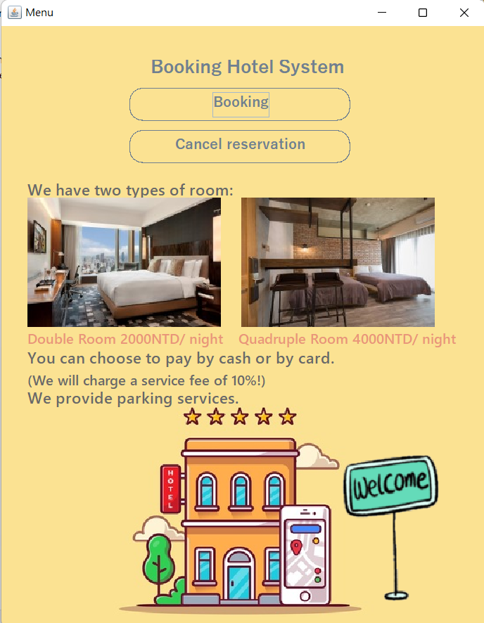
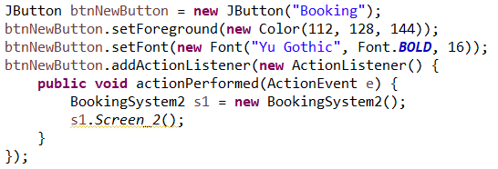
Introduction
1
Booking Button
2
Cancel reservation Button
3
Information of Hotel

Slide 4
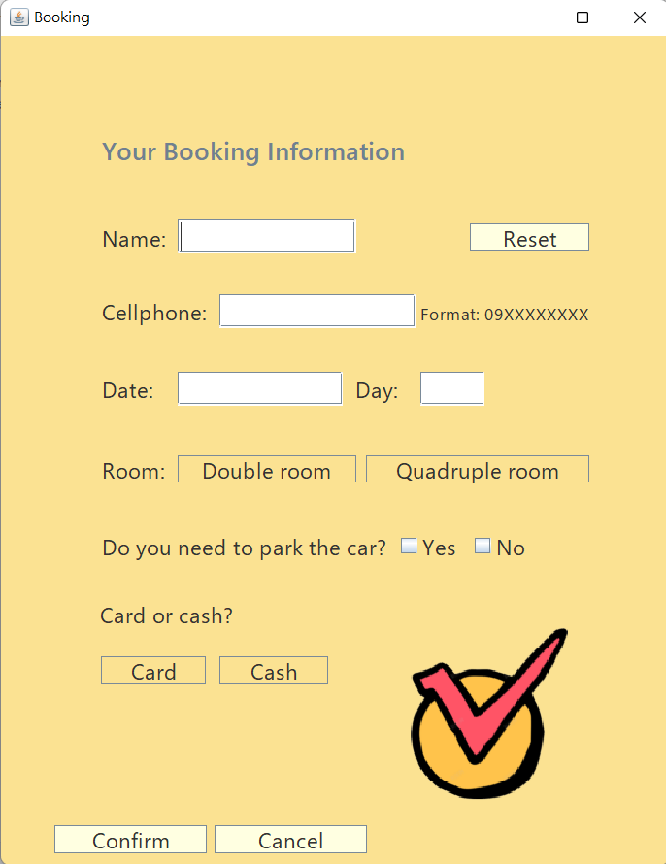
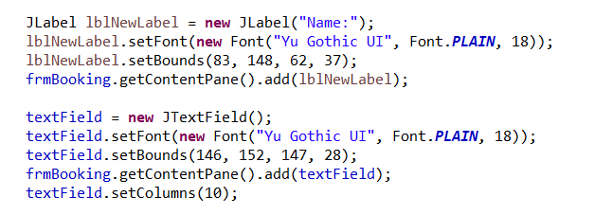
Booking
Customer Information

Slide 5
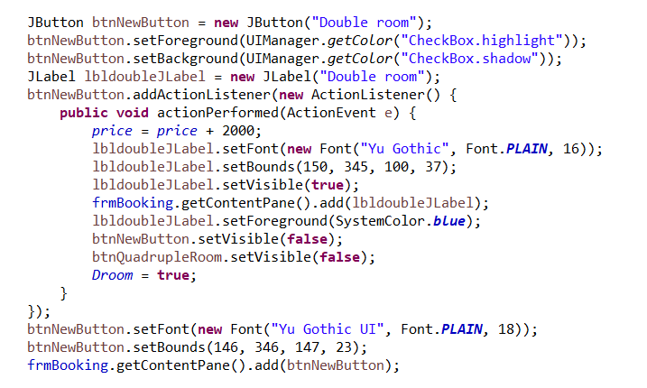
Booking
Choice Button

Slide 6
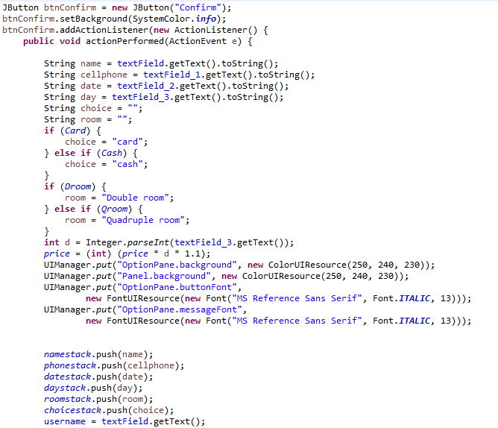
Booking
Confirm Button

Slide 7
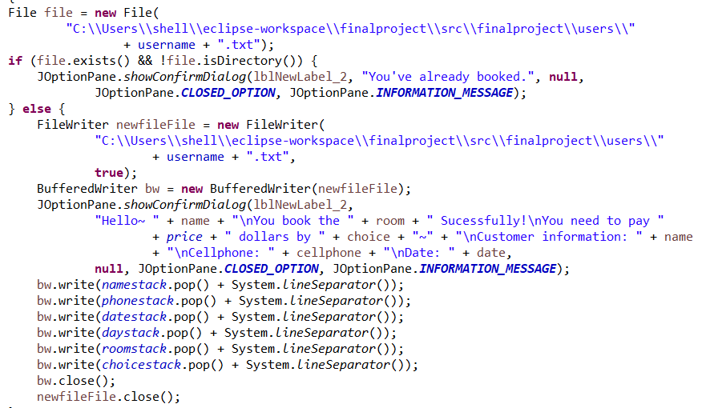
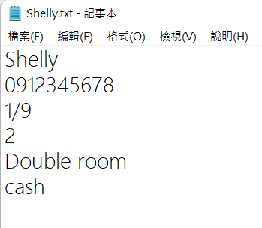
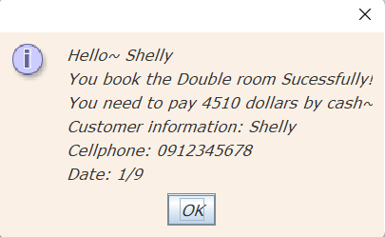
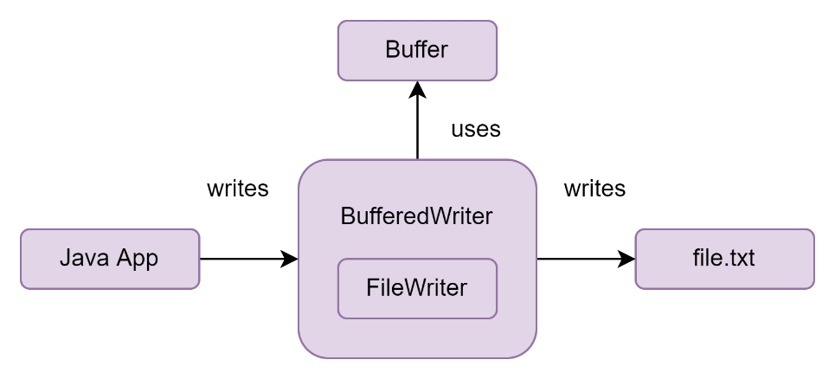
Write the customer information in file

Slide 8
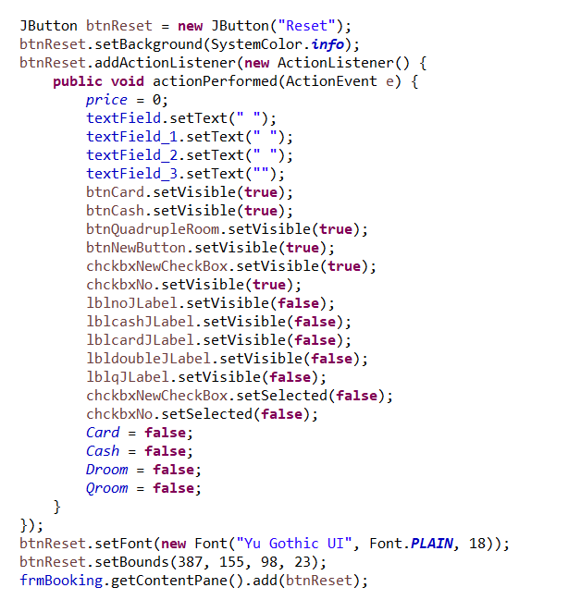
Booking
Reset Button

Slide 9
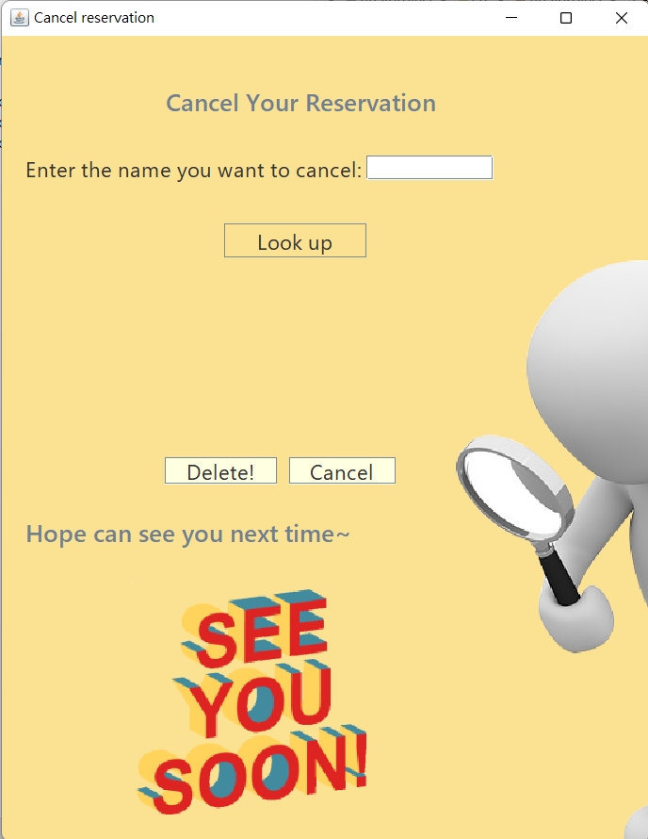
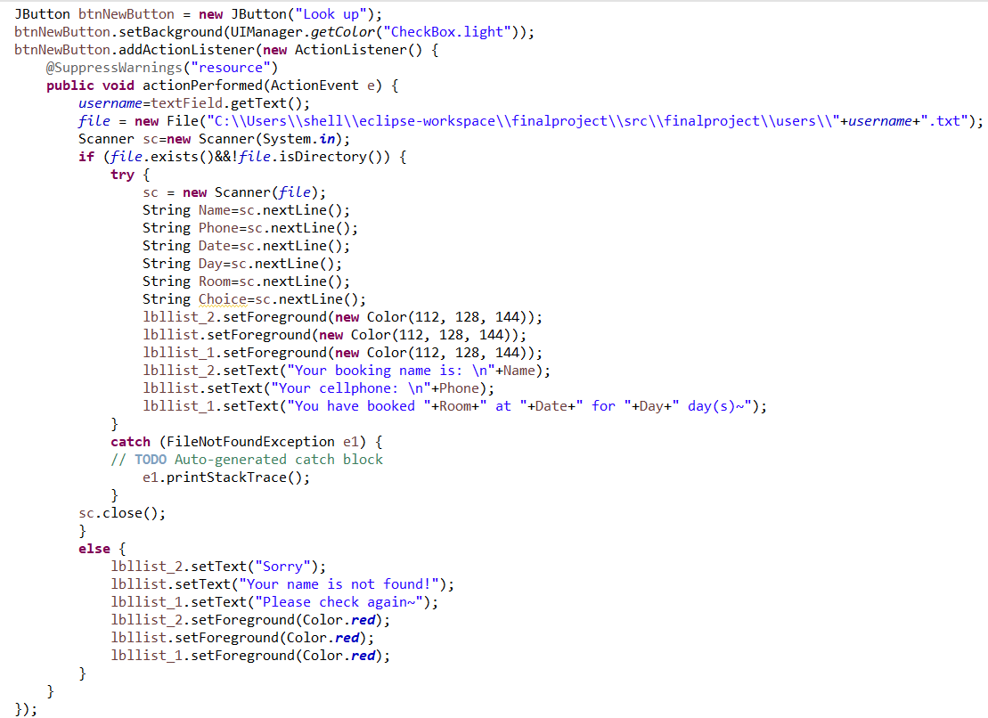
Cancel reservation
Look up button

Slide 10
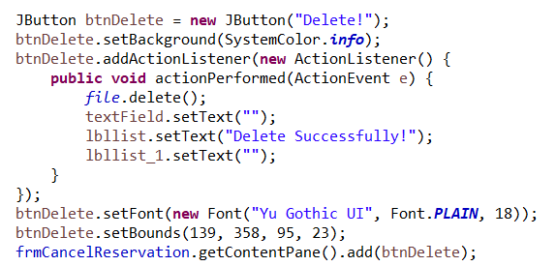
Cancel reservation
Delete button

Slide 11
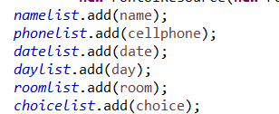
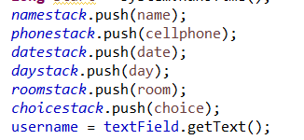
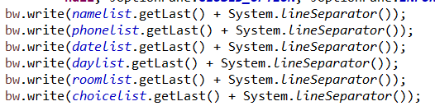
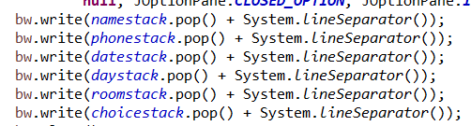
LinkedList vs Stack
 | LinkedList add() | Stack push() | LinkedList remove() | Stack pop()
Time complexity | O(1) | O(1) | O(1) | O(1)
Space complexity | O(n) | O(n) | O(n) | O(n)

Slide 12
Thanks for listening

