Slide 1
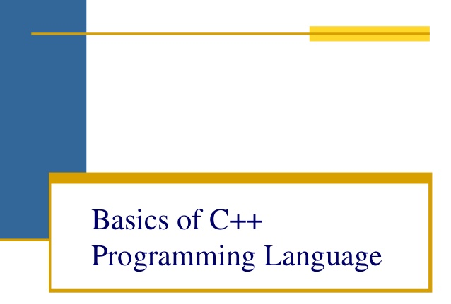

Slide 2
OBJECTIVES
An Introduction to the Object Oriented Paradigms.
A Detailed practical approach with each concept.
Relating the features of OOP to the x world needs.

Slide 3
Prerequisites
Awareness of programming concepts.
Completion of C programming course

Slide 4
OUTLINE
Module 1:Introduction to C++
Module 2:OOP Basic concepts
Module 3:C++ Basics
Module 4:Functions and Function Overloading
Lab session 1
Module 5:Constructors and Destructors
Lab session 2
Module 6:Operator Overloading and type casting
Inheritance
Polymorphism
Lab session 3
Summary

Slide 5


Introduction to C++
Why C++/OOP
Modeling approach c vs c++

Slide 6

Introduction to C++
C++ is basically an Object Oriented Programming(OOP) language .
It was developed by Bjarne Stroustrup at AT and T’s bell lab in USA in early 1980s
C language
Simula 67
C++

Slide 7
Why C++ / OOP ?
C++ is basically invented to –
remove some of the pitfalls of Procedural Oriented Programming
adding best of structured programming.
adding some new powerful concepts as..
Reusability
Data Hiding
Data Security

Slide 8
Modeling Approach C vs. C++
C Approach
C++ Approach
Structure Name
Fields
Class Name
Variables (Data Members)
Methods (Function Members)
Compare
Functions
Compare

Slide 9
In a class, all members are private by default unless otherwise stated.
Functions are binded within a class
In a struct, all members are public by default. They do not bind functions with struct.
class a class b
{ {
int x; public:
public: int y;
void f1(); void f1();
}; };
Note the difference
struct b
{
int y;
};

Slide 10

OOPS basic Features
OOP design aNd programming
OOP paradigm
Oop basic concepts
Modeling advantage of c++ vs c

Slide 11
OOP Basic features
OOPS is characterized by the following features:
Emphasis is more on data rather than procedure.
Programs are divided into objects.
Data structures (classes) are designed in such a way that they characterize the objects.
Data is hidden and cannot be accessed by external functions. OOP has access specifiers named Public, Private, Protected, etc. so provides more security.
Objects communicate with each other through functions
Bottom-up approach is adopted in program design.

Slide 12
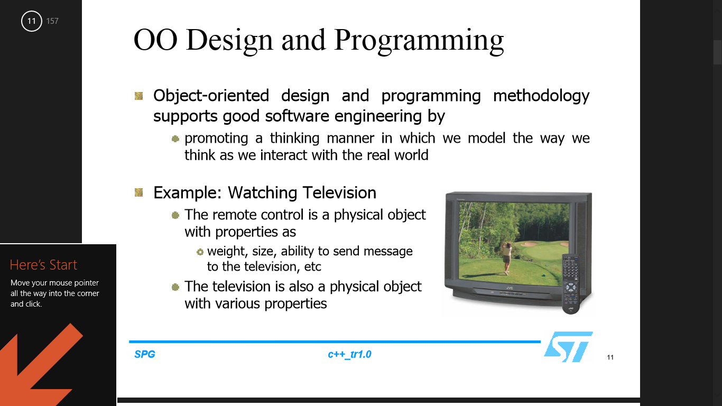
OOP DESIGN AND PROGAMMING
Object-oriented design and programming methodology supports good software engineering by
prompting a thinking manner in which we model the way we think as we interact with x world
Example: Watching Television
The remote control is a physical object with properties as
Weight, size, ability to send message to the television etc.
The television is also a physical object with
various properties

Slide 13
OOP Paradigm
In C++ ,we decompose our main problem into no. of entities called OBJECTS.
These objects communicate with other objects by passing message to functions
Object A
DATA
FUNCTIONS
Object Oriented Paradigm
Object C
Object B
DATA
DATA
FUNCTIONS
FUNCTIONS
Organisation of Data and Functions

Slide 14
Basic concepts of OOP
1. Objects
9. Message passing
2. Classes
8. Dynamic binding
OOP
3. Data Encapsulation
7. Polymorphism
4. Information Hiding
5. Data Abstraction
6. Inheritance

Slide 15
1. Object
It can be anything- a person, place, a bank account or any item which has
Name
Properties
Object is the basic run time entity in an object oriented system.
Each object contains data and code to manipulate the data.
Object are variable of type class.

Slide 16
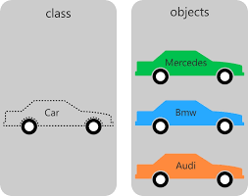

2. Class
A class is a collection of objects of similar types
For e.g.
Car is a class .Different types of car are its objects.
Class
Objects

Slide 17
General form of class declaration
class class_name
{
private:
variable declaration;
function declaration;
public:
variable declaration;
function declaration
};
General form of object declaration
class_name object_name;
Function calling using objects
object_name.functionname(arguments list);

Slide 18
Code snippet for declaring a class and its object
class student
{
private:
char name[15];
int rollno,marks,age; //Attributes
public:
void getdata() //methods
{
//code to accept data
}
void average()
{
//code to calculate average of marks
}
};
void main()
{
student s1,s2,s3; /objects declaration
s1.getdata();
s1.average();
}

Slide 19
CLASS AND ITS OBJECTS
Class
Object1
Object2
Object3
STUDENT
DATA NAME AGE MARKS Roll No
FUNCTIONS GETDATA( ) AVERAGE( )
“Pooja”
101
95
35
“Jack”
102
85
30
“Kim”
10
90
32
Notes:
kcvkxjkxfj
Fgfkg

Slide 20
Encapsulation
Encapsulation means to create a packet/module/class containing methods and data.
The process of bundling data and thereby restricting access to some of its components while allowing access to others is called encapsulation.
It is a way to obtain 'information hiding' .So, you don't "need to know the internal working of your mouse to operate" with it. You have an interface(mouse pointer) to use the device behavior without knowing implementation details.
Abstraction is the process of moving from a specific idea to a more general one. For example, take a look at your mouse. Is it wireless? What kind of sensors does it have? How many buttons? Is it ergonomic? How big is it? The answers to all of these questions can precisely describe your mouse, but regardless of what the answers are, it's still a mouse, because it's a pointing device with buttons. That's all it takes to be a mouse

Slide 21
Abstraction
Abstraction is the process of moving from a specific idea to a more general one.
For example, take a look at your mouse. Is it wireless? What kind of sensors does it have? How many buttons? Is it ergonomic? How big is it?
The answers to all of these questions can precisely describe your mouse, but regardless of what the answers are, it's still a mouse, because it's a pointing device with buttons. That's all it takes to be a mouse.

Slide 22
3.Data Encapsulation | 4. Data Abstraction | 5.Data Hiding
The wrapping up of data and functions into a single entity is called Data Encapsulation. In C++, a class combines data and functions into a single unit. | The act of representing only essential features without going into internal details is called data Abstraction. In C++,a class use concept of abstraction. So a class is also called Abstract data types(ADT) | The insulation of data from direct access by the program is called Data Hiding. In C++,Data can be accessed by the member functions of class only.

Slide 23
6. Inheritance
The process by which objects of one class acquire the properties of objects of other class is called inheritance.
The concept of Inheritance provides idea of REUSABILITY.
It means we can add additional features to an existing class without modifying it.
Person
Student
Employee
Graduate
Undergraduate
Driver
Engineer

Slide 24
7. Polymorphism
Polymorphism means the ability to take more than one form.
It is mainly used with Inheritance.
Poly
+
morphism
Polymorphism
Many
To act upon

Slide 25
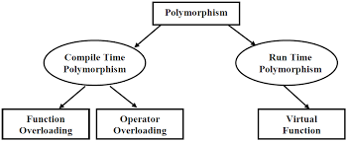
Types of Polymorphism
These are discussed in detail in later modules

Slide 26
8. Dynamic Binding
Binding means to link the code associated with the given function call.
Dynamic binding(dispatch) means that a block of code executed with reference to a procedure(method) call is determined at run time.
This is also called Late Binding/Run-time binding.
It is related with polymorphism and inheritance.
In C++, virtual functions are used to implement dynamic binding.

Slide 27
9. Message Passing
Message Passing is nothing but sending and receiving of information by the objects same as people exchange information.
This helps in building systems that simulate x life.
Following are the basic steps in message passing.
Creating classes that define objects and its behavior.
Creating objects from class definitions.
Establishing communication among objects.
In OOPs, Message Passing involves specifying the name of objects, the name of the function, and the information to be sent.

Slide 28
Modeling Advantages of C++ vs. C
Modular/User Defined Data Type–Abstract hardware design concepts such as concurrency and bit vectors can be added using the class mechanism
Data Hiding–Data hiding prevents users from changing data item and hides the implementation details from users
Code Reuse-By encapsulating the details of data and methods within an object, C++ provides high degree of reusability
Hierarchical-Users do not have to start their modeling effort from scratch but directly build upon the already-developed classes

Slide 29

c++ Basics
first glance at c++ program
Keywords
Data types
operators
Structure of c++ program

Slide 30
First glance at C++ program- message.cpp
Comments
Preprocessor directives
Provides simple access
//program: To display a message in c++
#include <iostream.h>
using namespace std;
Return type of main()
void main()
{
cout<<“Hello World!”;
}
main function
Insertion statement

Slide 31
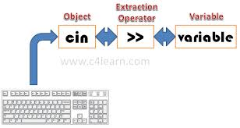
Input and Output in C++
cin
cin is a predefined object of istream class.
It corresponds to standard input stream i.e. keyboard.
It replaces the scanf() statement in C.
Its syntax is:
cin>>a;

Slide 32
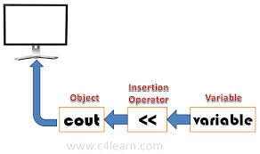
Input and Output in C++
cout
cout is a predefined object of ostream class.
It corresponds to standard output stream i.e. screen.
It replaces the printf() statement in C.
Its syntax is:
or
cout<<“Hello World”;
int a;
a=10;
cout <<a;

Slide 33
Keywords
auto
class
catch
bool
new
delete
extern
Friend
inline
public
private
protected
static
template
try
throw
mutable
this

Slide 34
C++ Data types
System Provided
(Primitive Data types)
char
int
long
float
double
bool
void
User Defined
structures
enumeration
unions
classes
Derived types
array
function
pointer
reference

Slide 35
Operators in C++
:: Scope resolution operator
::* Pointer- to-member declarator
.* Pointer-to-member operator
->* Pointer-to-member operator
>> Extraction operator
<< Insertion operator
delete Memory release operator
endl Line feed operator
new Memory allocation operator
setw Field width operator

Slide 36
Scope Resolution operator
Scope resolution operator(::) is used to
define a function outside a class .
when we want to use a global variable but also has a local variable with same name.
#include <iostream.h>
using namespace std;
char c = 'a'; // global variable
int main()
{
char c = 'b'; //local variable
cout << "Local variable: " << c << "\n";
cout << "Global variable: " << ::c << "\n"; //using scope resolution operator
return 0;
}
OUTPUT
Local variable: b
Global variable: a

Slide 37
Scope resolution operator in class
#include <iostream.h>
using namespace std;
class programming
{
public:
void output(); //function declaration
};
// function definition outside the class
void programming::output()
{
cout << "Function defined outside the class.\n";
}
int main()
{
programming x;
x.output();
return 0;
}
OUTPUT
Function defined outside the class.

Slide 38
Structure of C++ program
Include files
Class Declaration
Member function definitions
Main function program

Slide 39
4
Functions in c++
Functions definition
Types of functions
Call by value and call by reference
Default value for parameters
const modifier
Function overloading
static keyword

Slide 40
Functions Definition
A function is block of code which is used to perform a specific task.
It can be written in one program and can be used by another program without having to rewrite that piece of code. Hence it promotes usability.
Function can be put in a library .Thus it can be used by another program by just including a header file.

Slide 41
Types of Functions
Predefined functions
These are already defined in C++ library.
This function can be used by including header files as <string.h>,<math.h>
e.g. main(),getch(),sin(),strlen()
User defined functions
These functions are made by user to carry out his individual tasks.
Steps to make user defined functions:-
Function Declaration
Function Definition
Function Calling

Slide 42
User Defined Functions
Function Declaration/Create Function Prototype
The declaration (also known as the prototype) tells the compiler about
function name,
type and no. of arguments passed,
type of return values.
When a function is called ,the compiler matches the prototype. Any violation in matching arguments or return type will be caught by compiler at compile time
Syntax
type function-name(arguments list)
For e.g. void total();
void total(int,int);
int total(int,int);

Slide 43
User Defined Functions
Function Definition/Function Implementation
A function definition provides the actual body of the function.
The general form of a C++ function definition is as follows:
Syntax:
return_type function_name( parameter list )
{
body of the function
}
Example
void total(int a,int b)
{
int c;
c=a+b;
cout<<“sum=“<<c;
}

Slide 44
User Defined Functions
Function Calling
To use a function, you will have to call or invoke that function.
When a program calls a function
program control is transferred to the called function.
A called function performs defined task
when its return statement is executed or when its function-ending closing brace is reached, it returns program control back to the main program.

Slide 45
User Defined Functions
Three ways to call a function in C++
Call by value
Call by reference
Call by Pointer
Call by Value
In this calling technique we pass the values of arguments which are stored or copied into the formal parameters of functions.
In this case, changes made to the parameter inside the function have no effect on the argument.

Slide 46
Call by Reference
This method copies the reference of an argument into the formal parameter. i.e. we pass the address of the variable as arguments.
Inside the function, the reference is used to access the actual argument used in the call.
This means that changes made to the parameter affect the argument.
To pass an argument by reference, declare a function prototype as follows:
void someFunction (int &argByRef);
To call the function:
int a;
someFunction (a);

Slide 47
Call-by-Pointer
To pass an argument by pointer, declare a function prototype as follows:
void someFunction (int *argByPtr);
To call the function:
int a;
someFunction (&a);
The value of “a”can now be changed by the function

Slide 48
//call by value
#include <iostream.h>
void print(int a) //function definition
{
a+=10;
cout<<“in print function number=“<<a;
}
void main()
{
int num;
num=5;
print(num); //function calling
cout<<“in main function num=”<<num;
}
//call by reference
#include <iostream.h>
void print(int *a) //function definition
{
*a+=10;
cout<<“in print function number=“<<*a;
}
void main()
{
int num;
num=5;
print(&num); //function calling
cout<<“in main function num=”<<num;
}
Output
In print function num=15
In main function num=5
Output
In print function num=15
In main function num=15

Slide 49
Default values for parameters
When you define a function, you can specify a default value for each of the last parameters.
This value will be used if the corresponding argument is left blank when calling to the function.
If a value for that parameter is not passed when the function is called, the default given value is used, but if a value is specified, this default value is ignored and the passed value is used instead.
It allow the programmer to define a default behavior.

Slide 50
If the corresponding parameters are omitted in the function call, the default values are used.
e.g.,
All arguments to the right of the first default argument value must also be supplied with default values.
If an argument is omitted in the function call, all arguments to its right must also be omitted.
void func( int i = 5, double d = 1.234 );
func( 4, 5.67 ); // overrides both defaults
func( 4 ); // same as func( 4, 1.234 )
func(); // same as func( 5, 1.234 )
e.g.,
func( , 7.89 ); // error : cannot omit only 1st argument

Slide 51
Code for default arguments
#include <iostream>
using namespace std;
int sum(int a, int b=20) //with default value
{
int result;
result = a + b;
return (result);
}
int main ()
{
int a = 100;
int b = 200; int result; // local variable declaration
result = sum(a, b); // calling a function to add the values.
cout << "Total value is :" << result << endl;
result = sum(a); // calling a function again
cout << "Total value is :" << result << endl;
return 0;
}
Output
Total value is :300
Total value is :120

Slide 52
The const Qualifier
used to declare constants, as in ANSI C
specifies that the variable is read-only, except during its one-time initialization.
const variables can only be given values at initialization time.
can be used as a replacement for constants defined with the #define directive.
C++ allows const declarations in header files, unlike C
const variable values are accessible to a symbolic debugger, unlike those declared using the #define directive.
a const (read-only) pointer cannot be assigned to an ordinary pointer

Slide 53
Constant Parameters
The const modifier can be applied to formal parameter declarations
The const indicates that the function may not modify the parameter.
Example:
void print (int &n, const string &s)
{
cout << s ;
cin >> n ;
s = “trying to change"; // illegal assignment that compiler will catch
}

Slide 54
Function Overloading
What is Function Overloading/Function Polymorphism
Overloading means using the same thing for different purposes.
C++ permits overloading of functions, i.e. we can use the same function name to create functions that perform various tasks
A family of functions can be designed with a single function name but of
different no. of argument
different data types
C++ compiler selects the proper function by examining no., type and order of parameters.

Slide 55
Shape
Draw()
Circle
Draw()
Triangle
Draw()
Box
Draw()
Function Overloading

Slide 56
Example of Function Overloading in C++
Example :
An overloaded add() function where the correct function to be invoked is determined by checking the number and type of argument
//Declarations
int add (int a,int b); //prototype 1
int add (int a,int b,int c); //prototype 2
int add (double a,int b); //prototype 3
//Function calls
cout<<add(5,10); //uses prototype 1
cout<<add(5,10,20); //uses prototype 2
cout<<add(0.72,10); //uses prototype 3

Slide 57
Function Overloading(Cont’d)
Selection criteria for which function to call:
Look for an exact match and use it if found
Look for a match using standard conversions
Look for a match using user-defined conversions
Return type is not checked to resolve overloading
If any of the above criteria cannot be met, then it is an error.

Slide 58
‘static’ keyword
Static is a keyword in C++ used to give special characteristics to an element. It can be used with data members and member function as-
Static data member in class
Static Member Functions
Static data member in class
Static data members of class are those members which are shared by all the objects.
Static data member has a single piece of storage and is not available as separate copy with each object, like other non-static data members.
It is visible only within class but its lifetime is entire program

Slide 59
class sample
{
static int count;
public:
sample()
{
count++;
}
void display();
};
int sample::count=0;
void sample::display()
{
cout<<“Counter value=“<<count<<endl;
}
void main()
{
sample obj1,obj2;
obj2.display();
}
OUTPUT
Counter value=2

Slide 60
Static member functions in class
These functions work for the class as whole rather than for a particular object of a class.It is called using class name as follows:
Example
These functions can access only static data members and static member functions.
Class_name::member function();
class X
{
public:
static void f()
{ };
};
void main()
{
X::f(); // calling member function directly with class name
}

Slide 61
LAB
SESSION 1

Slide 62

Constructor and Destructors
About constructors
Types of constructors
Use of constructors
Constructor overloading
Copy constructors
Destructors

Slide 63
About Constructors
A constructor is a special member function of a class
that is executed automatically whenever we create new objects of that class.
that has exactly same name as the class
that has no return type not even void.
used to initialize member variables of class

Slide 64
USE OF CONSTRUCTOR IN C++
PROBLEM
Suppose you are working on 100's of objects and the default value of a data member is 0.Initialising all objects manually will be very tedious.
SOLUTION
you can define a constructor which initialises that data member to 0. Then all you have to do is define object and constructor will initialise object automatically. These types of situation arises frequently while handling array of objects. Also, if you want to execute some codes immediately after object is created, you can place that code inside the body of constructor.

Slide 65
Types of constructors
Default constructors
Constructor that has no parameter is called default constructor.
If no constructor is provided compiler adds a default parameter less constructor without a constructor initializer and a null body.
Parameterized constructors
Constructors that can take arguments are termed as parameterized constructors.
class_name obj1; //calls default constructor
class_name obj1(4,5); //calls parameterized constructor

Slide 66
CONSTRUCTOR OVERLOADING
Constructors Overloading are used to increase the flexibility of a class by having more number of constructor for a single class.
More than one way of initializing objects can be done using overloading constructors.
Code snippet for declaring constructors, its types and constructor overloading is as follows:

Slide 67
class circle
{
int radius;
double area;
public:
circle() //default constructor
{ radius=1; }
circle(int r) //parameterized constructor
{ radius=r; }
void area()
{
area=3.14*radius*radius;
cout<<“area=“<<area;
}
};
void main()
{
circle c1; c1.area(); //calls default constructor
circle c2(5); c2.area(); //calls parameterized constructor
}
OUTPUT
Area=3.14
Area=78.5

Slide 68
COPY CONSTRUCTOR IN C++
A copy constructor is a special constructor for creating a new object as a copy of an existing object.
Normally the compiler automatically creates a copy constructor for each class (known as an implicit copy constructor) but for special cases the programmer creates the copy constructor, known as a user-defined copy constructor.
In such cases, the compiler does not create one. Hence, there is always one copy constructor that is either defined by the user or by the system.
The most common form of copy constructor is shown here:
classname (classname &obj)
{
// body of constructor
}

Slide 69
class code
{
int id;
code(){} //constructor 1
code (int a){id=a;} //constructor 2
code (code & x) //copy constructor
{
id=x.id;
}
void print()
{
cout<<“id value-=“<<id;
};
void main()
{
cod e obj1(200);
code obj2(obj1); //calls copy constructor
code obj3=obj1; //calls copy constructor again
obj1.print();
obj2.print();
obj3.print();
}
OUTPUT
Id value=200
Id value=200
Id value=200

Slide 70
DESTRUCTORS IN C++
What does a Destructor do?
Destructors are used to clean up an object when the object is about to be destroyed
For instance, if your object has some pointers as its members, you might want to free the memory pointed by those pointers sometimes
Such operations can be performed by destructors
This is member function whose name is same as class namebut is preceded by tilde(~)
~classname ()
{
// body of destructor
}

Slide 71
DESTRUCTORS (cont’d)
How to Use Destructors
Destructors are called by default for each class object at the end of a program whenever the delete operation is called
Example:
The destructor for the class StudentRecord is
StudentRecord ::~ StudentRecord(){…};
Destructors are similar in nature to constructors except that they are executed when an object is about to be destroyed you cannot pass arguments to destructors.

Slide 72
LAB
SESSION 2

Slide 73
Operator Overloading
6
Meaning
Purpose
Types
Examples
Guidelines
Type Conversions and its types

Slide 74
OPERATOR OVERLOADING
Meaning
Operator overloading means giving some special meaning to operators.
C++ allows to apply operators on user defined objects with the same syntax as that on basic datatypes.
So, we can use operators on objects as well by operator overloading.

Slide 75
OPERATOR OVERLOADING
It means an operation is behaving differently on different instances (Datatypes).This is called OPERATOR OVERLOADING.
For e.g.
when we apply ‘+’ operator on integers →it gives addition
and when we apply ‘+’ operator on strings→ it gives concatenation
Integers (5,4),
gives
9
Addition on integers
+
String(“Hello", "Kitty”
gives
“HelloKitty”
Concatenation on strings

Slide 76
OPERATOR OVERLOADING
Purpose
C++ has several operators such as +, -, *, /, %, ++, --, =, +=, etc
Sometimes it is more meaningful and natural to use these operators on objects
Illustration Using “+”operator is more intuitive than using the “strcat” function if we want to add two strings This is done by treating an operator as a function that takes two arguments (or one argument in the case of a unary operator) For adding two strings, think of a = b+c; as a = +(b, c);.

Slide 77
Operator Overloading(Cont’d)
The process of overloading has following steps:
Create a class that defines the data type that is to be used in overloading operation.
Declare operator function operator op() in public part of class
It may be either a member function or friend function.
Define the operator function.
returntype classname::operator(arglist)
{
//function body
}

Slide 78
Operator Overloading(Cont’d)
Types of operator overloading
Unary Operator Overloading
Binary Operator Overloading

Slide 79
Operator Overloading(Cont’d)
The process of overloading has following steps:
Create a class that defines the data type that is to be used in overloading operation.
Declare operator function operator op() in public part of class
It may be either a member function or friend function.
Define the operator function.
returntype classname::operator(arglist)
{
//function body
}

Slide 80
1. UNARY OPERATOR OVERLOADING
//unary operator overloading
class unary
{
int a,b,c;
public:
unary(){}
unary(int a1, int b1, int c1)
{ a=a1;b=b1;c=c1;}
void print()
{
cout<<“ value are a,b,c”<<a<<b<<c;
}
void operator-();
};
Cont’d….

Slide 81
Cont’d….
void unary::operator-()
{
a=-a;
b=-b;
c=-c;
}
void main()
{
unary u1(5,-2,3);
u1.print();
-u1; //unary minus overloading
u1.print();
}
OUTPUT
Values are: 5 -2 3
Values are: -5

Slide 82
2. BINARY OPERATOR OVERLOADING
//binary operator overloading
class Complex
{
float x;
float y;
public:
Complex() {}
Complex(int x1,int y1) {x=x1;y=y1;}
Complex operator +(Complex);
void output()
{
cout<<"Output Complex number: "<<x<<y;
}
};
Cont’d….

Slide 83
//binary operator overloading
Complex Complex:: operator + (Complex c2) /* Operator Function */
{
Complex temp;
temp.x=x+c2.x;
temp.y=y+c2.y;
return temp;
}
void main()
{
Complex c1(5.5,4.5), c2(4.5,2.5), result;
result=c1+c2; /* c2 is furnised as an argument to the operator function.*/
result.output();
}
Cont’d….
OUTPUT
Output complex no.
10.0 7.0
In case of operator overloading of binary operators in C++ programming, the object on right hand side of operator is always assumed as argument by compiler.

Slide 84
GUIDELINES
Guidelines for operator overloading are as follows:
Some of the operators cannot be overloaded :
:: scope resolution
sizeof sizeof operator
. Membership operator
?: Conditional operator
New operators cannot be created
Unary operators can be overloaded
Binary operators can be overloaded

Slide 85
Type Conversions
Type conversions are required because compiler does not support automatic type conversion for user defined datatypes.
Three types of situations might arise in the data conversions between incompatible type:-
Conversion from basic type to class type.
Conversions from class type to basic type.
Conversions from one class type to another class type.

Slide 86
Conversion from basic type to class type.
#include <iostream>
const float MeterToFloat=3.280833;
class Distance {
int feets;
float inches;
public:
Distance() //Distance Constructor {
feets=0;
inches=0.0;
}
Distance(float numofmeters) //Single Parameter constructor {
float feetsinfloat= MeterToFloat * numofmeters;
feets=int(feetsinfloat);
inches=12*(feetsinfloat-feets);
}
Cont’d….

Slide 87
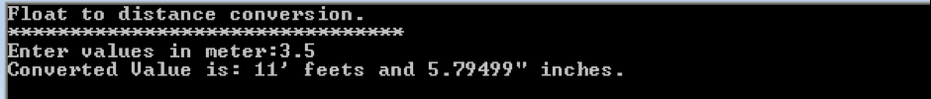
Cont’d….
void displaydist() // Method to display converted values
{
cout<<"Converted Value is: "<<feets<<"\' feets and "<<inches<<'\"'<<" inches.";
}
};
int main()
{
cout <<"Float to distance conversion. \n********************************\n ";
float meters;
cout<<"Enter values in meter:";
cin >>meters;
Distance distance = meters;
distance.displaydist();
}
OUTPUT
Values are: 5 -2 3
Values are: -5

Slide 88
Important facts used in above program
one meter contains 3.280833 feets
We multiplied the result with 12 to get exact figure in inches because one foot contains 12 inches. This the logic that will convert our float variable that contain meters to Distance variable which contain feet and inches.
We will convert a float type basic variable to a user defined type class variable. This was not possible explicitly therefore we had to write code to achieve the desired functionality. Now, when users enter the distance in meters, it will give back the result in corresponding number of feet and inches.
Distance distance = meters;

Slide 89
Conversion from class type to basic type.
A whole new concept is involved in conversion from user defined to basic data type, which is known as the overloading casting operator.
operator type()
{
. . .
}
There are three conditions that need to be satisfied for an overloaded casting operator.
Overloaded casting operator does not have any return type.
It cannot take any parameters
Finally, it has to be defined inside a class definition.

Slide 90
//class to basic type conversion
#include <iostream>
const float MeterToFloat=3.280833;
// Meter to feet
class Distance {
int feet;
float inches;
public:
Distance() // Default Constructor {
feet=0;
inches=0.0;
}
Distance(int ft, float in) //two arguements constructor {
feet=ft;
inches=in;
}
Cont’d….

Slide 91
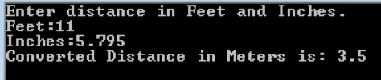
operator float() //overloaded casting operator
{
float feetinfractions=inches/12;
feetinfractions+=float(feet);
return (feetinfractions/MeterToFloat);
}};
int main()
{
int feet;
float inches;
cout <<"Enter distance in Feet and Inches.";
cout<<"\nFeet:";
cin>>feet;
cout<<"Inches:";
cin>>inches;
Distance dist(feet, inches);
float meters=dist; // This will call overloaded casting operator
cout<<"Converted Distance in Meters is: "<< meters;
}
Cont’d….

Slide 92
Conversion from class type to class type.
The conversion between objects of different classes can be done using either a one-argument constructor or a conversion function.
The choice depends upon whether the conversion routine has to be declared in the source class or in the destination class.
To illustrate, consider a program that contains two classes A and B. Also consider the statement:
if class B handles the conversion→it will hold a conversion function. if class A carries out the conversion→ it will do that by a constructor that takes an argument of type class B.
object_A = object_B;
destination source

Slide 93
//class to other class type conversion
class in1
{
int code,items;
float price;
public:
in1(int a,int b,int c)
{
code=a; items=b; price=c;
}
void putdata()
{
cout<<"CODE= "<<code<<endl;
cout<<"ITEMS= "<<items<<endl;
cout<<"VALUE= "<<price<<endl;
}
int getcode() { return code; }
int getitems() { return items; }
int getprice() { return price; }
operatorfloat () { return items*price; }
};
Cont’d….

Slide 94
Cont’d….
class in2
{
int code;
float value;
public:
in2()
{ code=0; value=0; }
in2(int x,float y)
{ code=x; value=y; }
void putdata()
{
cout<<"CODE= "<<code<<endl;
cout<<"VALUE= "<<value<<endl;
}
in2(in1 p)
{ code=p.getcode(); value=p.getitems()*p.getprice();
}
};
Cont’d….

Slide 95
Cont’d….
main()
{
clrscr();
in1 s1(100,5,140.0);
float tot_value;
in2 d1;
tot_value=s1;
d1=in1(s1);
cout<<"PRODUCT DETAILS INVENT-1 TYPES:->"<<endl;
s1.putdata();
cout<<"STOCK VALUE"<<endl;
cout<<"VALUE= "<<tot_value<<endl;
cout<<"PRODUCT DETAILS INVENT-2 TYPES:->"<<endl;
d1.putdata();
}
OUTPUT
Product details invent-1 types:->
Code=100
items=5
Value=140
Stock value
Value=700
Product details invent-2 types:->
Code=100
Value=700

Slide 96
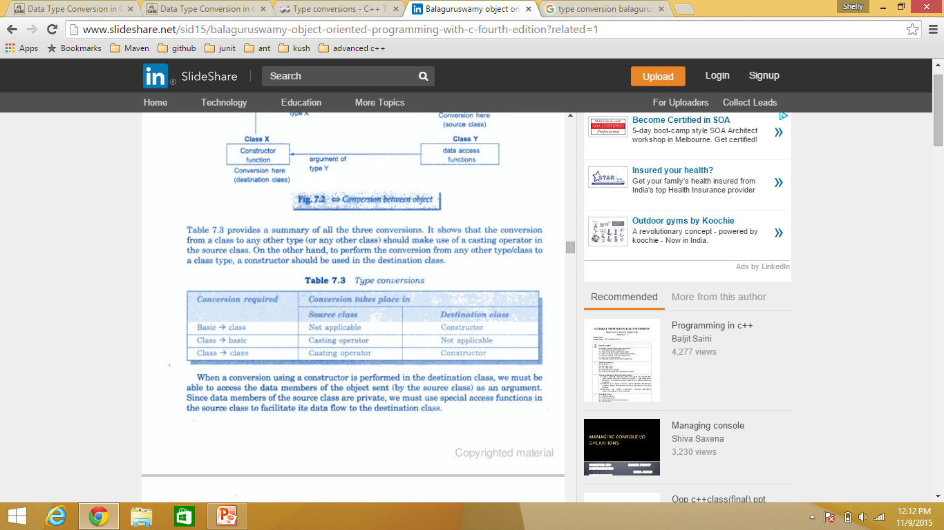
Summary for Type Conversion

Slide 97
Cast Operators
7
Basic of type casting.
Static_cast
Dynamic_cast

Slide 98
Basics of type casting.
C++ is a strong-typed language.
Many conversions, specially those that imply a different interpretation of the value, require an explicit conversion, known in C++ as type-casting.
There exist two main syntaxes for generic type-casting:
Functional
c-like:
double x = 10.3;
int y;
y = int (x); // functional notation
y = (int) x; // c-like cast notation

Slide 99
Type Casting(Cont’d)
Explicit type conversion (casting) is the use of direct and specific notation in the source code to request a conversion or to specify a member from an overloaded class.
There are cases where no automatic type conversion can occur or where the compiler is unsure about what type to convert to, those cases require explicit instructions from the programmer or will result in error.
It can be explained with following example

Slide 100
Type Casting
// class type-casting
#include <iostream>
class Dummy
{
double i,j;
};
class Addition {
int x,y;
public:
Addition (int a, int b) { x=a; y=b; }
int result() { return x+y;}
};
int main () {
Dummy d;
Addition * padd;
padd = (Addition*) &d;
cout << padd->result();
return 0;
}
PROBLEM
Unrestricted explicit type-casting allows to convert any pointer into any other pointer type, independently of the types they point to.
RESULT
The subsequent call to member result will produce either a run-time error or some other unexpected results.

Slide 101
Types of type casting
1. Static cast To convert non polymorphic types.
2. Dynamic cast To convert polymorphic types.
Basic syntax
name_cast<new_type> (expression)
where,
name_cast is either static or dynamic
new_type the result type of the cast
expression Expression to be cast

Slide 102
Type Casting(Cont’d)
static_cast
static_cast can perform conversions between pointers to related classes.
Two possibilities:
upcasts (from pointer-to-derived to pointer-to-base)
downcasts (from pointer-to-base to pointer-to-derived).
No checks are performed during runtime to guarantee that the object being converted is in fact a full object of the destination type.
Therefore, it is up to the programmer to ensure that the conversion is safe.
On the other side, it does not incur the overhead of the type-safety checks of dynamic_cast.

Slide 103
Type Casting(Cont’d)
static_cast
class Base { };
class Derived: public Base {};
Base * a = new Base;
Derived * b = static_cast<Derived*>(a);
This would be valid code, although b would point to an incomplete object of the class and could lead to runtime errors if dereferenced.
It can convert from void* to any pointer type.
In this case, it guarantees that if the void* value was obtained by converting from that same pointer type, the resulting pointer value is the same.
It can convert integers, floating-point values and enum types to enum types.

Slide 104
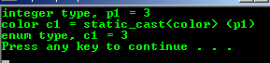
Code Snippet for the conversion of int to enum (by static_cast)
#include <iostream>
using namespace std;
// enum data type
enum color {blue, yellow, red, green, magenta};
int main()
{
int p1 = 3;
cout<<"integer type, p1 = "<<p1<<endl;
cout<<"color c1 = static_cast<color> (p1)"<<endl;
color c1 = static_cast<color> (p1);
cout<<"enum type, c1 = "<<c1<<endl;
return 0;
}

Slide 105
Type Casting(Cont’d)
Additionally, static_cast can also perform the following:
Explicitly call a single-argument constructor or a conversion operator.
Convert to rvalue references.
Convert enum class values into integers or floating-point values.
Convert any type to void, evaluating and discarding the value.

Slide 106
Type Casting(Cont’d)
Dynamic_cast
It is used for handling polymorphism.
Its purpose is to ensure that the result of the type conversion points to a valid complete object of the destination pointer type.
It can be used for :
casting upwards(upcast)-converting from pointer-to-derived to pointer-to-base( in the same way as allowed as an implicit conversion.)
casting downwards(downcast)- convert from pointer-to-base to pointer-to-derived) polymorphic classes (those with virtual members).

Slide 107
// dynamic_cast(down_cast)
#include <iostream>
#include <exception>
using namespace std;
class Base { virtual void dummy() {} };
class Derived: public Base { int a; };
int main () {
try {
Base * pba = new Derived; //dynamic cast
Base * pbb = new Base; //dynamic cast
Derived * pd;
pd = dynamic_cast<Derived*>(pba);
if (pd==0) cout << "Null pointer on first type-cast.\n";
pd = dynamic_cast<Derived*>(pbb);
if (pd==0) cout << "Null pointer on second type-cast.\n";
} catch (exception& e) {cout << "Exception: " << e.what();}
return 0;
}
OUTPUT
Null pointer on second type-cast

Slide 108
Type Casting(Cont’d)
Downcast is successful if -and only if- the pointed object is a valid complete object of the target type .
The dynamic_cast will seek out the desired object and return it if possible.
if it can't,
it will return NULL in the case of a pointer
or
throw std::bad_cast exception in the case of a reference.
NOTE:
This type of dynamic_cast requires Run-Time Type Information (RTTI) to keep track of dynamic types. This needs to be enabled for runtime type checking using dynamic_cast to work properly with these types.

Slide 109
Type Casting(Cont’d)
Dynamic_cast can also perform the other implicit casts allowed on pointers:
casting null pointers between pointers types (even between unrelated classes),
casting any pointer of any type to a void* pointer.
one type of dynamic_cast is cross_cast, a cast from a class to a sibling class in class hierarchy or sibling class.

Slide 110
INHERITANCE
Inheritance is a mechanism for deriving new classes from existing classes
Base class: The existing class is called base class.
Derived class: The new class is called derived/sub class.
Each new class is a specialized version of the parent class that will inherit all attributes and behavior of the parent class
The inherited properties can be overwritten if necessary.

Slide 111
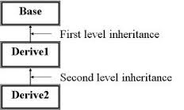
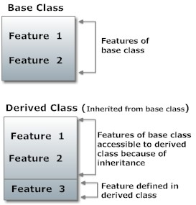
ADVANTAGE OF INHERITANCE
The concept of Inheritance provides idea of REUSABILITY.
It means we can add additional features to an existing class without modifying it.

Slide 112
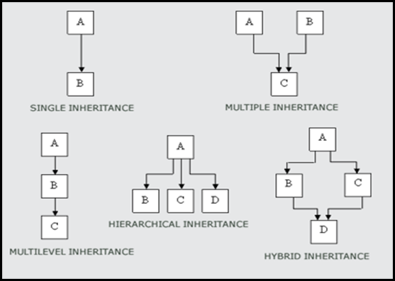
TYPES OF INHERITANCE
Single Inheritance
Multiple Inheritance
Hierarchical Inheritance
Multilevel Inheritance
Hybrid Inheritance

Slide 113
INHERITANCE(Cont’d)
Syntax to define derived class
class derived-class-name: visibility mode base-class-name
{
….
….
….
};
class abc:public xyz
{
….
….//members of abc
….
};

Slide 114
Program for single level inheritance
// Base class
#include <iostream.h
class Shape
{
public:
void setWidth(int w)
{
width = w;
}
void setHeight(int h)
{
height = h;
}
protected:
int width;
int height;
};
// Derived class
class Rectangle: public Shape
{
public:
int getArea()
{
return (width * height);
}
};
void main(void)
{
Rectangle Rect;
Rect.setWidth(5);
Rect.setHeight(7);
// Print the area of the object.
cout << "Total area: " << Rect.getArea() << endl;
}
OUTPUT
Total area=35

Slide 115
Member Access Specifier
Three types of members exist in a class
Public Member
Protected Member
Private Member
Such characteristic is indicated by the member access specifier of public, protected, and private.
The member functions of a derived class can access public or protected members of the base class.
Private members of the base class are not accessible by derived class.
A protected member can be accessed by member functions of its own class or any derived class based on it’s own class.

Slide 116
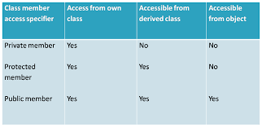
INHERITANCE(Cont’d)
The table shown below summarizes the access right to a class member according to its different access specifiers

Slide 117
INHERITANCE(Cont’d)
Public and Private Inheritance
Public Inheritance
Indicated by the keyword public in the derived class
It specifies that objects of such derived class can access public and protected members of the base class but not the private members
Private Inheritance
Indicated by the keyword private in the derived class
It specifies that public and protected members of the base class become private members in the derived class ( not recommended), as usual private can not be access.
Examples
class student : public person {…};
class student : private person {…};

Slide 118
Inheritance complete
polymorphism
Friend function,class
Template,
Excception handling

