Slide 1
Research project
Tianyi Dai

Slide 2
Research Question
Is there a gender gap exist in education in each region of Victoria?
- sustainability
- inclusiveness

Slide 3
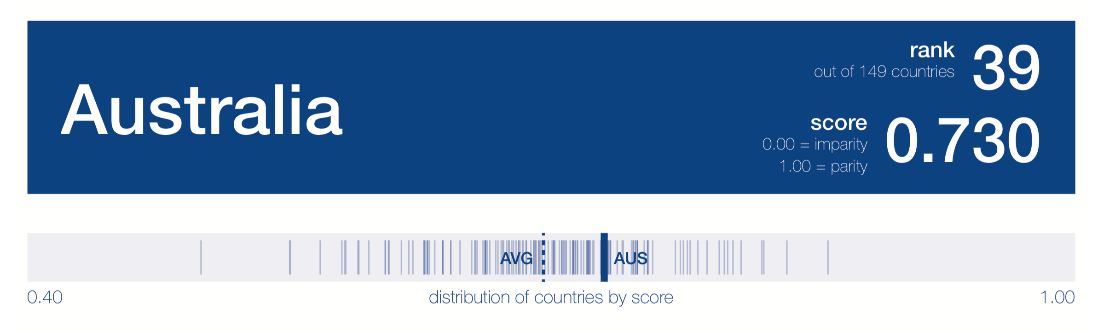
MOTIVATION
Figure 1: rank of Australia in The Global Gender Gap Report
url: http://www3.weforum.org/docs/WEF_GGGR_2018.pdf
- government official
- Feminist (women’s right) advocates

Slide 4
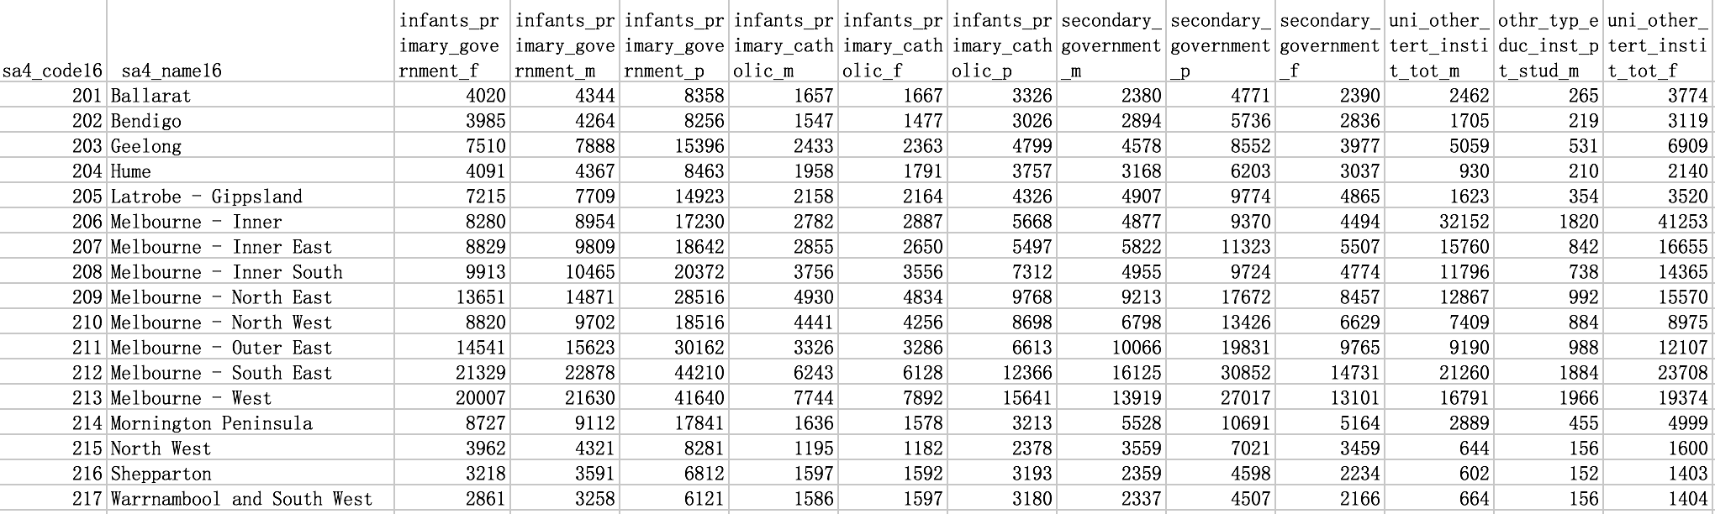
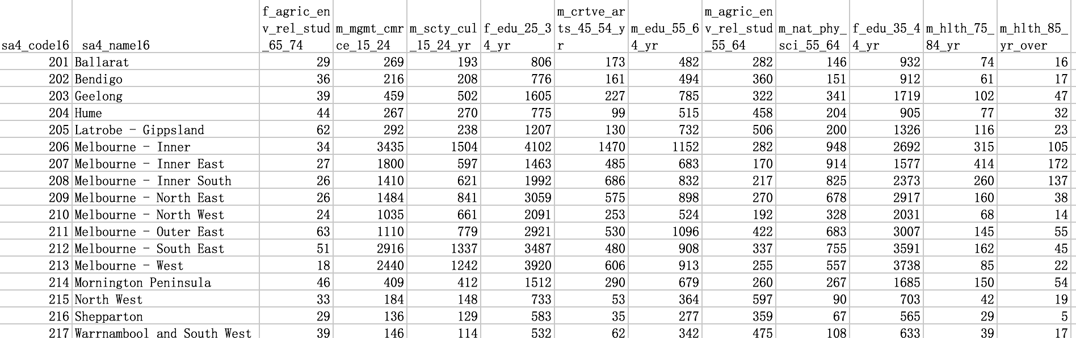
Datasets
SA4-G15 Type of Educational Institute Attending by Sex-Census 2016
aurin:datasource-AU_Govt_ABS_Census-UoM_AURIN_DB_2_sa4_g15_type_of_edu_institute_by_age_by_sex_census_2016
SA4-P39a Non-School Qualification: Field of Study by Age by Sex-Census 2016
aurin:datasource-AU_Govt_ABS_Census-UoM_AURIN_DB_2_sa4_p39a_non_schl_qual_field_of_study_by_age_by_sex_census_2016

Slide 5
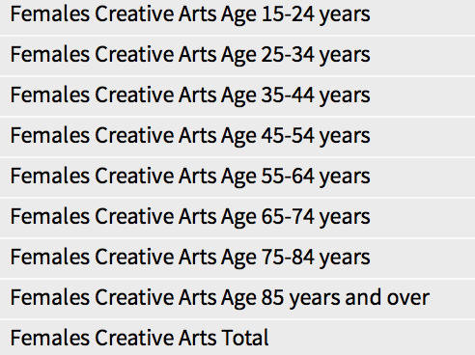
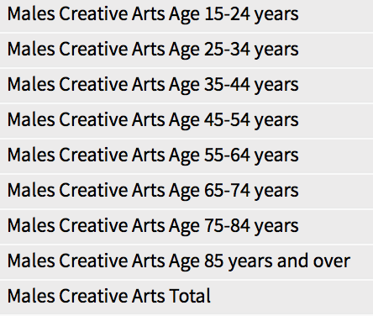
Data pre-processing
Just keep the total attributes
Remove empty and unrelated data

Slide 6
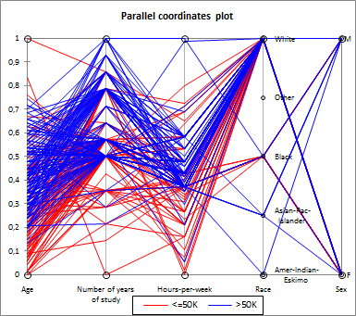
Data wrangling
1. Import data into a panda data frame
2. Parallel coordinates plot
Example of Parallel coordinates
url: https://help.xlstat.com/customer/en/portal/articles/2062061-parallel-coordinates-visualization-in-excel-tutorial?b_id=9283

Slide 7
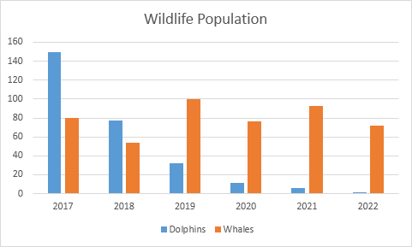
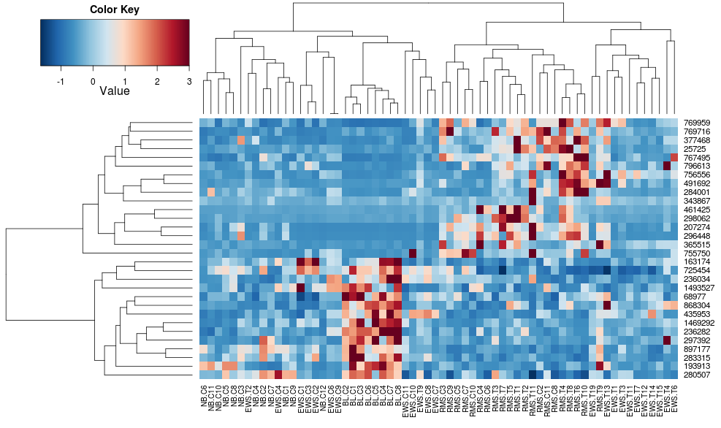
3. For each region/ subject, bar chart
Data wrangling
Example of bar chart
url: https://www.excel-easy.com/examples/column-chart.html
4.Clustring, heatmap
Example of clustering heatmap
url:https://stackoverflow.com/questions/17924828/differences-in-heatmap-clustering-defaults-in-r-heatplot-versus-heatmap-2

Slide 8
Challenging and risk
The data is reduced
Out of date
Complex data
Time-consuming

