Slide 1

Programming in Android NDK
Dheeraj Kaushik/ABHIJEET JAIN
15 & 16 Jan, 2016

Slide 2
Objective - Programming in Android NDK
Objective1: How to integrate and use C/C++ Source Code in Android Applications
Developing Android NDK samples from scratch using both gradle-stable and gradle-experimental plugins
Objective 2: How to use already existing pre-build C/C++ libraries (compiled for x86/x86_64 or cross compiled for ARM Android) in NDK
OpenGL demo example
Encryption/Decryption demo example
Objective 3: How to cross-compile C/C++ libraries and generate binaries for NDK integration in above Step 2.
Cross-compiling openssl library for armeabi-v7a
Objective 4: Debugging C/C++ application in android studio

Slide 3
Training - Day 1
Module1: Android NDK overview
Module 2: Introduction to JNI
Lab session 1(NDK integration gradle-stable)
Module 3: Experimental gradle plugin
Lab session 2(NDK integration gradle-experimental)
Module 4: Introduction to OpenGL
Lab session 3
Module 5: Introduction to cross compilation steps
Wrap-up

Slide 4
Training - Day 2
Module 6: Cross compiling OpenSSL library
Lab session 4
Module 7: Prebuilt static/dynamic library (OpenSSL library) integration in NDK
Lab session 5 (gradle-stable plugin)
Lab session 6 (gradle-experimental plugin)
Module 8: Debugging
Wrap-up

Slide 5
Training - Day 1
Module1: Android NDK overview
Module 2: Introduction to JNI
Lab session 1
Module 3: Experimental gradle plugin
Lab session 2
Module 4: Introduction to OpenGL
Lab session 3
Module 5: Introduction to cross compilation steps
Wrap-up

Slide 6
Lab Session - System Check

Slide 7

Packages to be installed
Download and Install Javahttp://www.oracle.com/technetwork/java/javase/downloads/jdk8-downloads-2133151.html
Download JDK for Windows 64-bit (jdk-8u65-windows-x64.exe) Install
Download and Install Android Studio for Windows
http://developer.android.com/sdk/index.html
Install Android NDK
http://developer.android.com/ndk/downloads/index.html#download
Download Android NDK: android-ndk-r10e-windows-x86_64.exe
MinGW
http://www.mingw.org/wiki/Install_MinGW

Slide 8


Android NDK overview
Introduction
Why to use native code
What is android NDK?
Contents of NDK
List of APIs supported by NDK
How to use NDK in android framework
About libraries

Slide 9
Introduction
Android applications are typically written in Java with its elegant object-oriented design.
At times, there is a need to overcome the limitations of Java, such as memory management and performance, by programming directly into Android native interface.

Slide 10
Why use native code?
Reasons to use NDK:
Pre-Existing code: Integration with pre-existing code may be required
Native Libraries
CPU Intensive
IO Intensive
Examples:
Codec – for encoding or decoding algorithms

Slide 11
What is NDK?
NDK stands for Native Development Kit.
It allows the developer to implement parts of your application using native-code languages such as C and C++.
NDK builds native code as a library that your application can call using Java Native Interface (JNI).
NDK includes all the scripts, Makefiles, toolchains and libraries that are required to compile native C or C++ code

Slide 12
What is Android NDK?
The Android NDK is a companion tool used only in conjunction with Android SDK which allows application developers to build performance-critical portions of their apps by use of native (C/C++) code.
Android NDK is available for three platforms:
Windows
Mac OS X (intel)
Linux 32/64-bit (x86)

Slide 13
Contents of NDK
A set of tools and build files for generating native code libraries from C and C++ sources.
A way to embed the corresponding native libraries into application package files (.apks) that can be deployed on Android devices.
A set of native system headers and libraries supported starting from Android 1.5 .
Documentation, samples, and tutorials.

Slide 14
List of APIs supported by NDK
NDK includes support for the following APIs:
libc (C library) headers
libm (math library) headers
JNI interface headers
libz (Zlib compression) headers
liblog (Android logging) header
OpenGL EoS 1.1 and OpenGL ES 2.0 (3D graphics libraries) headers
OpenSL
libjnigraphics (Pixel buffer access) header (for Android 2.2 and above).
A Minimal set of headers for C++ support
Android native application APIs
And more

Slide 15
How to use NDK in Android Framework?
Two ways to use native code in android framework
Write apps using the Android framework.
Use JNI to access the APIs provided by the Android NDK.
Within an application, handle activity lifecycle callbacks (such as onCreate(), onPause()
and onResume()) in your own native code.

Slide 16
About Libraries
A library is a collection of pre-compiled object files that can be linked into your programs via the linker.
Examples are the system functions such as printf() and sqrt().
Two types of external libraries:
Static library
Dynamic library

Slide 17
About Libraries
 | Static Libraries | Dynamic Libraries
Extension | “.a” in Unix/Linux “.lib” in Windows | “.so” in Unix/Linux “.dll” in Windows
Linking | When your program is linked against a static library, the machine code of external functions used in your program is copied into the executable. | When your program is linked against a shared library, only a small table is created in the executable.
 | Statically Linked | Before the executable starts running, OS performs dynamic linking - loading the machine code needed for the external functions. Dynamic linking makes executable files smaller

Slide 18
Training - Day 1
Module1: Android NDK overview
Module 2: Introduction to JNI
Lab session 1
Module 3: Experimental gradle plugin
Lab session 2
Module 4: Introduction to OpenGL
Lab session 3
Module 5: Introduction to cross compilation steps
Wrap-up

Slide 19

Introduction to JNI
What is JNI?
Requirements of JNI
How JNI works
Semantics for JNI function calls
Passing Arguments and Result between Java & Native Programs
Pitfalls of JNI

Slide 20
What is JNI?
JNI stands for Java Native Interface
It is a programming framework.
It enables Java code running in a Java Virtual Machine (JVM) to call native applications and libraries written in other languages such as C, C++
Application
C Side
Java Side
J
N
I
Exceptions
Functions
Classes
Libraries
VM

Slide 21
Requirement of JNI
JNI is used under the following circumstances:
Developer needs to access core device features that cannot be accessed using available APIs in Java.
Example: you typically can’t write a device driver in Java because you can’t directly access the hardware.
Utilize existing code libraries in your Java programs.
Example: there might be a file compression library written in C which you want to use in your Java program.
Leverage the improved speed possible with natively compiled code (such as C or assembler).
Example: you might need an extremely fast math routine for a scientific application or game program.

Slide 22
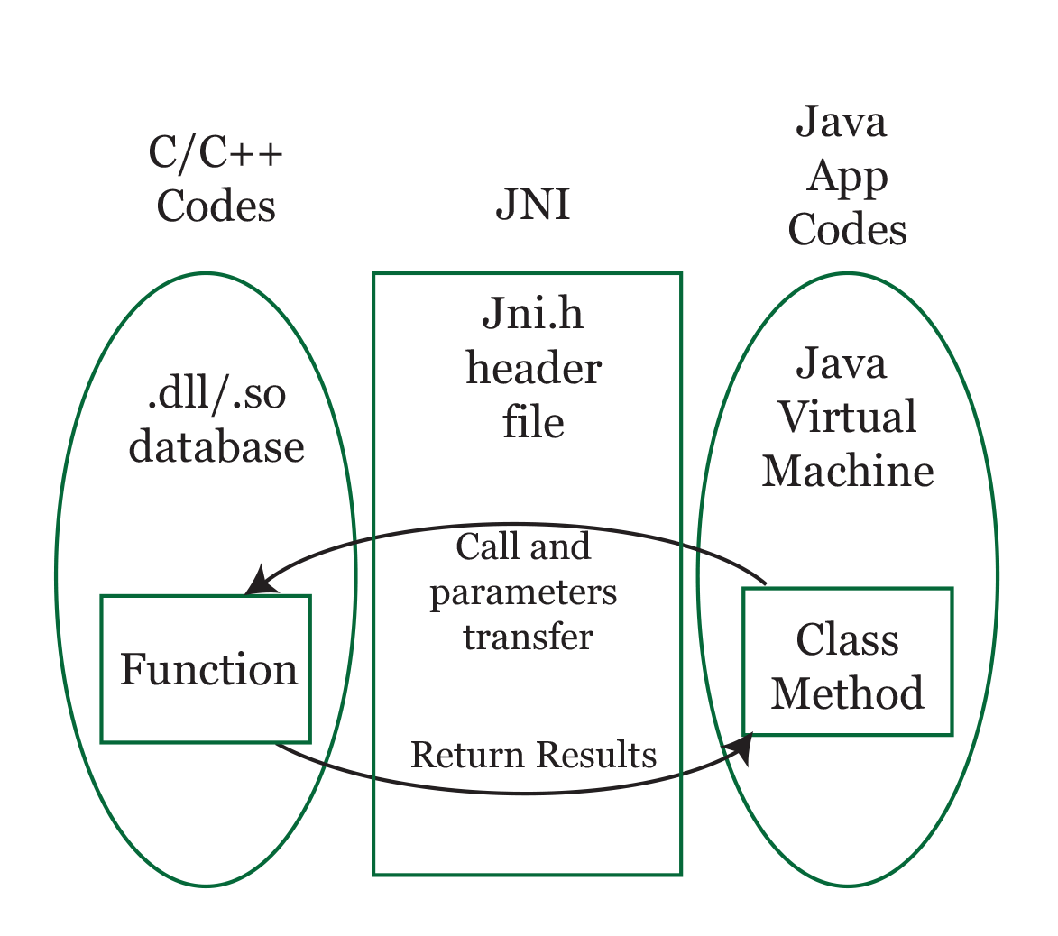
How JNI works?
In the JNI framework, native functions are implemented in separate .c or .cpp files.

Slide 23
JNI implementation
Java Native Interface
At Java Side:
System.LoadLibrary()
Native keyword
At C/C++ Side
#include<jni.h>
Java primitives types, objects and methods
JNIEnv *env

Slide 24
Code for JNI in c file
When the JVM invokes the function, it passes a JNIEnv pointer, a jobject pointer, and any Java arguments declared by the Java method.
A JNI function may look like this:
jstring Java_com_example_hellojni_HelloJni_stringFromJNI( JNIEnv* env, jobject thiz )
{
/*Implement Native Method Here*/
}

Slide 25
Semantics for JNI function
After jstring comes the function name, which is based on the Java function name and the path to the file containing it.
Construct it according to the following rules:
Prepend Java_ to it.
Describe the file path relative to the top-level source directory.
Use underscores in place of forward slashes.
Omit the .java file extension.
After the last underscore, append the function name.
Example: the function name “Java_com_example_hellojni_HelloJni_stringFromJNI” refers to a Java function called ”stringFromJNI()”, which resides in hellojni/src/com/example/hellojni/HelloJni.java.

Slide 26
JNI function explanation
A JNI environment pointer (JNIEnv*) is passed as an argument for each native function mapped to a Java method.
It allows for interaction with the JNI environment within the native method (such as converting between C types and standard Java types)
This JNI interface pointer can be stored, but remains valid only in the current thread.
The env pointer is a structure that contains the interface to the JVM.
jobject is a pointer to the implicit “this” object passed from the Java side.

Slide 27
JNI in java file
In java file, we declare the C/C++ function to call as a method in our Activity and tell java to load the compiled code.
public native String stringFromJNI();//native method
static //static initializer code
{
System.loadLibrary("hello-jni"); //loads Helloworld.dll
}
This tells the compiler that print() will be accessed from an external library, and that it should not look for it in the Java source code.

Slide 28
Passing Arguments and Result between Java & Native Programs
Two types of datatypes for arguments
Primitive datatypes:
boolean, byte, char, short, int, long, float, and double
Reference types:
String, arrays, and other classes

Slide 29
Passing Arguments and Result between Java & Native Programs
Passing Primitives types: Primitive types are directly mapped to C/C++ equivalents
Java type | JNI type | C/C++ type | Size
boolean | jboolean | unsigned char | 8 bits
byte | jbyte | char | 8 bits
char | jchar | unsigned short | 16 bits
short | jshort | short | 16 bits
int | jint | int | 32 bits
long | jlong | long long | 64 bits
float | jfloat | Float | 32 bits
double | jdouble | double | 64 bits

Slide 30
Passing Arguments and Result between Java & Native Programs
Passing Reference types: Reference types are passed as opaque references to the native code rather than native data types, and they cannot be consumed and modified directly.
JNI provides a set of APIs for interacting with these reference types. These APIs are provided to the native function through the JNIEnv interface pointer.
Example: GetStringUTFChars() function for accessing the contents of a string
All JNI references have type jobject .
All reference types are subtypes of jobject
Correspond to the most used types in Java - jstring, jobjectArray, etc.

Slide 31
Passing Arguments and Result between Java & Native Programs
Java type | Native Type
java.lang.Class | jclass
java.lang. String | jstring
java.lang.Throwable | jthrowable
other objects | jobject
java.lang.Object[] | jobjectArray
boolean[] | jbooleanArray
byte[] | jbyteArray
short[] | jshortArray
int[] | jintArray
long[] | jlongArray
float[] | jfloatArray
double[] | jdoubleArray
Other arrays | jarray

Slide 32
Example: Passing string
Java JNI Program: TestJNIString.java
public class TestJNIString
{
static {
System.loadLibrary("myjni"); // myjni.dll (Windows) or libmyjni.so (Unix/Linux)
}
// Native method that receives a Java String and return a Java String
private native String sayHello(String msg);
public static void main(String args[]) {
String result = new TestJNIString().sayHello("Hello from Java");
System.out.println("In Java, the returned string is: " + result);
}
}

Slide 33
Example: Passing string
The “C” implementation TestJNIString.c is as follows:
It receives the JNI string (jstring), convert into a C-string (char*), via GetStringUTFChars().
It then performs its intended operations - displays the string received and prompts user for another string to be returned.
It converts the returned C-string (char*) to JNI string (jstring), via NewStringUTF(), and return the jstring.

Slide 34
#include <jni.h>
#include <stdio.h>
#include "TestJNIString.h"
JNIEXPORT jstring JNICALL Java_TestJNIString_sayHello(JNIEnv *env, jobject thisObj, jstring inJNIStr) {
// Step 1: Convert the JNI String (jstring) into C-String (char*)
const char *inCStr = (*env)->GetStringUTFChars(env, inJNIStr, NULL);
if (NULL == inCSt) return NULL;
// Step 2: Perform its intended operations
printf("In C, the received string is: %s\n", inCStr);
(*env)->ReleaseStringUTFChars(env, inJNIStr, inCStr); // release resources
// Prompt user for a C-string
char outCStr[128];
printf("Enter a String: ");
scanf("%s", outCStr); // not more than 127 characters
// Step 3: Convert the C-string (char*) into JNI String (jstring) and return
return (*env)->NewStringUTF(env, outCStr);
}

Slide 35
Pitfalls of JNI
Your program is no longer platform independent.
Your program is not as robust - If there is a null pointer exception in your native code, then JVM can’t display a helpful message. It might even lock up or crash.

Slide 36
LAB SESSION 1
NDK Integration using gradle-stable plugin
Notes:
Here we will do live coding with the participants

Slide 37
Training - Day 1
Module1: Android NDK overview
Module 2: Introduction to JNI
Lab session 1
Module 3: Experimental gradle plugin
Lab session 2
Module 4: Introduction to OpenGL
Lab session 3
Module 5: Introduction to cross compilation steps
Wrap-up

Slide 38

Experimental gradle plugin
Experimental Gradle Plugin - An Introduction
Migrating from Traditional Android Gradle Plugin

Slide 39
Experimental Gradle Plugin – An Introduction
The Android Studio supports a new experimental Gradle plugin for Android NDK
You’ll need to edit your build.gradle files manually to configure your projects.
The new experimental plugin is based on Gradle’s new component model mechanism.
It allows significant reduction in configuration time.
It also includes NDK integration for building JNI applications.

Slide 40
Experimental Gradle Plugin – An Introduction
Requirements
Gradle 2.8 and above only
Android NDK r10e (if you are using NDK)
SDK with Build Tools at least version 19.0.0

Slide 41
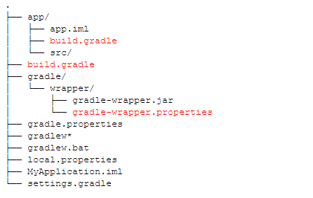
Migrating from Traditional Android Gradle Plugin
A typical Android Studio project may have a directory structure as follows:
File that needs to be change is highlighted in red

Slide 42
Migrating from Traditional Android Gradle Plugin
Change in ./build.gradle (as marked by red)
Classpath for the plugin is “com.android.tools.build:gradle-experimental” instead of “com.android.tools.build:gradle”.
The current version is 0.2.0.
// Top-level build file where you can add configuration options common to all sub-projects/modules. buildscript { repositories { jcenter() } dependencies { classpath "com.android.tools.build:gradle-experimental:0.2.1" // NOTE: Do not place your application dependencies here; they belong // in the individual module build.gradle files }} allprojects { repositories { jcenter() } }

Slide 43
Migrating from Traditional Android Gradle Plugin
Change in ./app/build.gradle (as marked by red)
Modifications to the DSL of plugin:
Plugin name is “com.android.model.application” instead of “com.android.application”.
Configuration is wrapped with the model { } block
Most properties require the = operator
Adding elements to a Collection should be done using the add method.

Slide 44
Migrating from Traditional Android Gradle Plugin
apply plugin: "com.android.model.application" model { android { compileSdkVersion = 22 buildToolsVersion = "22.0.1" defaultConfig.with {
applicationId = "com.example.user.myapplication" minSdkVersion.apiLevel = 15 targetSdkVersion.apiLevel = 22 versionCode = 1 versionName = "1.0"
buildConfigFields.with
{
create()
{ type = "int" name = "VALUE" value = "1" }
}
}
}

Slide 45
Migrating from Traditional Android Gradle Plugin
android.buildTypes { release { minifyEnabled = false proguardFiles.add(file("proguard-rules.pro"))
} }
android.productFlavors { create("flavor1") {
applicationId = "com.app" } }
// Configures source set directory.
android.sources {
main {
java {
source {
srcDir "src"
} } } }
} dependencies { compile fileTree(dir: "libs", include: ["*.jar"]) compile "com.android.support:appcompat-v7:22.2.0" }

Slide 46
Migrating from Traditional Android Gradle Plugin
The build.gradle of a simple NDK application may look like this:
apply plugin: 'com.android.model.application'
model { android { compileSdkVersion = 22 buildToolsVersion = "22.0.1"
}
android.ndk {
moduleName = "native"
}
}
*Note that the module Name is the name of resulting native library

Slide 47
LAB SESSION 2
NDK Integration using
gradle-experimental plugin
Notes:
Here we will do live coding with the participants

Slide 48
Training - Day 1
Module1: Android NDK overview
Module 2: Introduction to JNI
Lab session 1
Module 3: Experimental gradle plugin
Lab session 2
Module 4: Introduction to OpenGL
Lab session 3
Module 5: Introduction to cross compilation steps
Wrap-up

Slide 49
4
Introduction to OpenGL
OpenGL – An Introduction
History and its uses
Programming OpenGL in C/C++

Slide 50
OpenGL – An Introduction
OpenGL stands for Open Graphics Library.
OpenGL is a cross-language, cross-platform application programming interface (API) for rendering 2D and 3D vector graphics.
The API is typically used to interact with a graphics processing unit (GPU), to achieve hardware-accelerated rendering.
An OpenGL application is typically written in C or C++.
The OpenGL library can usually be found by the name OpenGL32.dll under the \system32 folder, located in your system's root folder (usually C:\Windows).

Slide 51
OpenGL - History and uses
Silicon Graphics Inc., (SGI) started developing OpenGL in 1991 and released it in January 1992.
Applications use it extensively in the following fields:
computer-aided design (CAD),
virtual reality
scientific visualization
information visualization
flight simulation
video games

Slide 52
Programming OpenGL in C/C++
C/C++ compiler is required:
GCC (GNU Compiler Collection) from MinGW or Cygwin (for Windows)
Visual C/C++ Compiler, or others.
Following sets of libraries are required:
Core OpenGL (GL)
(e.g., glColor, glVertex, glTranslate, glRotate).
OpenGL Utility Library (GLU)
(e.g., gluLookAt, gluPerspective)
OpenGL Utilities Toolkit (GLUT)
(e.g., glutCreatewindow, glutMouseFunc).
OpenGL Extension Wrangler Library (GLEW)

Slide 53
LAB
SESSION 3

Slide 54
Training - Day 1
Module1: Android NDK overview
Module 2: Introduction to JNI
Lab session 1
Module 3: Experimental gradle plugin
Lab session 2
Module 4: Introduction to OpenGL
Lab session 3
Module 5: Introduction to cross compilation steps
Wrap-up

Slide 55

Introduction to cross compilation steps

Slide 56
Cross Compilation
A cross compiler is a compiler capable of creating executable code for a platform other than the one on which the compiler is running.
Example: A compiler that runs on a Windows 7 PC but generates code that runs on Android smartphone is a cross compiler.
A cross compiler is necessary to compile for multiple platforms from one machine.
A cross compiler could generate an executable for each of them from one main source.
GCC, a free software collection of compilers, can be set up to cross compile. It supports many platforms and languages.

Slide 57
Cross Compilation
Compile your library for Android
NDK includes a toolchain for cross-compiling C/C++ to Android.
Extract the NDK somewhere and add the tools to your path.
Install the standard toolchain. The commands below will install it to /tmp/my-android-toolchain.
$ PATH="<your_android_ndk_root_folder>:${PATH}"
$ export PATH
$ /path/to/ndk/build/tools/make-standalone-toolchain.sh \
--platform=android-8 \
--install-dir=/tmp/my-android-toolchain
$ cd /tmp/my-android-toolchain

Slide 58
Cross Compilation
Set some environment variables so that the configuration and build process will use the right compiler.
Extract your library tarball
Start the configuration and building process.
Since we are building a static library we will also instruct it to build one.
$ export PATH=/tmp/my-android-toolchain/bin:$PATH
$ export CC="arm-linux-androideabi-gcc"
$ export CXX="arm-linux-androideabi-g++"
$ cd yourLibrary
$ mkdir build
$ ./configure --prefix=$(pwd)/build --host-arm-linux-androideabi --disable-shared
$ make
$ make install

Slide 59
Cross Compilation
You should now have Library “.a” file in build/lib and headers in build/include.
Create a folder called prebuild in your Android project root folder.
The root folder is one level down from the YourAppNameProject folder and is usually named after your app.
Copy the Library “.a” file to the prebuild folder and also copy the include folder.
$ mkdir ~/AndroidStudioProjects/YourAppNameProject/AppName/prebuild
$ cp build/lib/yourLibrary.a ~/AndroidStudioProjects/YourAppNameProject/AppName/prebuild
$ cp -r build/include ~/AndroidStudioProjects/YourAppNameProject/AppName/prebuild

Slide 60
Cross Compilation
Write the C/C++ wrapper for your library
/* C Version */
#include <string.h>
#include <jni.h>
#include <YourLibrary/YourLibrary.h>
jstring
Java_com_example_hellojni_HelloJni_stringFromJNI
(JNIEnv *env, jobject thiz)
{
return (*env)->NewStringUTF(env, "Hello from JNI !");
}

Slide 61
Wrap-up

Slide 62
Objective - Programming in Android NDK
Objective1: How to integrate and use C/C++ Source Code in NDK
Android NDK sample is developed from scratch using gradle-stable and gradle-experimental plugin
Objective 2: How to use already existing pre-build C/C++ libraries (cross compiled for ARM Android) in NDK
Encryption/Decryption demo example
OpenGL demo example
Objective 3: How to cross-compile C/C++ libraries and generate binaries for NDK integration in above Step 2.
openssl library is cross-compiled for armeabi-v7a
Objective 4: Debugging C/C++ application in android studio

Slide 63
Training - Day 2
Module 6: Cross compiling OpenSSL library
Lab session 4
Module 7: Prebuilt static/dynamic library(OpenSSL library) integration in NDK
Lab session 5
Lab session 6
Module 8: Debugging
Wrap-up

Slide 64
Training - Day 2
Module 6: Cross compiling OpenSSL library
Lab session 4
Module 7: Prebuilt static/dynamic library(OpenSSL library) integration in NDK
Lab session 5
Lab session 6
Module 8: Debugging
Wrap-up

Slide 65
6
Cross compiling OpenSSL library

Slide 66
LAB
SESSION 4
OpenSSL cross Compilation

Slide 67
Training - Day 2
Module 6: Cross compiling OpenSSL library
Lab session 4
Module 7: Prebuilt static/dynamic library(OpenSSL library) integration in NDK
Lab session 5
Lab session 6
Module 8: Debugging
Wrap-up

Slide 68
7
Prebuilt static/dynamic library(OpenSSL library) integration in NDK

Slide 69
LAB
SESSION 5
Gradle stable plugin

Slide 70
LAB
SESSION 6
Experimental stable plugin

Slide 71
Training - Day 2
Module 6: Cross compiling OpenSSL library
Lab session 4
Module 7: Prebuilt static/dynamic library(OpenSSL library) integration in NDK
Lab session 5
Lab session 6
Module 8: Debugging
Wrap-up

Slide 72
8
Debugging

Slide 73
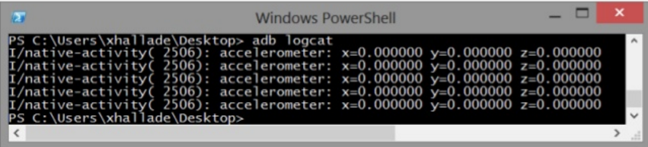
Debugging native code
Debugging with logcat
NDK provides log API in <android/log.h>:
int __android_log_print(int prio, const char *tag, const char *fmt,…..)
Typically used as follows:
#define LOGI(…) ((void)__android_log_print(ANDROID_LOG_INFO,”APPTAG”,__VA_ARGS__))
Usage example:
LOGI(“accelerometer:x=%f y=%f z=%f”,x,y,z);

Slide 74
Debugging native code
Debugging with logcat
To get more information on native code execution:
adb shell setprop debug.checkjni 1
(already enabled by default in emulator)
And to get memory debug information (root only):
adb shell setprop libc.debug.malloc 1
->leak detection
adb shell setprop libc.debug.malloc 10
->overruns detection
adb shell start/stop->reload environment

Slide 75
Wrap-up

Slide 76
Objective - Programming in Android NDK
Objective1: How to integrate and use C/C++ Source Code in NDK
Android NDK sample is developed from scratch using gradle-stable and gradle-experimental plugin
Objective 2: How to use already existing pre-build C/C++ libraries (cross compiled for ARM Android) in NDK
Encryption/Decryption demo example
OpenGL demo example
Objective 3: How to cross-compile C/C++ libraries and generate binaries for NDK integration in above Step 2.
openssl library is cross-compiled for armeabi-v7a
Objective 4: Debugging C/C++ application in android studio

Slide 77
Q & A

Slide 78
References
https://github.com/googlesamples/android-ndk
http://developer.android.com/tools/sdk/ndk/index.html#choosing

