Slide 1
Kerberos

Slide 2
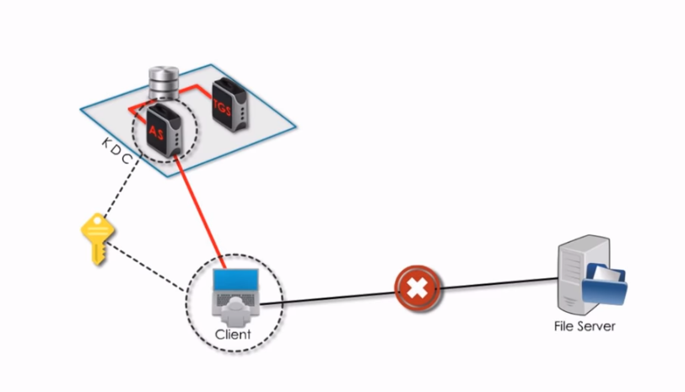
Kerberos components-Kerberos is an authentication protocol for client server application.

