Slide 1

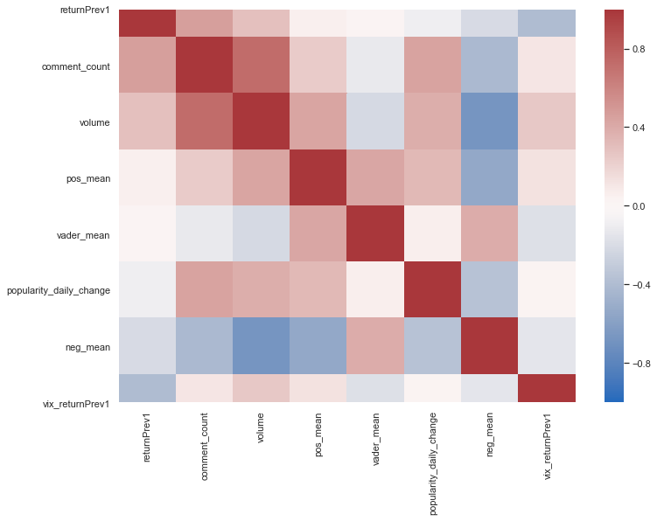
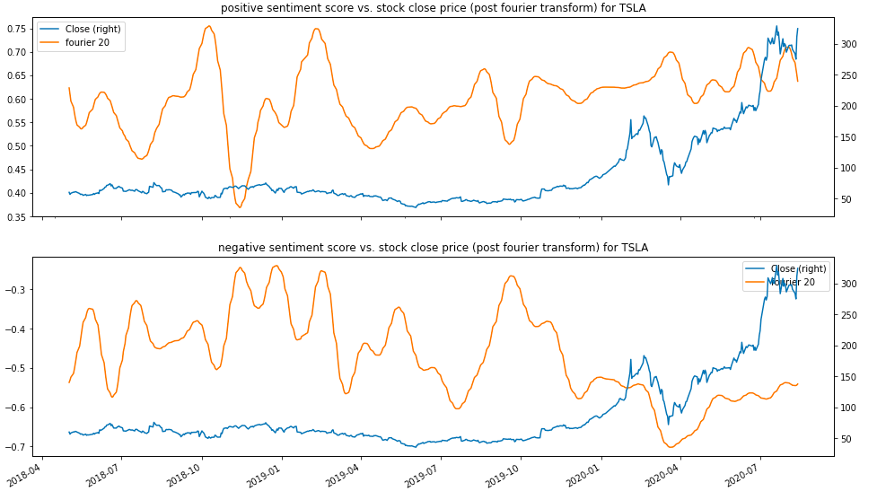




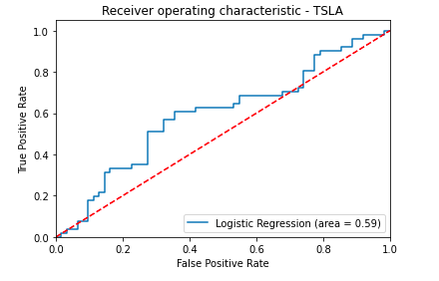
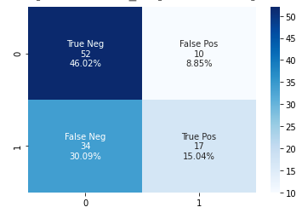
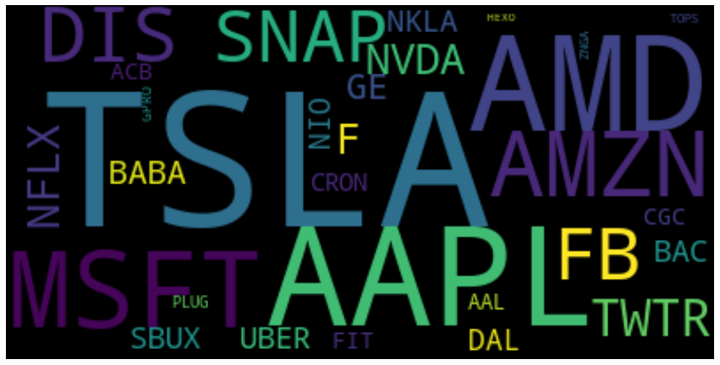
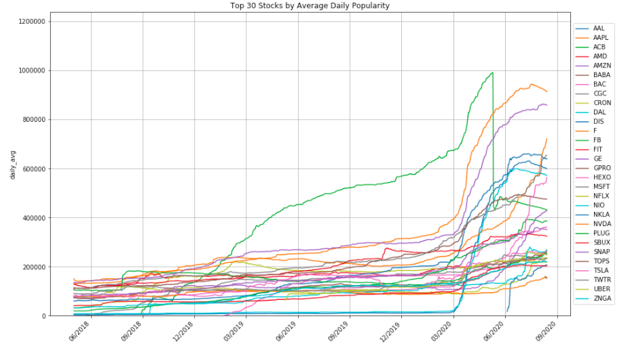
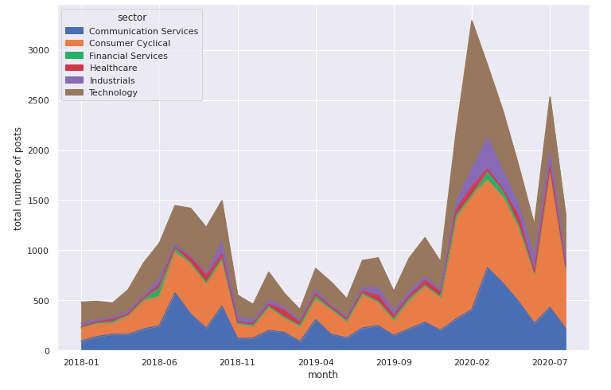
Can we really earn “tendies” from WallStreetBets?
Exploratory Data Analysis
Phyllis Yang, Shelly Wang, Christina Jin, Katherine Engelman, Melody Lui
Example: TSLA
We create a pairwise correlation map between our chosen variables for Tesla stock. There is a positive correlation between the stock return and the comment count, and negative correlation between the return and negative sentiment score calculated.
The plot on the right is the fourier transform of positive and negative sentiment scores against the stock close prices, we see a more prominent correlation since this year.
Background
Recent years, retail investors have become more engaged in stock trading due to the rise in apps like Robinhood. This has lead to communities on social networking sites like r/wallstreetbets (WSB), a subreddit where users can freely post their trading plans and results, while others comment. The goal of our project is to analyze some of these comments using sentiment analysis to see if they can be used to predict the next day’s movement of a stock
Data Sets and Preprocessing
WSB comments and posts : we use Python API to extract the best 500 comments from Daily Discussion posts; we also get a dataset of WSB posts from Kaggle
Robinhood stock popularity : we get the data on Robinhood users’ holding on each stock from Kaggle
Stock Close Price and CBOE Volatility Index (VIX) from YAHOO FInance
Sentiment Score
We use Vader, a lexicon that performs exceptionally on social media posts, to provide us with a base sentiment score for each comment, we then use different metrics such as average of compound, positive comment count, etc. to measure the over sentiment for each day.
We also modified the Lexicon to include slang terms frequently used by WSB users such as “go to the moon”, “drill”, “printer”, etc.
Top Performed
Stocks
Modeling
Logistic Regression: we identify the important features to be market volatility, sentiment, and previous 1-day return. After fitting a model. Achieve 0.61 accuracy score for TSLA.
MLP: After GridSearch, trained 16 features through a network of (32,16,8). Model suffers from overfitting as testing results stick around 0.58 for 80% split; 0.6 for 90%.
Decision Tree: Trained and CVed with 80% split. In general, the model achieved an accuracy of 0.54. The important features identified in the model are VIX and sentiment.
Random Forest: All scores around ~50% with a variety of thresholds for classification and number of trees.
Exploratory Data Analysis
Retail Investors’ Engagement
We select the most popular 30 stocks from the Robinhood dataset and see a huge increase in users’ holdings in stocks since from this year such as ACB, AMZN, TSLA, etc. The surge in retail investors’ engagement is also more prominent in technology and consumer cyclical sector. A potential drawback of this conclusion is that the stocks varied from penny stocks to over three thousand dollars, making it difficult to compare.
Conclusion & Future Work
Though we have seen correlations between stock price and WSB sentiments for some stocks, the models we have tried on only have slightly better performance than random guesses. We have summarized the following ways to improve the mode:
Improve Dataset Quality: expand the dataset to include longer period; select a subset of high quality WSB posts through flair, upvote ratio, etc.
Improve Modelling: more rule-based sentiment scores tailed to WSB, use advanced models such as BERT to predict the sentiment score

Slide 2
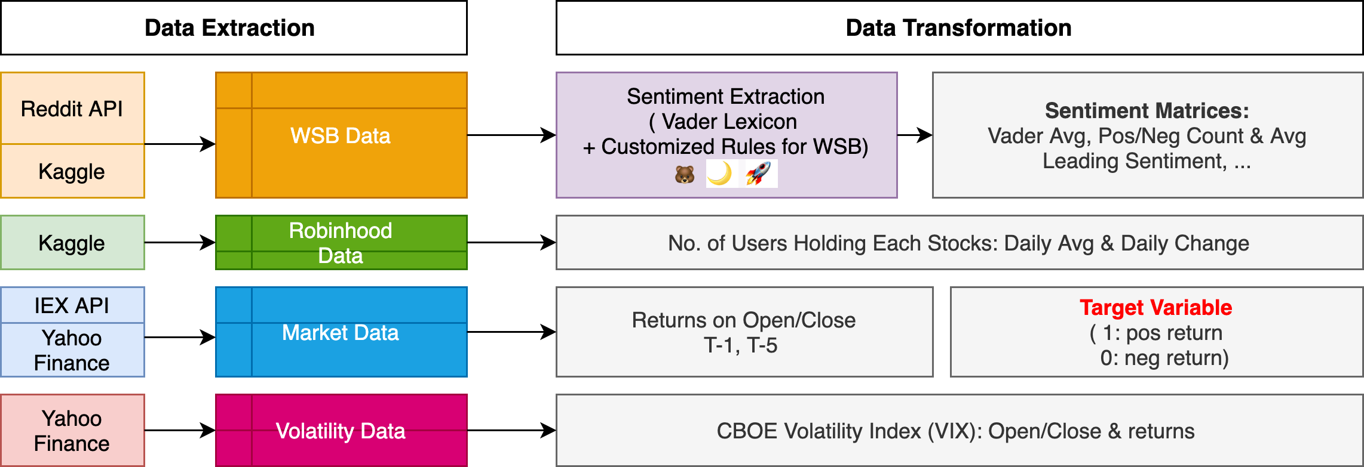
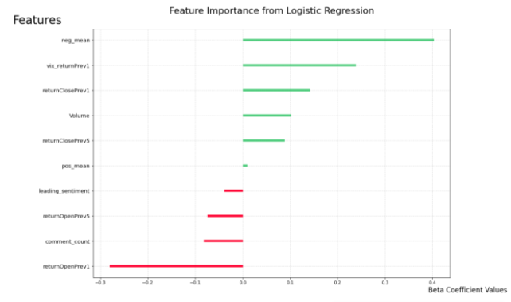
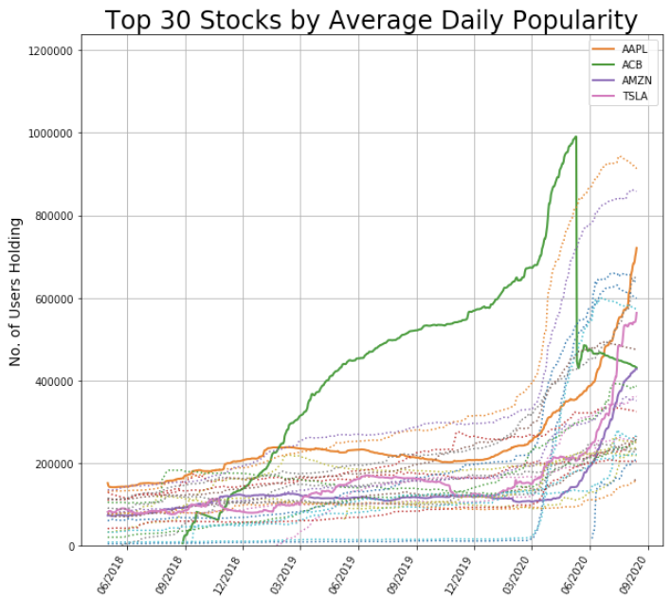
Can we really earn “tendies” from WallStreetBets?
Exploratory Data Analysis
Phyllis Yang, Shelly Wang, Christina Jin, Katherine Engelman, Melody Lui
TSLA (Top 1 in WSB Count, +49% than 2nd)
We create a pairwise correlation map between our chosen variables for Tesla stock. There is a positive correlation between the stock return and the comment count, and negative correlation between the return and negative sentiment score calculated.
The plot on the right is the fourier transform of positive and negative sentiment scores against the stock close prices, we see a more prominent correlation since this year.
Background
Recent years, retail investors have become more engaged in stock trading due to the rise in apps like Robinhood. This has lead to communities on social networking sites like r/wallstreetbets (WSB), a subreddit where users can freely post their trading plans and results, while others comment. The goal of our project is to analyze some of these comments using Sentiment Analysis to see if they can be used to predict the next day’s movement of a stock
Data Sets and Preprocessing
Top Performed
Stocks
Modeling
Logistic Regression: we identify the important features to be market volatility, sentiment, and previous 1-day return. After fitting a model. Achieve 0.61 accuracy score for TSLA.
MLP: After GridSearch, trained 16 features through a network of (32,16,8). Model suffers from overfitting as testing results stick around 0.58 for 80% split; 0.6 for 90%.
Decision Tree: Trained and CVed with 80% split. In general, the model achieved an accuracy of 0.54. The important features identified in the model are VIX and sentiment.
Random Forest: All scores around ~50% with a variety of thresholds for classification and number of trees.
Exploratory Data Analysis
Retail Investors’ Engagement
We select the most popular 30 stocks from the Robinhood dataset and see a huge increase in users’ holdings in stocks since this year such as ACB, AMZN, TSLA, etc. The surge in retail investors’ engagement is also more prominent in technology and consumer cyclical sector. A potential drawback of this conclusion is that the stocks varied from penny stocks to over three thousand dollars, making it difficult to compare.
Conclusion & Future Work
Though we have seen correlations between stock price and WSB sentiments for some stocks, the models we have tried on only have slightly better performance than random guesses. We have summarized the following ways to improve the mode:
Improve Dataset Quality: expand the dataset to include longer period; select a subset of high quality WSB posts through flair, upvote ratio, etc.
Improve Modelling: more rule-based sentiment scores tailed to WSB, use advanced models such as BERT to predict the sentiment score

Slide 3
Thank You!
especially to
Elaine Wah,
Kessie Zhang,
and everyone at Correlation-One that made this happen

