Slide 1
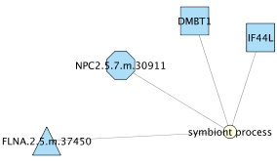
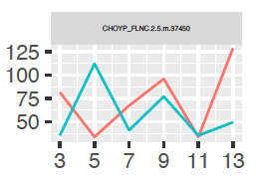
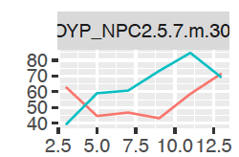
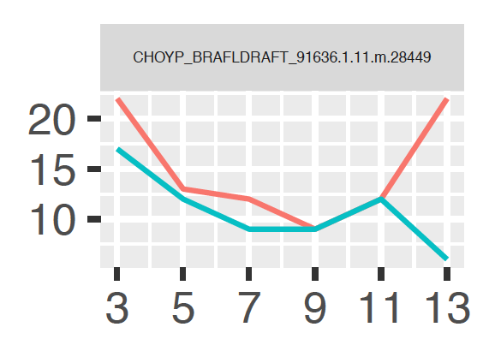
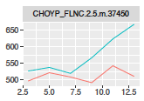
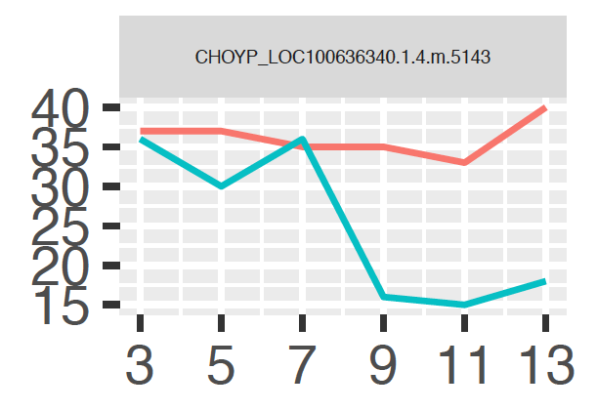
How changed is a particular process?
4 proteins associated with symbiont process
Adjusted NSAF
FLNA
NPC2.5.7
Methods that ID’d each protein:
octagon = HC
triangle = ASCA
square = ChiSq
TotNumSpec
IF44L
FLNA
Does it make sense to calculate log FC adjNSAF? And sum that with totnumspec FC data? That way, it incorporates what ASCA/HC used to ID changed proteins and what ChiSq. Test used to ID proteins
DMBT1

Slide 2
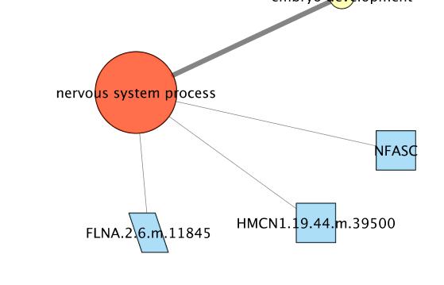
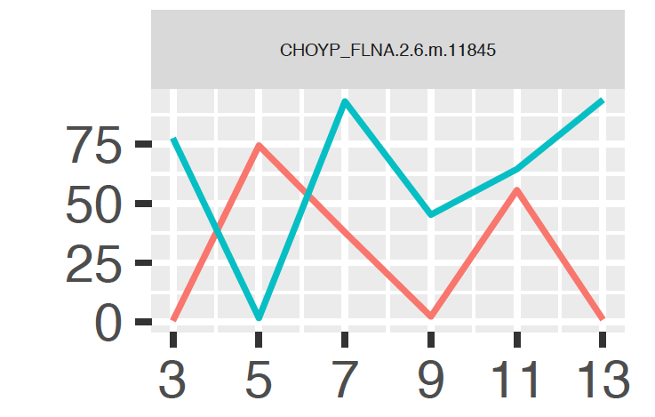
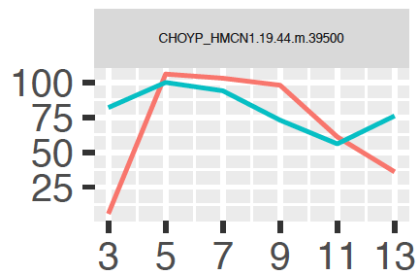
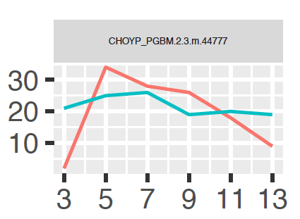
Methods that ID’d each protein:
parallelogram = HC/ASCA
square = ChiSq
FLNA
HMCN
NFASC

