Slide 1
ADJNSAF values
Known contaminants
Log₂ ADJNSAF values
Known contaminants

Slide 2
a
d
PC1 vs PC2 for temperature factor
relative NSAF values
23ºC
29ºC
protein
b
PC2 Loadings
0.025
c
protein
-0.025
PC2 Loadings
protein

Slide 5
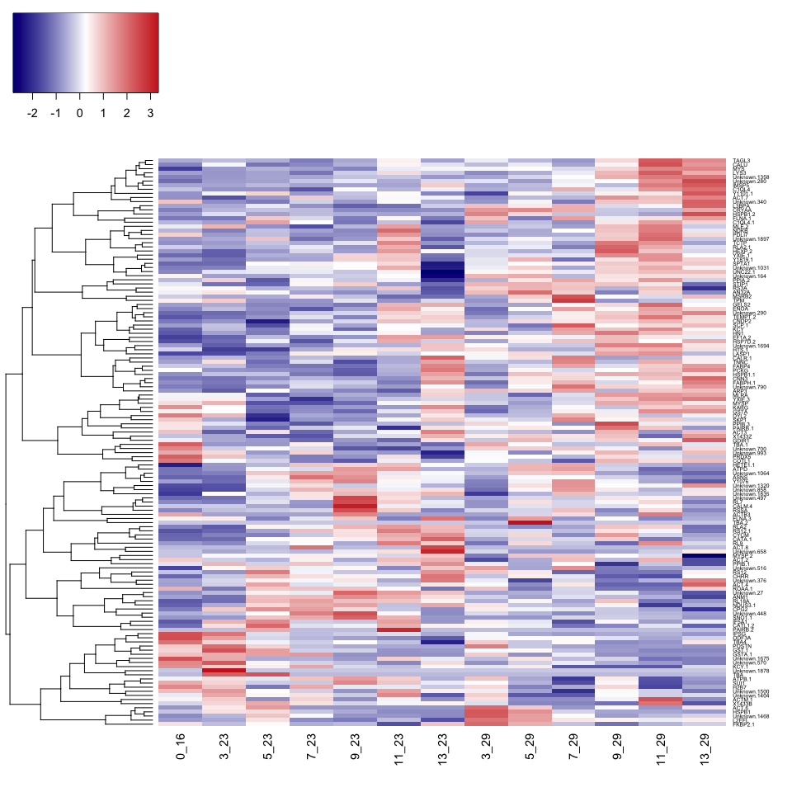
Proteins affected by temperature
relative NSAF values
23ºC
29ºC
protein

Slide 6
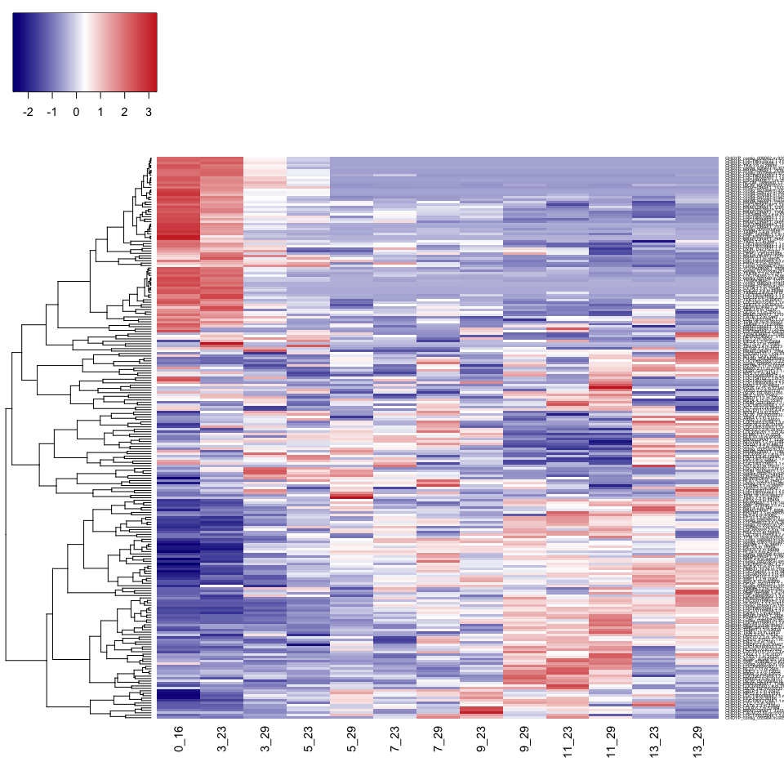
Proteins affected by time
relative NSAF values
Days
0
3
5
7
9
11
13
protein

Slide 7
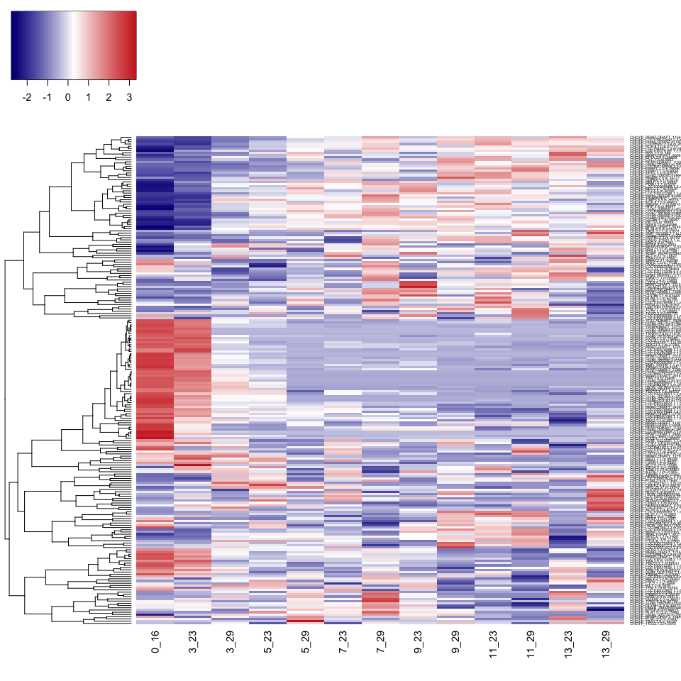
Proteins affected by time x temperature interaction
relative NSAF values
Days
0
3
5
7
9
11
13
protein

