Slide 1
Geoduck Broodstock Conditioning
Nov 2018- Feb 2019

Slide 2
Timeline
https://docs.google.com/spreadsheets/d/1EiauNj5O2P6f5kKR60B-r6xAHBk-Bkhm8xIgD8nidGI/edit#gid=0
Date | Event
10/25/18 | ~80 geoducks collected from Coon Bay and in ambient tanks
11/12/18 | started geoduck low pH treatments tanks 1+2
11/21/18 | 40 geoducks collected from Coon Bay and in ambient tanks
11/29/18 | started variable pH
12/7/18 | continuous feeding with high density algae began
12/9/18 | started ramping temperature up a little
1/6/19 | spawning attempt 1
1/15/19 | variable low pH treatment stopped (not sure why)
1/22/19 | spawning attempt 2, tank 3 animals 9 and 10 males went off
1/23/19 | sacrificed 5 per tank (tanks 1-4), collected gonad, ctenidia, siphon, and hemolymph samples, strip spawned tank3 animals
1/31/2019 | spontaneous spawn in tank 2, 1 female and 3 males
2/1/2019 | collected fertilized egg samples
2/19/2019 | spawning attempt 3

Slide 3
Experimental Setup
started Nov 12, 2018
Tank 1
pH 6.8
Tank 2
pH 6.8
Tank 3
pH amb
Tank 4
pH amb
~20 animals
~20 animals
~20 animals
~20 animals
started Nov 29, 2018
Tank 5
pH 6.8-7.0
Tank 6
pH amb
~20 animals
~20 animals

Slide 4
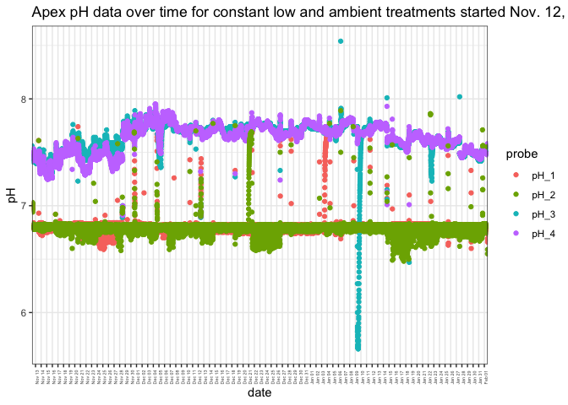
Water Chemistry: Apex

Slide 5
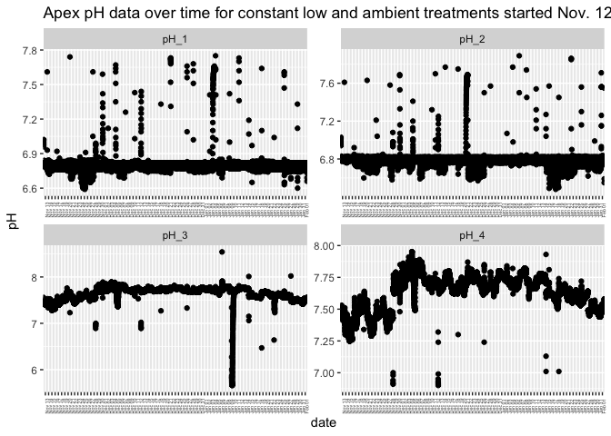
Water Chemistry

Slide 6
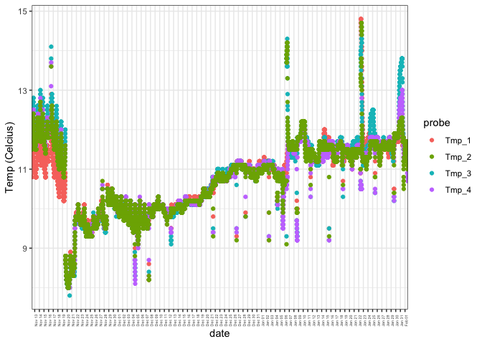
Water Chemistry: Apex
Apex temperature over time for constant low and ambient treatments started Nov. 12

Slide 7
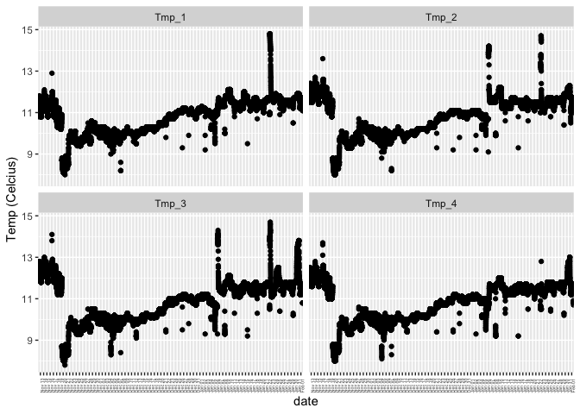
Water Chemistry
Apex temperature over time for constant low and ambient treatments started Nov. 12

Slide 8
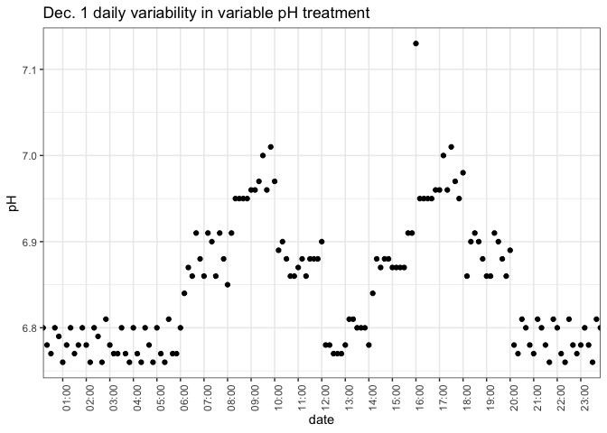
Water Chemistry: Apex

Slide 9
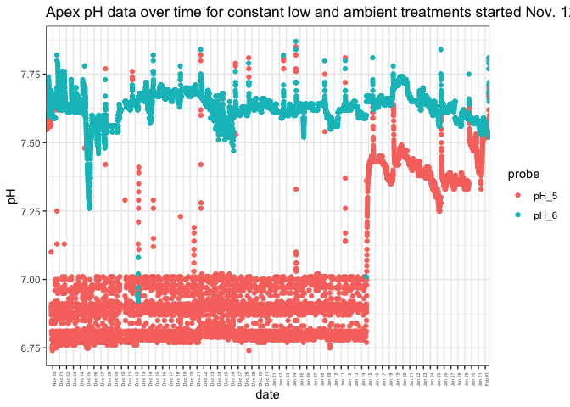
Water Chemistry: Apex
Apex pH over time for variable low and ambient treatments started Nov. 29

Slide 10
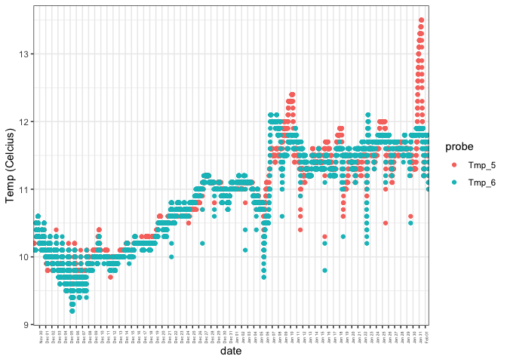
Water Chemistry: Apex
Apex temp. over time for variable low and ambient treatments started Nov. 29

Slide 11
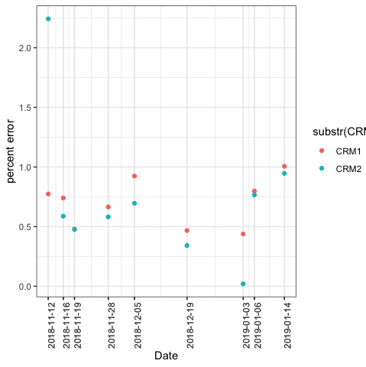
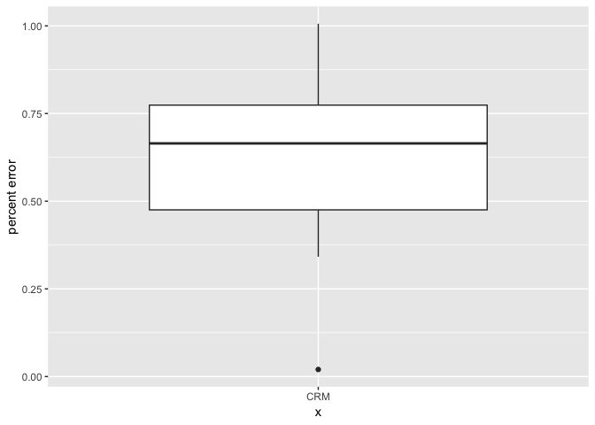
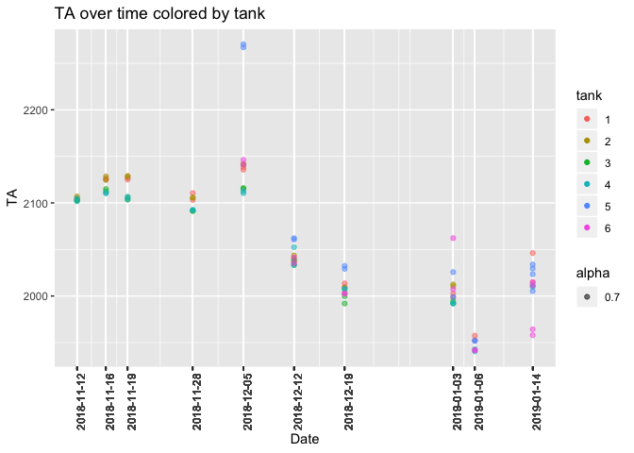
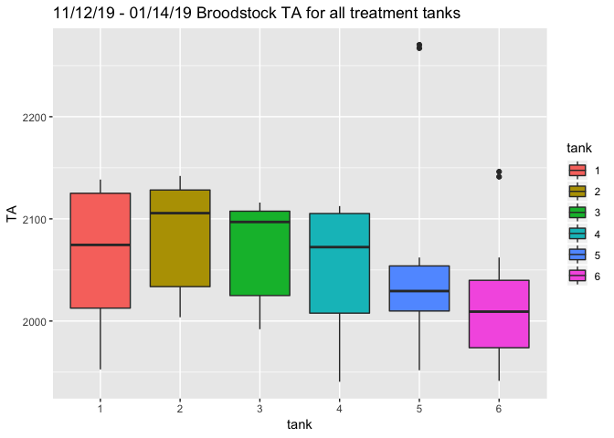
Water Chemistry: TA
CRM % error over time
Sample

Slide 12
Samples collected
Tissue samples from Jan 23, 2019
Hemolymph
Gonad histology just received

Slide 14
