Slide 1
n total = 80
rep 1
rep 2
rep 3
Amb pH (8.2)
13
13
13
n = 39
Low pH (7.4)
13
13
13
n = 39
If n = 39, Cohen D effect size must be >= 0.643 with power = 0.8
@ Ttest Cohen D effect size = 0.5 and power = 0.8 , need ~22 animals/tank

Slide 2
n total = 80
Like this scenario the best
Acute Low pH (7.4)
Or Variable Low (7.6-7.2?)
Amb pH (8.2)
Constant Low pH (7.4)
n = 26
n = 26
n = 26
Need holding tanks for post spawned and non-spawners…what do we want to do with these?
rep 1
13
13
13
rep 2
13
13
13
Can we double the number of animals collected? 50% max are going to be female. Are these wild or cultured/planted?
If n = 26, AOV effect size must be >= 0.359 with power = 0.8
@ AOV effect size = 0.25 and power = 0.8 , need ~26 animals/tank, ~52 animals/condition

Slide 3
Power Analysis
Death rate at ambient/normal aquaculture conditions
Estimated death rate with sampling
Estimated N for sufficient spawning

Slide 4
Setting up system
Brent to order Venturi injectors to infuse CO2
Need to set up manifold for feeding:
Head tank (black conical tank?) and upstream mixng for universal dispersal
Peristaltic pump in each tank (not as simple, more parts to be non—niform)
Feed: can we use algae paste?
Start off with algal paste and can change to live algae if needed
What flow can we accommodate and still maintain pH?
Sterilization:
1micron filter?
UV?

Slide 5
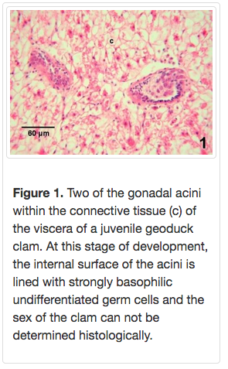
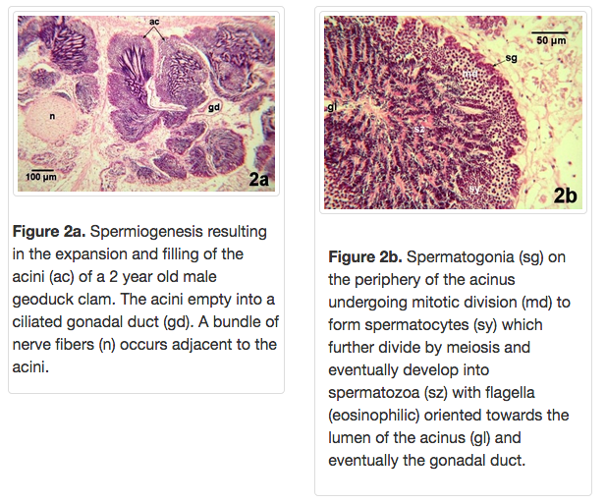
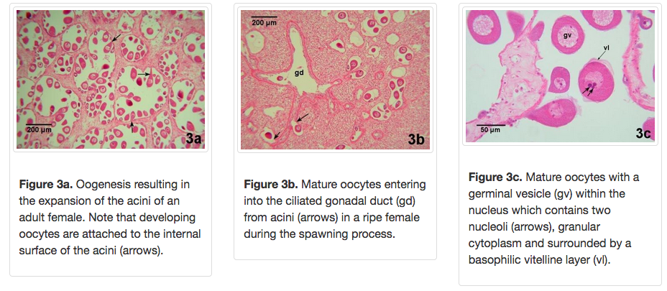
Estimating Gametogenesis
Immature
Male
Female
ELISA for vitellogenin:
Kit?

Slide 6
Sampling
Hemolymph
1mL Can be sampled up to once/week: mortality low (maya)
Freeze serum and do analysis later
Monitor gonad development over time by ELISA
Read out that animals are maturing
Gonad
Needle biopsy and histology

Slide 7
Assays
QPCR for checking expression of maturation genes
Blood samples in the freezer from known stages
Vitellogenin ELISA or DotBlot assay
Freezer blood samples will work for this as well
Can use males a neg. control
Can use vitellogenin levels in Emma’s proteomes as a baseline

