Slide 1




Environmental influence on the Atlantic salmon epigenome during sea lice infestation
Shelly Trigg, Ph.D.
Steven Roberts Lab
School of Aquatic and Fishery Sciences
University of Washington
In collaboration with Cristian Gallardo-Escárate, Valentina Valenzuela-Muñoz, and Gustavo Núñez-Acuña
Universidad de Concepción, Chile
Notes:
Hi Everyone,
I'm happy to be here and excited to share this new project which is my first involving salmonid biology. My background is in functional genomics in plants. And I'm currently a post doc in Steven Roberts lab at UW studying molecular physiology with omics tools. This project is a collaboration with Cristian Gallardo Escarate's lab en Chile . So I'd like to thank my lab and collaborators

Slide 2
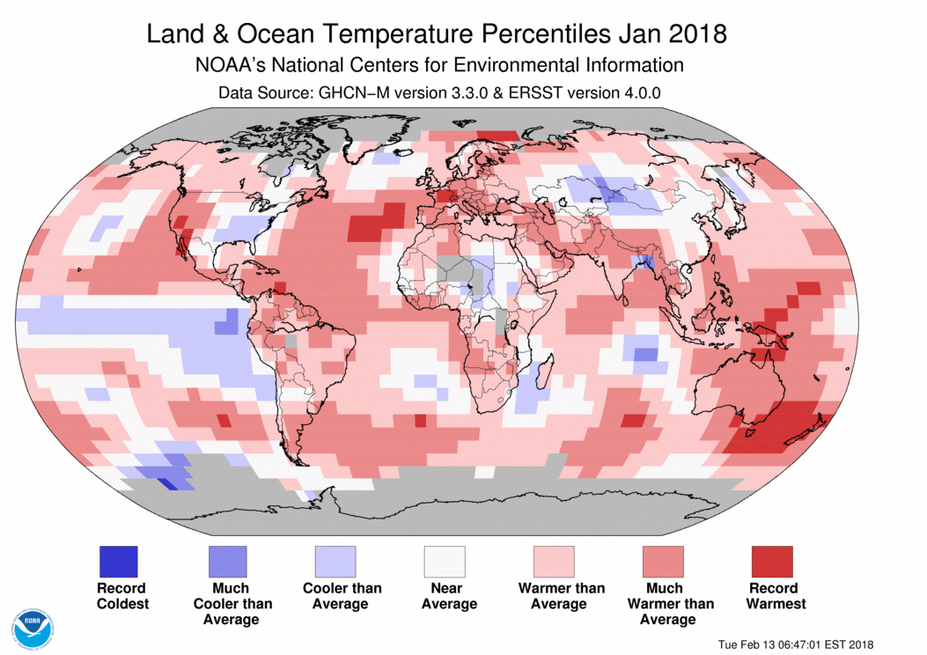
Environmental threats to Salmon
Ocean change
temperature impacts salmon physiology
Some studies show heat tolerance BUT at a cost
Anttila et al (2014) Nat Comm, Tromp et al. (2018) Aquaculture, Nuez-Ortin et al. (2018) BMC Genomics
Notes:
Salmon are faced with environmental challenges in the face of climate change. For instance ocean
Changing environmental conditions are a threat to Salmon. Stress and immunity (https://journals.plos.org/plosone/article?id=10.1371/journal.pone.0054656)

Slide 3
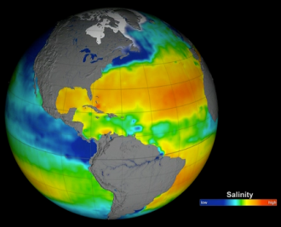
Environmental threats to Salmon
Ocean change
temperature impacts salmon physiology
Some studies show heat tolerance BUT at a cost
Anttila et al (2014) Nat Comm, Tromp et al. (2018) Aquaculture, Nuez-Ortin et al. (2018) BMC Genomics
salinity
Brown et al. (2018) J. Fish Biol.
https://science.nasa.gov/earth-science/oceanography/physical-ocean/salinity
Notes:
Salmon are faced with environmental challenges in the face of climate change. For instance ocean Changing environmental conditions are a threat to Salmon. Stress and immunity (https://journals.plos.org/plosone/article?id=10.1371/journal.pone.0054656)
Changing environmental conditions are a threat to Salmon. Stress and immunity (https://journals.plos.org/plosone/article?id=10.1371/journal.pone.0054656)

Slide 4
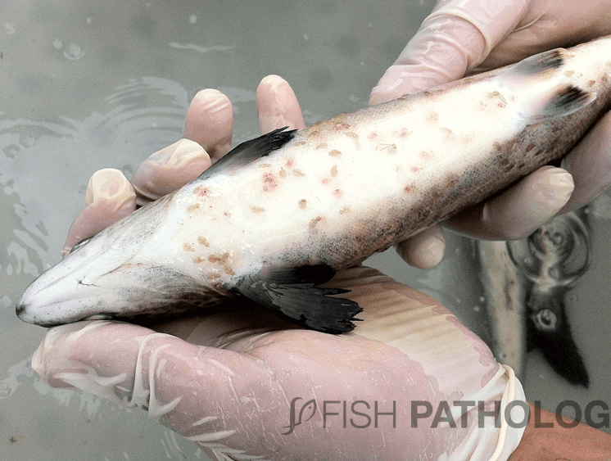
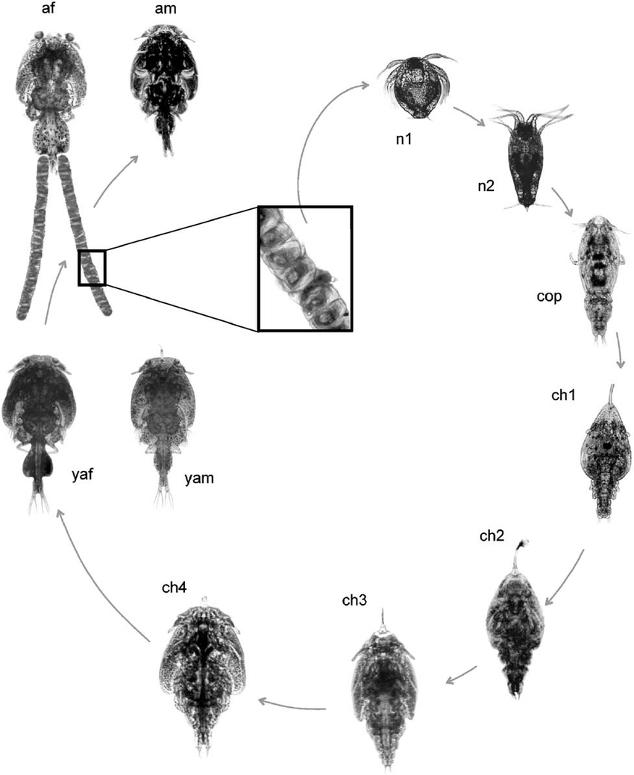
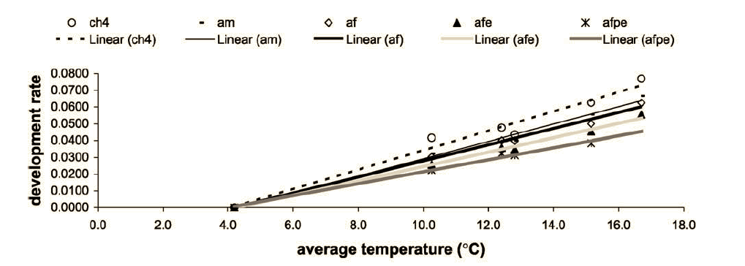
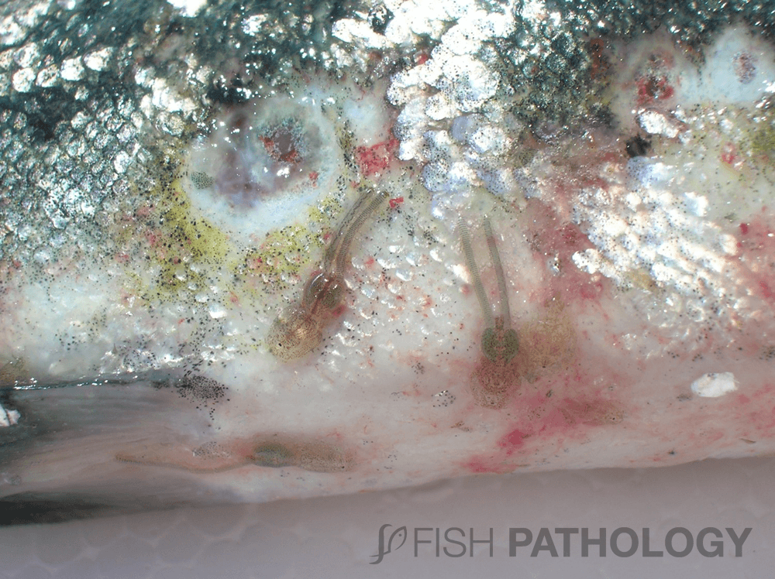
Environmental conditions can exacerbate sea lice infestation
Temperature affects development
González et al (2003) Aquaculture

Slide 5
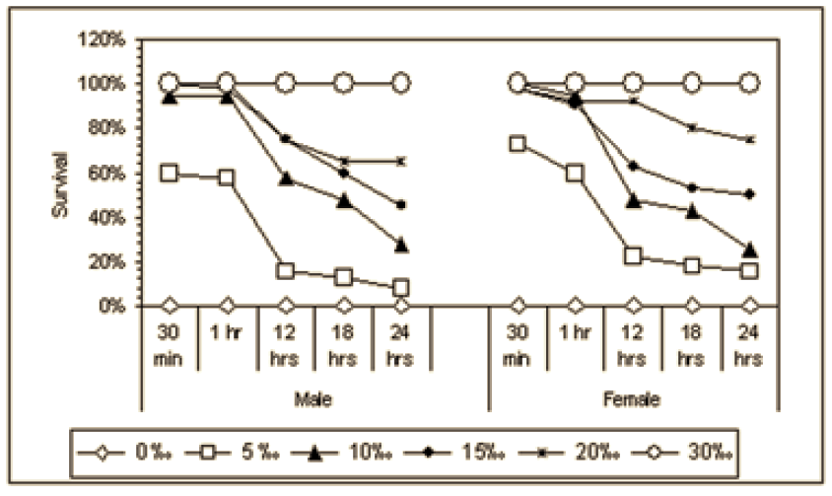
Environmental conditions can exacerbate sea lice infestation
Temperature affects development
González et al (2003) Aquaculture
Salinity affects survival
Bravo et al (2008) Bulletin of the European Association of Fish Pathologists
Notes:
a problem for industry where infestation is already exacerbated by crowding

Slide 6
How do temperature and salinity affect salmon response to sea lice?
Notes:
In planning for the future

Slide 7
How do temperature and salinity affect salmon response to sea lice?
Methylation is a good way to measure wide-spread change
Epigenetic marks can be directly influenced by the environment
They mediate phenotypic response through gene regulation
Notes:
In planning for the future

Slide 8
How do temperature and salinity affect salmon response to sea lice?
Methylation is a good way to measure wide-spread change
Epigenetic marks can be directly influenced by the environment
They mediate phenotypic response through gene regulation
Do salmon methylomes change in response to environment during sea lice infestation?
How might these methylation changes influence physiology?
Are specific regulatory pathways affected by one factor more than another?
Notes:
In planning for the future

Slide 9


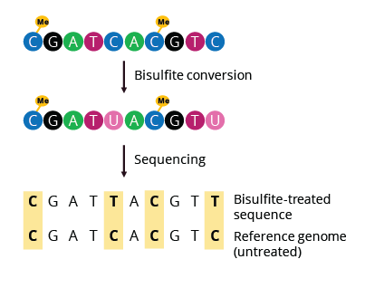
Temperature x salinity experimental set-up
8 fish (S. salar) per tank
Initial load: 35 sea lice (C. rogercresseyi) per fish
4 tanks/treatment
30 days
Reduced-Representation
Bisulfite Sequencing
8°C
skin sections
4 fish/ treatment
16°C
32 psu
26 psu
Normal conditions in Chile = 12 °C and 32 psu
Notes:
6-8 months old, siblings from the same parents.

Slide 10
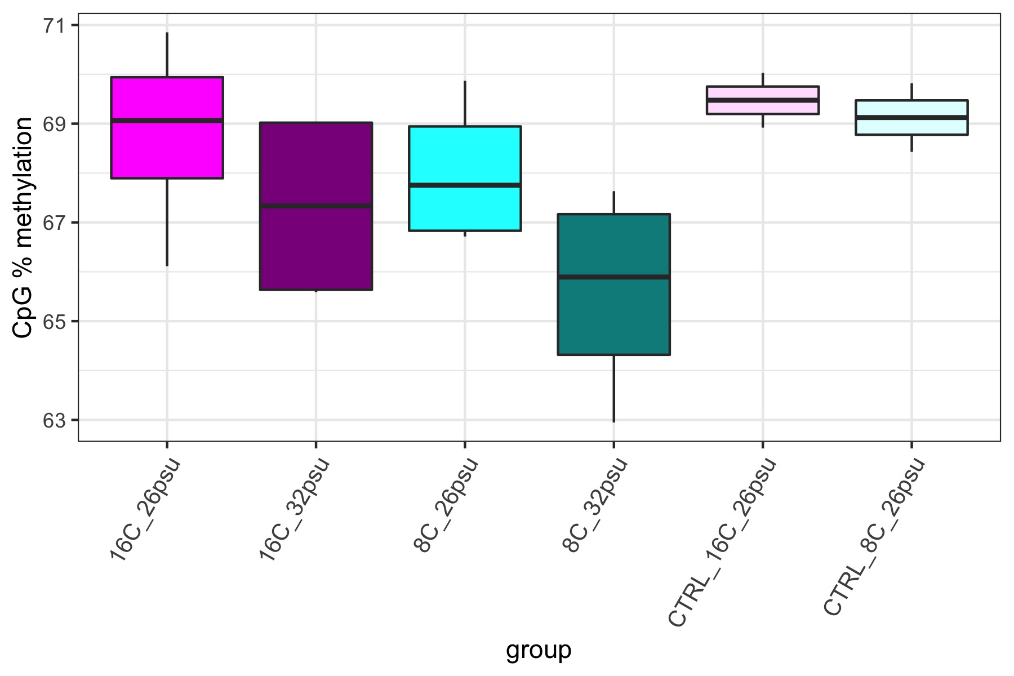
CpG methylation across groups
Total CpGs analyzed: 34,478,010
High salinity groups show a general decrease in overall methylation and greater variance
Notes:
with 5x coverage in ¾ individuals per group

Slide 11
CpG methylation across groups
Total CpGs analyzed: 34,478,010
No sea lice
Notes:
with 5x coverage in ¾ individuals per group

Slide 12
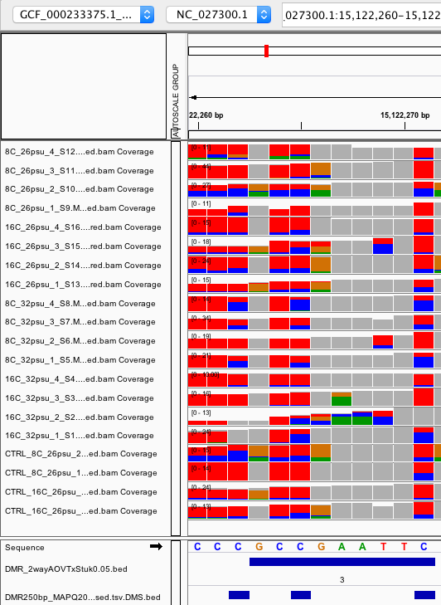
DMR: Differentially methylated region
A 10 - 300bp region containing at least 3 CpGs that are significantly differentially methylated
Notes:
Filtered at 5x coverage within a sample and 3x coverage by individuals within a group

Slide 13
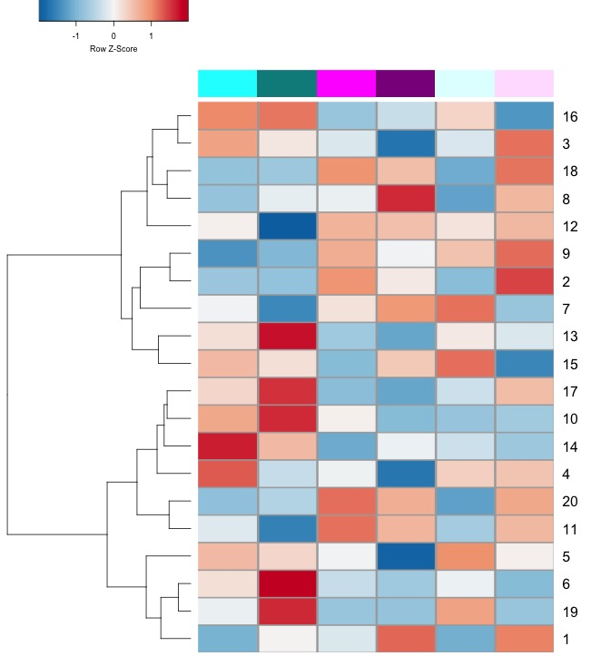
Influence of temperature on methylation
Relative % methylation
8°C
26PSU
8°C
32PSU
16°C
26PSU
16°C
32PSU
8°C
26PSU
16°C
26PSU
Notes:
Significant DMRs

Slide 14
Influence of temperature on methylation
Relative % methylation
8°C
26PSU
8°C
32PSU
16°C
26PSU
16°C
32PSU
8°C
26PSU
16°C
26PSU
Increase in methylation under low temperature (8°C)
Notes:
Significant DMRs

Slide 15
Influence of temperature on methylation
Relative % methylation
SEA LICE
NO SEA LICE
Sea lice-dependent increase in methylation under low temperature (8°C)
8°C
26PSU
8°C
32PSU
16°C
26PSU
16°C
32PSU
8°C
26PSU
16°C
26PSU
Notes:
Maintenance of marks at low temperature make infection less bad?

Slide 16
Influence of temperature on methylation
Relative % methylation
SEA LICE
NO SEA LICE
Sea lice-dependent increase in methylation under low temperature (8°C)
8°C
26PSU
8°C
32PSU
16°C
26PSU
16°C
32PSU
8°C
26PSU
16°C
26PSU
RARA (intron)
HOX activator complex
HOX: specify spatial plan in organ development
Agrin-like (intron)
modulates growth (favors aggregation)
Uncharacterized lncRNA
EGR1
zinc finger that regulates inflammatory response and cell proliferation
Notes:
First Intron methylation correlates with reduced gene expression: https://epigeneticsandchromatin.biomedcentral.com/articles/10.1186/s13072-018-0205-1 (agrin: https://www.sciencedirect.com/science/article/pii/S2211124719308022)

Slide 17
Influence of salinity on methylation
Notes:
Significant DMRs; colored by temperature and shaded by salinity

Slide 18
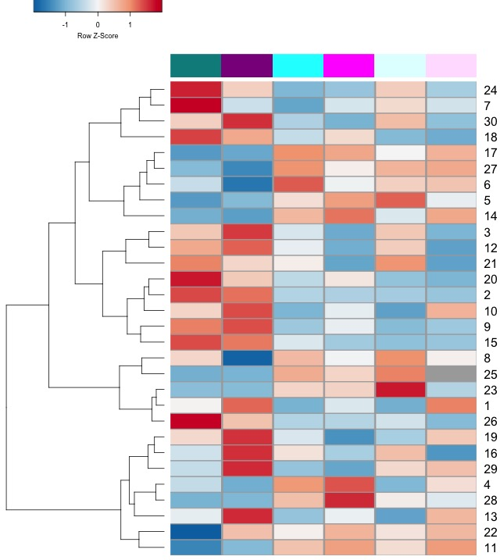
Influence of salinity on methylation
Relative % methylation
SEA LICE
NO SEA LICE
8°C
32PSU
16°C
32PSU
8°C
26PSU
16°C
26PSU
8°C
26PSU
16°C
26PSU
Sea lice-dependent decrease in methylation under low salinity (26psu) and low temp (8°C)
Notes:
Significant DMRs

Slide 19
Influence of salinity on methylation
Relative % methylation
SEA LICE
NO SEA LICE
8°C
32PSU
16°C
32PSU
8°C
26PSU
16°C
26PSU
8°C
26PSU
16°C
26PSU
Sea lice-dependent decrease in methylation under low salinity (26psu) and low temp (8°C)
LBX1
HOX transcription factors
Cell differentiation, spatial specificity
HOXC8
HOXC9
Notes:
Gene body methylation and downstream of gene. Are their targets?
HoxC8 over expression inhibits glycolysis (decreases glucose uptake and lactate production) and increases TCA activity (https://www.ncbi.nlm.nih.gov/pmc/articles/PMC4564361/)
Involved in cell differentiation and multicellular organism development, region specificity of skin (Chuong, 2003 J Invest Dermatol.)
Gene-body hypermethylation is associated with elevated HOX expression (Li, Huang, Wei 2019 Cancers)

Slide 20
Influence of salinity on methylation
Relative % methylation
SEA LICE
NO SEA LICE
Sea lice-dependent decrease in methylation under low salinity (26psu) and low temp (8°C)
8°C
32PSU
16°C
32PSU
8°C
26PSU
16°C
26PSU
8°C
26PSU
16°C
26PSU
RAPGEF6 (intron)
HCCA2 (intron)
genes associated with
apoptosis
inhibition of cell proliferation
response to damage
UNC5D (intron)
Notes:
Gene body methylation and downstream of gene. Are their targets?
HoxC8 over expression inhibits glycolysis (decreases glucose uptake and lactate production) and increases TCA activity (https://www.ncbi.nlm.nih.gov/pmc/articles/PMC4564361/)

Slide 21
Influence of salinity on methylation
Relative % methylation
SEA LICE
NO SEA LICE
8°C
32PSU
16°C
32PSU
8°C
26PSU
16°C
26PSU
8°C
26PSU
16°C
26PSU
increase in methylation under high salinity (32psu)
Cell aggregation
ALS10
lncRNA
Associated with FAM1142a
(MAPK signaling/cell proliferation)
Notes:
Gene body methylation and downstream of gene. Are their targets?
HoxC8 over expression inhibits glycolysis (decreases glucose uptake and lactate production) and increases TCA activity (https://www.ncbi.nlm.nih.gov/pmc/articles/PMC4564361/)

Slide 22
Conclusions
Methylation is significantly affected by temperature and salinity in Atlantic Salmon infested with sea lice
Notes:
Capture the epigenetic marks that lead to an optimal response and use those to control gene regulation. Because epigenetics are upstream of gene expression, they have the power to control more through fewer changes.
Put together with expression data to get a clearer picture how methylation is controlling regulation

Slide 23
Conclusions
Methylation is significantly affected by temperature and salinity in Atlantic Salmon infested with sea lice
Salinity induces more changes (30 DMRs) than temperature (20 DMRs)
Notes:
Capture the epigenetic marks that lead to an optimal response and use those to control gene regulation. Because epigenetics are upstream of gene expression, they have the power to control more through fewer changes.
Put together with expression data to get a clearer picture how methylation is controlling regulation

Slide 24
Conclusions
Methylation is significantly affected by temperature and salinity in Atlantic Salmon infested with sea lice
Salinity induces more changes (30 DMRs) than temperature (20 DMRs)
Conditions seem to lead to different fine-tuning of cell proliferation/growth vs. apoptosis/damage control processes
Notes:
There is an apparent fine balance between cell proliferation and damage control that is trying to be achieved
Capture the epigenetic marks that lead to an optimal response and use those to control gene regulation. Because epigenetics are upstream of gene expression, they have the power to control more through fewer changes.
Put together with expression data to get a clearer picture how methylation is controlling regulation

Slide 25
Conclusions
Methylation is significantly affected by temperature and salinity in Atlantic Salmon infested with sea lice
Salinity induces more changes (30 DMRs) than temperature (20 DMRs)
Conditions seem to lead to different fine-tuning of cell proliferation/growth vs. apoptosis/damage control processes
A deeper understanding of this fine-tuning in light of expression data and phenotypes could pinpoint optimal epigenomic profiles that could be targeted for industry
Notes:
Capture the epigenetic marks that lead to an optimal response and use those to control gene regulation. Because epigenetics are upstream of gene expression, they have the power to control more through fewer changes.
Put together with expression data to get a clearer picture how methylation is controlling regulation

Slide 26
Conclusions
Methylation is significantly affected by temperature and salinity in Atlantic Salmon infested with sea lice
Salinity induces more changes (30 DMRs) than temperature (20 DMRs)
Conditions seem to lead to different fine-tuning of cell proliferation/growth vs. apoptosis/damage control processes
A deeper understanding of this fine-tuning in light of expression data and phenotypes could pinpoint optimal epigenomic profiles that could be targeted for industry
Next steps
Compare with expression data (check for targets of regulators)
Notes:
Capture the epigenetic marks that lead to an optimal response and use those to control gene regulation. Because epigenetics are upstream of gene expression, they have the power to control more through fewer changes.
Put together with expression data to get a clearer picture how methylation is controlling regulation

