Slide 1
Influence of ocean acidification on DNA methylation patterns in geoduck
Shelly Trigg, Ph.D.
^{Steven Roberts Lab}
School of Aquatic and Fishery Sciences
^{University of Washington}

Slide 2
Outline
Intro
Methods
  Genome assembly
    Illumina PE transcriptome
    Phase genomics
  OA experiment
    RRBS
      DMR and DMG
Results

Slide 3
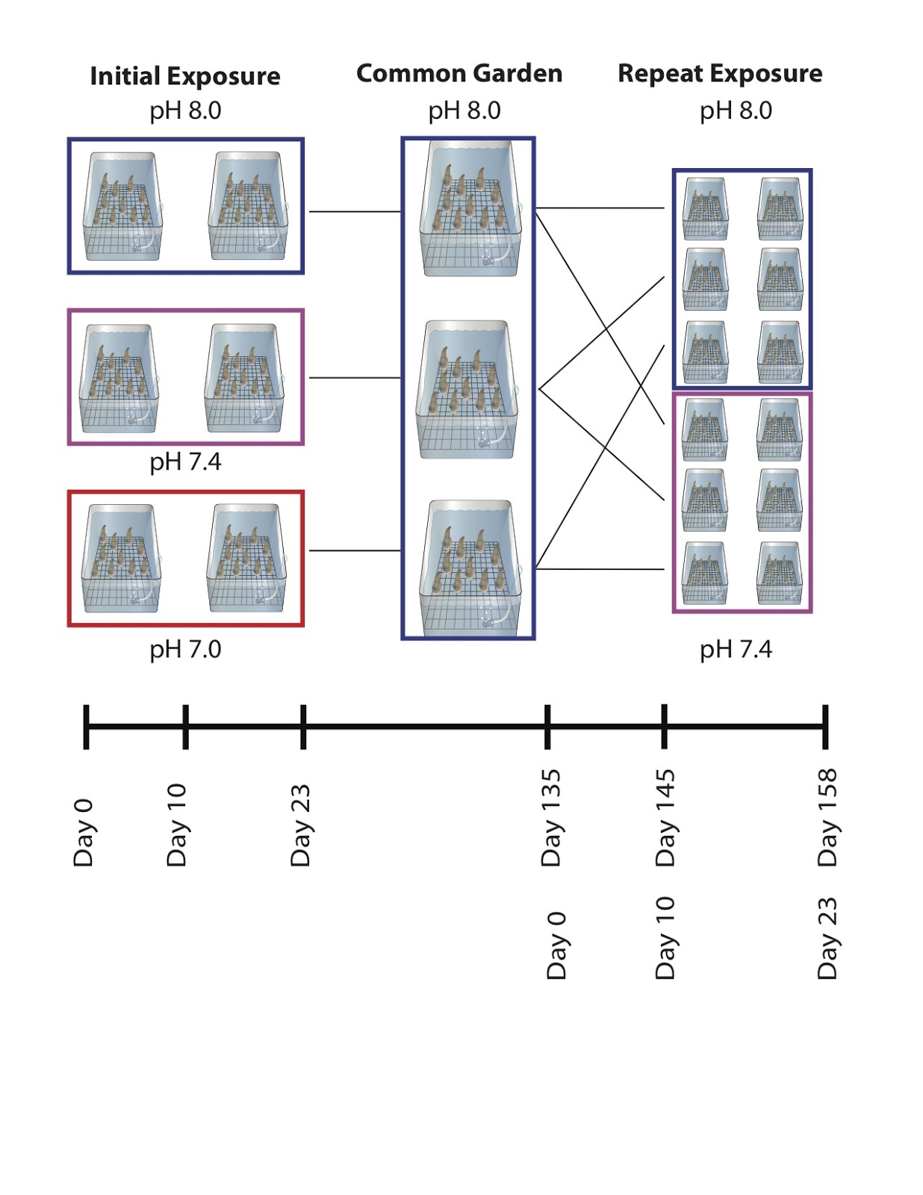
Experimental setup
0
10
23
135
Days

Slide 4
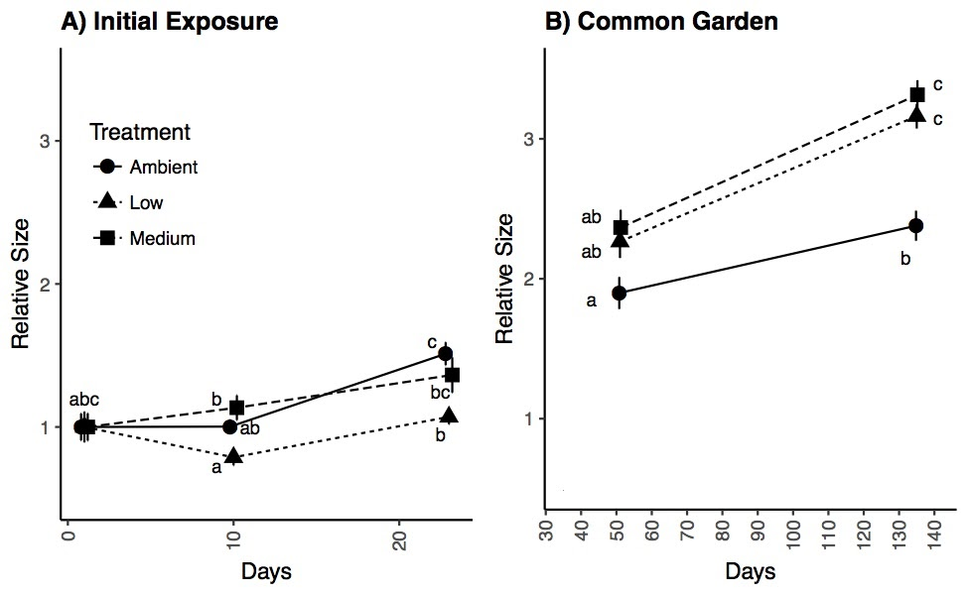
Low pH leads to compensatory growth
pH 7.0
pH 7.4

Slide 5
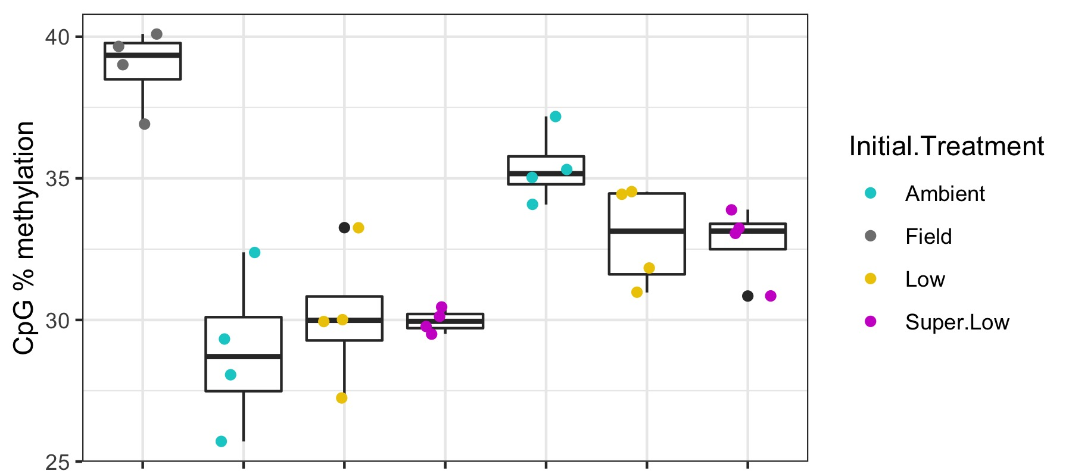
CpG methylation across groups
Treatment
Day 0
Day 10
Day 135

Slide 6
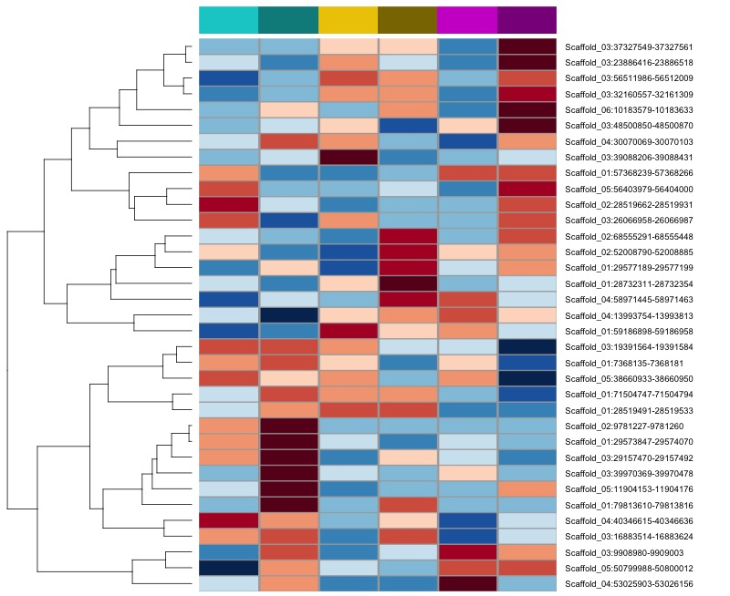
Influence of pH on methylation
ambient
pH 7.4
pH 7.0
days
10
135
10
135
10
135

Slide 7
Influence of pH on methylation
ambient
pH 7.4
pH 7.0
days
10
135
10
135
10
135
Persistent hypermethylated DMRs in low pH
Persistent hypomethylated DMRs in low pH

