Slide 1
Comparing DMRs overlapping in Day 10 and Day 135 to determine if they are persistent or transient
Image Key:
Left image = day 10
Right image = day 135
Tracks
Top 4 .bw tracks = ambient
Middle 4 .bw tracks = low pH
Bottom 4 .bw tracks = super low pH
Very bottom tracks = DMR bed files (top = day 10, bottom = day 135)
.bw blocks = 25bp chunks
White block = 0% mCG
Dark Blue block = 100% mCG
Gray block = no sequence data

Slide 2
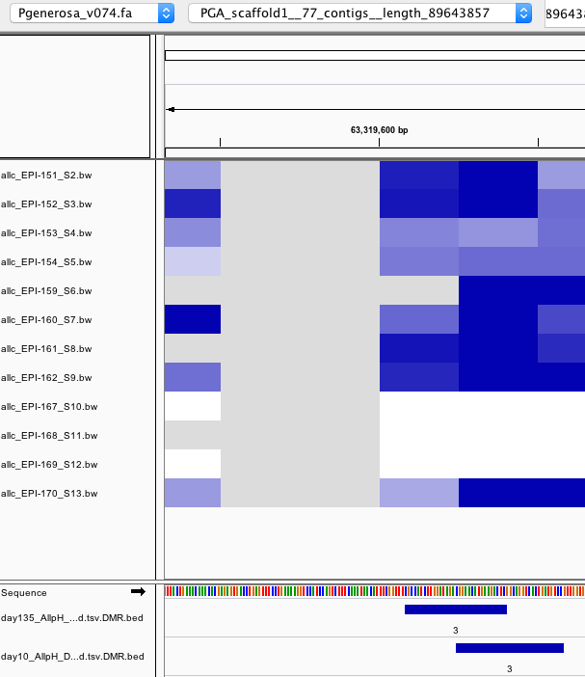
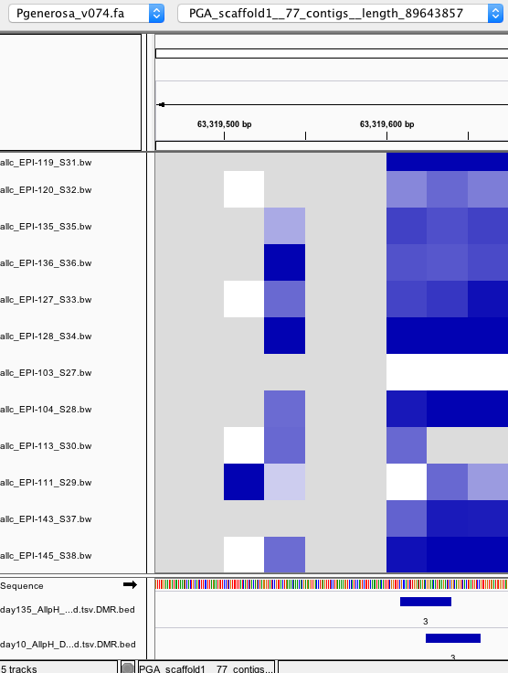
Super.low pH low methylation persists
Day 135
Day 10
ambient
Low pH
Super.Low pH

Slide 3
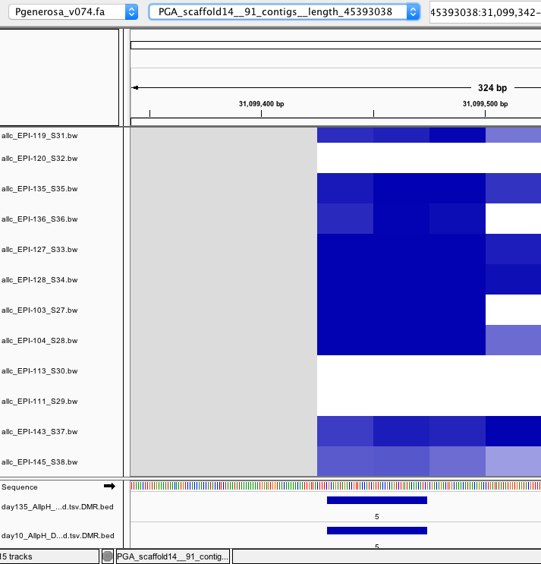
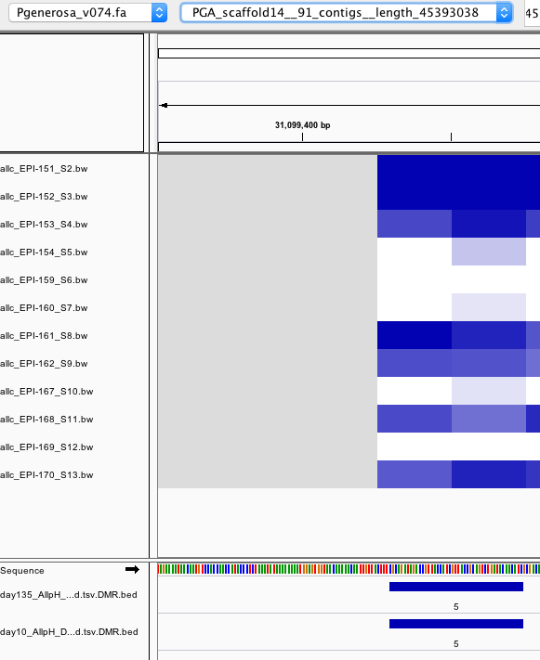
Super.low pH low methylation persists
Day 10
Day 135
ambient
Low pH
Super.Low pH

Slide 4
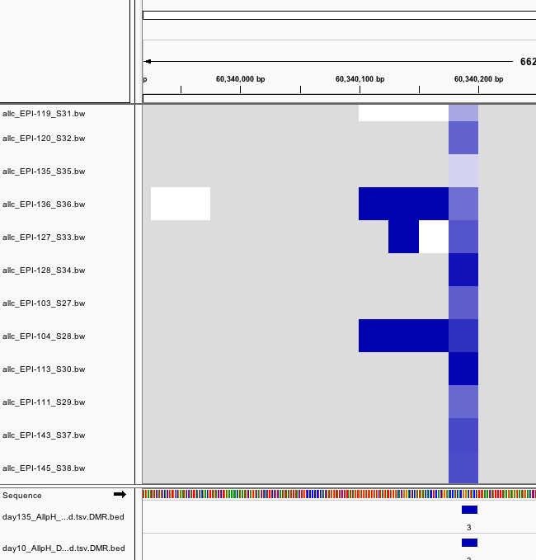
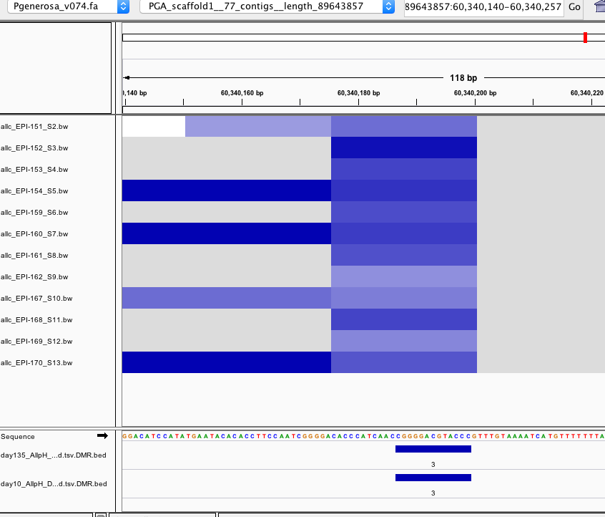
Patterns seem to remain the same, except for ambient which seems to get more methylated
Day 10
Day 135
ambient
Low pH
Super.Low pH

Slide 5
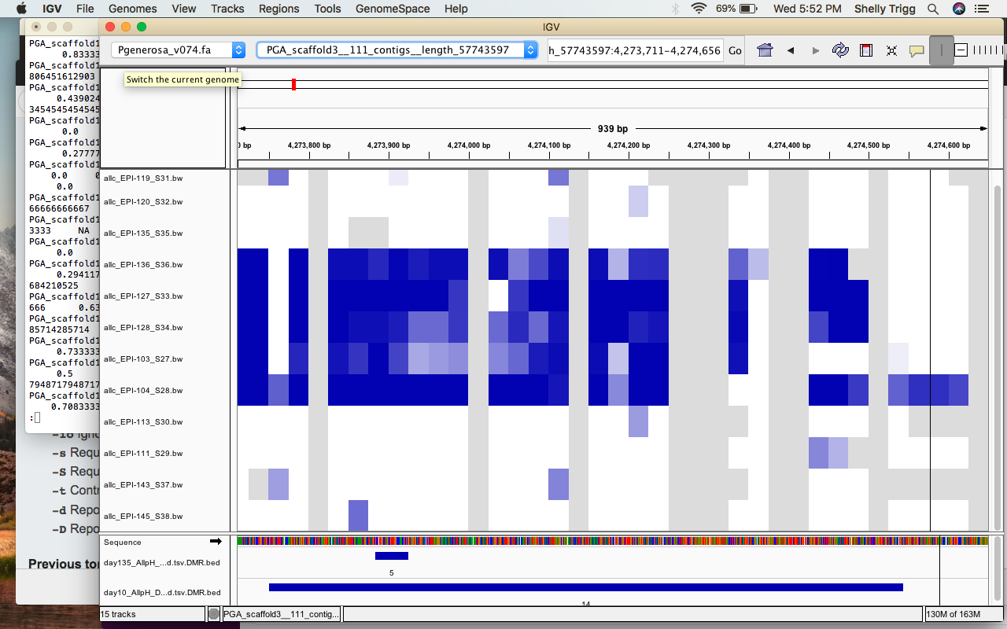
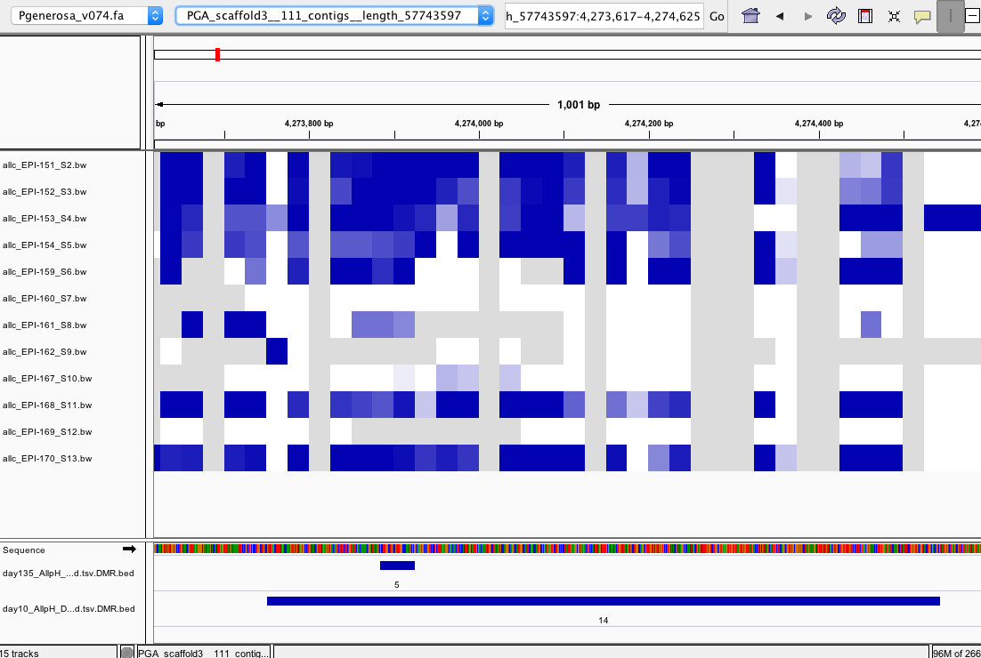
Patterns in all groups seem to change here
Day 10
Day 135
ambient
Low pH
Super.Low pH

Slide 6
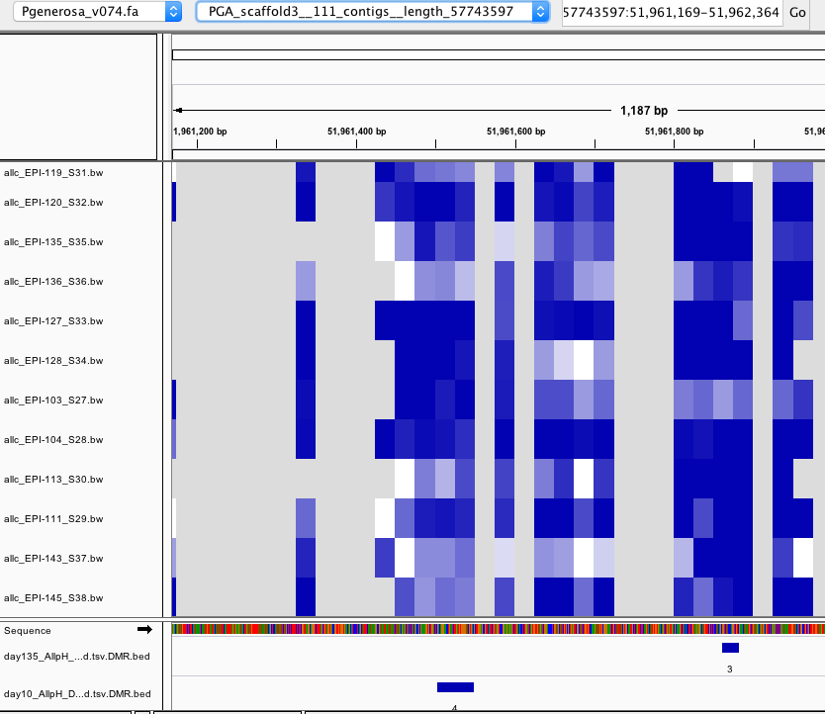
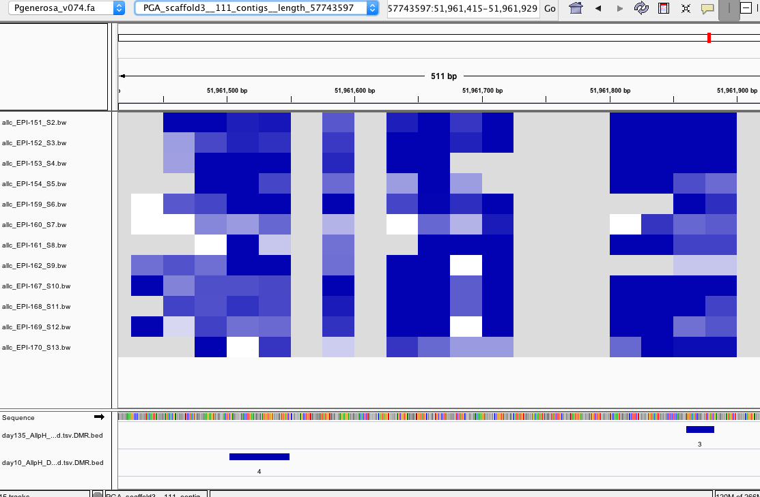
Non-overlapping DMRs that are close
Day 10
Day 135

Slide 7
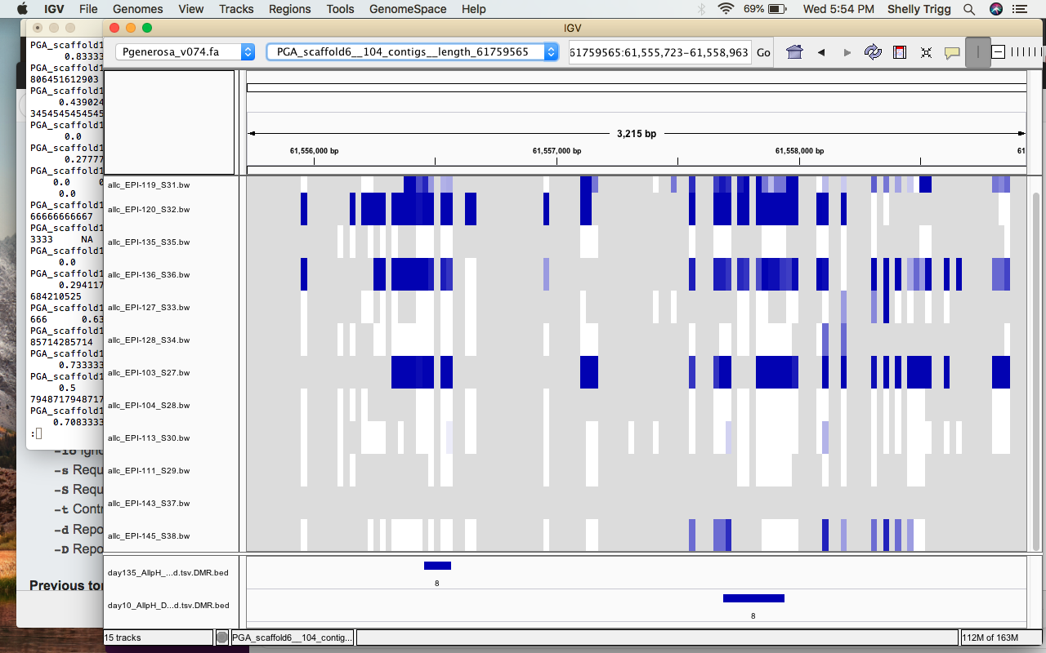
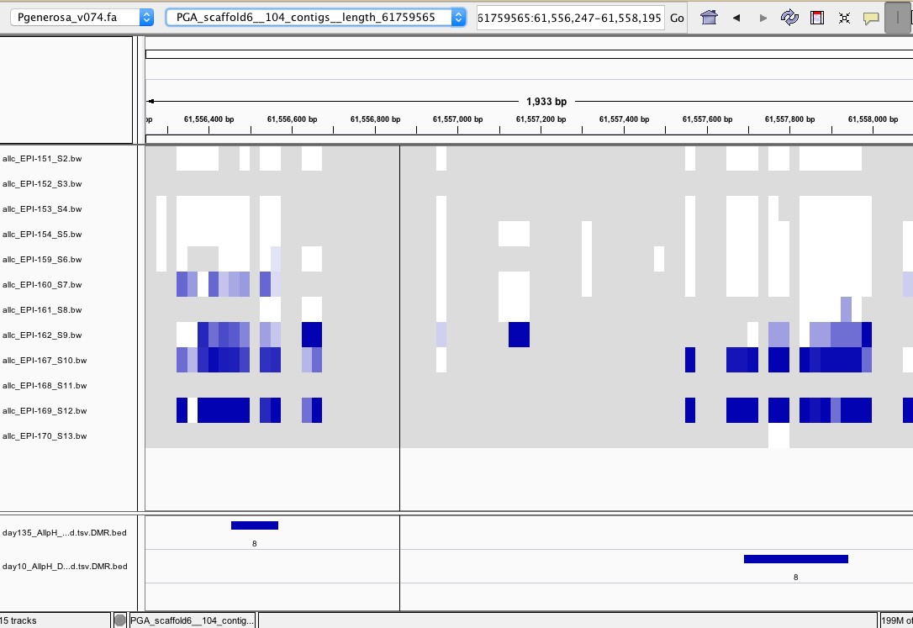
Non-overlapping DMRs that are close
Day 10
Day 135

