Slide 1
How does low pH influence DNA methylation
in juvenile geoduck?
Shelly Trigg, Ph.D.
Roberts Lab
FISH546 Fall 2018

Slide 2
Question:

Slide 3
Experiment
Juvenile geoduck were exposed to an array of OA conditions

Slide 4
DNA methylation analysis pipeline
RRBS
raw data
(.fastq)
Deduplicated
aligned data
(.bams)
Sorted deduplicated
aligned data
(.bams)
Bismark aligner (uses bowtie)
bash
Methylkit
(R)
Bedtools
Identify and visualize differential loci/regions
Assess genome coverage

Slide 5
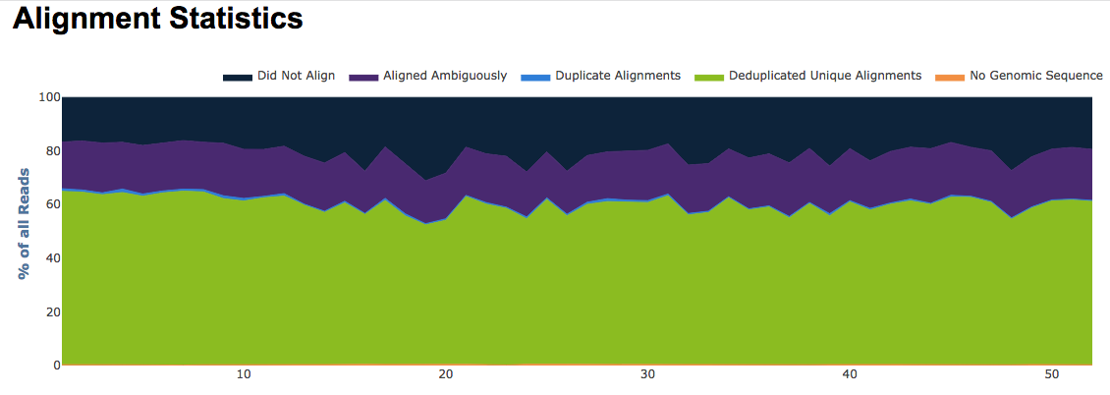
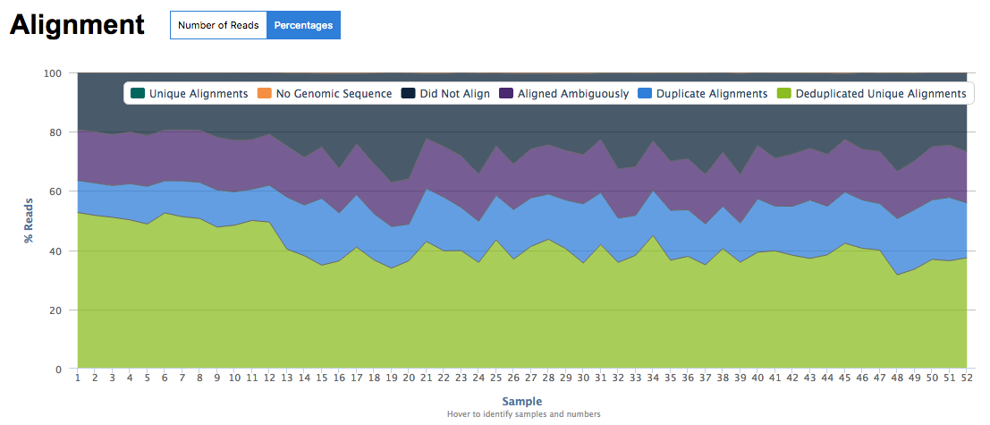
Bismark mapping
Subset of reads (10K/sample)
All reads (~20M reads/sample)
10-20% reads = clones

Slide 6
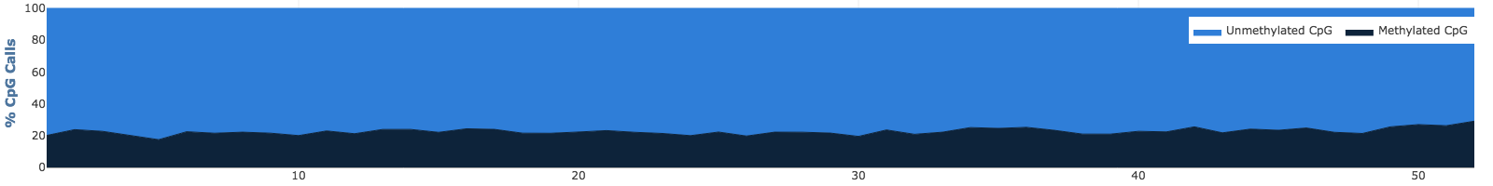
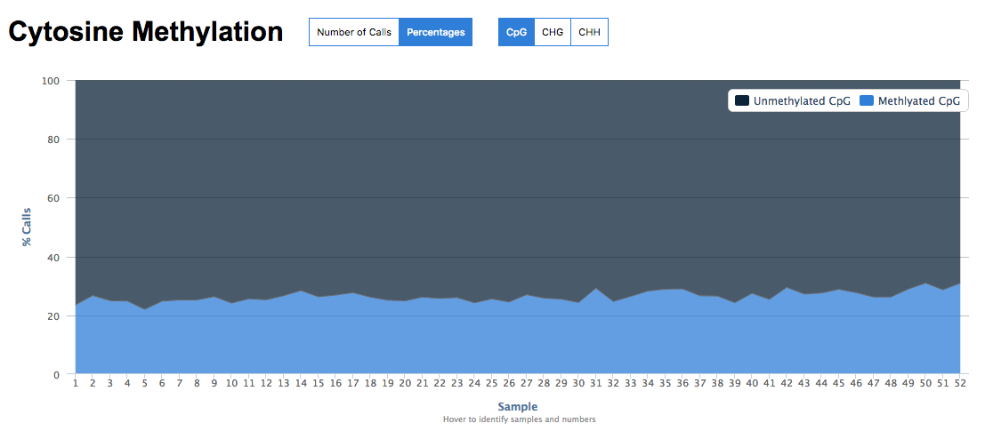
Bismark Methylation
~20% CpGs are methylated
Subset of reads (10K/sample)
All reads (~20M reads/sample)

Slide 7
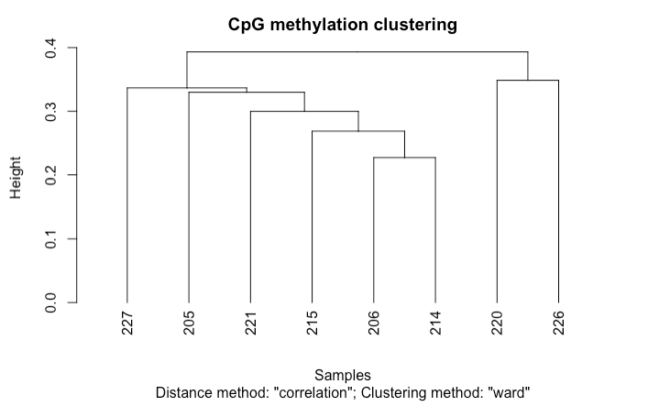
Super.low-low
Amb-low

Slide 8
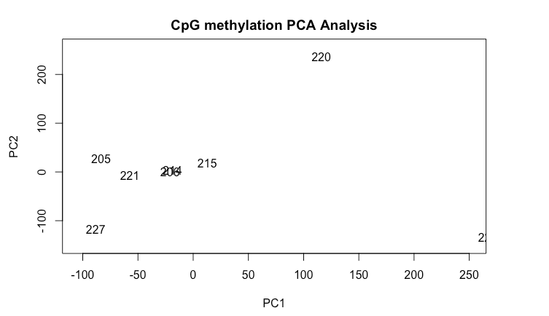
Super.low-low
Amb-low

Slide 9
Next Steps
Visualizing differential loci

