Slide 1
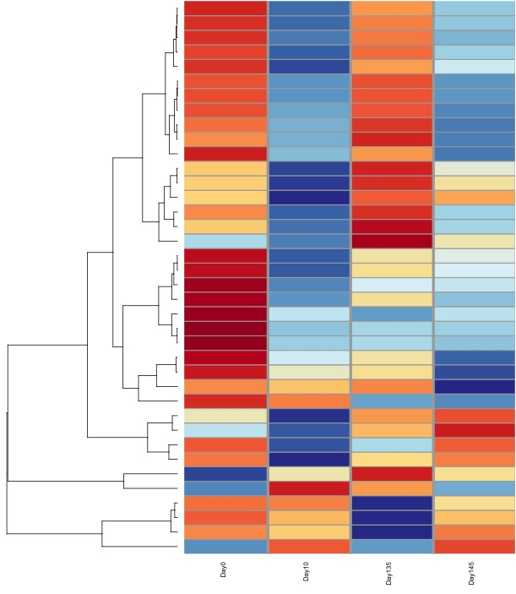
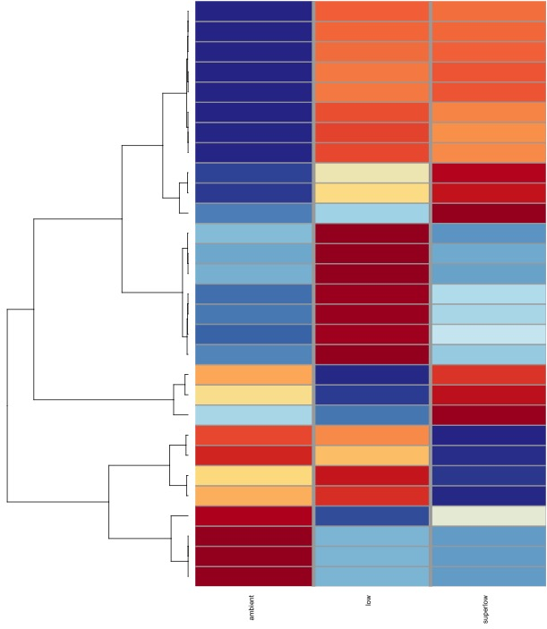
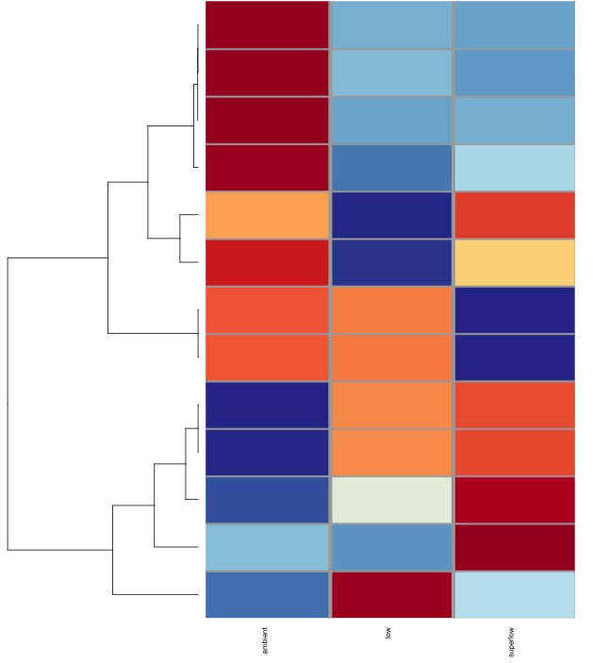
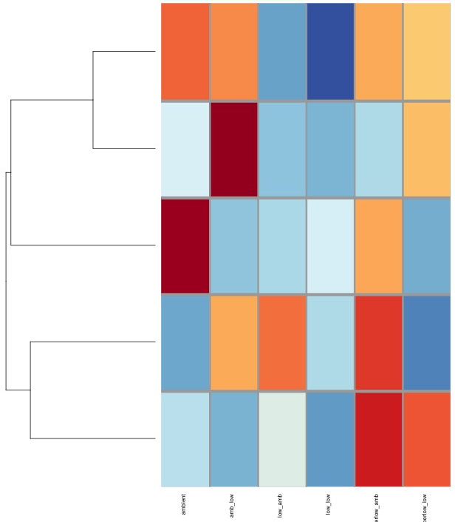
A
B
C
D
pH 8.0
pH 7.4
pH 7.0
pH 8.0 → pH 8.0
pH 7.0 → pH 7.4
pH 8.0 → pH 7.4
pH 7.4 → pH 8.0
pH 7.4 → pH 7.4
pH 7.0 → pH 8.0
Day 0
Day 10
Day 135
Day 145
pH 8.0
pH 7.4
pH 7.0

Slide 2
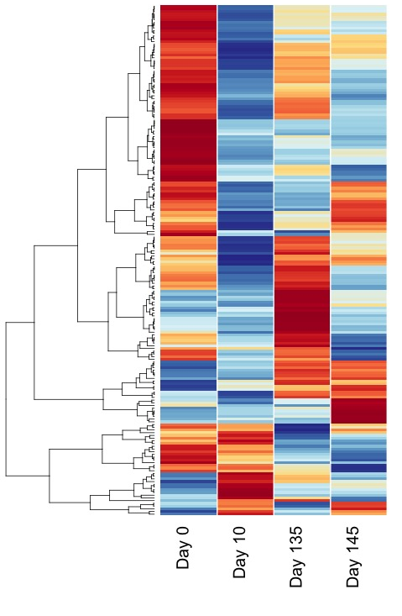
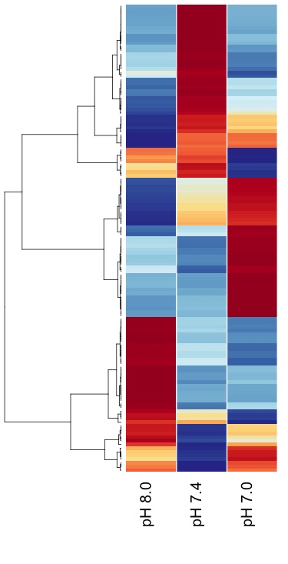
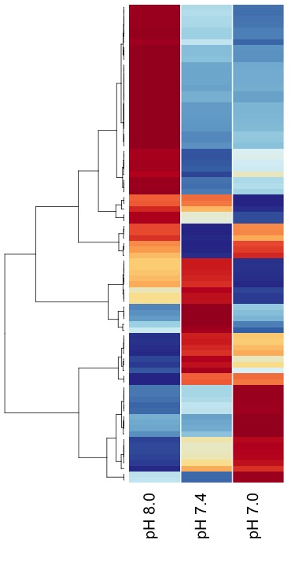
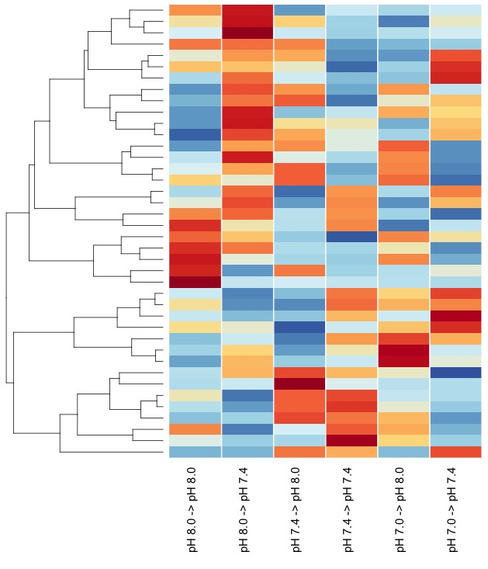
A
B
C
D

Slide 3
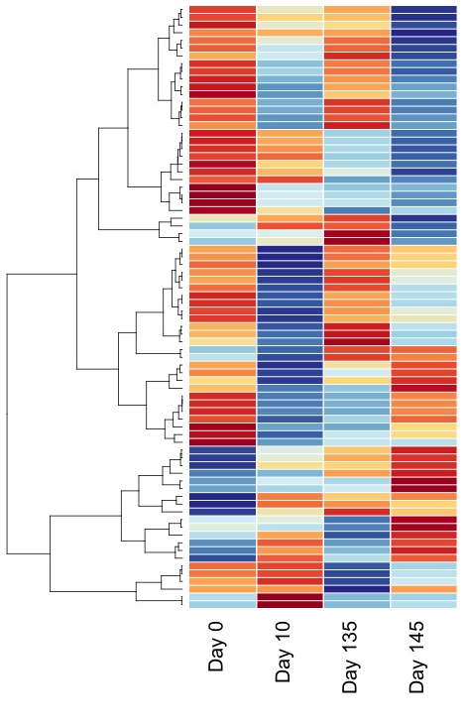
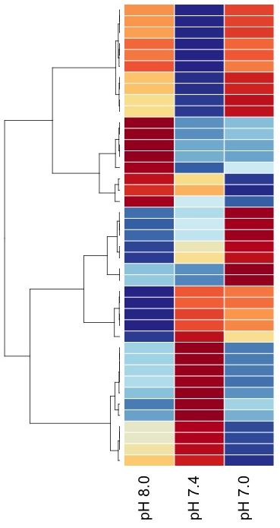
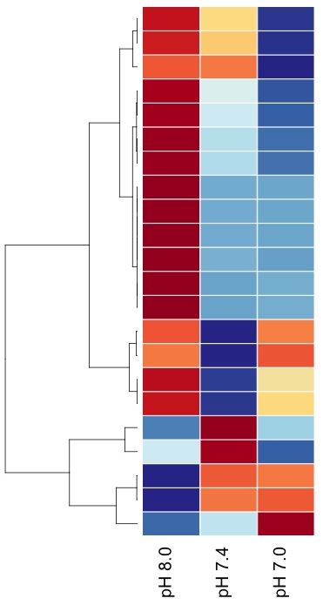
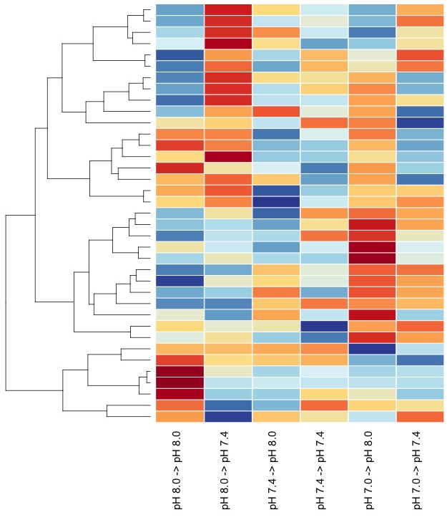
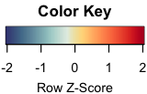
A
B
C
D

Slide 4
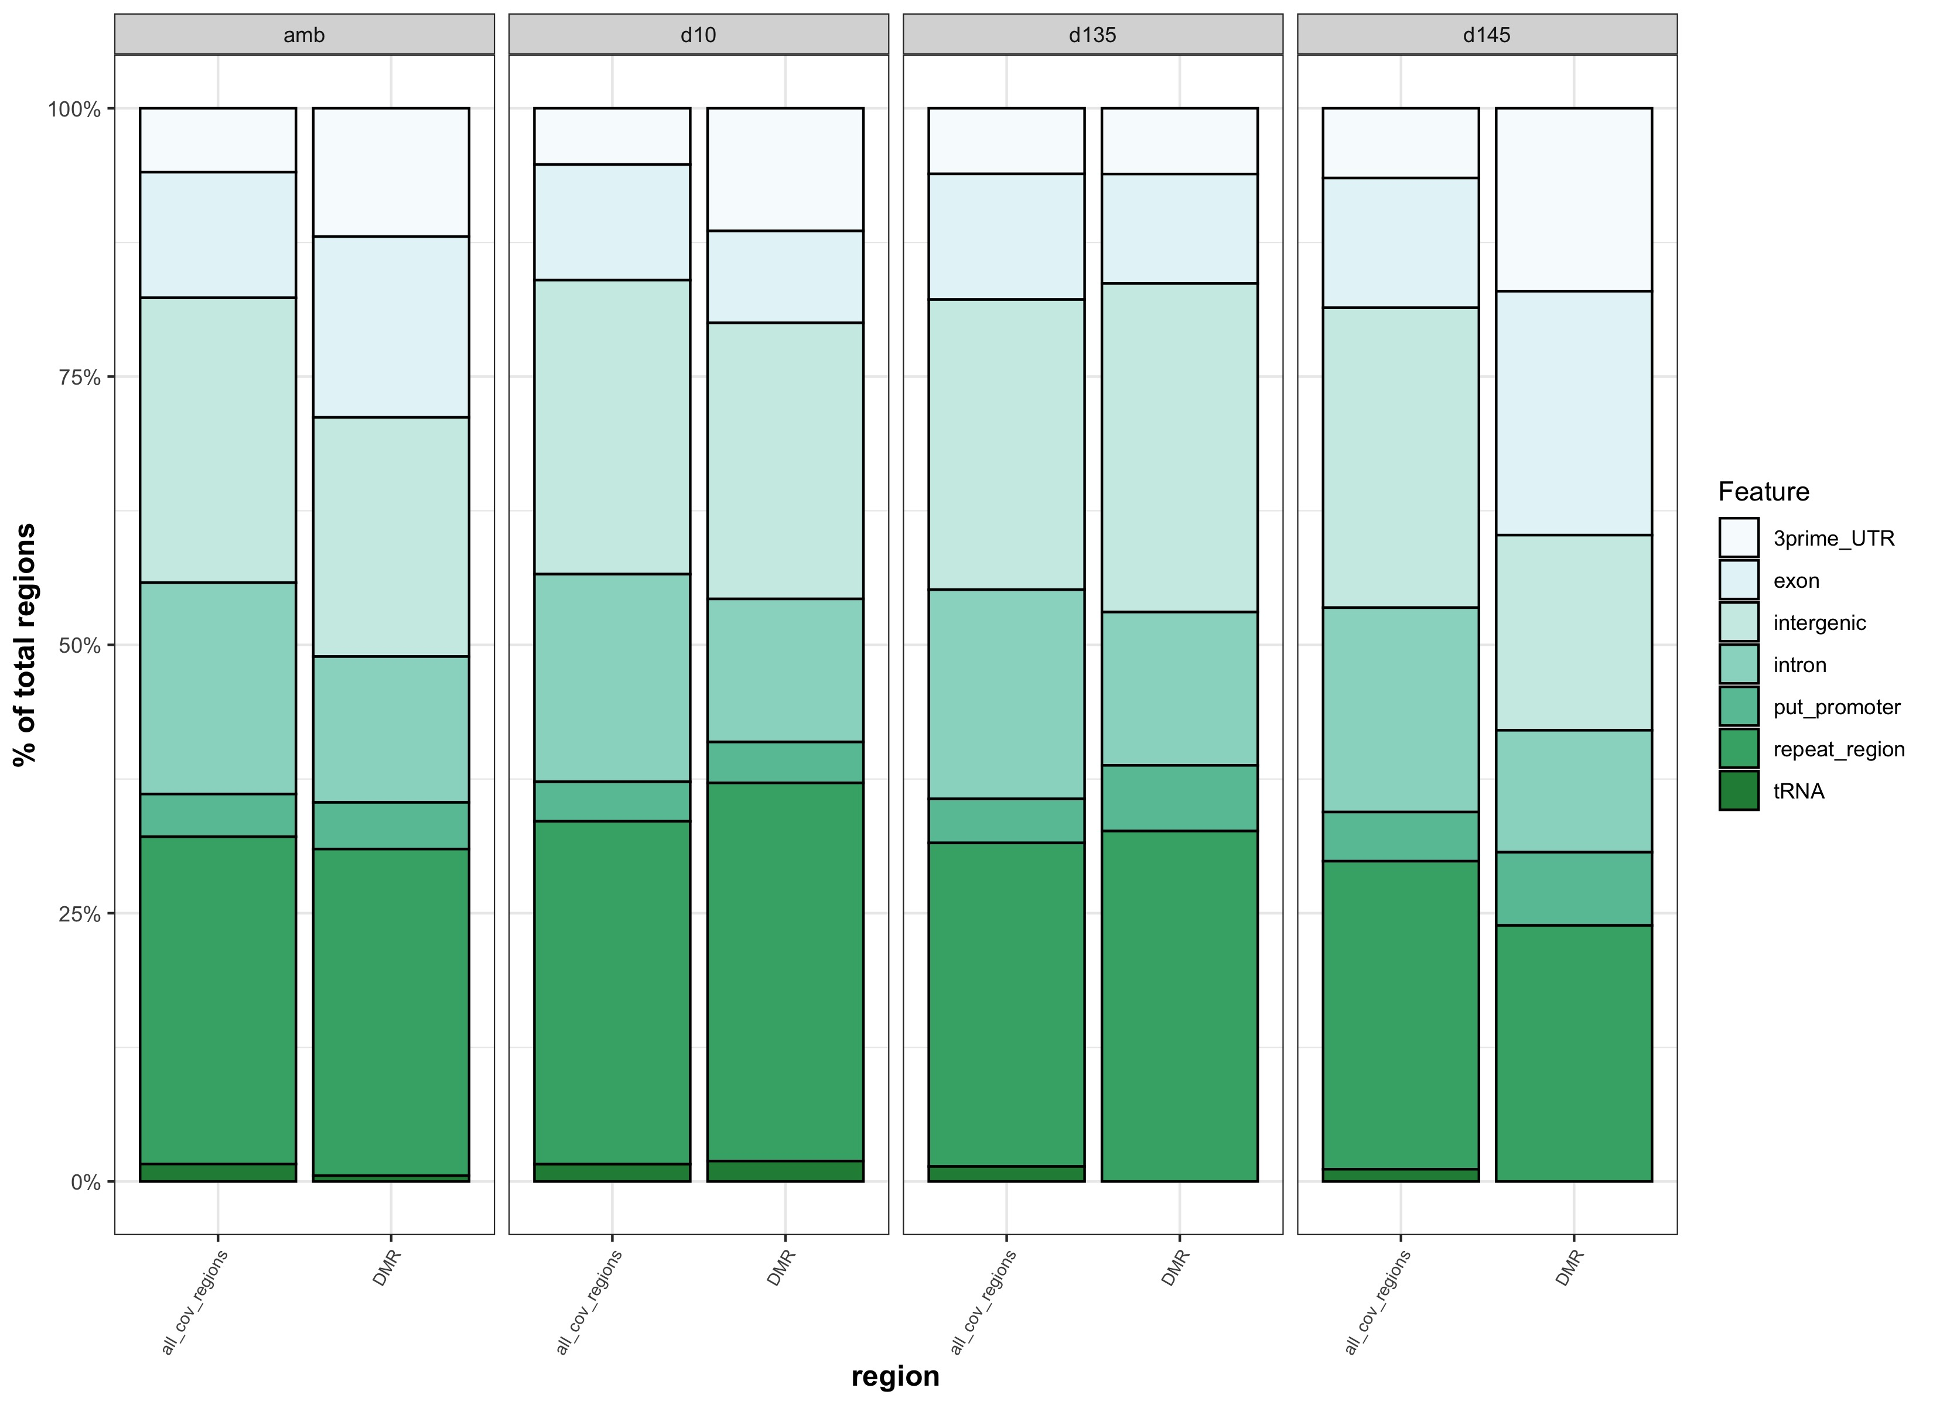
**
*
***
*
*
*
*
*** adj.p < 0.0005
** adj.p < 0.005
* adj.p < 0.05
* adj.p < 0.05

