Slide 1
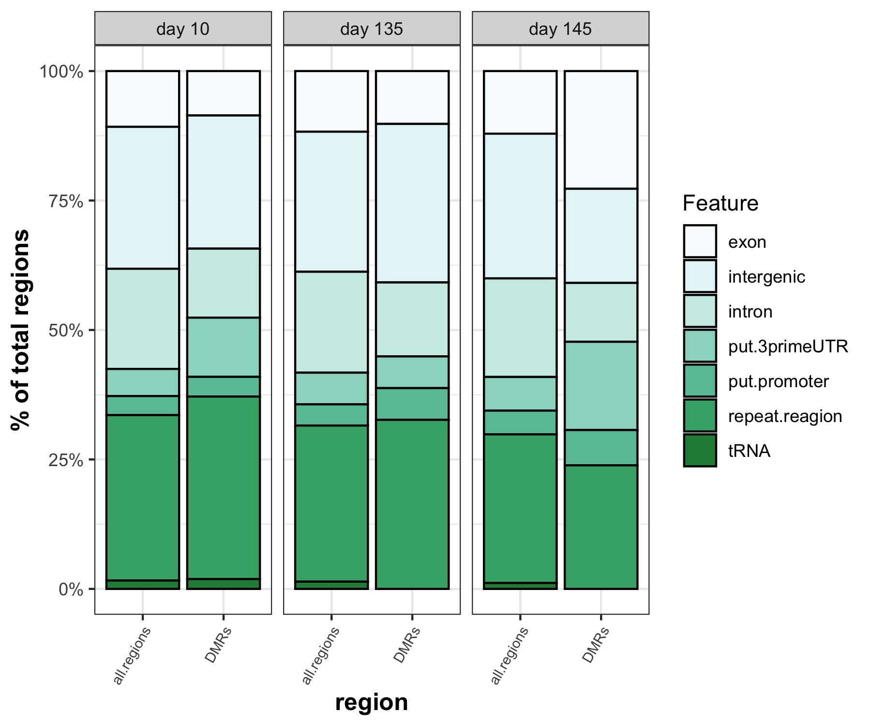
*
*
*
***
*** adj.p < 0.0005
** adj.p < 0.005
* adj.p < 0.05
* adj.p < 0.1

Slide 2
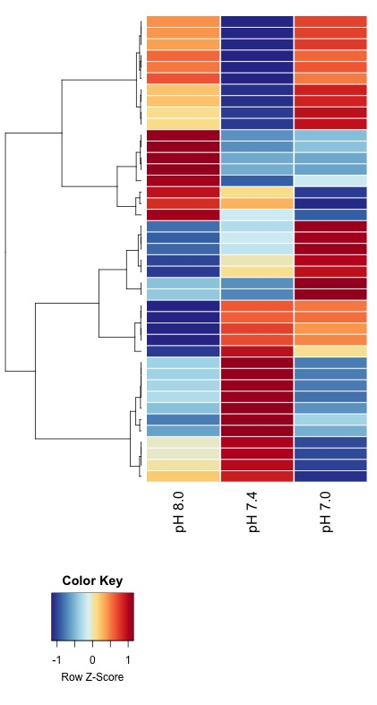
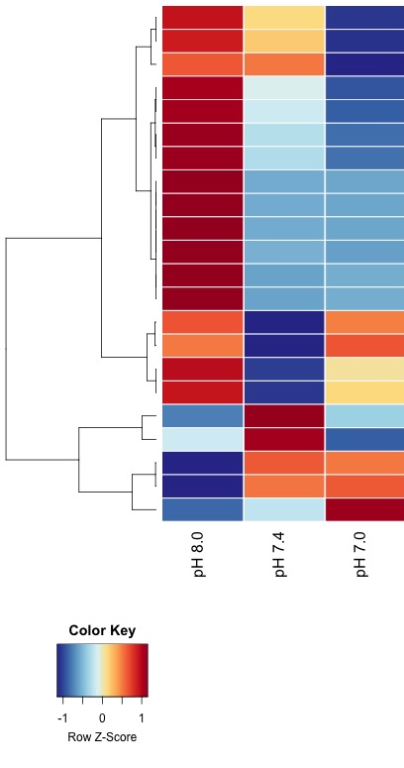
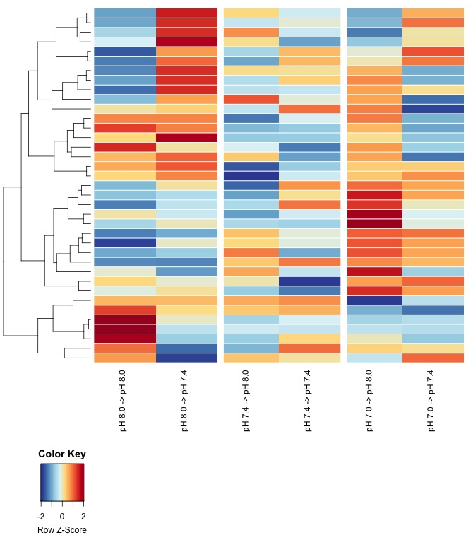
A
B
C

Slide 3
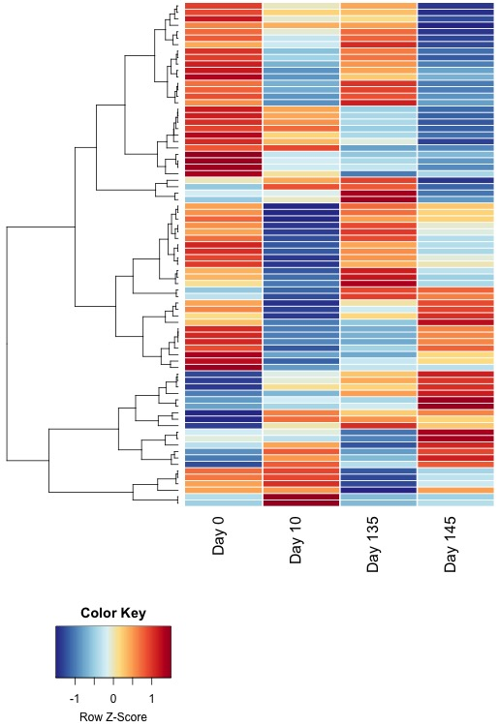
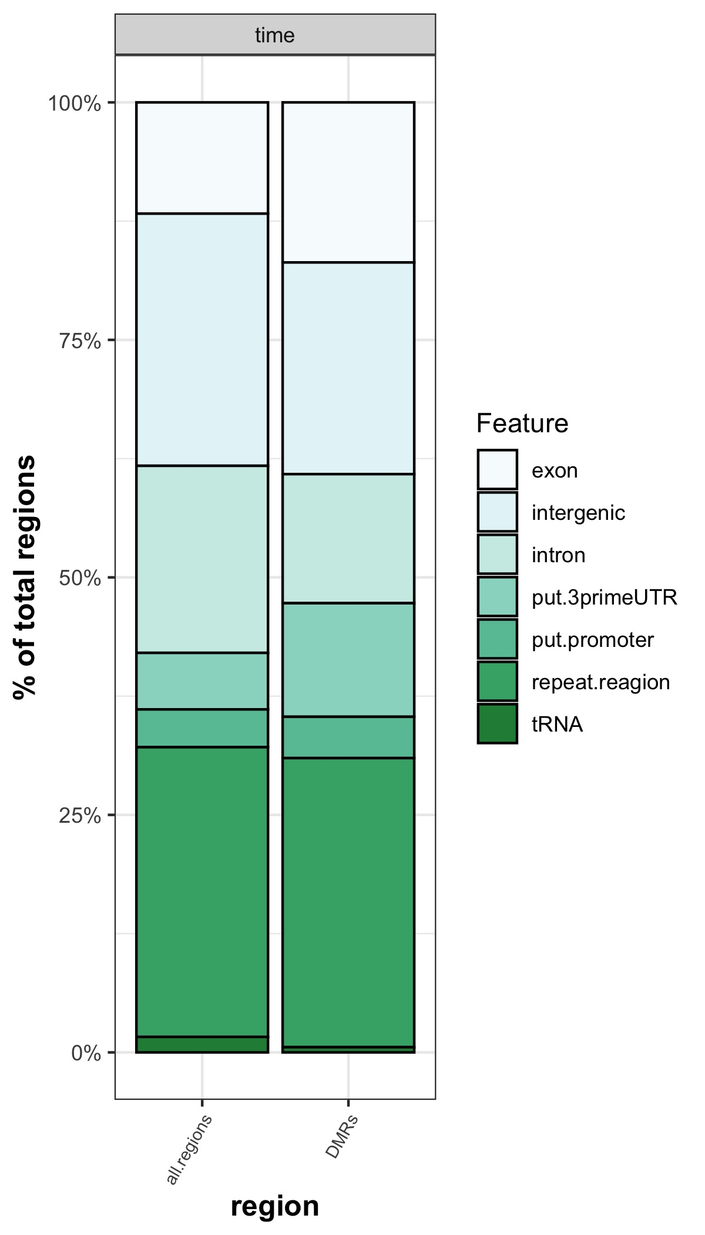
A
B
*
*
**
*** adj.p < 0.0005
** adj.p < 0.005
* adj.p < 0.05
* adj.p < 0.1

Slide 4
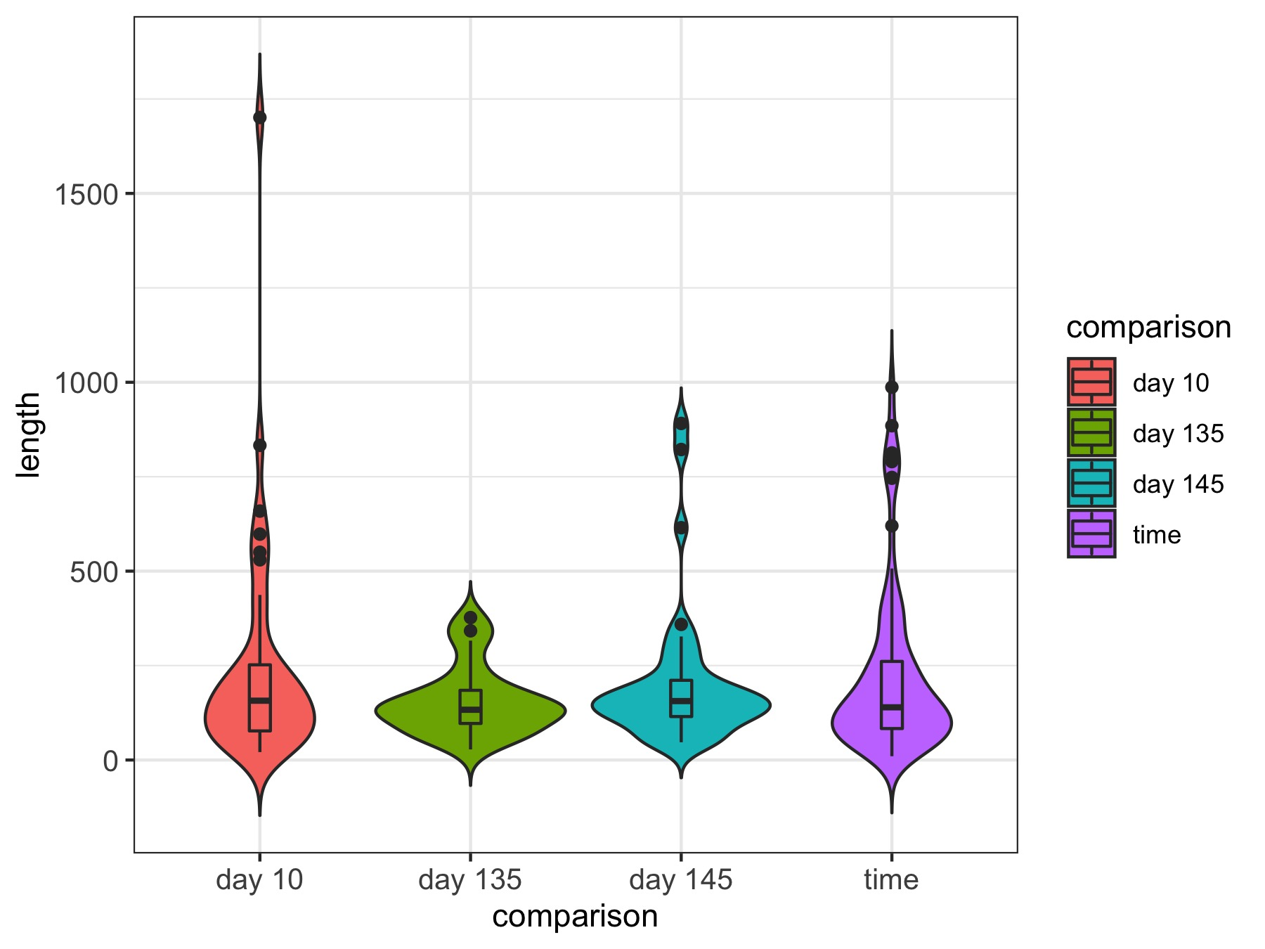
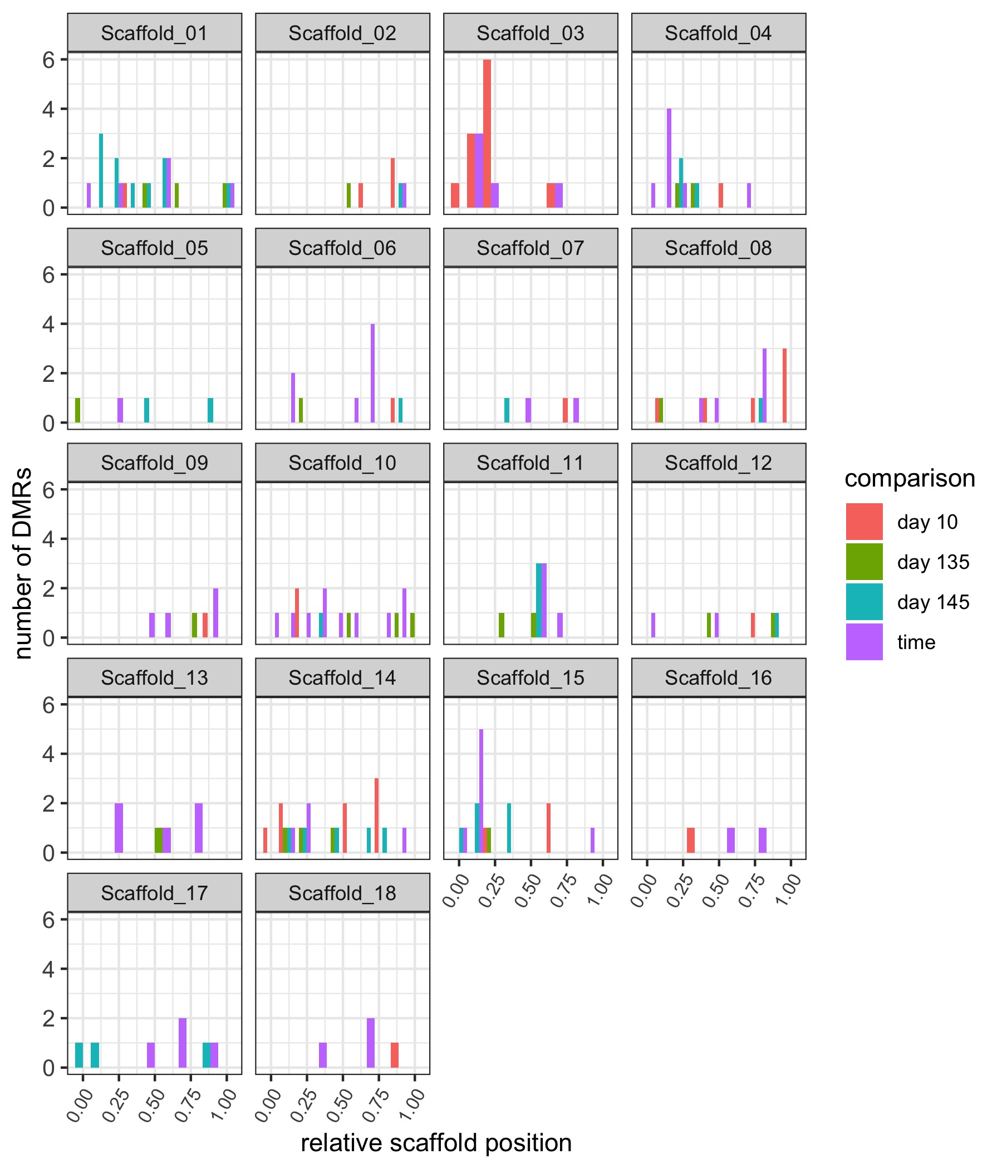
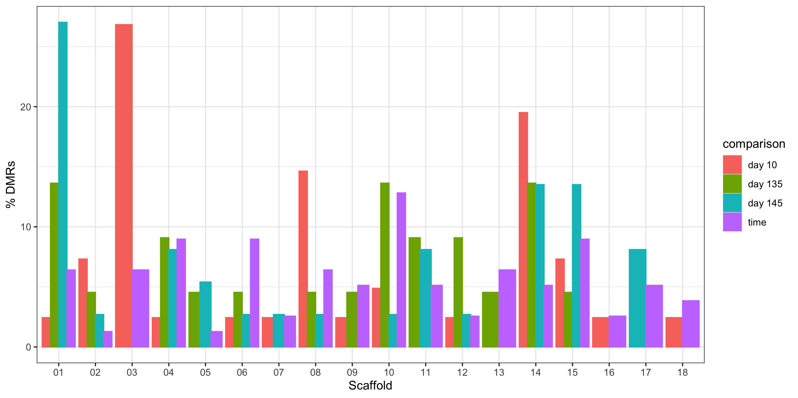
A
n = 41
n = 22
n = 37
n = 78
C
B

