Slide 1
FDP on Agentic AI: Foundations, Applications, and Future Directions
“Exploring the Power of Agentic AI with IBM Granite and LangFlow”

Slide 2


Name of the team: IT
Details of Team members
TEAM MEMBER NAME | Recent Passport Photo | Email ID | Phone number [WhatsApp]
Dr. Vijay S. Gulhane |  | vijaygulhane27@gmail.com | 9422126922
Yogesh R. Shelokar |  | Shelokar.yogesh@gmail.com | 8625955263

Slide 3
Problem Statement
Problem Statement No.2 - An AI agent designed to assist faculty with NBA accreditation processes (RAG Based)
The Challenge - An AI agent designed to assist faculty with NBA accreditation processes using RAG (Retrieval-Augmented Generation). It retrieves relevant NBA criteria, formats, and past documentation from internal and external sources. Faculty can query the agent for guidance on SAR preparation, CO-PO mapping, and documentation. The RAG model ensures up-to-date and context-aware responses, grounded in trusted data. It reduces manual effort, ensures consistency, and speeds up accreditation readiness. This intelligent assistant supports continuous improvement and compliance with NBA standards.

Slide 4
Research Work
Develop an AI agent using RAG for NBA accreditation support.
Retrieve updated NBA criteria, formats, and documents automatically.
Provide quick guidance for SAR preparation and CO–PO mapping.
Reduce manual work and human errors in documentation.
Improve accuracy, consistency, and readiness for accreditation.

Slide 5
Proposed Solution
Upload NBA accreditation documents into the system.
User asks a question related to NBA / SAR / CO-PO mapping.
The AI retrieves the relevant part of the uploaded document.
The model generates an accurate answer from that retrieved content.
Response is displayed to the faculty for quick guidance.
Fig: Proposed Solution

Slide 6
Langflow Component Used
Chat Input : Collects faculty questions as input text.
File Loader (File Component) : Uploads NBA documents like SAR, manuals, CO-PO formats.
Prompt Template : Structures the question and document content into a proper query format.
Language Model (LLM Component) : Uses the selected model (e.g., Gemini 2.5 flash) to generate the final response.
Chat Output : Displays the resulting answer/guidance to the faculty.

Slide 7
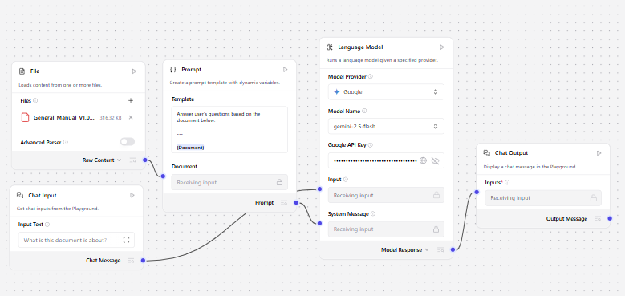
Workflow

Slide 8
Role of Agentic AI in assist faculty with NBA Accreditation Processes
Automated Information Retrieval
Agentic AI quickly finds relevant NBA criteria, SAR templates, and compliance guidelines — saving time and reducing confusion.
Guided CO–PO Mapping
It gives suggestions for correct Course Outcome to Program Outcome mapping based on course structure and NBA rules.
Document Preparation Support
Helps faculty auto-fill report sections like SAR, course files, attainment sheets, and evidence documentation with accuracy.
Continuous Monitoring & Progress Tracking
Tracks which documents are completed, which are pending, and sends reminders to faculty for timely updates.

Slide 9
Role of Agentic AI in assist faculty with NBA Accreditation Processes
Consistency & Standardization
Ensures all departments follow the same structure and formatting, improving accreditation success chances.
Decision-Making Assistance
Provides intelligent recommendations for improving course outcomes, feedback systems, and teaching–learning practices.
Knowledge Sharing & Collaboration
Acts as an intelligent assistant that can answer faculty queries anytime — reducing dependency on NBA experts.

Slide 10
Technology Used
Agentic AI + RAG Architecture : Retrieval-Augmented Generation to provide accurate and document-grounded answers.
LangFlow : Visual workflow builder used to design the RAG pipeline and integrate all components (Chat Input, File Loader, LLM, Output, etc.).
Large Language Model (LLM): Google Gemini Used to understand queries and generate accurate NBA-based guidance.
Document Loaders & Text Processing: Used to upload and read NBA files (PDF, Word, Manuals). Splits text into chunks for efficient retrieval.
Embeddings & Vector Database : Converts document text into searchable vectors. Helps retrieve relevant chunks when questions are asked.
Prompt Engineering : Custom prompts ensure responses align with NBA criteria and SAR documentation rules.
User Interface (Chat Interface): Simple chat screen for faculty to type questions and get guidance instantly.

Slide 11
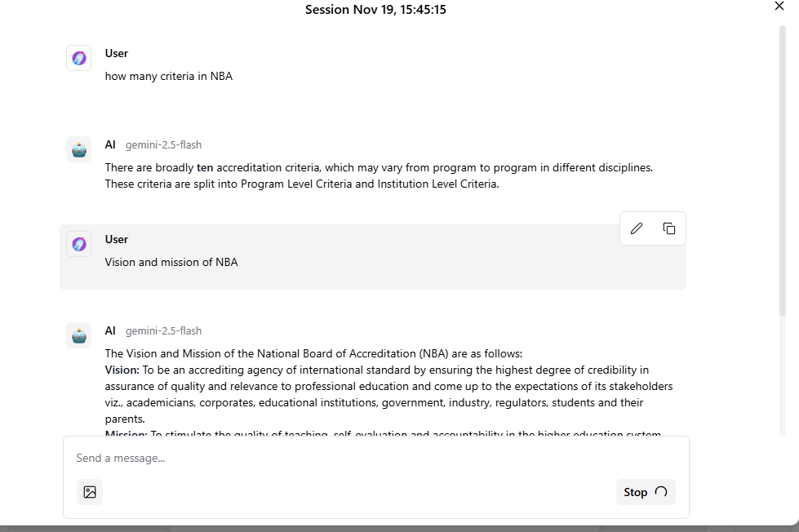
Output Screen Shots
·
·
·

Slide 12
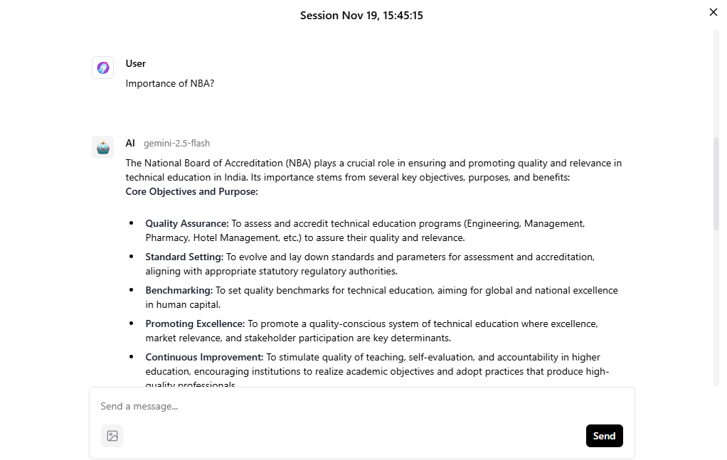
Output Screen shots
·
·
·

Slide 13
Future Scope
Integrate automated CO-PO attainment calculation and analytics dashboard.
Add multi-language support for easier use by faculty across India.
Enable real-time updates of latest NBA guidelines from official sources.
Provide role-based collaboration for HoDs, coordinators, and faculty.
Incorporate document auto-generation for SAR, course files, and compliance reports.
Implement mobile app access for on-the-go query assistance.
Use advanced Agentic capabilities for task automation like workflow reminders and progress tracking.
Support integration with ERP/LMS systems for automatic data import.
·
·

Slide 14
References
NBA Official Website – National Board of Accreditation. Guidelines, Manuals & SAR Formats. Retrieved from: https://www.nbaind.org
·
·
·

Slide 15


