Slide 1
H1B Visa Application Analysis
Sheldon Rodrigues
Andres Salcedo

Slide 2
Agenda
Overview of the dataset
Basic insights
Policy analysis

Slide 3
Overview of the dataset and limitations
H1B visa applications and case status from 2014 to 2017. Data obtained from: https://www.foreignlaborcert.doleta.gov/performancedata.cfm
Certification is different than getting an H1B Visa: Although the analysis will be more interesting, the randomness in the allocation makes relationships spurious.
Data merged in Tableau with complementary information:
Native-born unemployment for 2015 and 2016 by U.S. region.
Minimum and maximum tax rates for different states.
Fortune 500 company locations
Limitations:
Some interesting fields like age are not present.
Time scope.
Standardization of job titles.

Slide 4
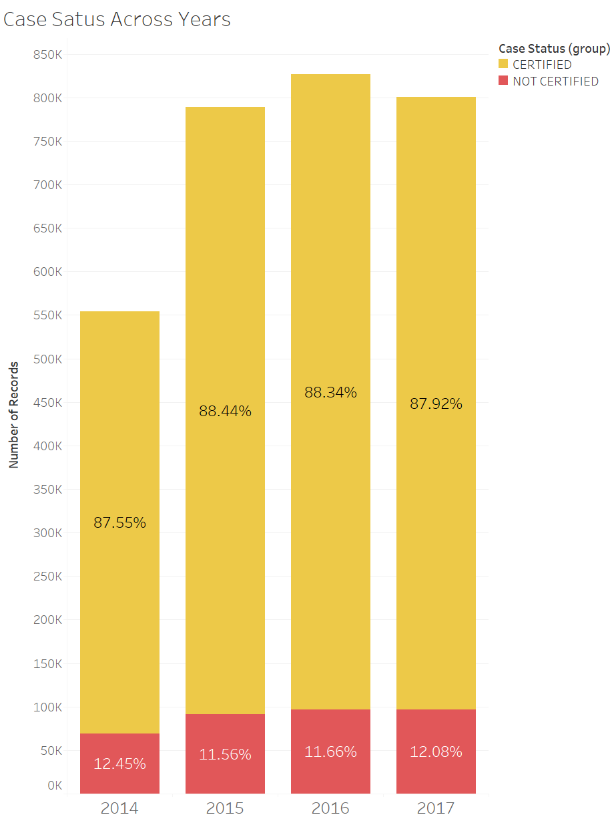
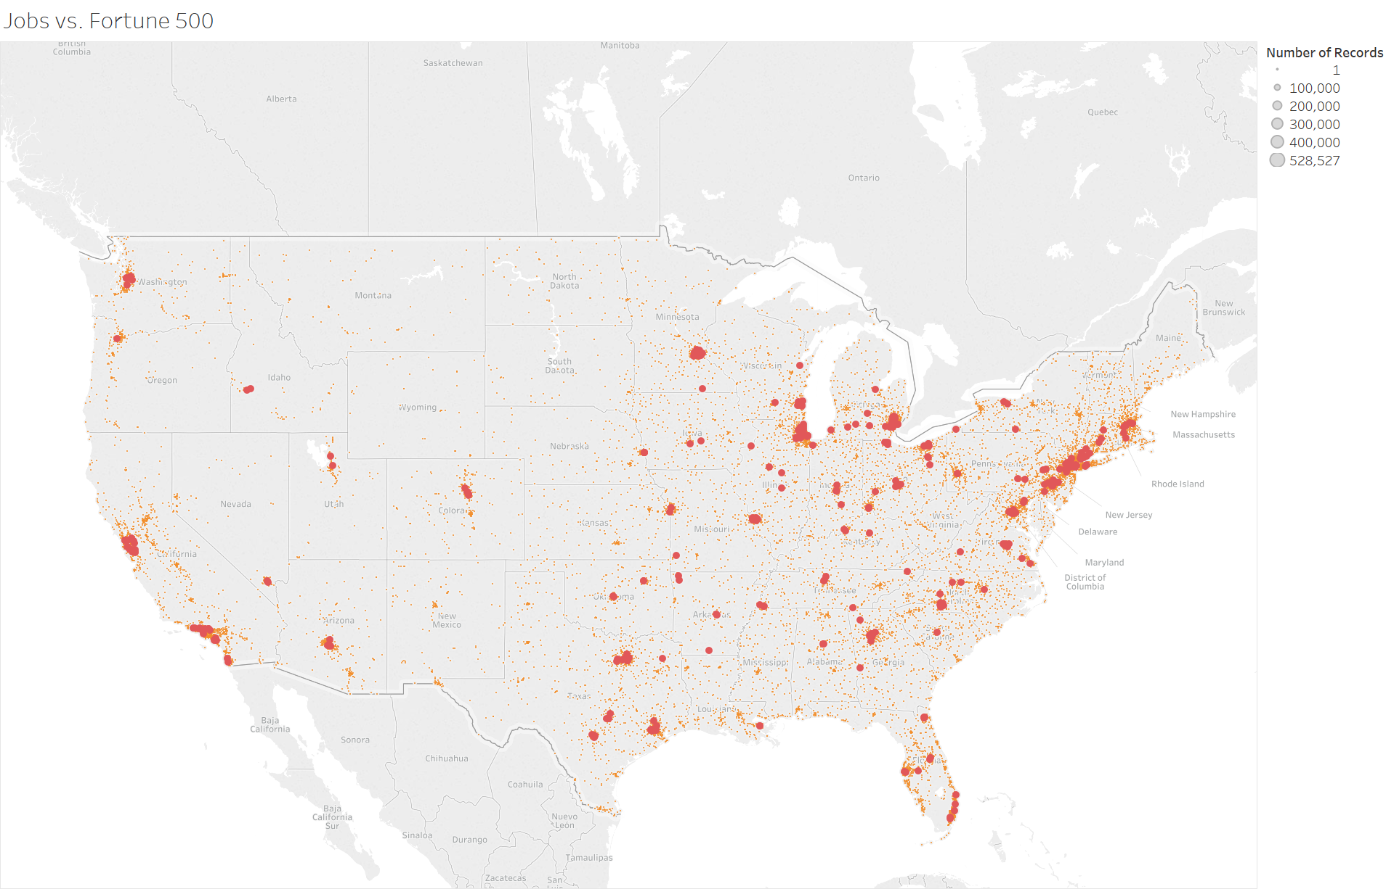
How many and where are people applying for H1Bs?

Slide 5
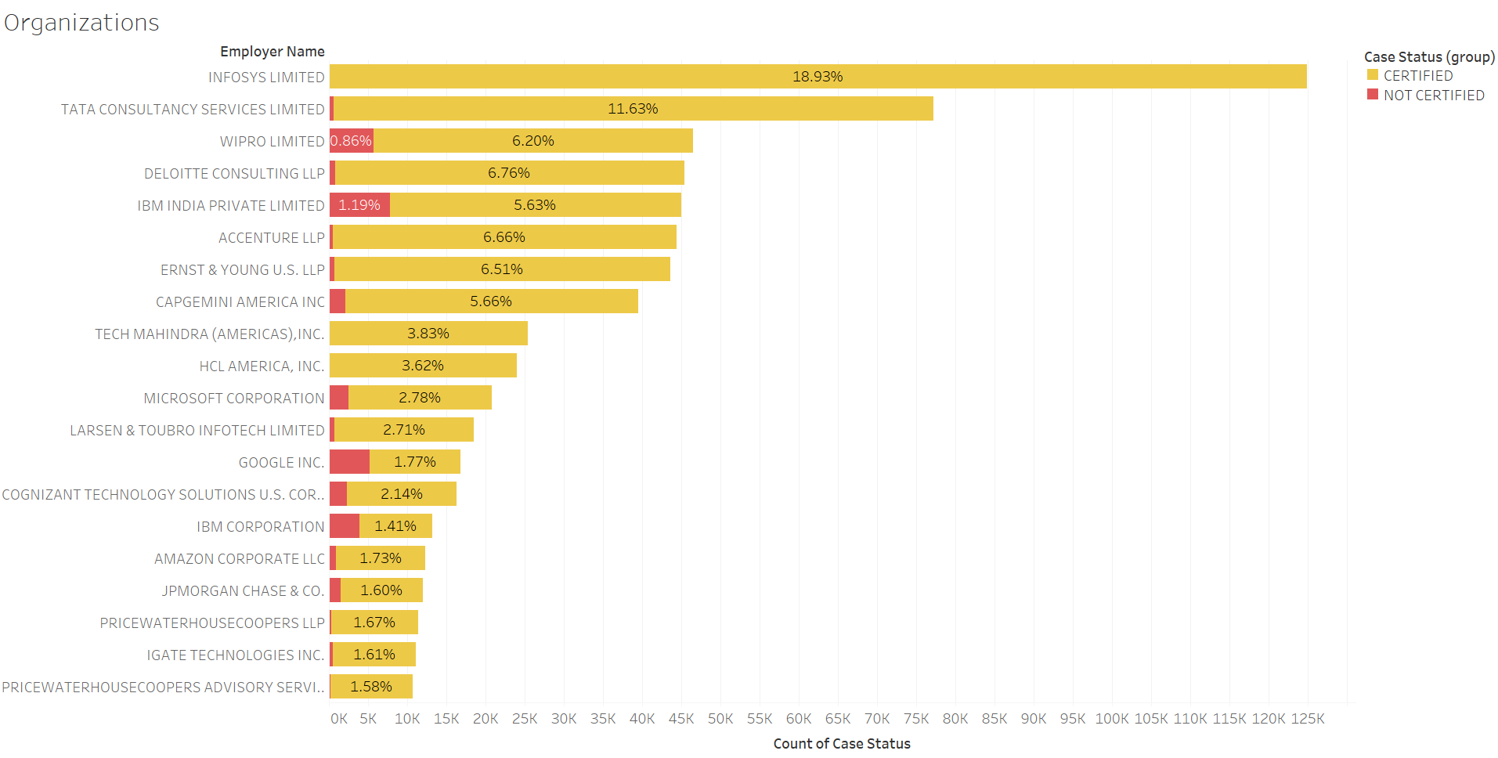
Which are the top sponsors?

Slide 6
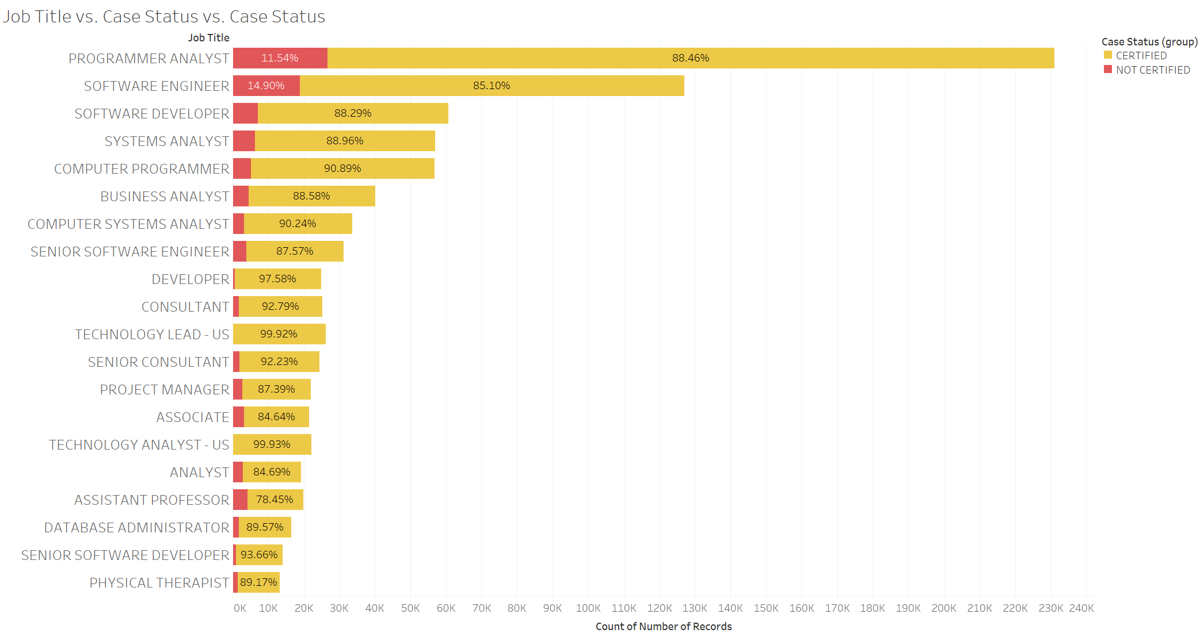
Job titles vs. status

Slide 7
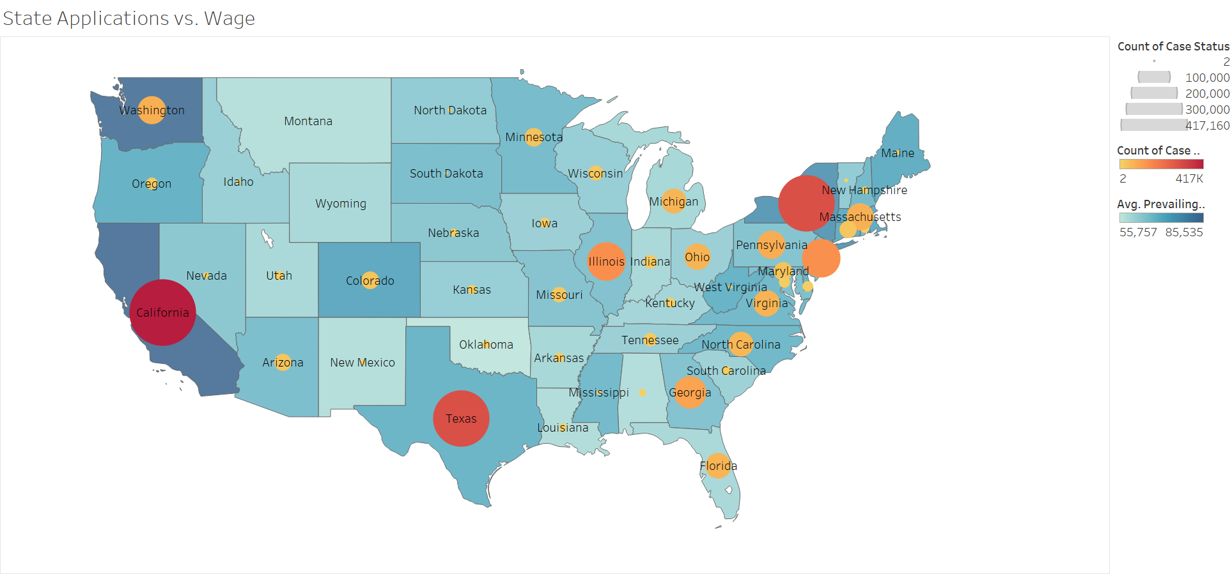
Show me the money

Slide 8
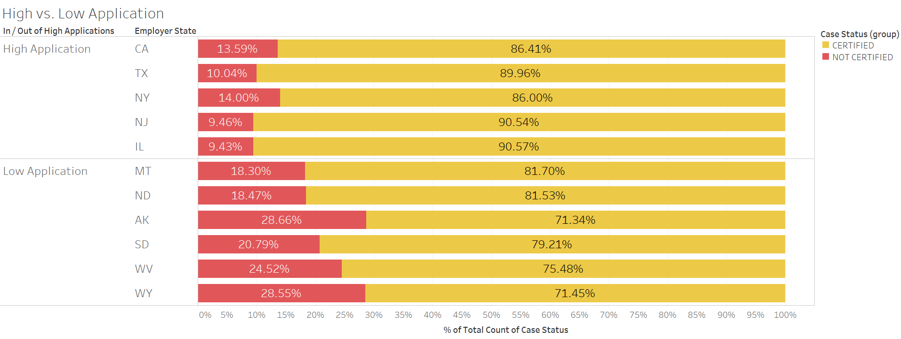
How about applying to states with least demand?

Slide 9
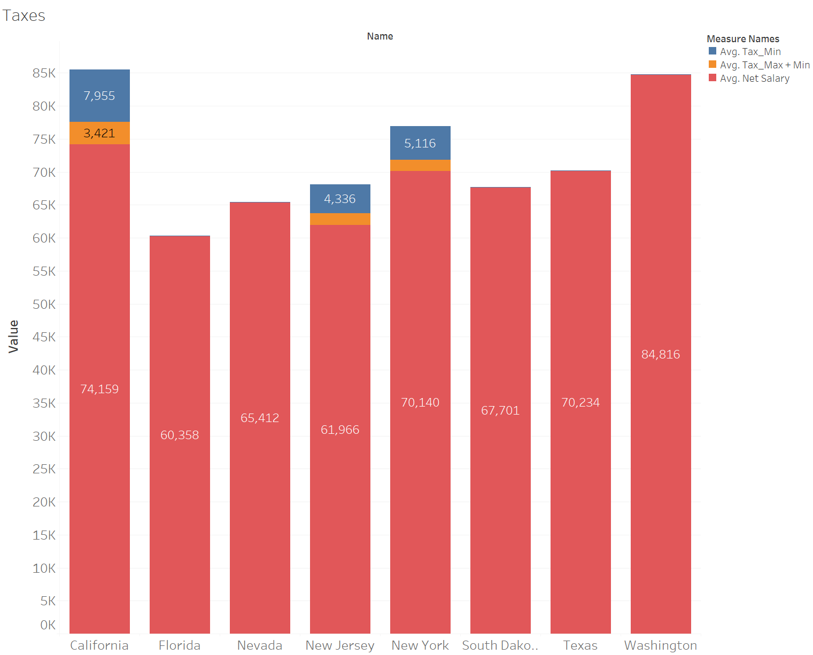
California is the highest paying state, but…

Slide 10
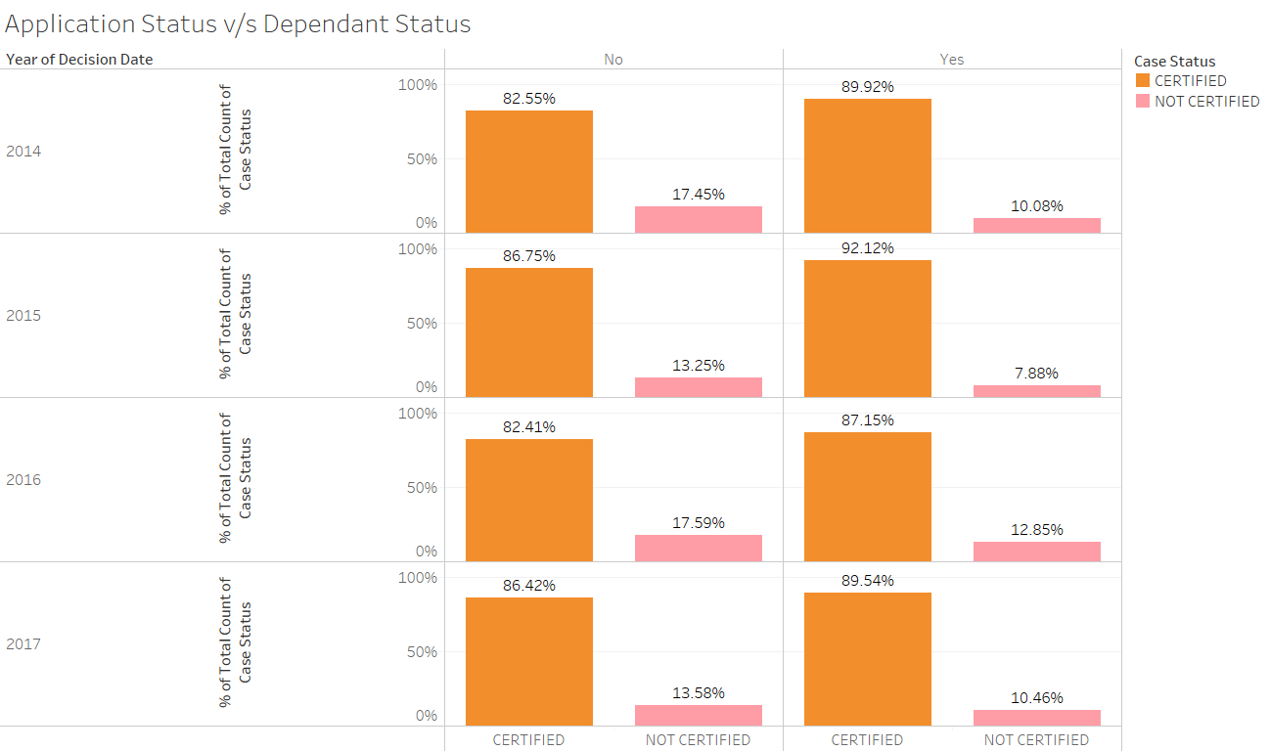
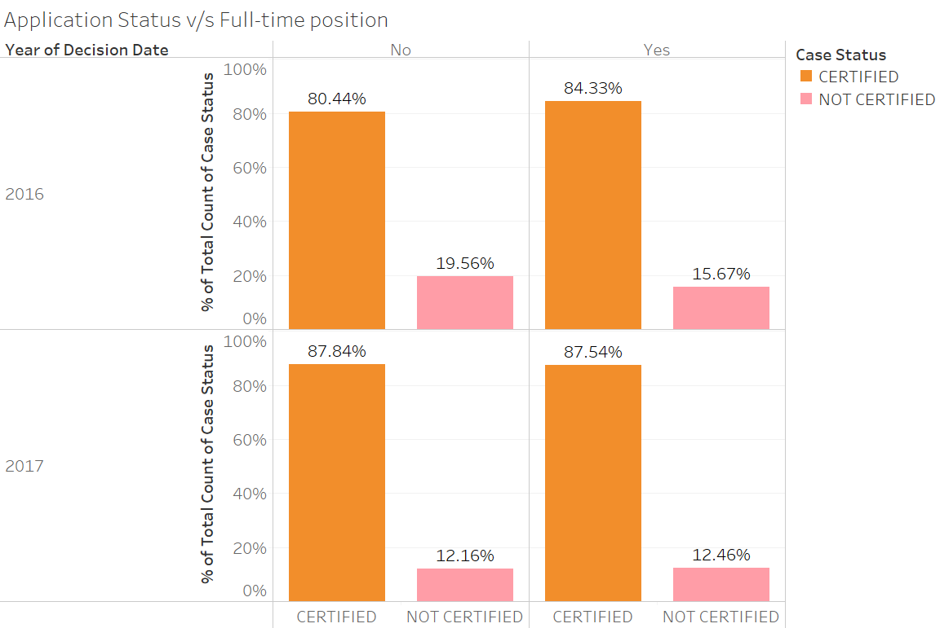
Factors application status depends on?

Slide 11

Policy Analysis

Slide 12
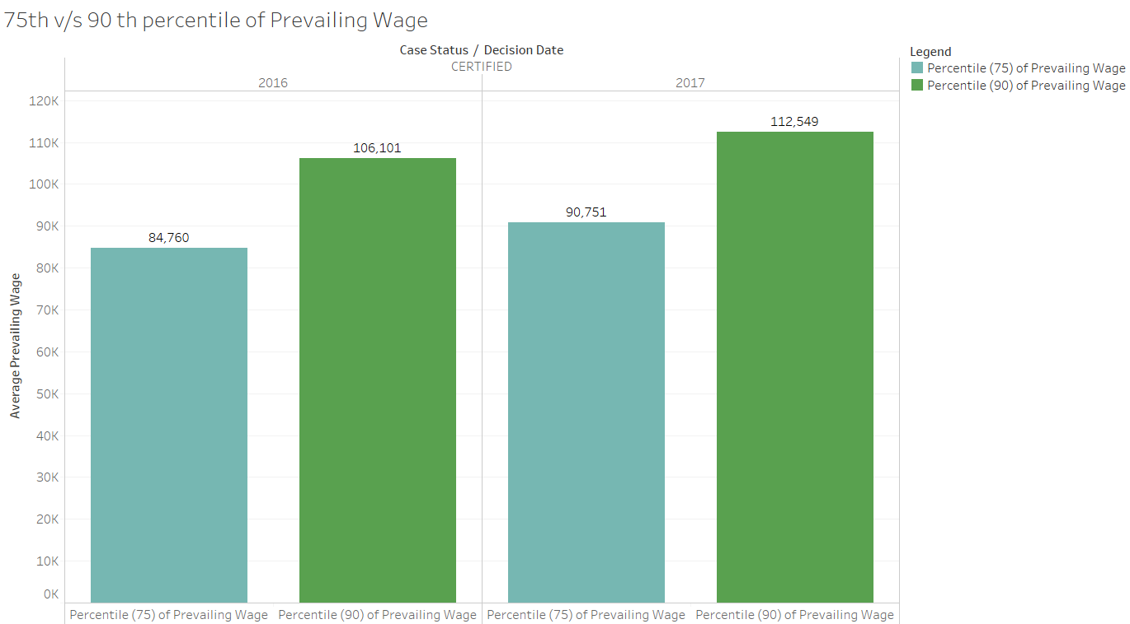
Floor on H1B salary
Notes:
90.000

Slide 13
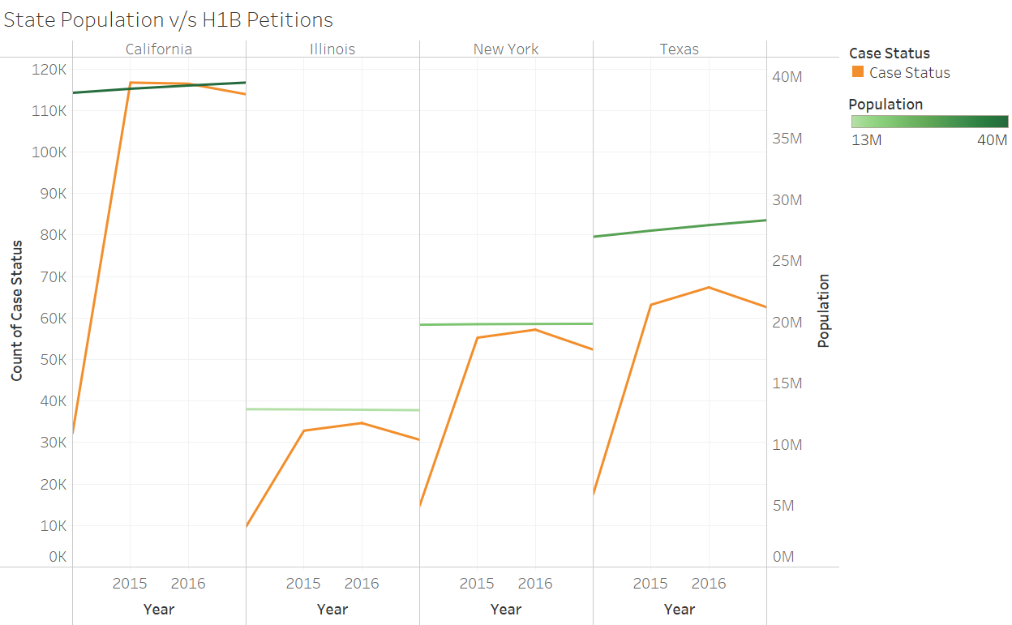
State population vs. immigration
Notes:
90.000

Slide 14
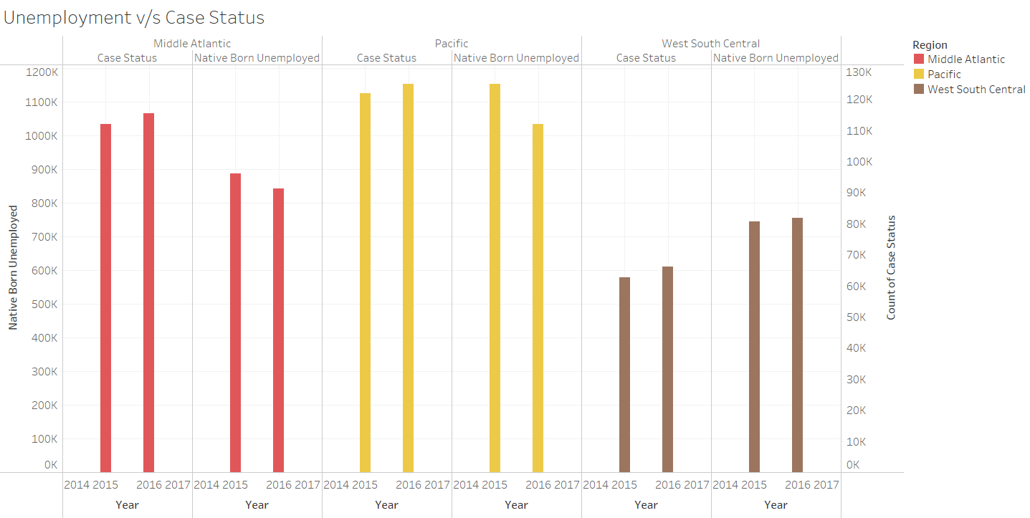
Immigrants taking jobs of Americans?
Notes:
90.000

Slide 15
Remaining questions
What happens with the fraction of applicants that were certified but did not file an H1B petition for lottery (about 70%)?
How does age relates with the change of getting a certified petition?
What are the impacts of a possible merit-based system (e.g., Canada or Australia)?
Further analysis using a standardized job category.

