Slide 1
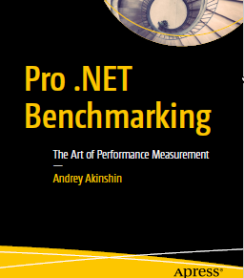
Pro .NET Benchmarking

Slide 2

Author

Slide 3
Links
Book
https://www.apress.com/gp/book/9781484249406
Source Code
https://github.com/Apress/pro-.net-benchmarking
BenchmarkDotNet
https://github.com/dotnet/BenchmarkDotNet
Rstudio
https://www.rstudio.com/
R
https://cran.r-project.org/bin/windows/base/

Slide 4
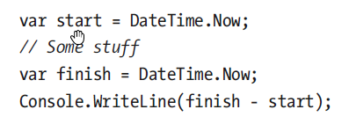
First Benchmark

Slide 5
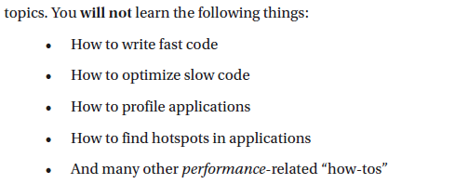
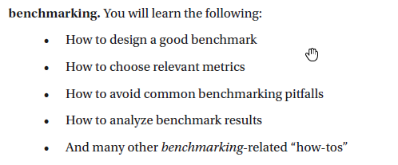
About Expectations

Slide 6
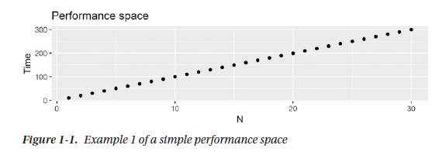

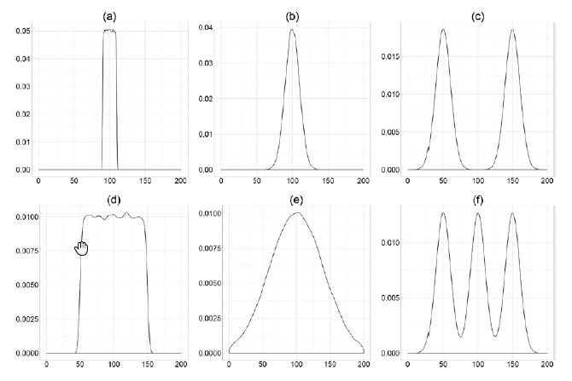
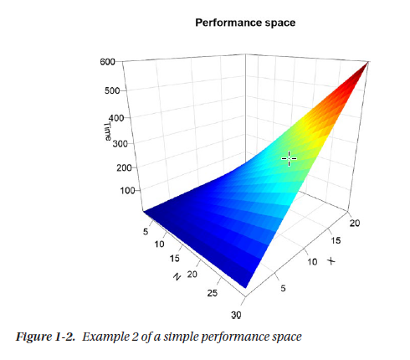
Perfomance Space

Slide 7
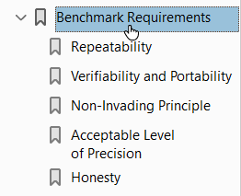
Benchmark requirements

Slide 8
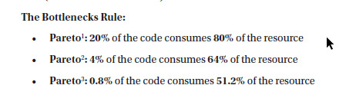
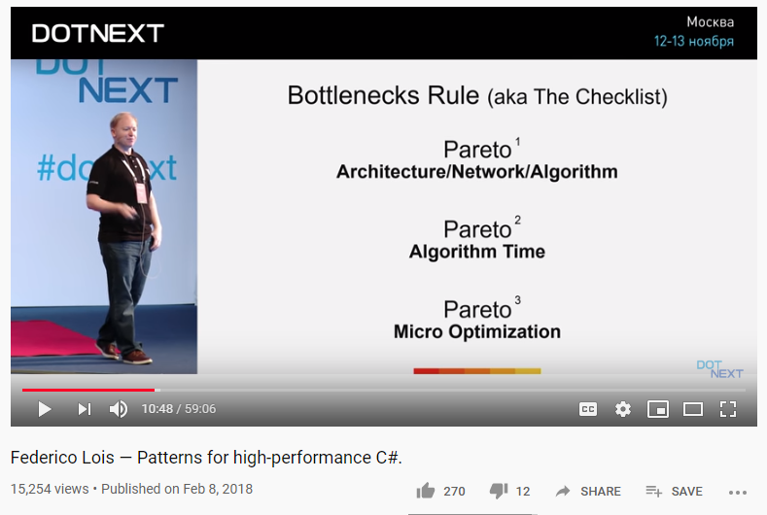
Find Your Bottleneck
https://www.youtube.com/watch?v=7GTpwgsmHgU

Slide 9
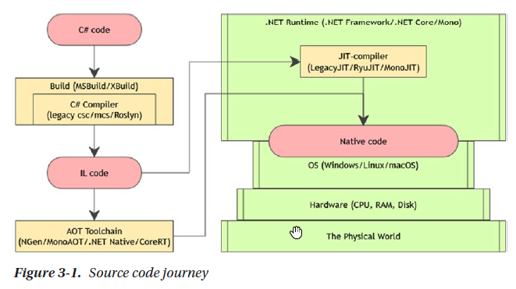
How Environment Affects Performance - Source code journey

Slide 10
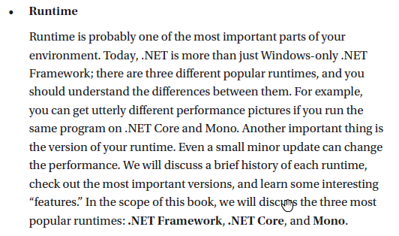
How Environment Affects Performance - Runtime

Slide 11
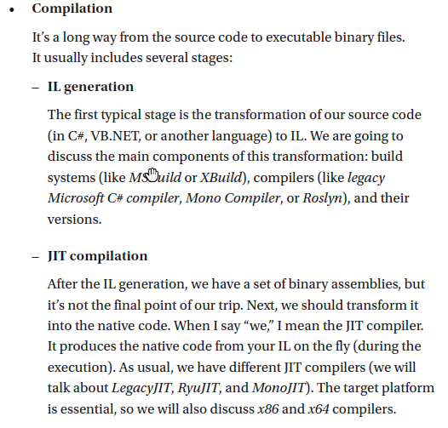
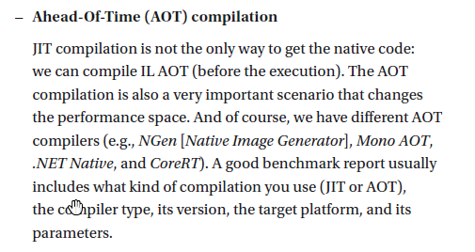
How Environment Affects Performance - Compilation

Slide 12
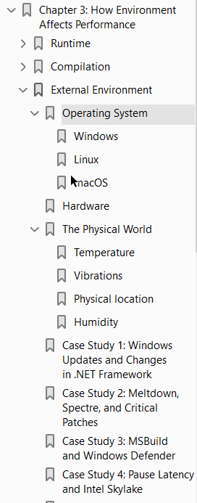
How Environment Affects Performance - External Environment

Slide 13
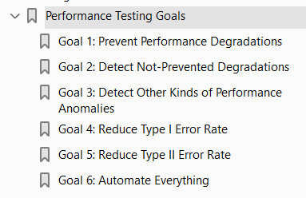
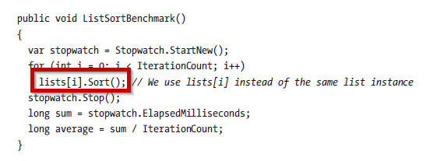
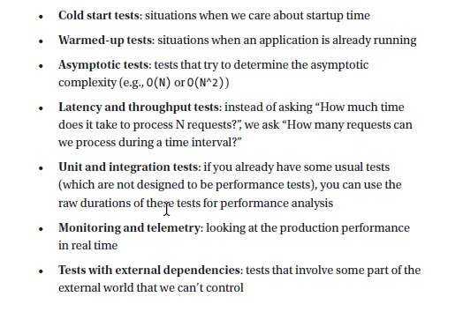

Performance Analysis and Performance Testing
Kinds of Benchmarks and Performance Tests

Slide 14
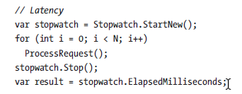
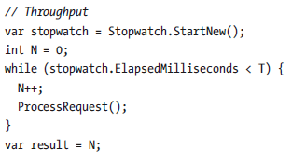
Kinds of Benchmarks and Performance Tests Latency vs Throughput

Slide 15

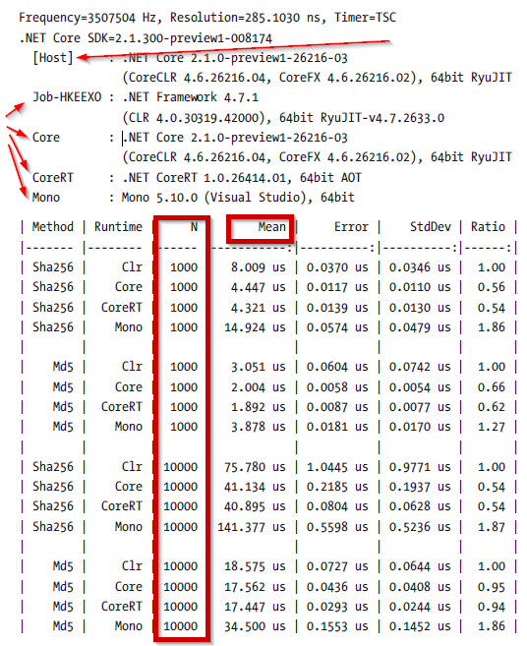
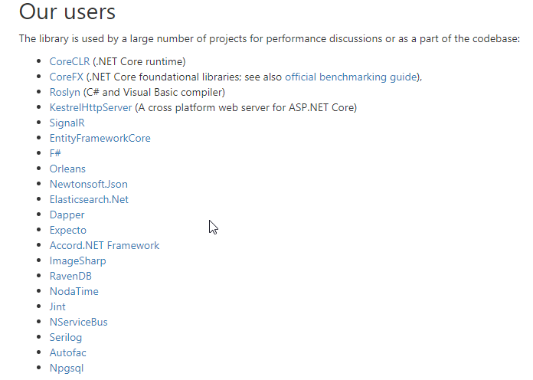
TOOLS – benchmarkdotnet
https://github.com/dotnet/benchmarkdotnet
https://benchmarkdotnet.org/

Slide 16
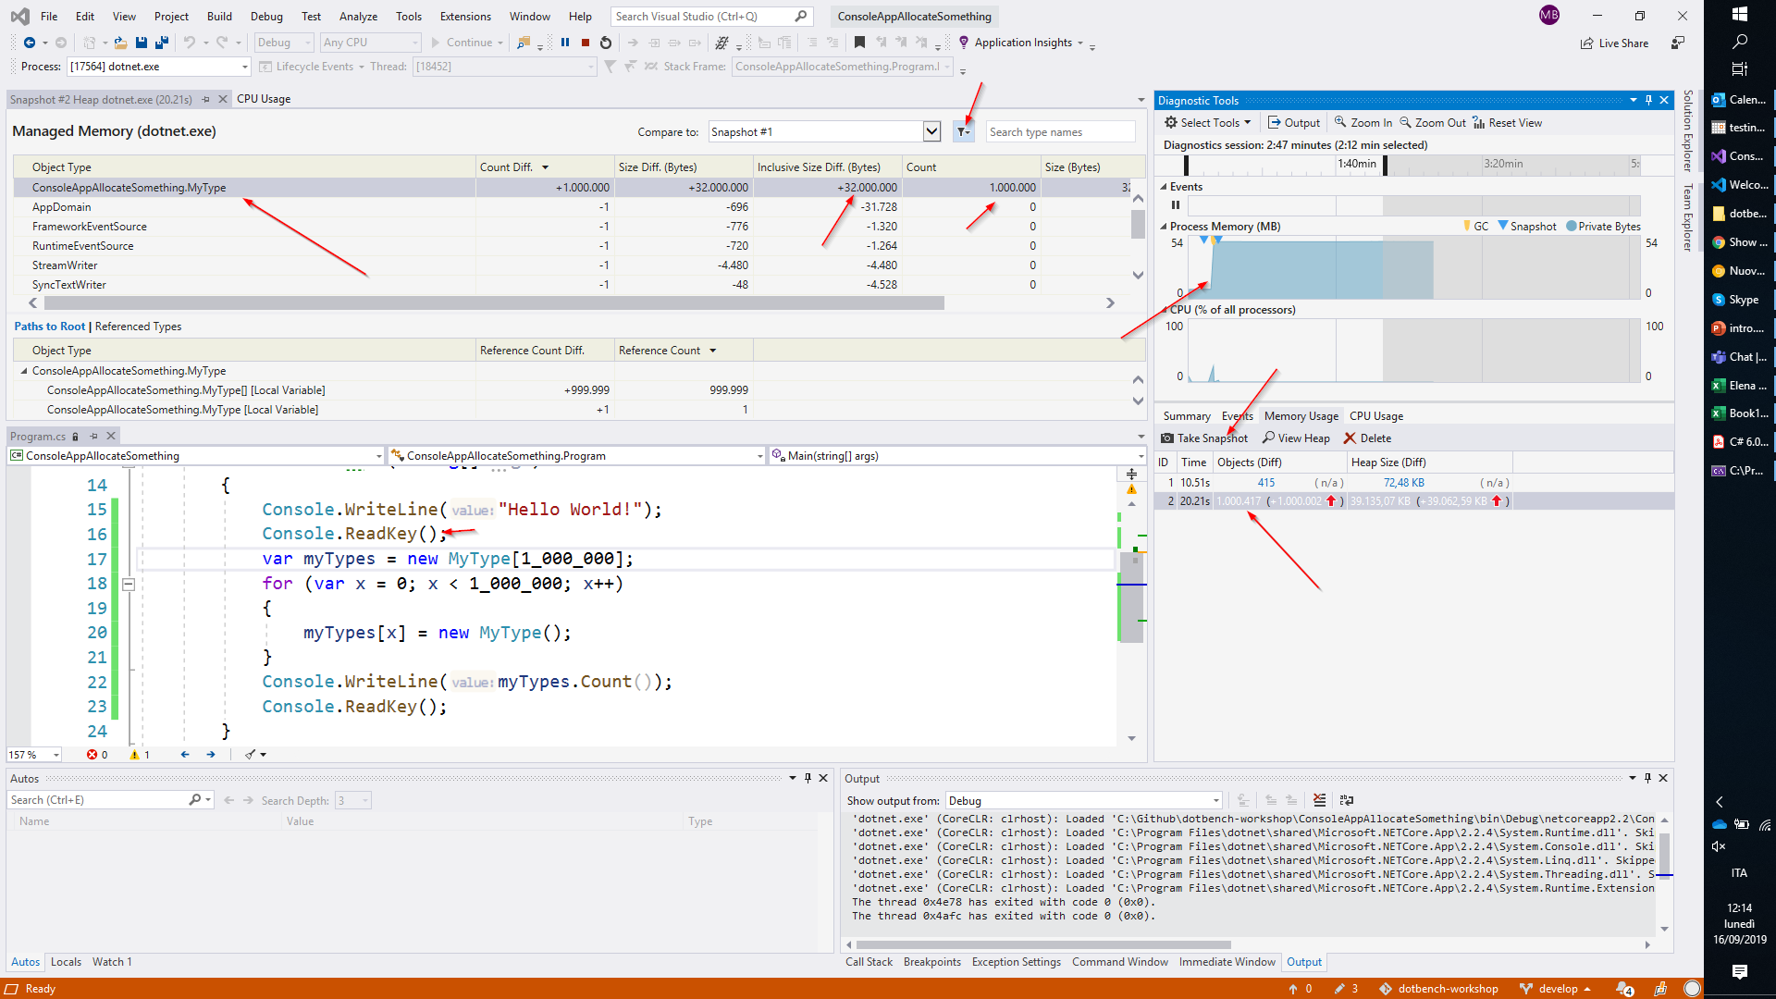
Tools - Performance and memory profilers in Visual Studio

Slide 17
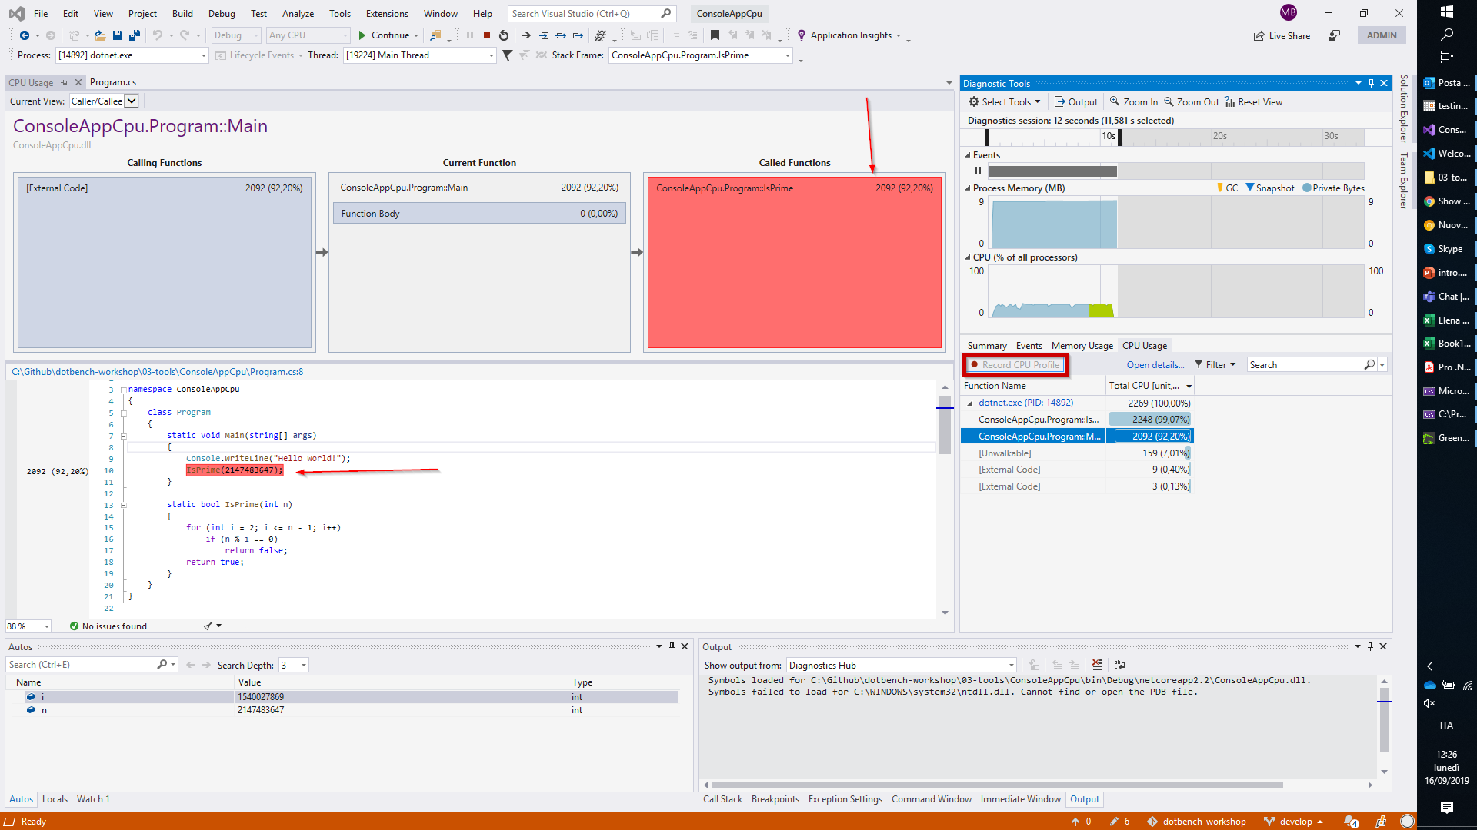
Tools - Performance and memory profilers in Visual Studio

Slide 18
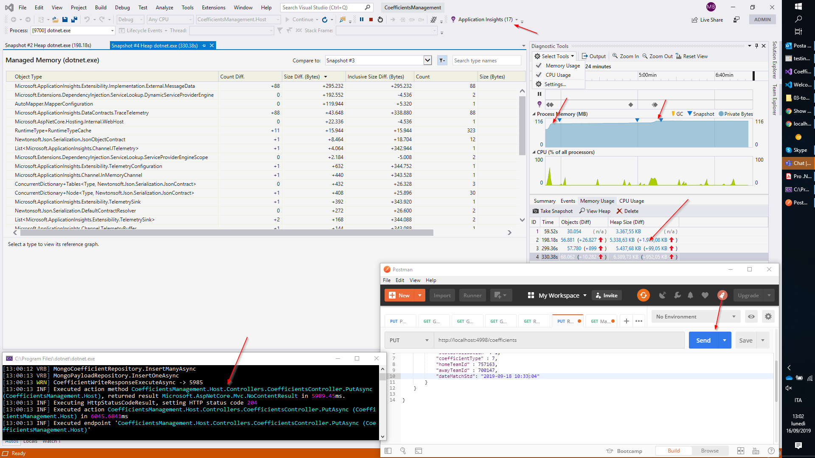
Tools - Performance and memory profilers in Visual Studio

Slide 19
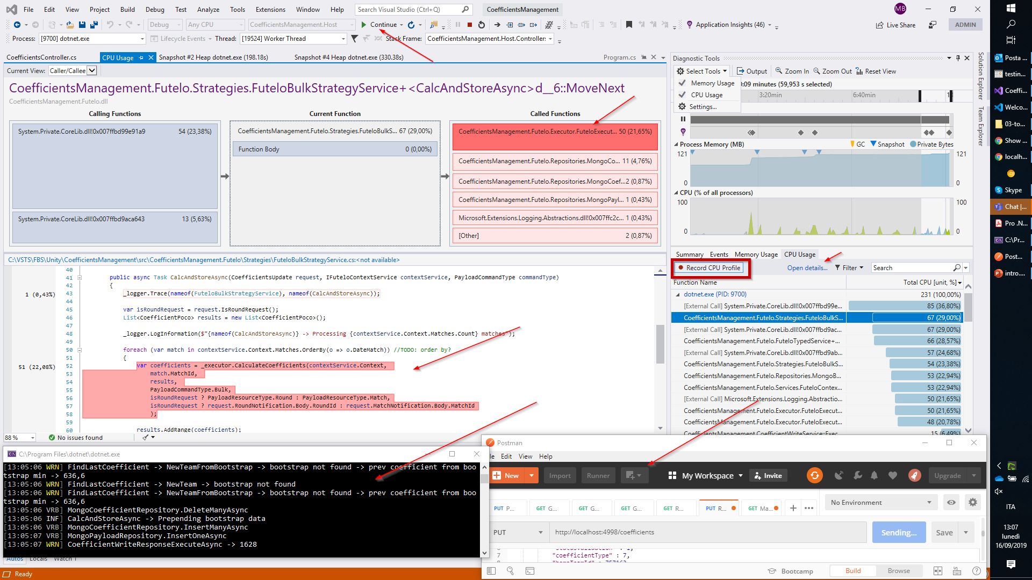
Tools - Performance and memory profilers in Visual Studio

Slide 20
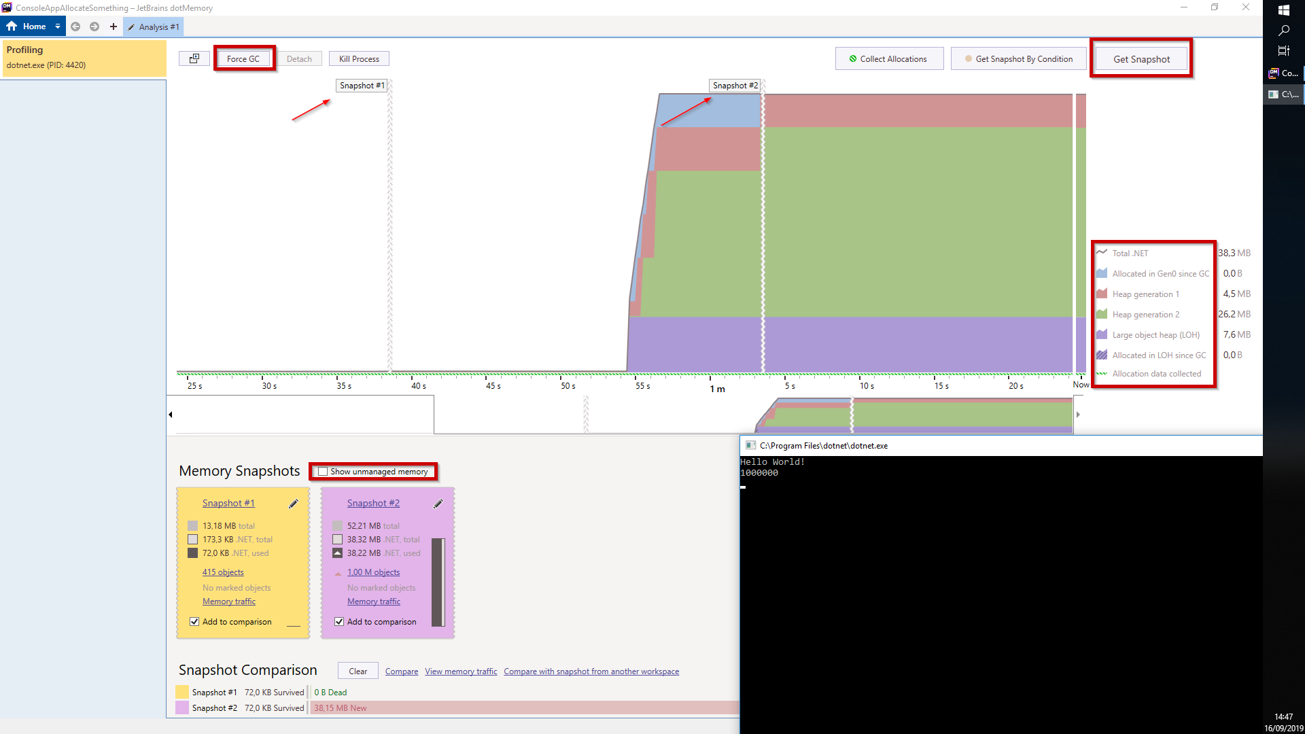
Tools - DOTMEMORY

Slide 21
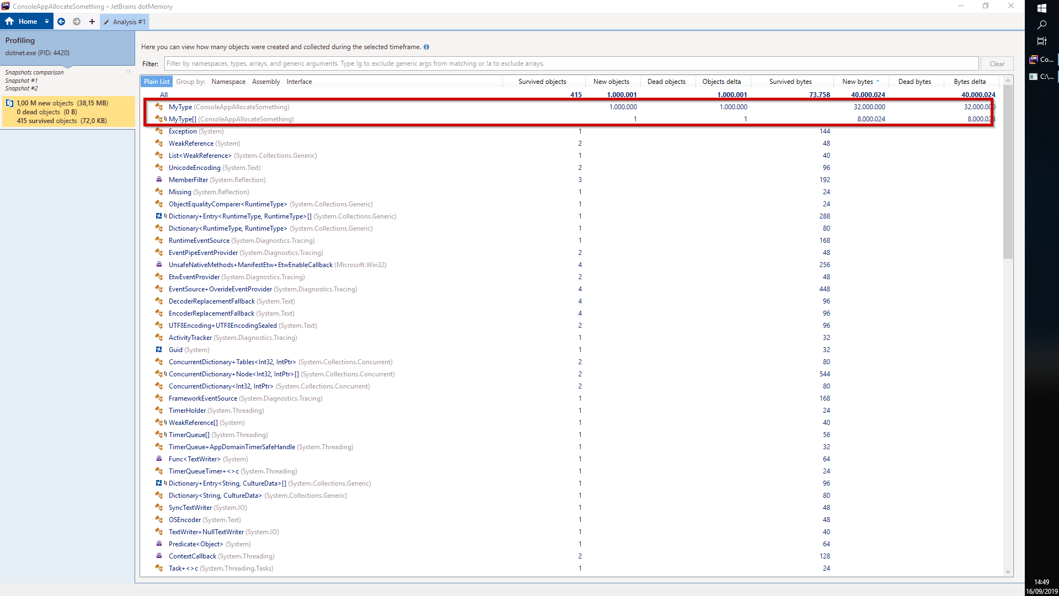
Tools - DOTMEMORY

Slide 22
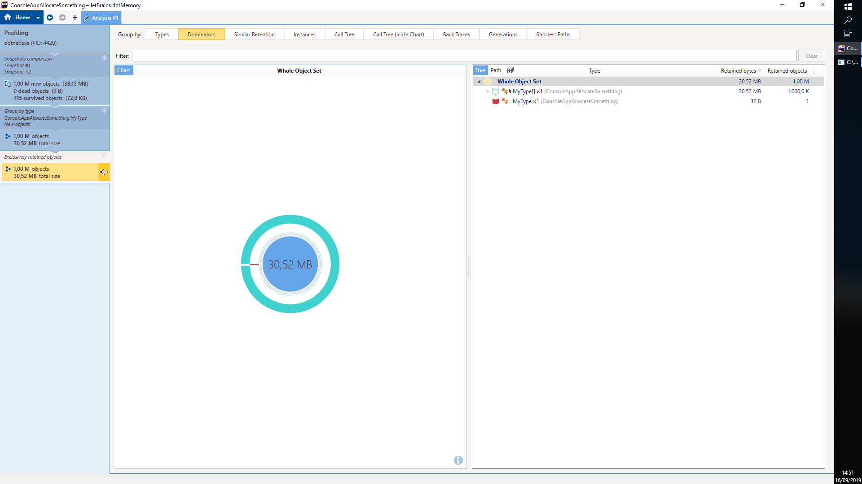
Tools - DOTMEMORY

Slide 23
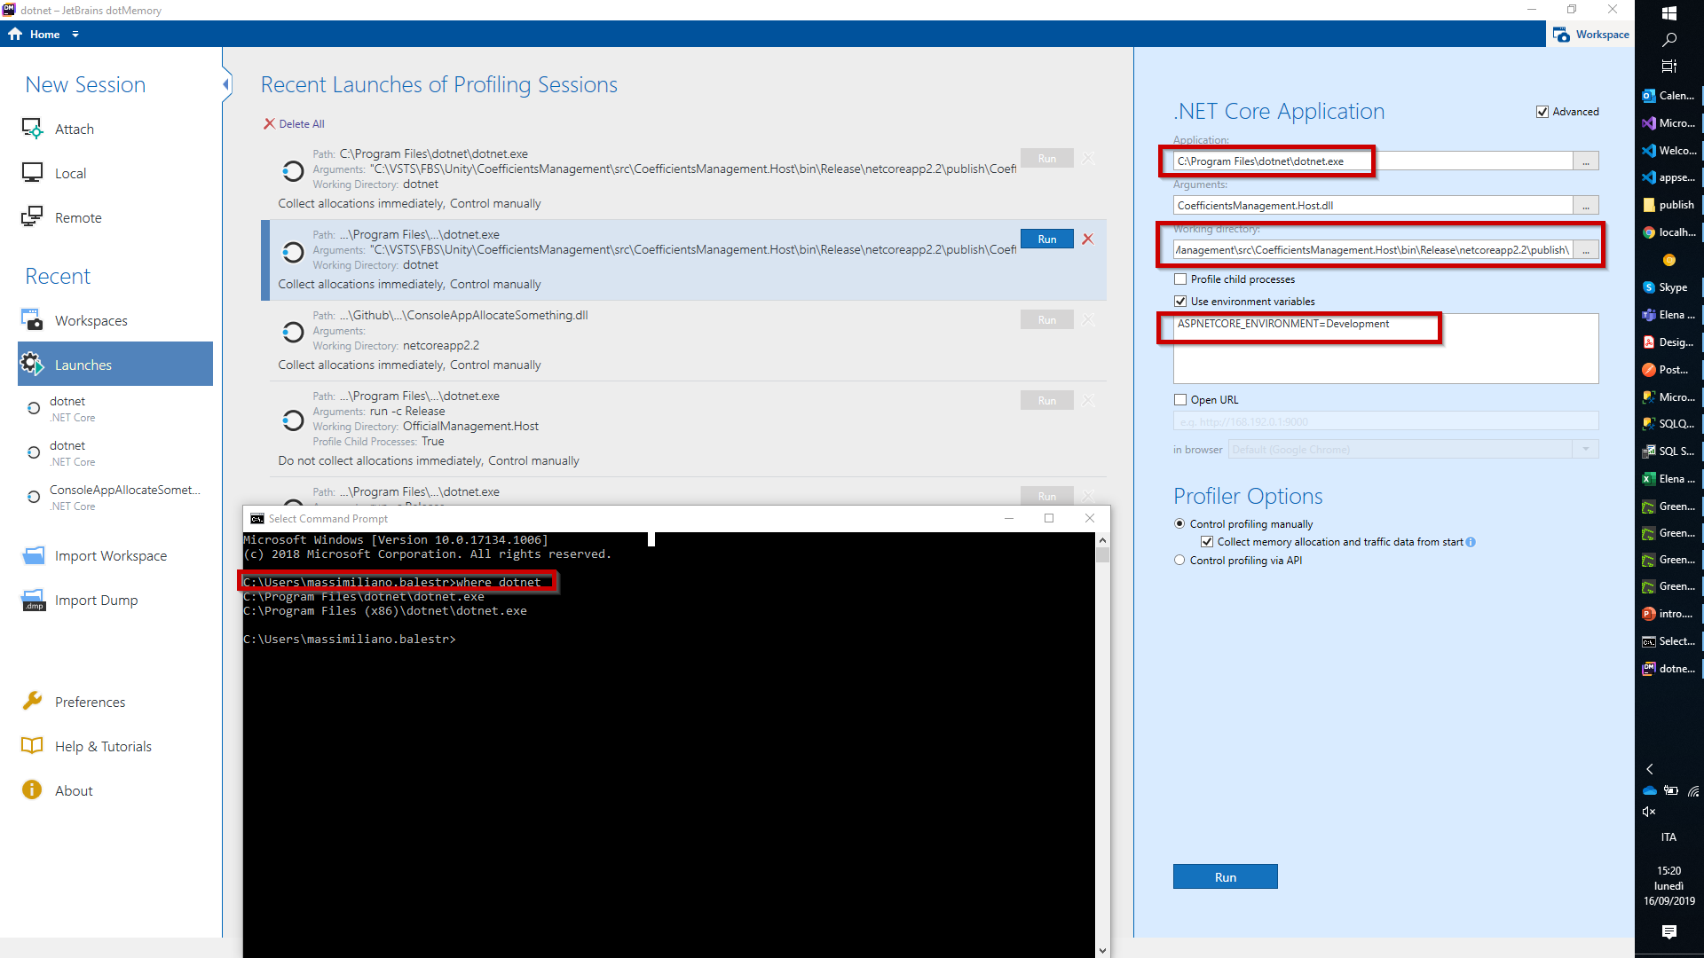
Tools - DOTMEMORY

Slide 24
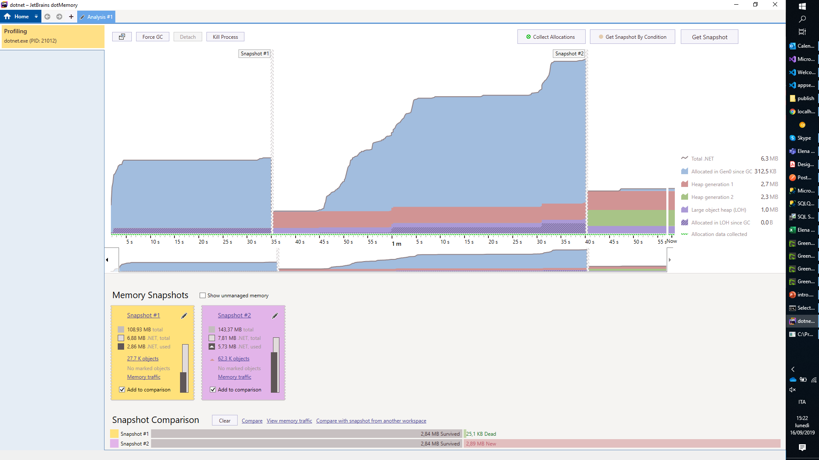
Tools - DOTMEMORY

Slide 25
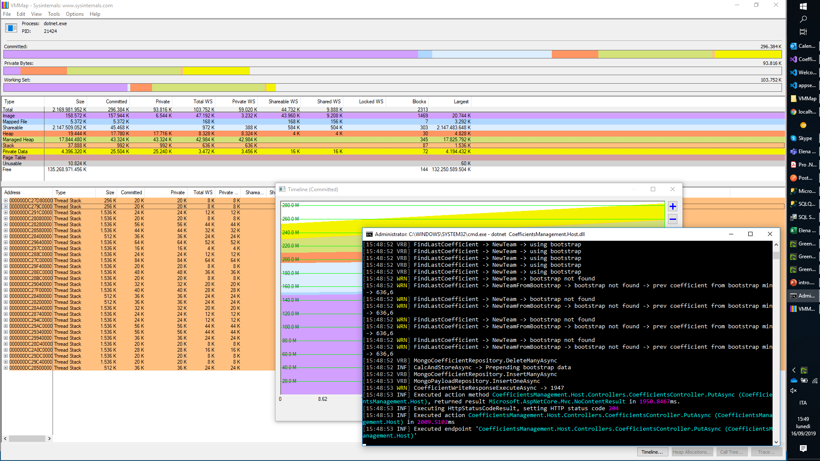
Tools - VMMAP

