Slide 1
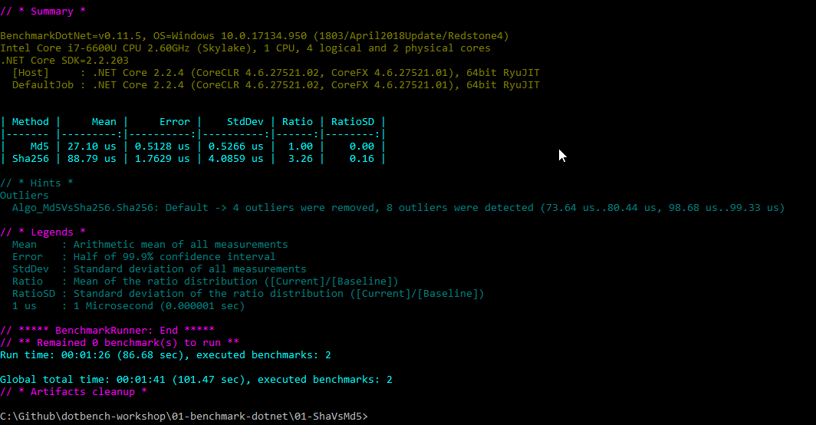
BenchmarkDotNet

Slide 2
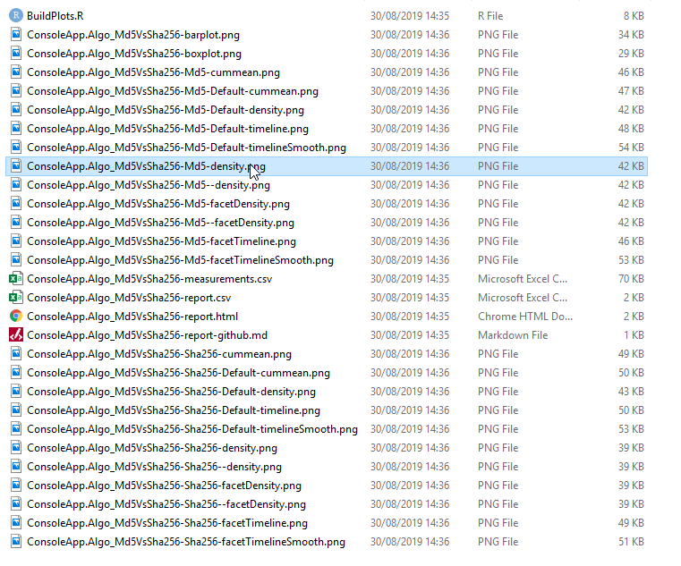
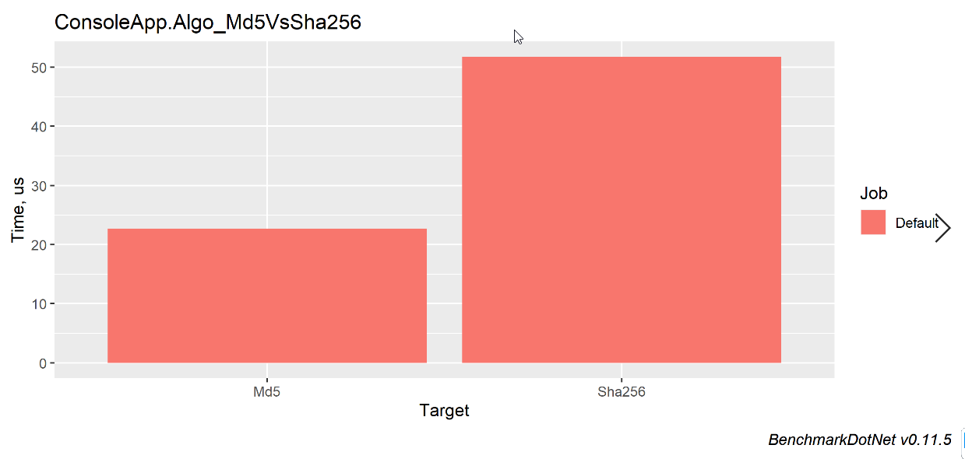
[RPlotExporter] + RStudio

Slide 3
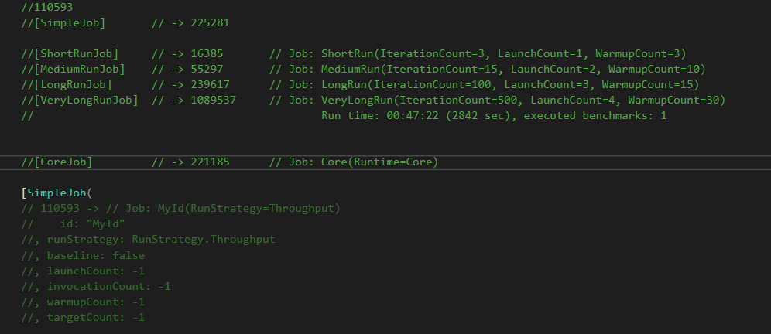
Jobs - Attributes

Slide 4
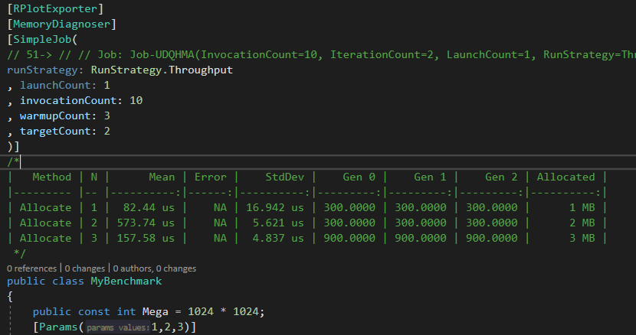
MemoryDiagnoser

Slide 5

Runtimes

Slide 6
