Slide 1

Pro .NET Benchmarking

Slide 2

Author

Slide 3
Links
Book
https://www.apress.com/gp/book/9781484249406
Source Code
https://github.com/Apress/pro-.net-benchmarking
BenchmarkDotNet
https://github.com/dotnet/BenchmarkDotNet
Rstudio
https://www.rstudio.com/
R
https://cran.r-project.org/bin/windows/base/

Slide 4
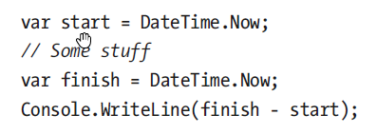
First Benchmark

Slide 5
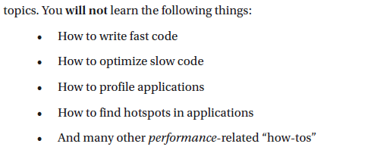
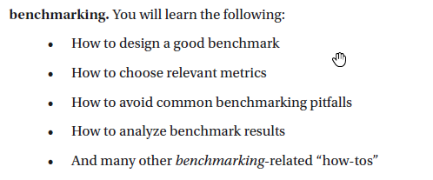
About Expectations

Slide 6

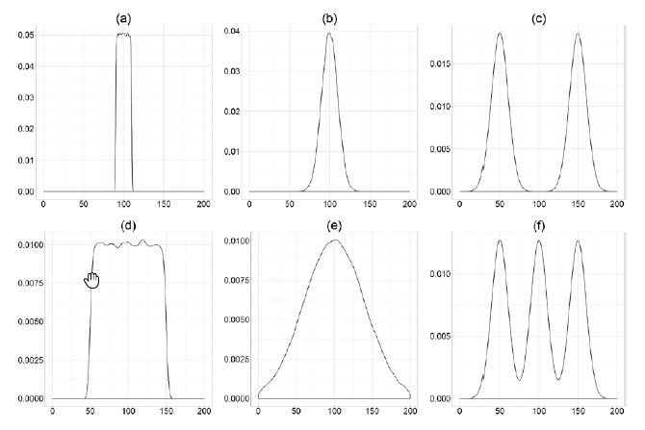
Perfomance Space

Slide 7
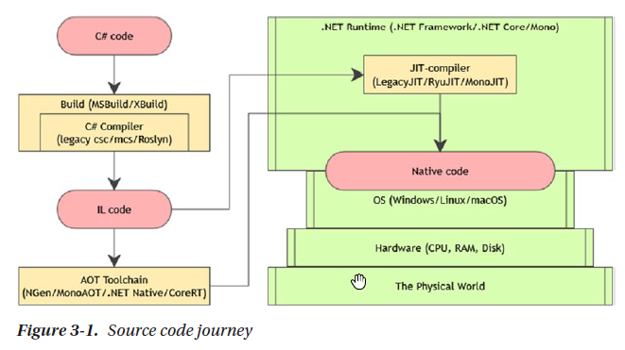
Source code journey

Slide 8
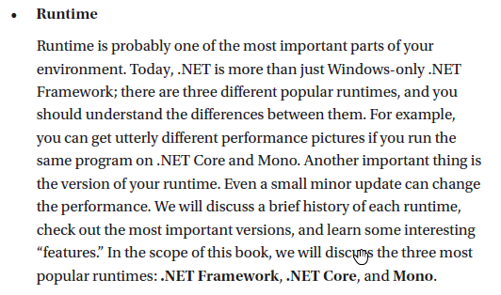
Runtime

Slide 9
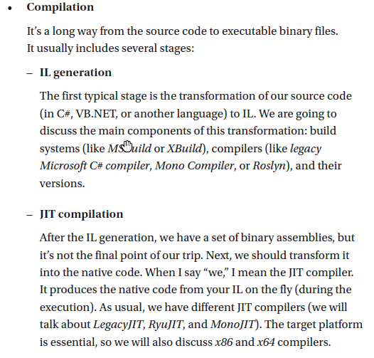
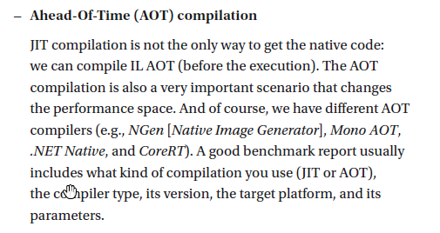
Compilation

