Slide 1
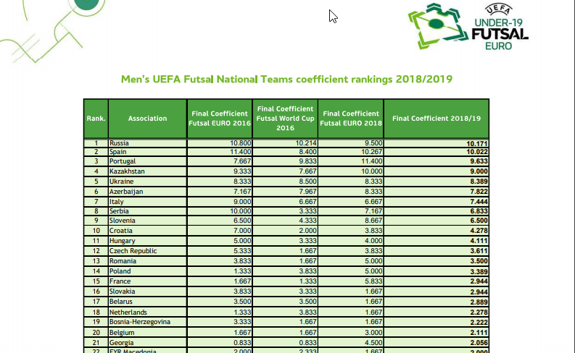
Futelo ranking
https://www.uefa.com/MultimediaFiles/Download/competitions/General/02/57/94/19/2579419_DOWNLOAD.pdf

Slide 2
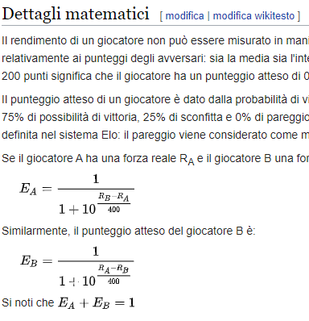
Futelo ranking
https://it.wikipedia.org/wiki/Elo

Slide 3
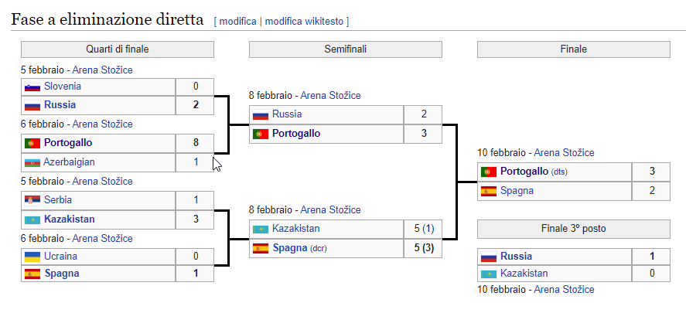
Futelo ranking
https://it.wikipedia.org/wiki/Elo

Slide 4
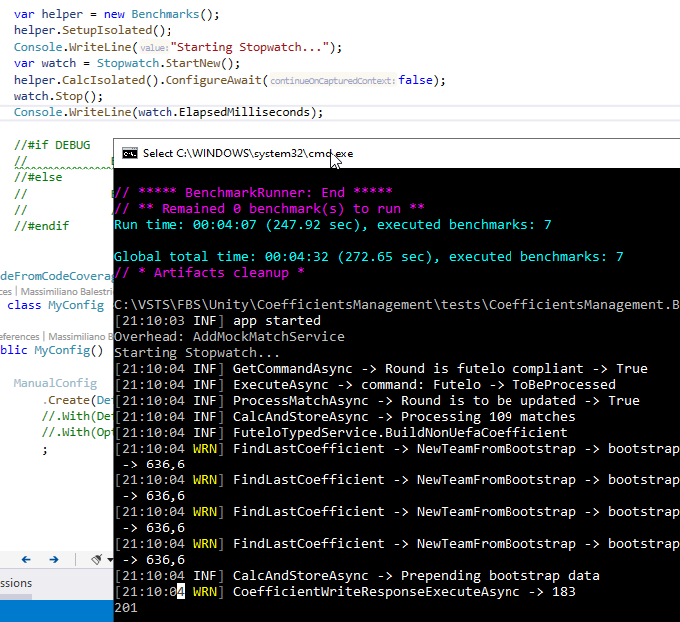

Slide 5
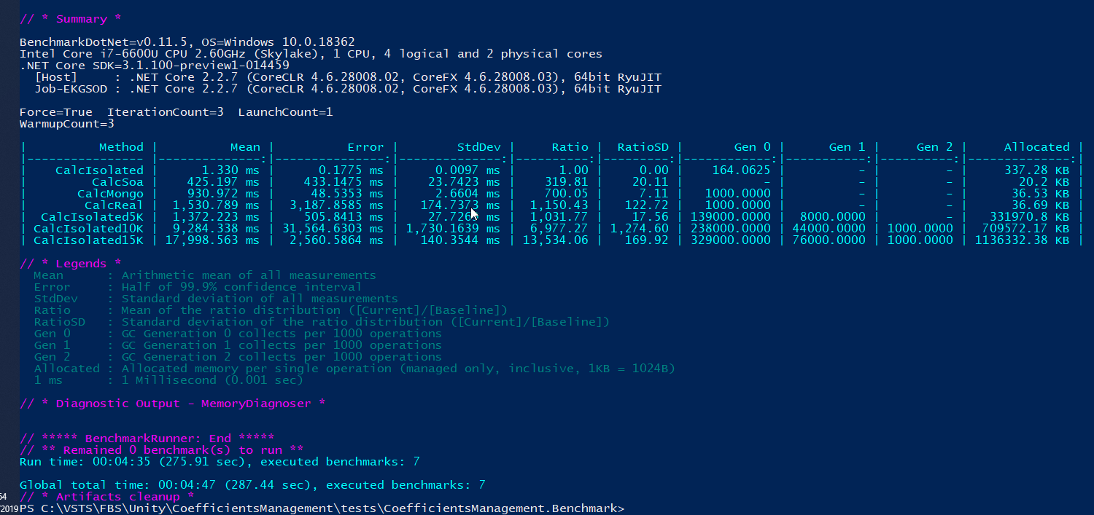

Slide 6
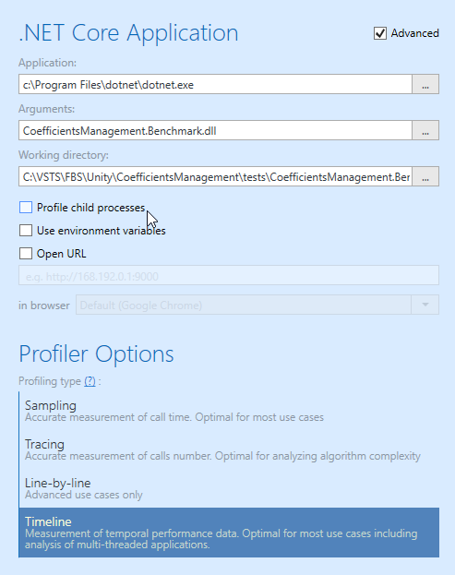
dottrace

Slide 7
dottrace

Slide 8
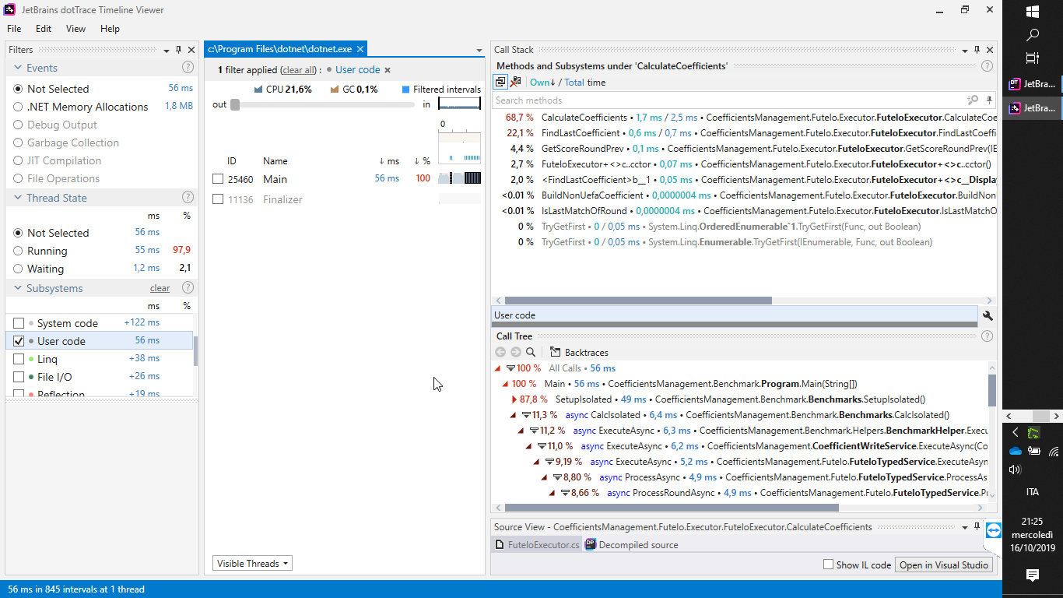
dottrace

Slide 9
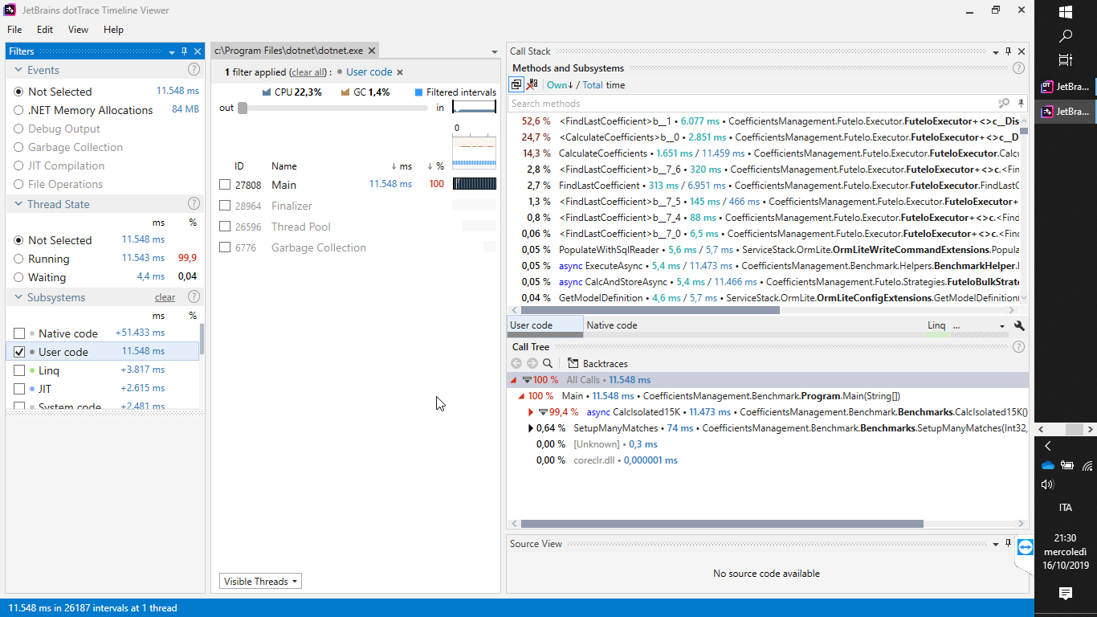
dottrace

Slide 10
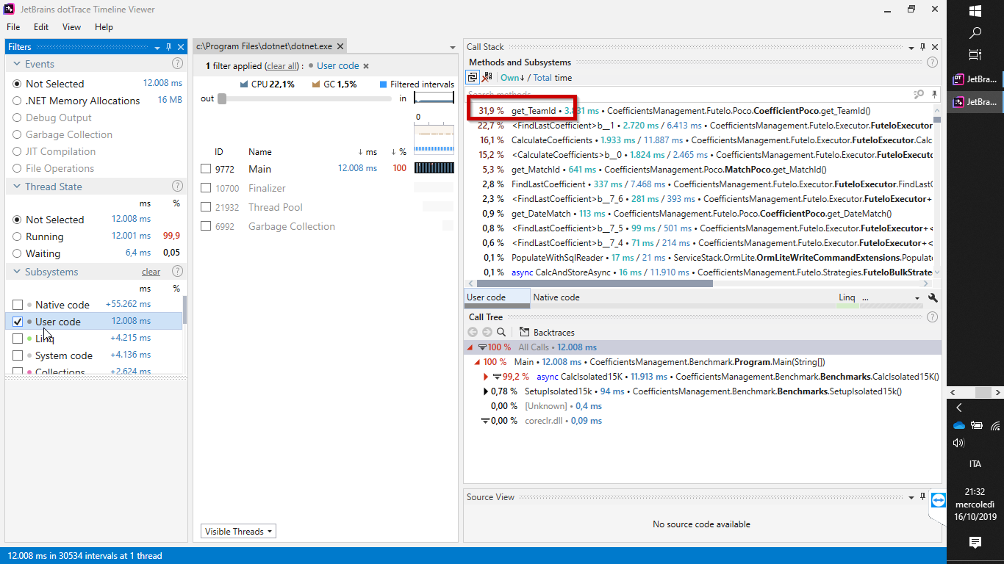
dottrace

Slide 11
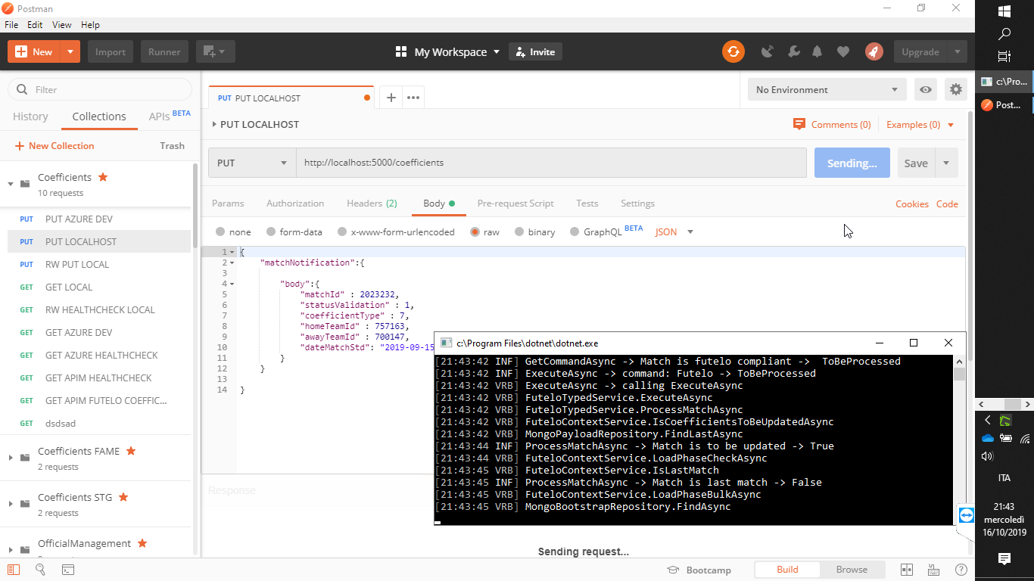
dotmemory

Slide 12
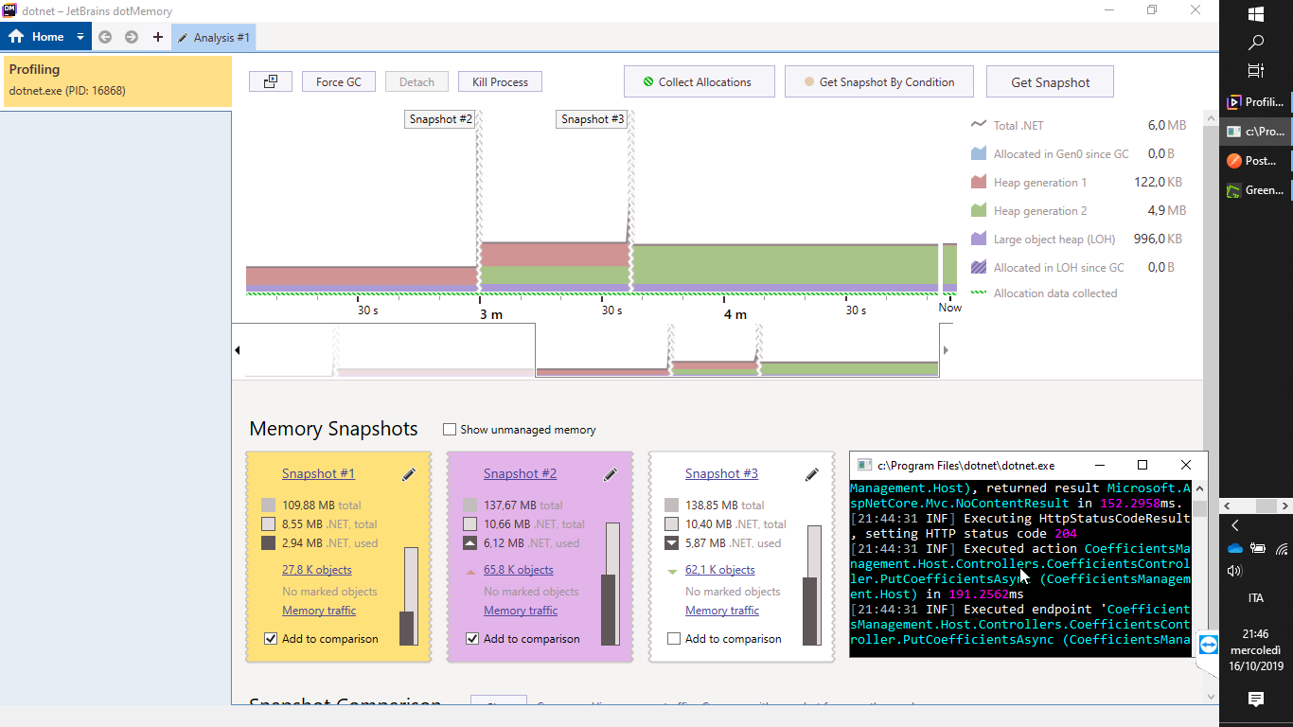
dotmemory

Slide 13
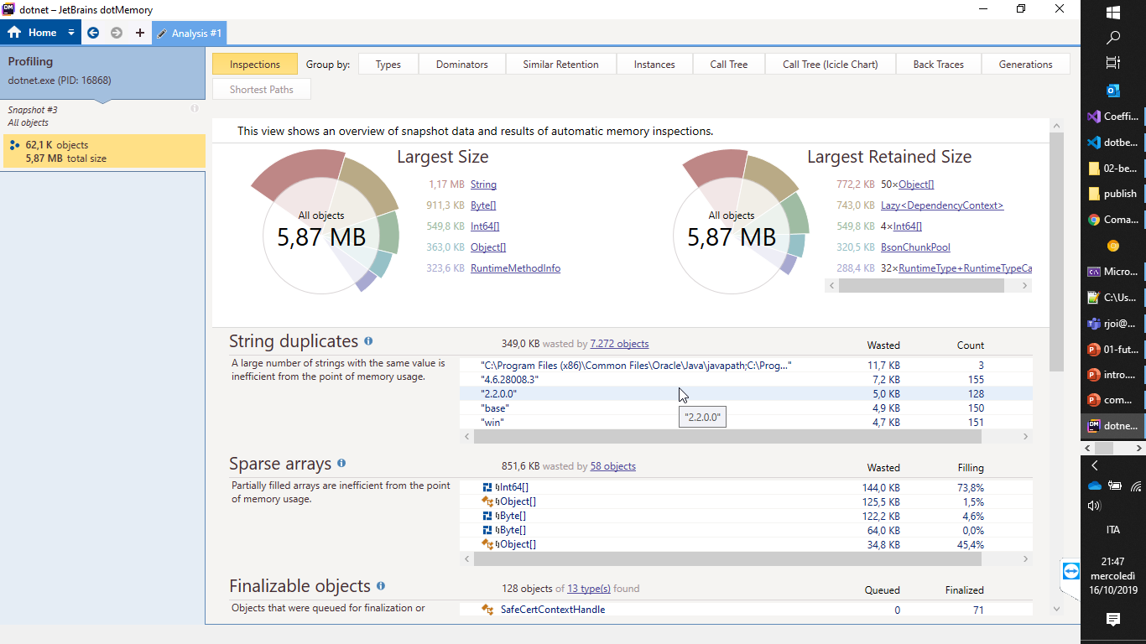
dotmemory

