Slide 1
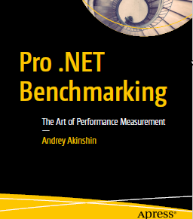
Pro .NET Benchmarking

Slide 2

Author

Slide 3
Links
Book
https://www.apress.com/gp/book/9781484249406
Source Code
https://github.com/Apress/pro-.net-benchmarking
BenchmarkDotNet
https://github.com/dotnet/BenchmarkDotNet
Rstudio
https://www.rstudio.com/
R
https://cran.r-project.org/bin/windows/base/

Slide 4
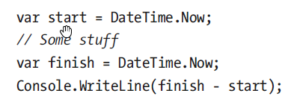
First Benchmark

Slide 5
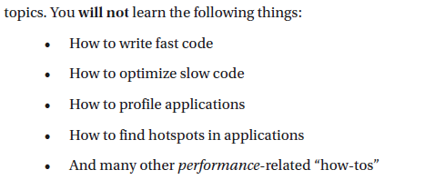
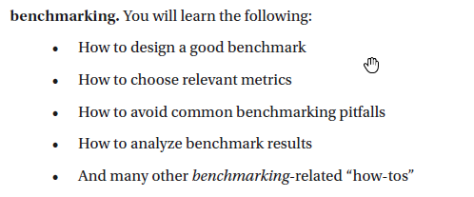
About Expectations

Slide 6
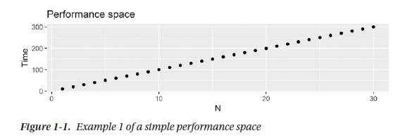

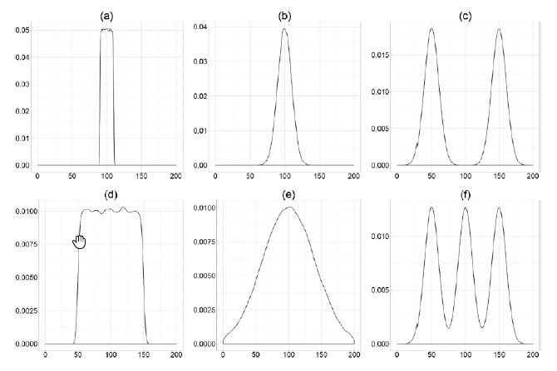
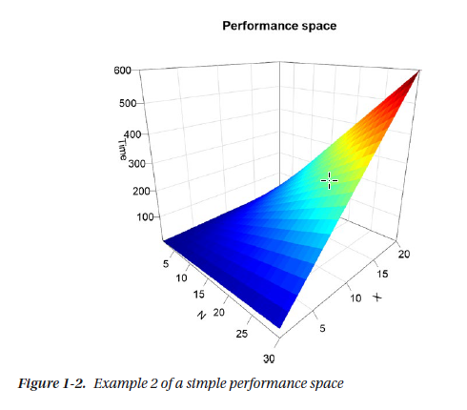
Perfomance Space

Slide 7
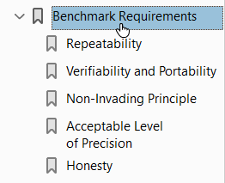
Benchmark requirements

Slide 8
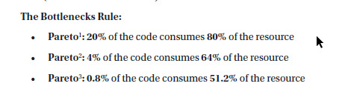
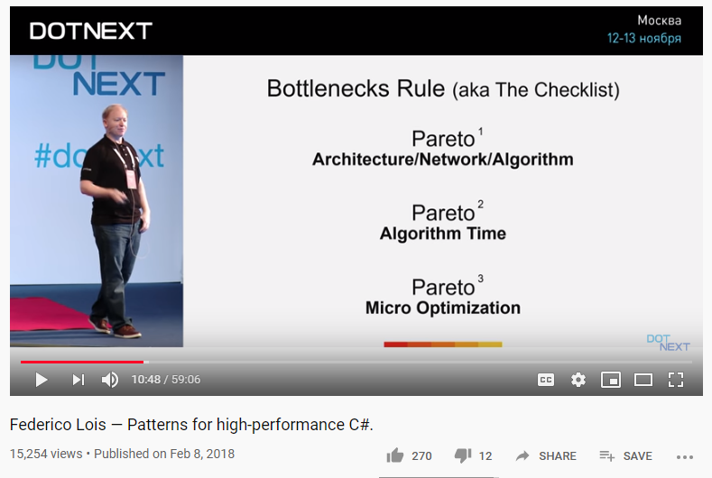
Find Your Bottleneck
https://www.youtube.com/watch?v=7GTpwgsmHgU

Slide 9
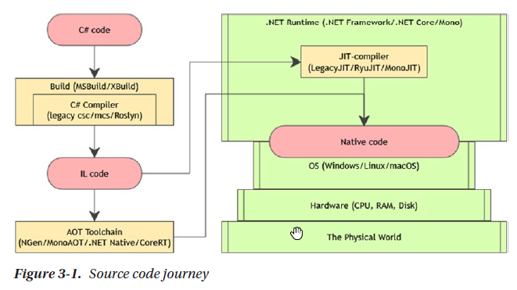
How Environment Affects Performance - Source code journey

Slide 10
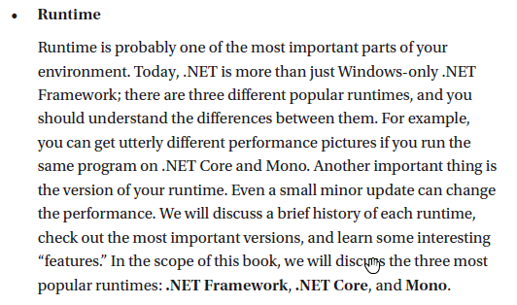
How Environment Affects Performance - Runtime

Slide 11
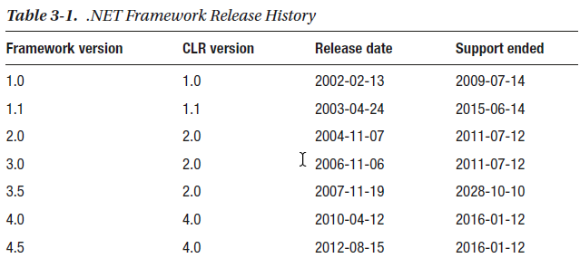
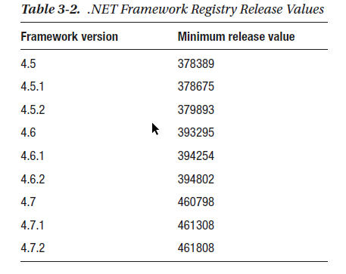
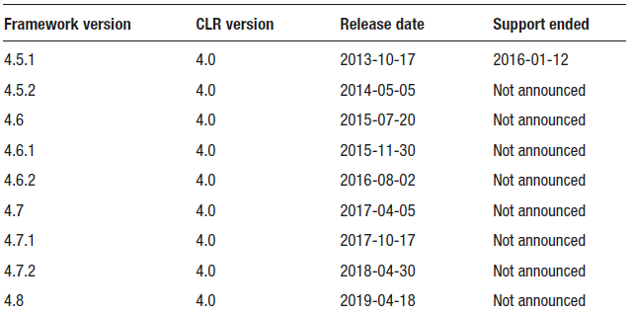
Runtimes - FULL .NET FRAMEWORK

Slide 12
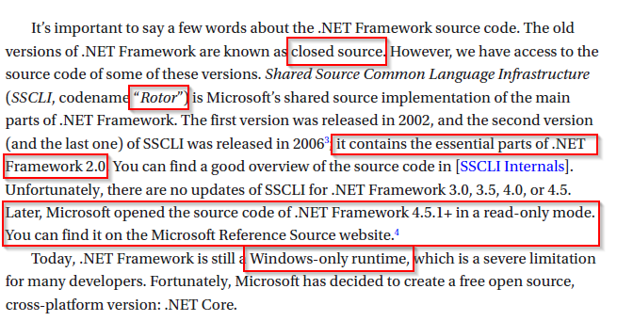
Runtimes - FULL .NET FRAMEWORK

Slide 13
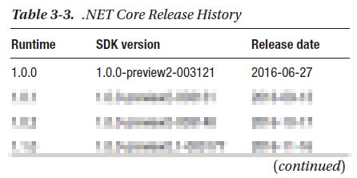
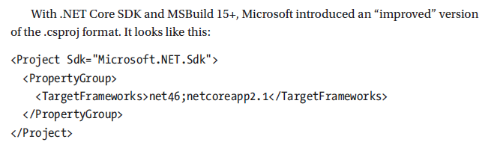
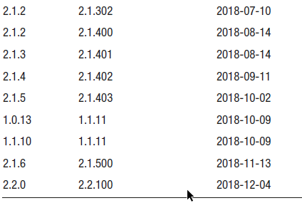
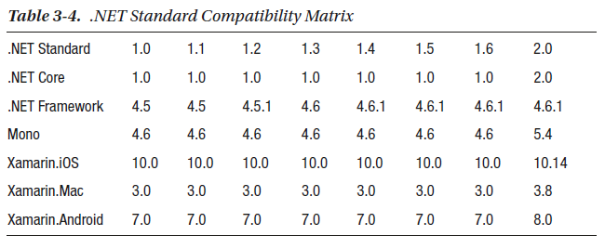
Runtimes - .net core

Slide 14
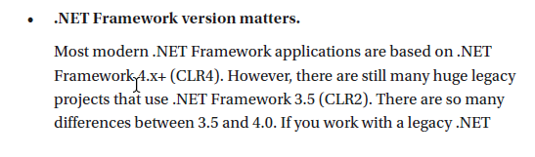
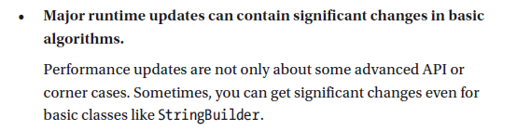
Runtimes - conclusions

Slide 15
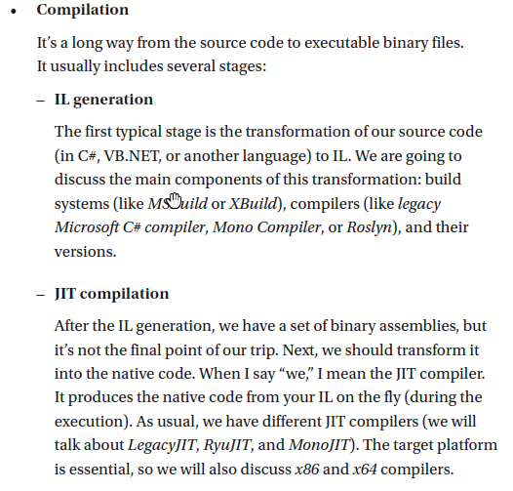
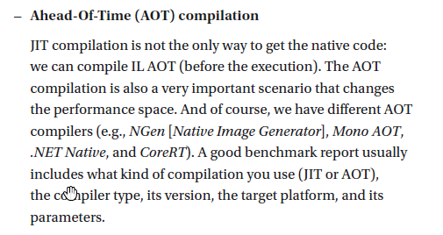
How Environment Affects Performance - Compilation

Slide 16
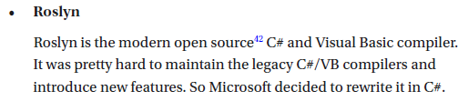
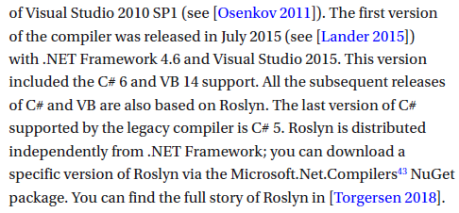
Compilation

Slide 17

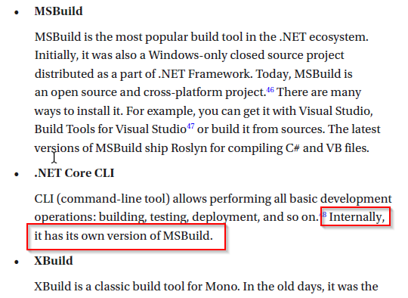


Build systems

Slide 18
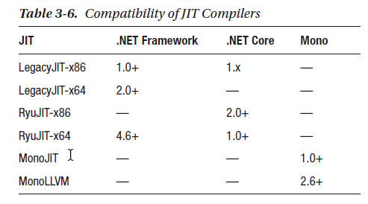
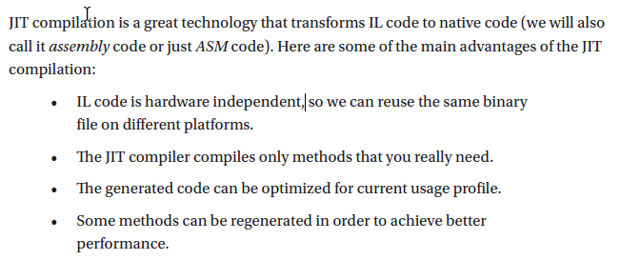
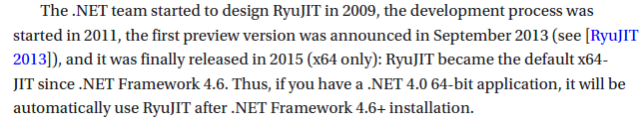
Just in time compilation

Slide 19
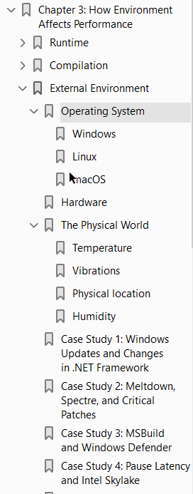
How Environment Affects Performance - External Environment

Slide 20
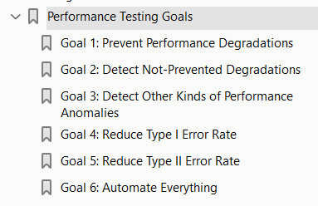
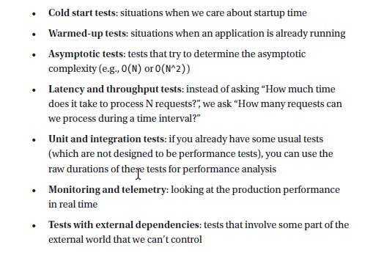

Performance Analysis and Performance Testing
Kinds of Benchmarks and Performance Tests

Slide 21
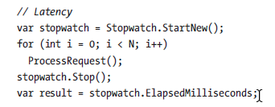
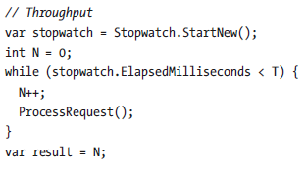
Kinds of Benchmarks and Performance Tests Latency vs Throughput

Slide 22
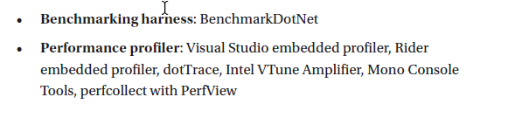
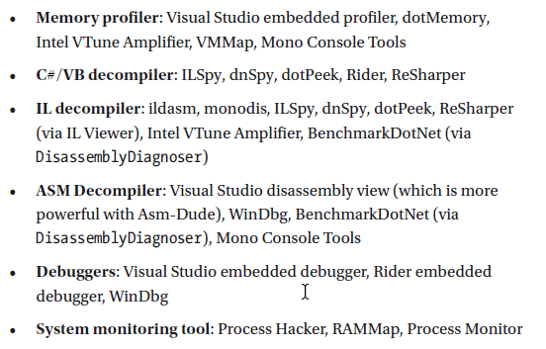
TOOLS

Slide 23

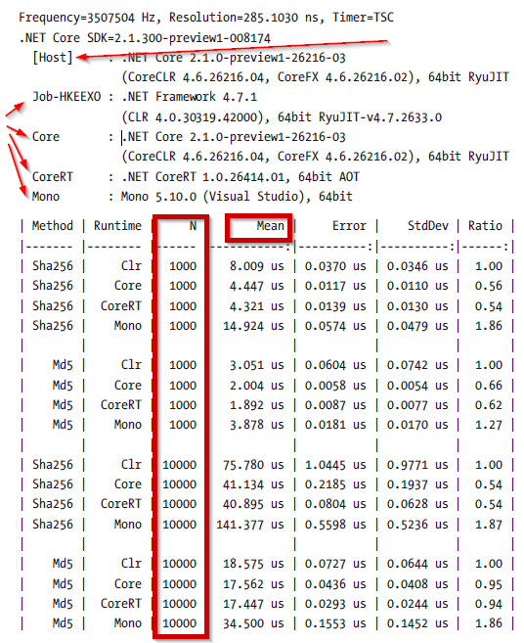
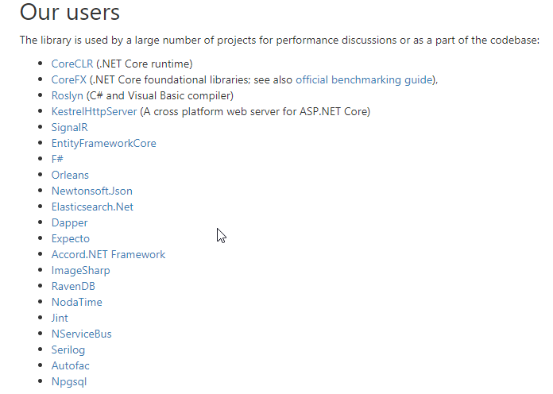
TOOLS – benchmarkdotnet
https://github.com/dotnet/benchmarkdotnet
https://benchmarkdotnet.org/

Slide 24
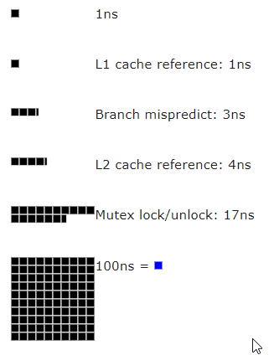
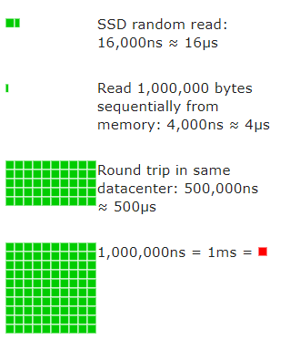
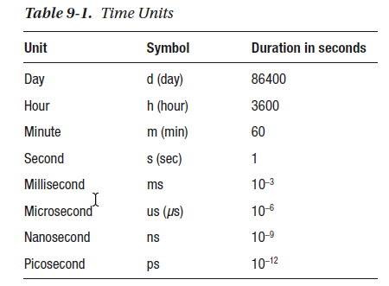
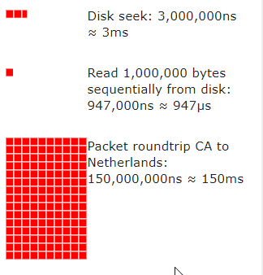
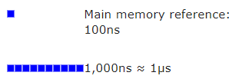
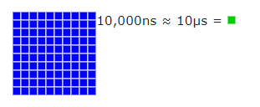
Time units
https://people.eecs.berkeley.edu/~rcs/research/interactive_latency.html
A picosecond relates to a second as a second relates to 31710 years!

Slide 25
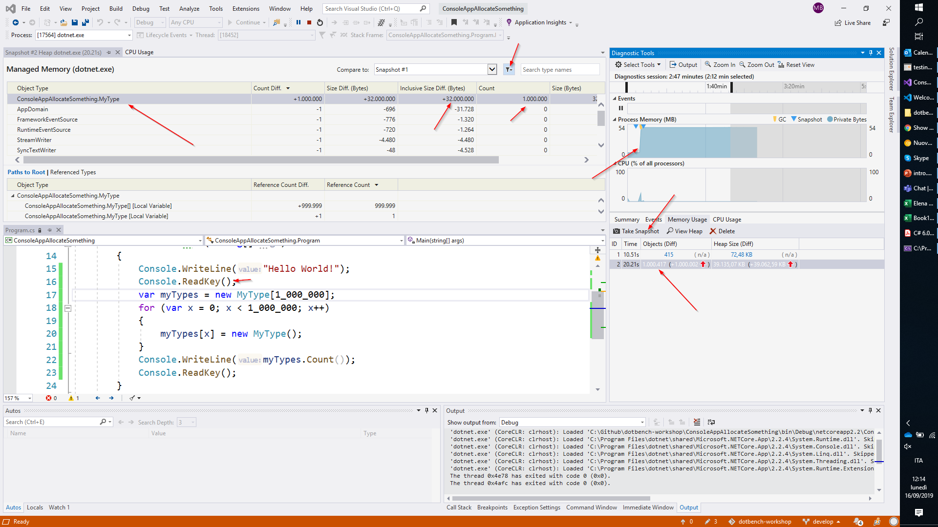
Tools - Performance and memory profilers in Visual Studio

Slide 26
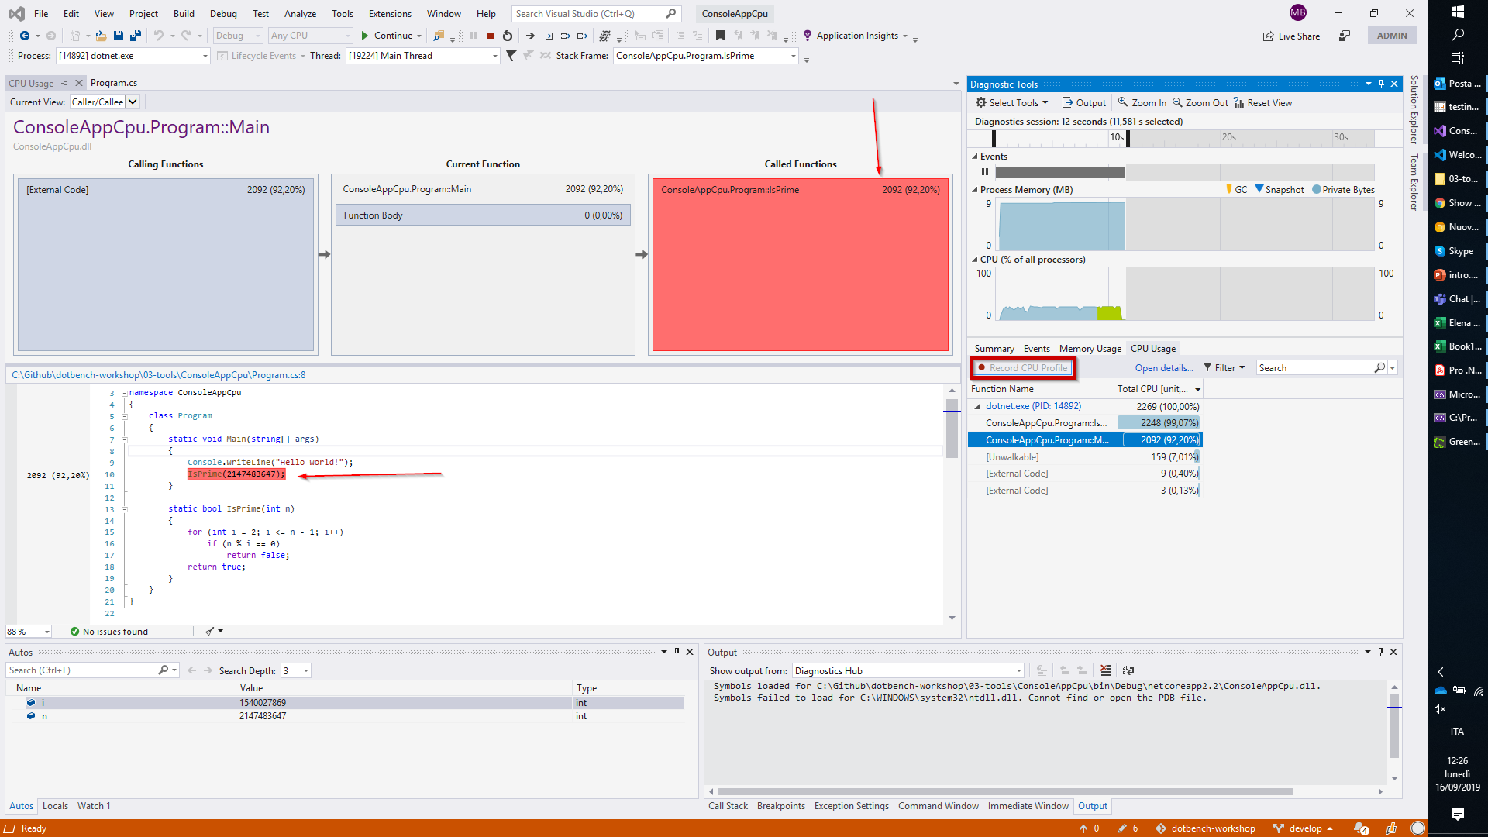
Tools - Performance and memory profilers in Visual Studio

Slide 27
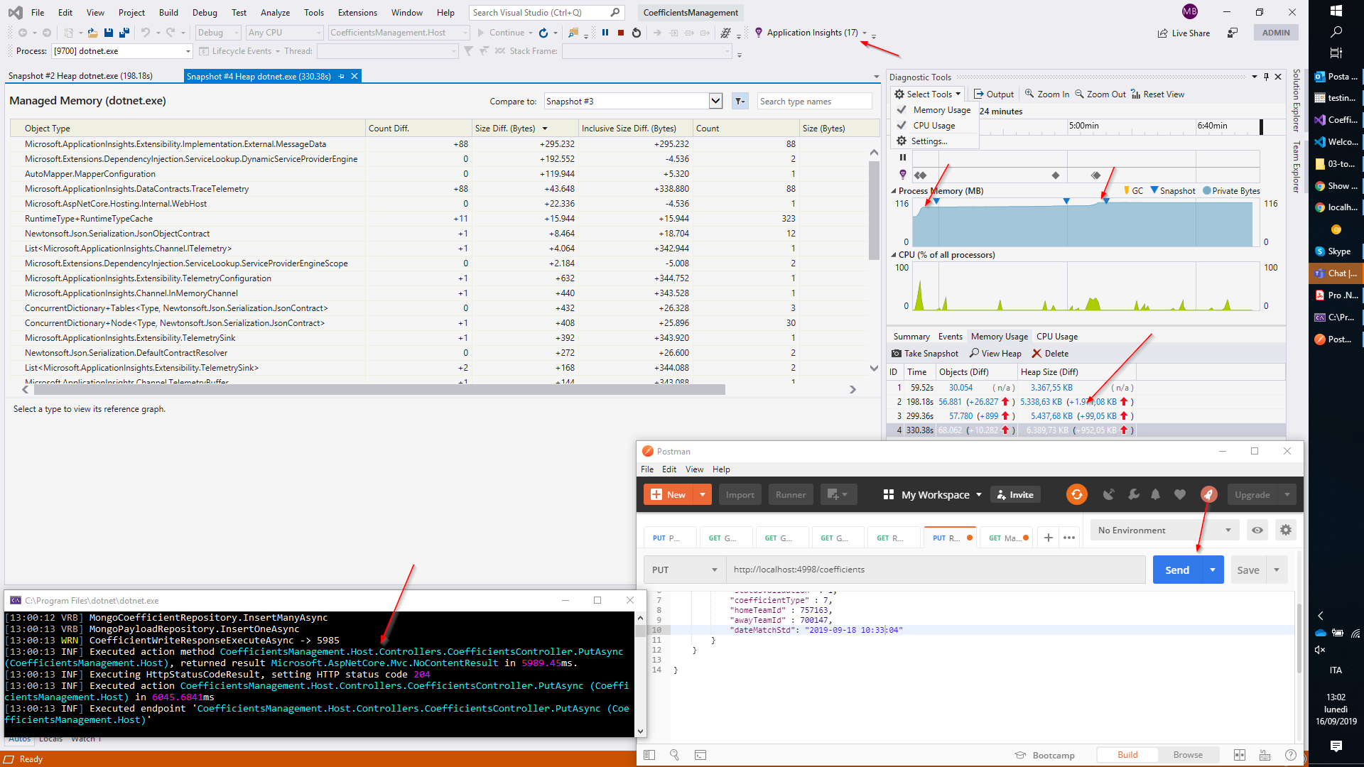
Tools - Performance and memory profilers in Visual Studio

Slide 28
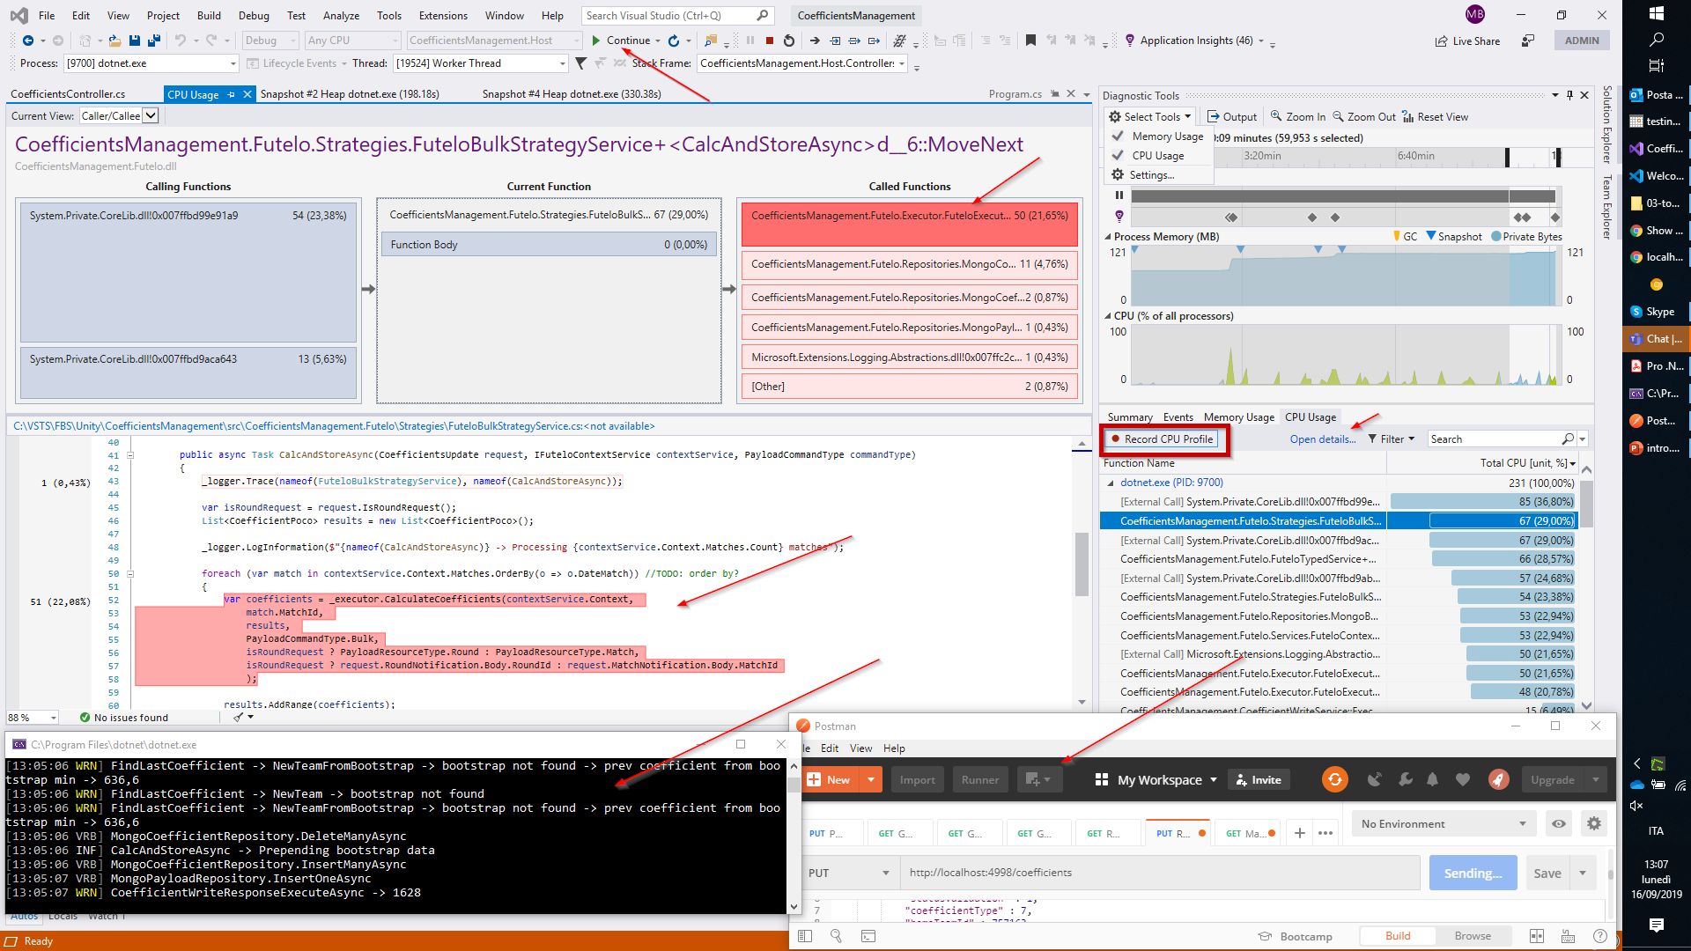
Tools - Performance and memory profilers in Visual Studio

Slide 29
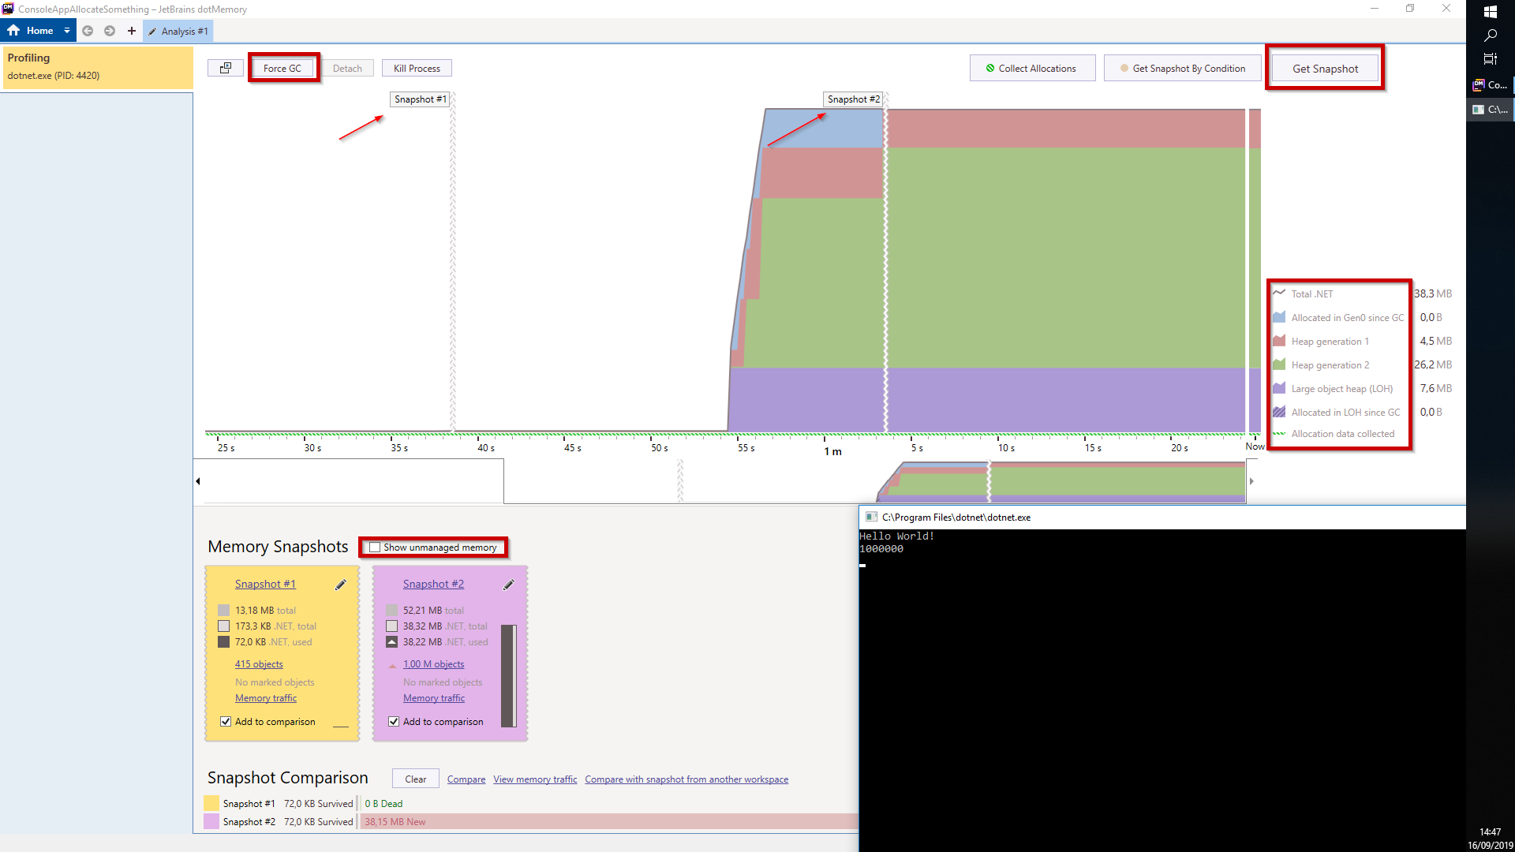
Tools - DOTMEMORY

Slide 30

Tools - DOTMEMORY

Slide 31

Tools - DOTMEMORY

Slide 32

Tools - DOTMEMORY

Slide 33

Tools - DOTMEMORY

Slide 34

Tools - VMMAP

