Slide 1
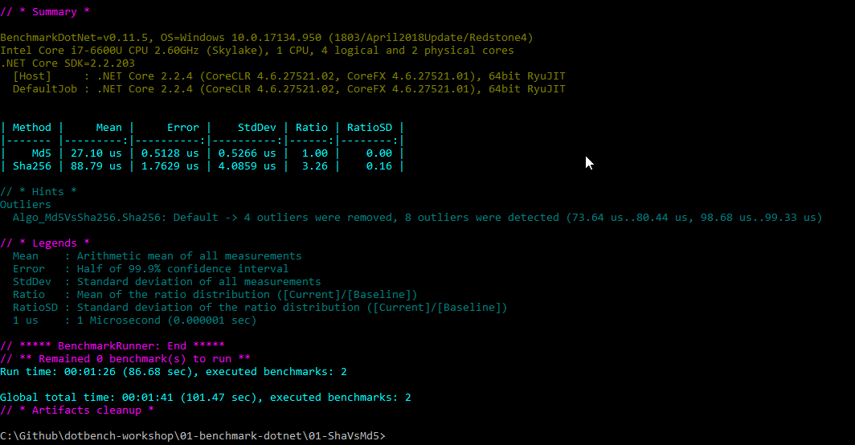
BenchmarkDotNet

Slide 2
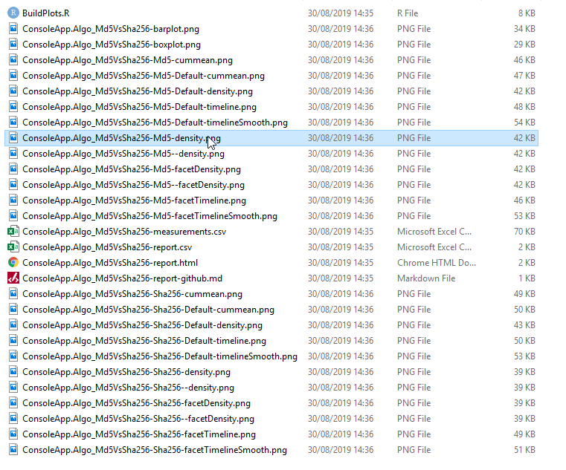
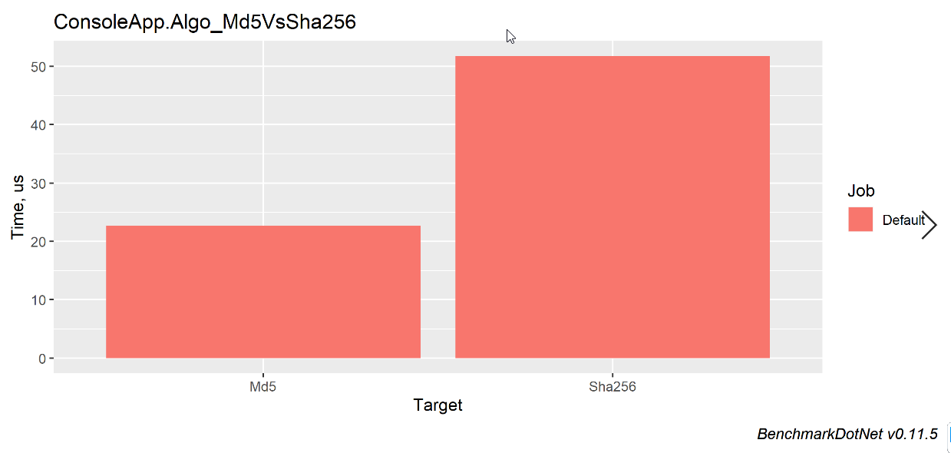
[RPlotExporter] + RStudio

Slide 3
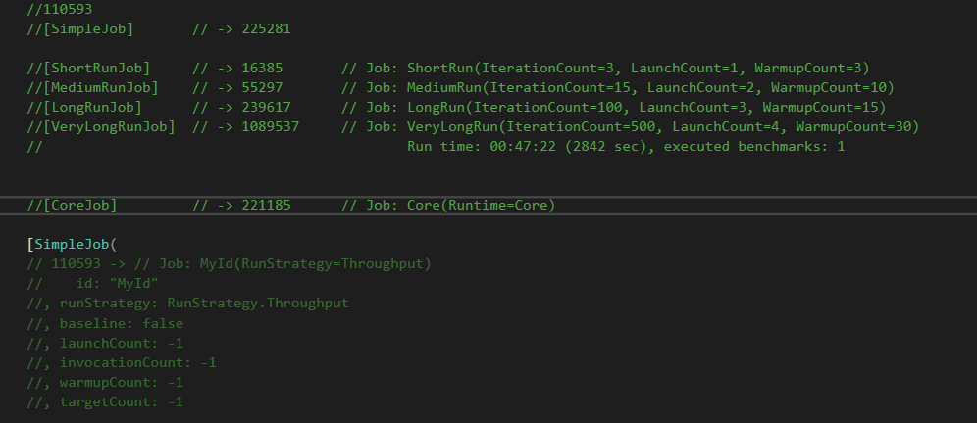
Jobs - Attributes

Slide 4
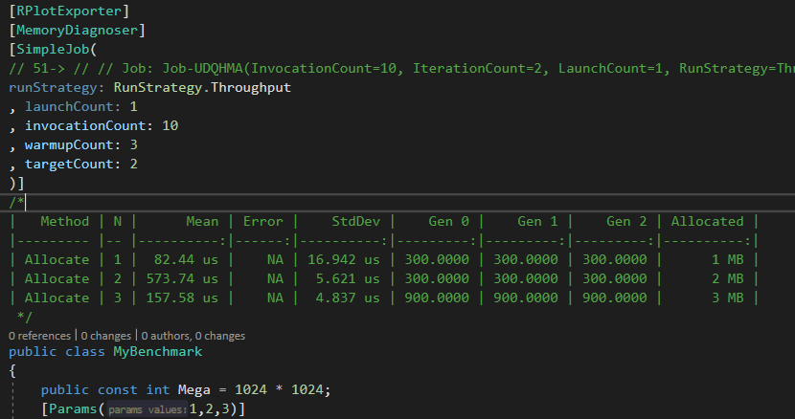
MemoryDiagnoser

Slide 5
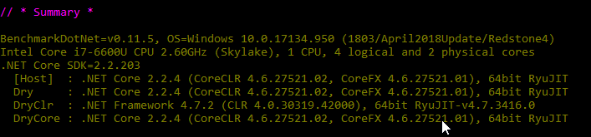
Runtimes

Slide 6
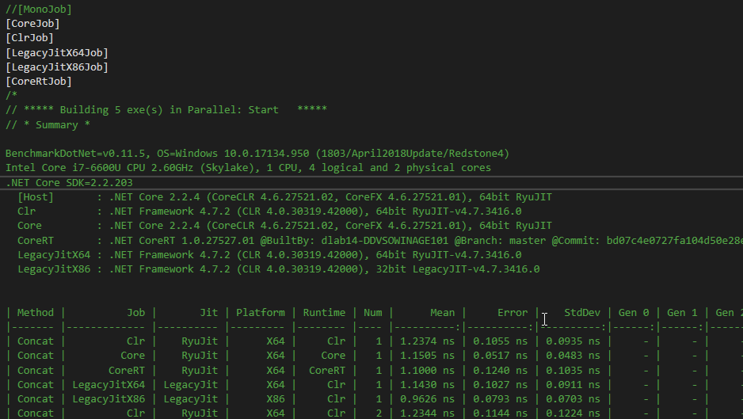

Slide 7

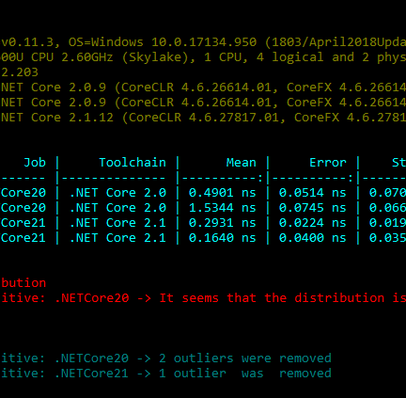
Benchmarks – Compare DotNetCore Versions

Slide 8
Benchmark Tips
Inaccurate Timestamping - Advice: prefer Stopwatch over DateTime
Use Release - Advice: use Release and don't use empty loops to benchmark
Natural Noise - Each benchmark iteration has random errors because of the natural noise.
Calculate Average - Advice: We can't prevent natural noise
Tricky Distributions - Advice: always look at your distribution
Measuring Cold Start Instead of Warmed Steady State - Advice: use different approaches for cold and warm states
Insufficient Number of Invocations - Advice: do many invocations
Benchmark infrastructure overhead - Advice: always calculate your infrastructure overhead
.NET-Specific Pitfalls
Loop Unrolling - Advice: use variables instead of constants in loops
Dead Code Elimination - Advice: always use results of your calculations
Inlining - Advice: control inlining of the benchmarked methods

