Slide 1
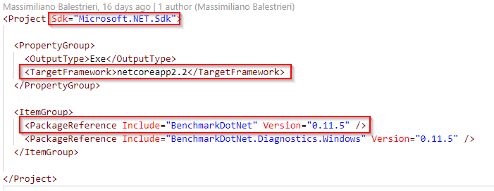
BenchmarkDotNet

Slide 2
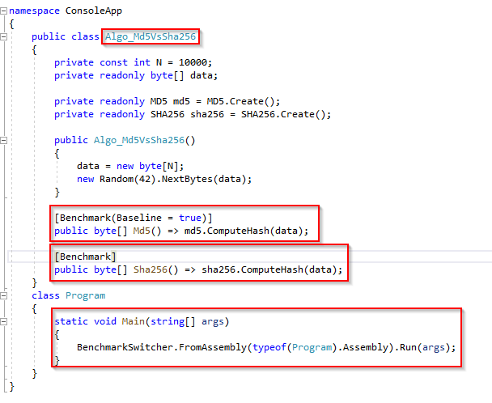
Benchmark

Slide 3
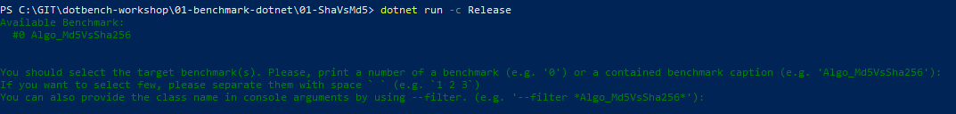
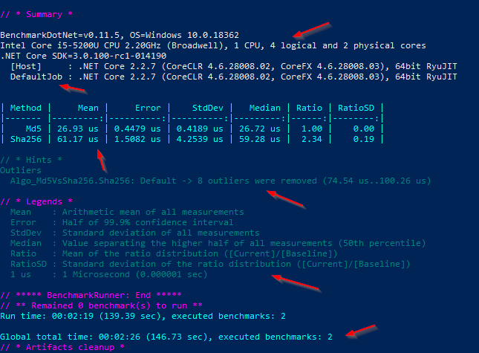
Run

Slide 4






Run
Boilerplate
Several iterations
Several invokations
Several Warm-up
Separate Process
Several environments
Subtract overhead
Check RELEASE mode
Check Inlining
Best timestamp API
Best practices by default (warm-up + isolation)

Slide 5

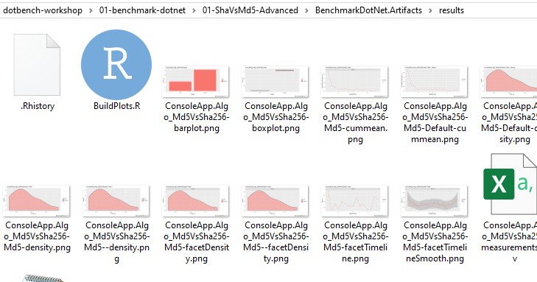
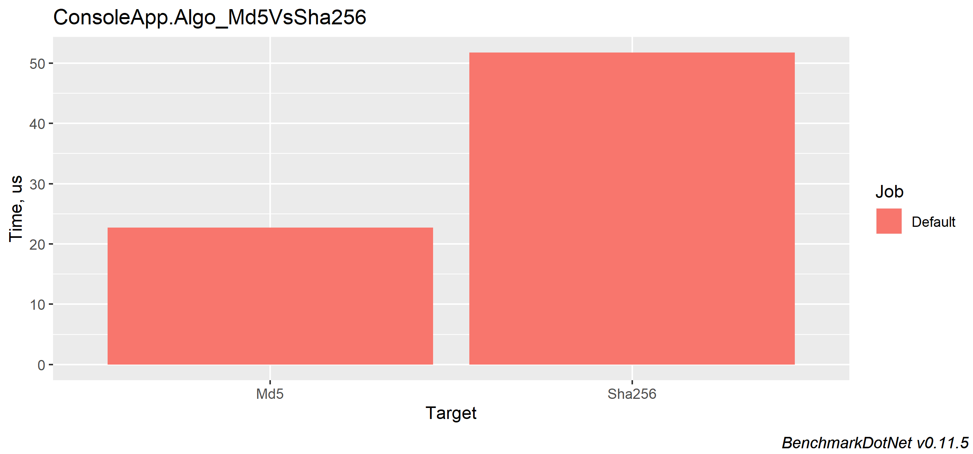
RPlotExporter

Slide 6
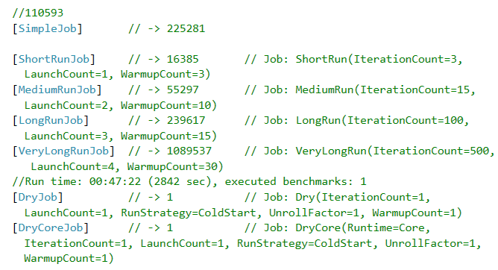
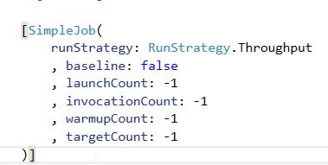
Attributes - Jobs

Slide 7
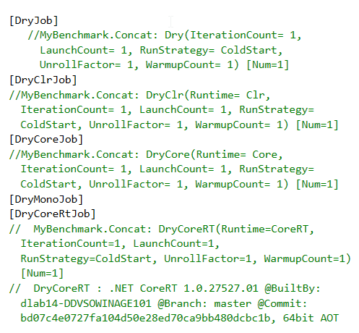
Attributes - Runtimes

Slide 8
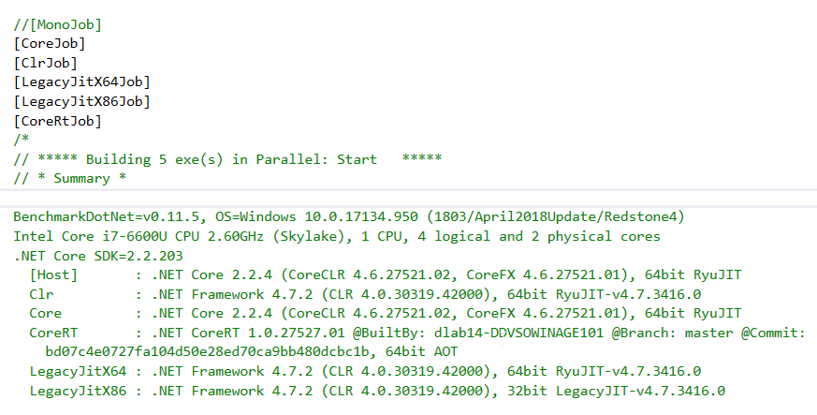
Attributes - Runtimes

Slide 9
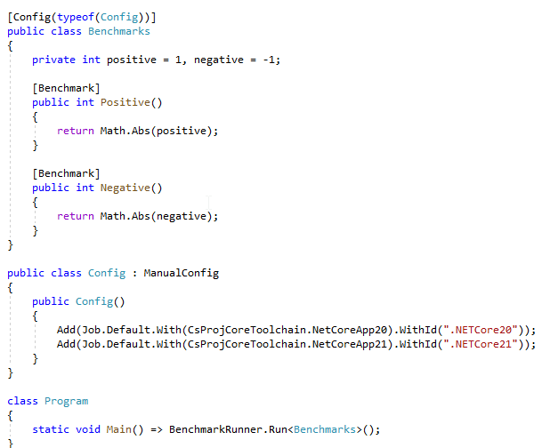
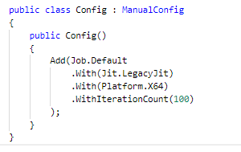
Manual Configuration

Slide 10
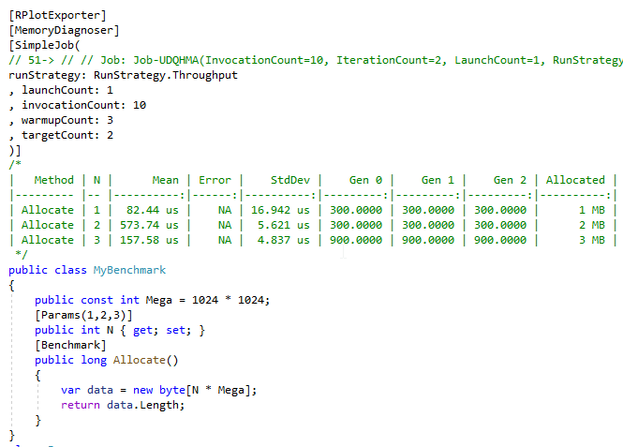
Memory Diagnoser

Slide 11
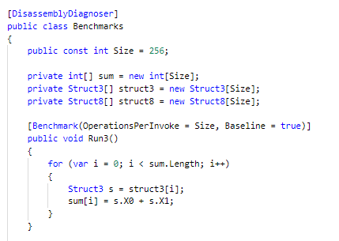
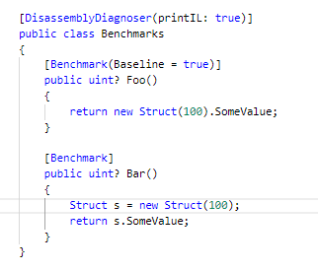
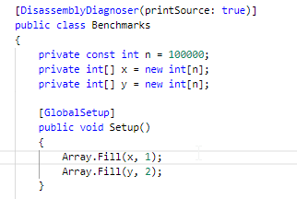
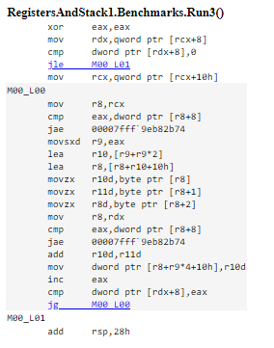
Disassembler Diagnoser

Slide 12
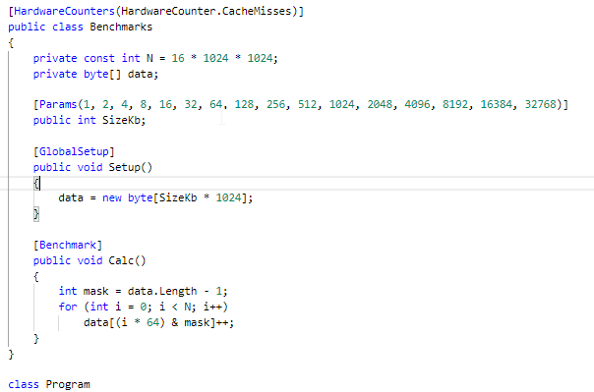
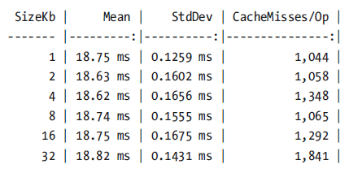
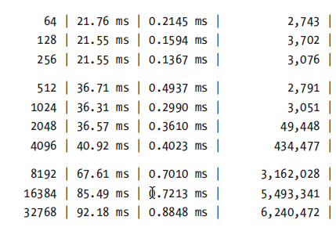
Hardware Counters

Slide 13
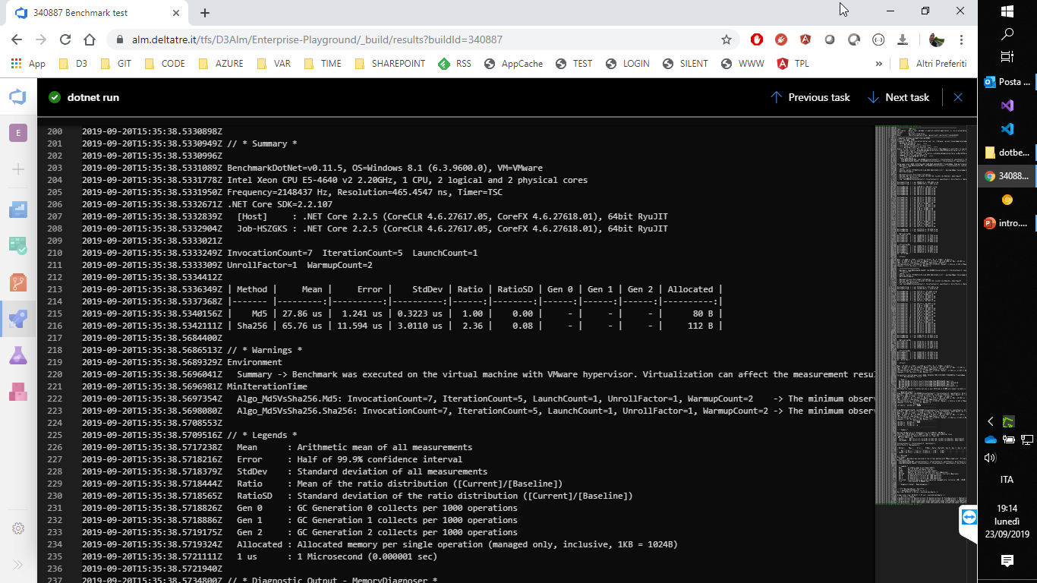
Automated in pipeline
https://alm.deltatre.it/tfs/D3Alm/Enterprise-Playground/_build/results?buildId=340887

Slide 14
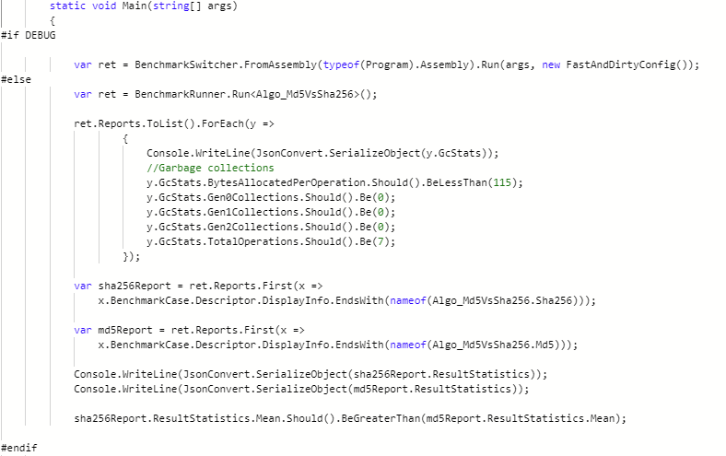
Debug & Assertions
https://alm.deltatre.it/tfs/D3Alm/Enterprise-Playground/_git/dotbench-workshop-private?path=%2FConsoleApp%2FProgram.cs&version=GBmaster&fullScreen=true

