Slide 1

Using Kerberos
the fundamentals

Slide 2

Computer/Network Security needs:
Authentication
  Who is requesting access
Authorization
  What user is allowed to do
Auditing
  What has user done
Kerberos addresses all of these needs.

Slide 3
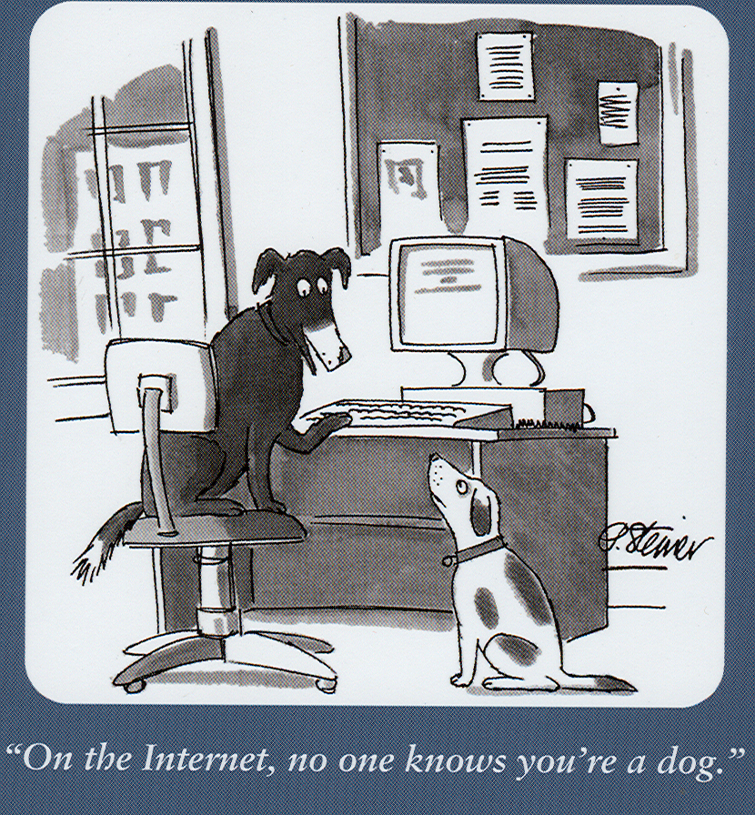
The authentication problem:

Slide 4
Authentication
Three ways to prove identity
  Something you know
  Something you have
  Something you are
Kerberos is ‘something you know’, but stronger.
Fermilab computers that offer login or FTP services over the network cannot accept passwords for authentication.
Increasing
Strength

Slide 5
What is Kerberos Good For?
Verify identity of users and servers
Encrypt communication if desired
Centralized repository of accounts
(Kerberos uses ‘realm’ to group accounts)
Local authentication
Enforce ‘good’ password policy
Provide an audit trail of usage

Slide 6
How does Kerberos Work? (Briefly)
A password is shared between the user and KDC
Credentials are called tickets
Credentials are saved in a cache
Initial credential request is for a special ticket granting ticket (TGT)

Slide 7
Using Kerberos
MS Windows
  Windows domain login
  3rd party Kerberos tools
    WRQ Reflection
    MIT Kerberos for Windows (KfW) Leash32
    Exceed
Unix, Linux and Mac OS X

Slide 8
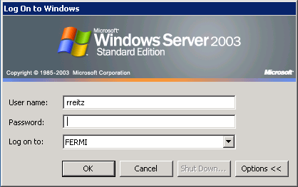
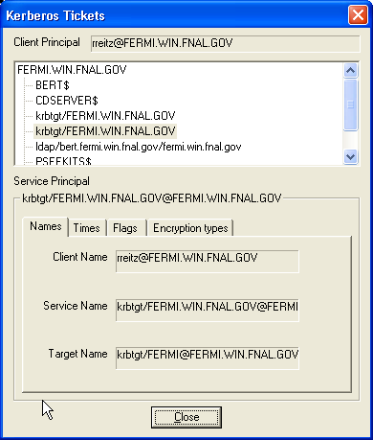
MS Windows
Domain login
Kerberos Ticket
(Windows Kerbtray.exe application)
Notice realm - FERMI.WIN.FNAL.GOV

Slide 9
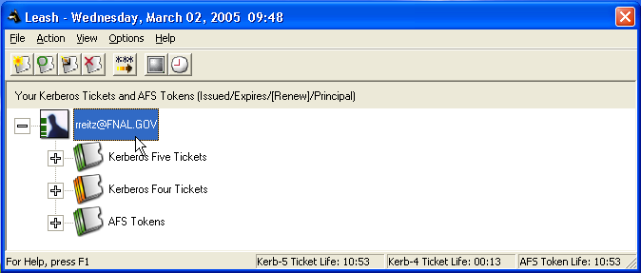
MS Windows
Managing Credentials
MIT Kerberos for Windows (KfW)
http://web.mit.edu/kerberos/
Notice realm - FNAL.GOV

Slide 10
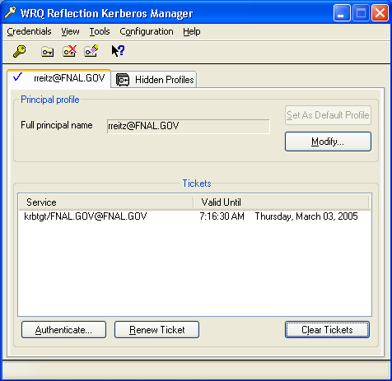
MS Windows
Managing Credentials
WRQ Kerberos Manager

Slide 11
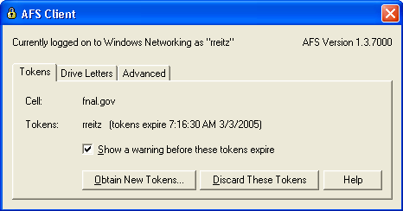
MS Windows
Managing Credentials
OpenAFS Token

Slide 12
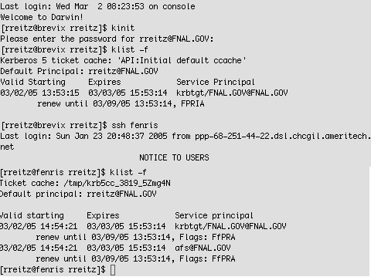
UNIX, Linux, Mac OS X
Kerberos tools:
  kinit
  klist
  kdestroy
  k5push
Clients:
  telnet, ssh, ftp
  rlogin, rsh, rcp

Slide 13
Things to watch for:
Cryptocard gothas.
SSH end-to-end?

Slide 14
Cryptocard Gotchas
Where is that ‘kinit’ command running?
(Beware of remote connections.)
Cryptocard doesn’t mean encryption.
(Cryptocard authentication yields a Kerberos credential cache.)
Notes:
Sometimes, you don’t have Kerberos-aware tools or clients. Then you use your Cryptocard.

Slide 15

SSH considerations
Use cryptocard authentication yields an ecrypted connection.
Need to be aware where the endpoints of the SSH connection are. (Beware of ‘stacked’ connections.)
Local
Host
telnet
Remote
Host
ssh
Remote
Host
Notes:
There may be non-encrypted segments of a ‘stacked’ connection.

