Slide 1
Kerberos
Jean-Anne Fitzpatrick
Jennifer English

Slide 2
What is Kerberos?
Network authentication protocol
Developed at MIT in the mid 1980s
Available as open source or in supported commercial software

Slide 3
Why Kerberos?
Sending usernames and passwords in the clear jeopardizes the security of the network.
Each time a password is sent in the clear, there is a chance for interception.

Slide 4
Firewall vs. Kerberos?
Firewalls make a risky assumption: that attackers are coming from the outside. In reality, attacks frequently come from within.
Kerberos assumes that network connections (rather than servers and work stations) are the weak link in network security.

Slide 5
Design Requirements
Interactions between hosts and clients should be encrypted.
Must be convenient for users (or they won’t use it).
Protect against intercepted credentials.

Slide 6
Cryptography Approach
Private Key: Each party uses the same secret key to encode and decode messages.
Uses a trusted third party which can vouch for the identity of both parties in a transaction. Security of third party is imperative.

Slide 7
How does Kerberos work?
Instead of client sending password to application server:
  Request Ticket from authentication server
  Ticket and encrypted request sent to application server
How to request tickets without repeatedly sending credentials?
  Ticket granting ticket (TGT)

Slide 8
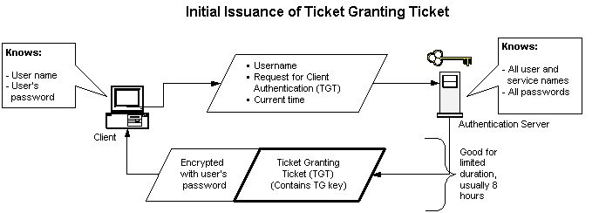
How does Kerberos work?: Ticket Granting Tickets

Slide 9
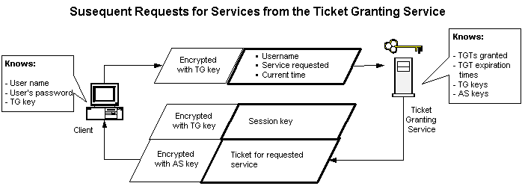
How does Kerberos Work?: The Ticket Granting Service

Slide 10
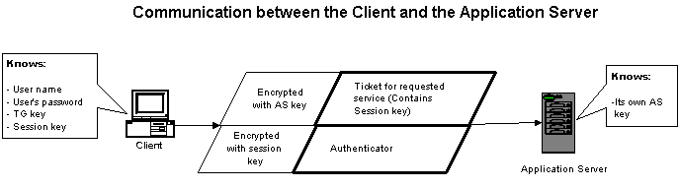
How does Kerberos work?: The Application Server

Slide 11
Applications
Authentication
Authorization
Confidentiality
Within networks and small sets of networks

Slide 12
Weaknesses and Solutions
If TGT stolen, can be used to access network services. | Only a problem until ticket expires in a few hours.
Subject to dictionary attack. | Timestamps require hacker to guess in 5 minutes.
Very bad if Authentication Server compromised. | Physical protection for the server.

Slide 13
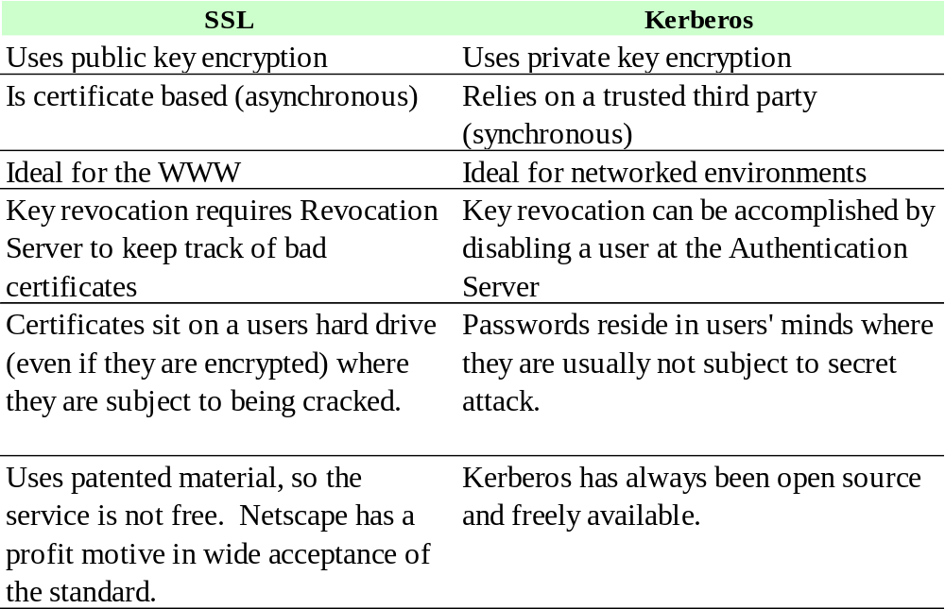
The Competition: SSL

Slide 14
Limitation: Scalability
Recent modifications attempt to address this problem
Public key cryptography for Client Authentication and cross realm authentication
Issues are not resolved

Slide 15
Questions?

