Slide 1

Chapter 4
Authentication Applications
Henric Johnson
Blekinge Institute of Technology,Sweden
http://www.its.bth.se/staff/hjo/
henric.johnson@bth.se

Slide 2
Outline
Security Concerns
Kerberos
X.509 Authentication Service
Recommended reading and Web Sites

Slide 3
Security Concerns
key concerns are confidentiality and timeliness
to provide confidentiality must encrypt identification and session key info
which requires the use of previously shared private or public keys
need timeliness to prevent replay attacks
provided by using sequence numbers or timestamps or challenge/response

Slide 4

KERBEROS
In Greek mythology, a many headed dog, the guardian of the entrance of Hades

Slide 5
KERBEROS
Users wish to access services on servers.
Three threats exist:
  User pretend to be another user.
  User alter the network address of a workstation.
  User eavesdrop on exchanges and use a replay attack.

Slide 6
KERBEROS
Provides a centralized authentication server to authenticate users to servers and servers to users.
Relies on conventional encryption, making no use of public-key encryption
Two versions: version 4 and 5
Version 4 makes use of DES

Slide 7
Kerberos Version 4
Terms:
  C = Client
  AS = authentication server
  V = server
  IDc = identifier of user on C
  IDv = identifier of V
  P_{c} = password of user on C
  ADc = network address of C
  Kv = secret encryption key shared by AS an V
  TS = timestamp
  || = concatenation

Slide 8
A Simple Authentication Dialogue
C  AS: IDc || P_{c} || IDv
AS  C: Ticket
C  V: IDc || Ticket
Ticket = E_{Kv}[IDc || P_{c} || IDv]

Slide 9
Version 4 Authentication Dialogue
Problems:
  Lifetime associated with the ticket-granting ticket
  If too short  repeatedly asked for password
  If too long  greater opportunity to replay
The threat is that an opponent will steal the ticket and use it before it expires

Slide 10
Version 4 Authentication Dialogue
Authentication Service Exhange: To obtain Ticket-Granting Ticket
C  AS: IDc || IDtgs ||TS1
AS  C: E_{Kc} [K_{c,tgs}|| IDtgs || TS₂ || Lifetime₂ || Tickettgs]
Ticket-Granting Service Echange: To obtain Service-Granting Ticket
(3) C  TGS: IDv ||Ticket_{tgs} ||Authenticatorc
(4) TGS  C: E_{Kc} [K_{c,¨v}|| IDv || TS₄ || Ticketv]
Client/Server Authentication Exhange: To Obtain Service
(5) C  V: Ticket_{v} || Authenticatorc
(6) V  C: EKc,v[TS5 +1]

Slide 11
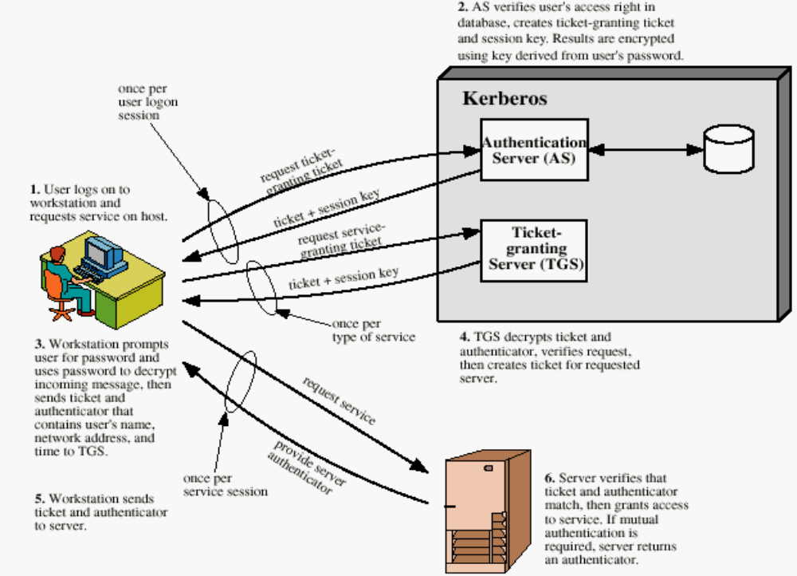
Overview of Kerberos

Slide 12
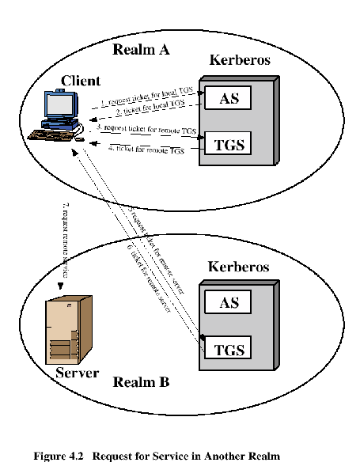
Request for Service in Another Realm

Slide 13
Difference Between Version 4 and 5
Encryption system dependence (V.4 DES)
Internet protocol dependence
Message byte ordering
Ticket lifetime
Authentication forwarding
Interrealm authentication

Slide 14
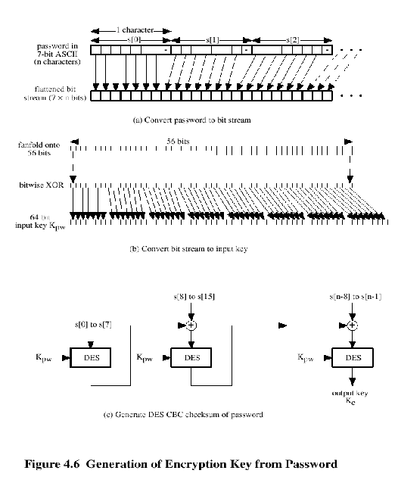
Kerberos Encryption Techniques

Slide 15
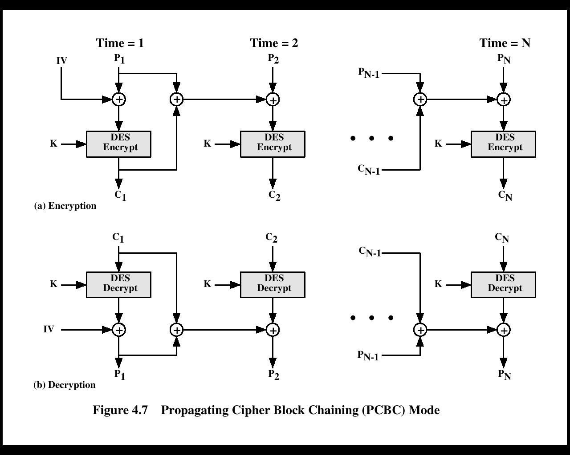
PCBC Mode

Slide 16
Kerberos - in practice
Currently have two Kerberos versions:
4 : restricted to a single realm
5 : allows inter-realm authentication, in beta test
Kerberos v5 is an Internet standard
specified in RFC1510, and used by many utilities
To use Kerberos:
need to have a KDC on your network
need to have Kerberised applications running on all participating systems
major problem - US export restrictions
Kerberos cannot be directly distributed outside the US in source format (& binary versions must obscure crypto routine entry points and have no encryption)
else crypto libraries must be reimplemented locally

Slide 17
X.509 Authentication Service
Distributed set of servers that maintains a database about users.
Each certificate contains the public key of a user and is signed with the private key of a CA.
Is used in S/MIME, IP Security, SSL/TLS and SET.
RSA is recommended to use.

Slide 18
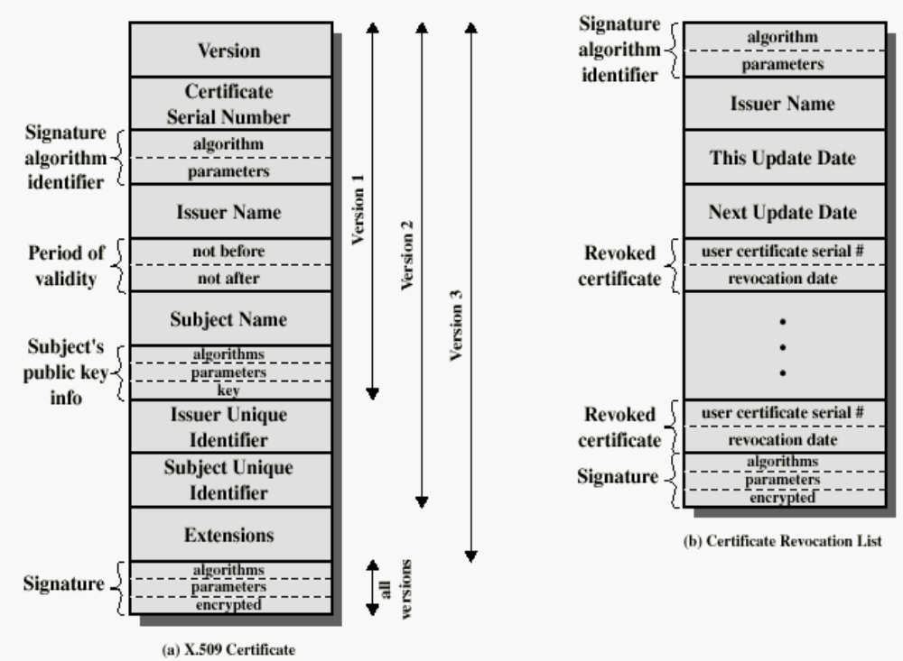
X.509 Formats

Slide 19
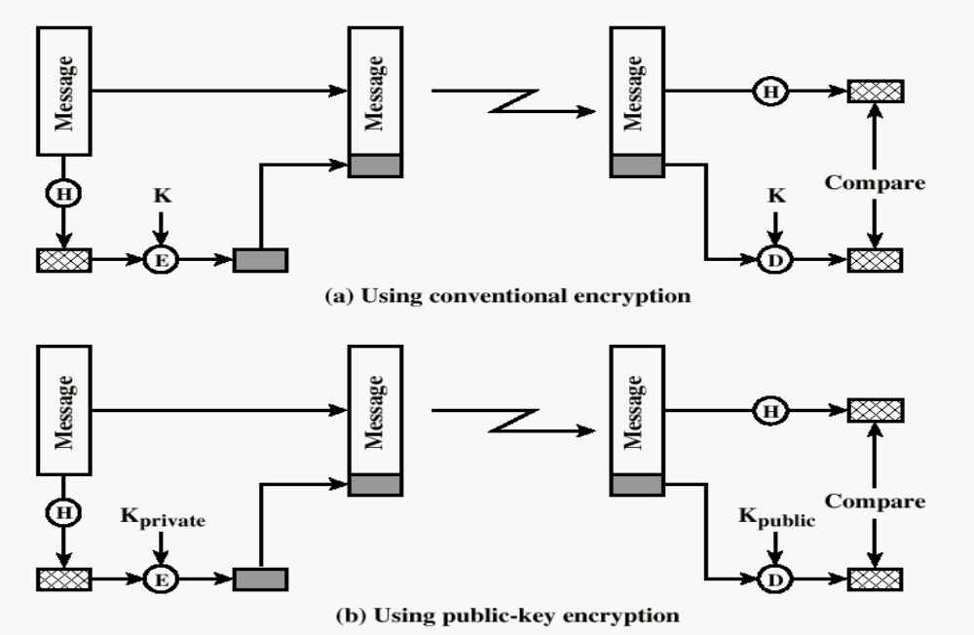
Typical Digital Signature Approach

Slide 20
Obtaining a User’s Certificate
Characteristics of certificates generated by CA:
  Any user with access to the public key of the CA can recover the user public key that was certified.
  No part other than the CA can modify the certificate without this being detected.

Slide 21
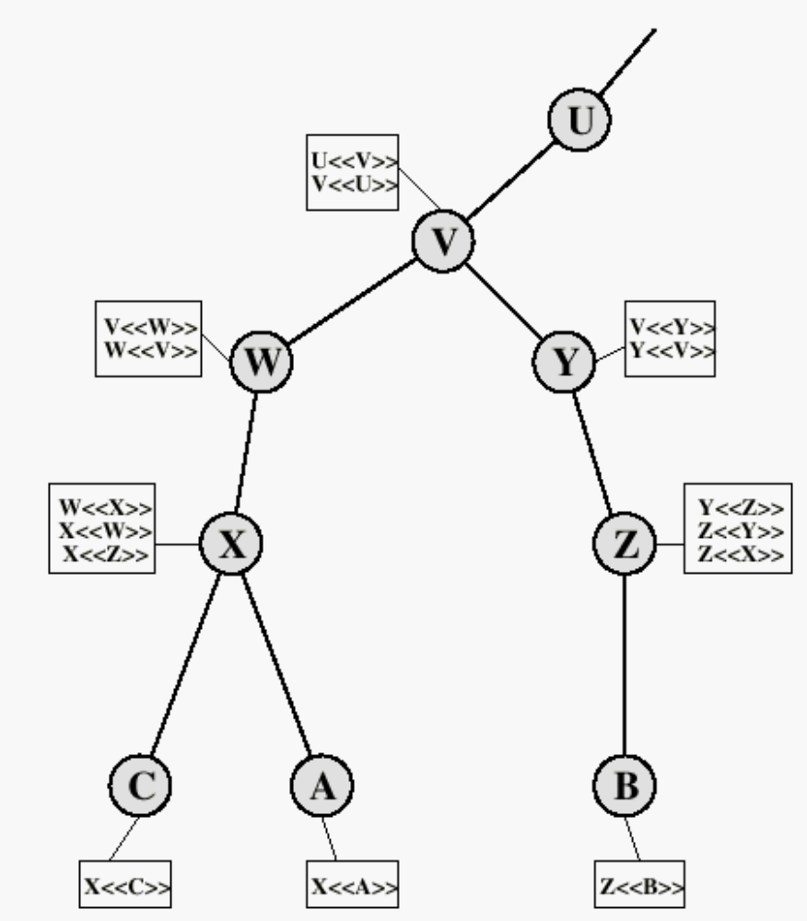
X.509 CA Hierarchy

Slide 22
Revocation of Certificates
Reasons for revocation:
  The users secret key is assumed to be compromised.
  The user is no longer certified by this CA.
  The CA’s certificate is assumed to be compromised.

Slide 23
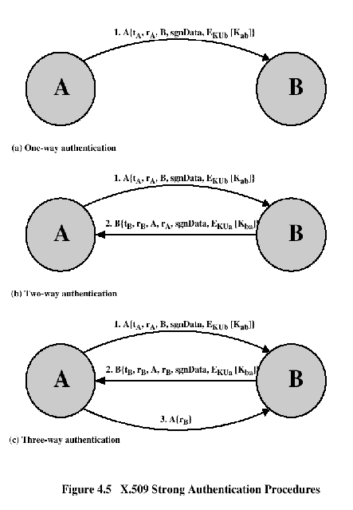
Authentication Procedures

Slide 24
Recommended Reading and WEB Sites
www.whatis.com (search for kerberos)
Bryant, W. Designing an Authentication System: A Dialogue in Four Scenes. http://web.mit.edu/kerberos/www/dialogue.html
Kohl, J.; Neuman, B. “The Evolotion of the Kerberos Authentication Service” http://web.mit.edu/kerberos/www/papers.html
http://www.isi.edu/gost/info/kerberos/

