Slide 1

SNOW MELTING MATS
MEE4099 CAPSTONE PROJECT
Final Presentation
Shelvin Pauly (16BME1191)
Rajit Halder (16BME1189)
Dr M Sasikumar
School of Mechanical Engineering

Slide 2
Contents
Introduction
Field of Work and Objectives
Literature survey
Methodology/Work Plan (Chart)
Design standards & Realistic Constraints
Project Demonstration
Conclusions
Future Scope
Timeline
References

Slide 3
Introduction
The primary problem we have tried to tackle is to design a heating mat system that can be placed over cars and will help in removing the accumulated ice and snow over the vehicles. This design is to be included with a convenient heat source and should be structured properly as that it fits on the car roof without much hindrance and stays affixed there. About 33% of industrialized Earth experiences heavy snowfall. Snowfall creates various hindrances that which is mostly concentrated causing machinery to lose the edge and cause technical difficulties in moving parts. Snowfall accumulation over unmoving vehicles is a widely experienced problem. Failing to tackle the problem of unmelted snow can cause accidents on road and could also damage vehicular parts. Hence our project tackles the problem in a modern and sustainable way

Slide 4
Field of Work and Objectives
Area of Work:
Area of work involves Cold Region Sciences.
Also involves applications of IoT.
Also involves designing of heat generation system through usage of heat producing resistive wires.
Objectives
The project aims to present a heating mat that shall be placed on the roof of automobiles and shall help in melting the ice accumulated during times of heavy snowing.
It shall include smart sensing of snow accumulation. Prolonged usage of electricity and heat generation will not be required as heat will be supplied as long as there is unmelted snow present. This will also help in reducing costs.
The Heating Mat itself shall me made with lightweight, flexible material so that portability is made easier.

Slide 5
Literature Survey
Sl. No. | Paper title | Journal Name | Author and Year of Publication | Important findings
1. | Review of technologies for snow melting systems | Journal of Mechanical Science and Technology | Kwesi Mensah, Jong Min Choi, 2015 | Due to many serious problems associated with snow accumulations during winter season, the removal of snow is not only a convenience, but can as well enhance safety and prevent property damage.
2. | Electrical resistance heating for deicing and snow melting applications: Experimental study | Cold Regions Science and Technology | Abubakar Gambo Mohammeda, Gokhan Ozgurb, Ercan Sevkatc, 2019 | Using electrical resistance heating enough heat was generated to performing melting and deicing operations

Slide 6
Literature Survey
Sl. No. | Paper title | Journal Name | Author and Year of Publication | Important findings
3. | Thermal Conductivity of Graphite-Based Polymer | Impact of Thermal Conductivity on Energy Technologies | Teboho Clement Mokhena, Mokgaotsa Jonas Mochane, Jeremia Shale Sefadia, 2018 | Using graphite based polymer we can help in proper heat conduction and spread of heating to melt snow uniformly

Slide 7
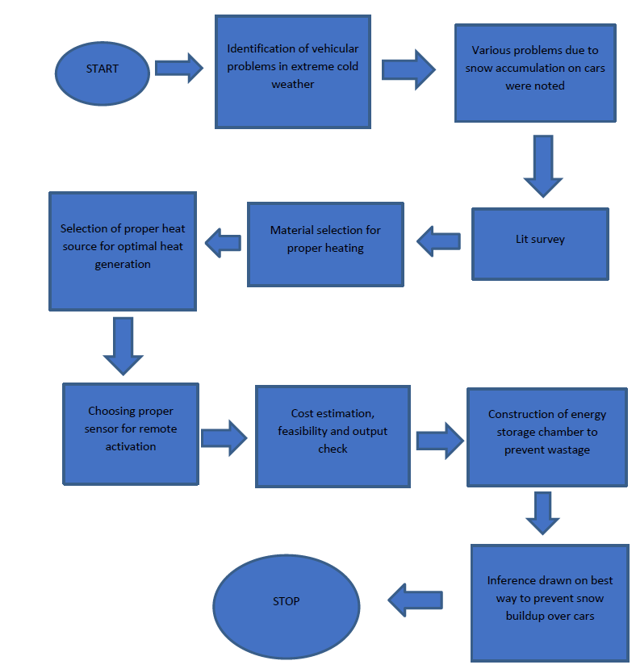
Methodology/Work Plan

Slide 8
Design Standards & Realistic Constraints
Design standards used in the project:
Arduino UNO 5V
Relay Module REES52 16220 4 CHANNEL 5V MODULE
Compression Load Cell (TE CONNECTIVITY FX1901-0001-0025-L COMPRESSION LOAD CELL, 25LB, 5VDC)
NodeMCU ESP-12E module similar to ESP-12 module but with 6 extra GPIOs.
FR4 Fibreglass Sheet 300*150mm, Sheet Length: 300mm / 11.8" Width: 150mm / 5.9" Thickness: 0.8mm
PANASONIC ELECTRONIC COMPONENTS EYGA091203PA Thermal Interface Material, EYG Series, 1700 W/m.K, Graphite Sheet, 0.025 mm
Nichrome Resistance wire; 1.72Ω/m; -100÷1300°C; Øout: 1mm; FeCrAl; 0,1kg

Slide 9
Design Standards & Realistic Constraints
Realistic constraints of the project:
Carbon fiber as the conducting material was not chosen due to its high manufacturing cost and not so easy availability although it had higher conductivity and was more durable.
Tungsten was not chosen as the heating element because it oxidized when exposed to the atmosphere although it gave high heating values.
Lack of snowfall in our regions suppresses proper testing methods of our product and proper study of snow particles and characteristics was not possible
3D simulation of the product was not successful due to extremely high load times.

Slide 10
Project Demonstration
Technical Details:
The basic concept includes heat generation through resistance provided with high resistivity wires.
These wires are connected to an Arduino which interprets information through a relay and a weight sensor.
The wires are situated below a flexible and durable material that forms our mat.
Snow accumulation on the surface of mat causes weight changes that gets relayed the Arduino present inside the adapter connected to an AC source.
Current is generated through the adapter into the NodeMCU which converts the AC to DC and provides it to our thermally resistive wires.
Removal of load signals the Arduino which in turn cuts off the flow of electricity hence signaling that all the ice has melted.

Slide 11
Project Demonstration
Components:
Arduino Uno
Relay Module REES52 16220 4 CHANNEL 5V
Compression Load Cell
Node MCU
Heat resistive Nichrome Wires
Graphite Sheet as Conducting element and main body of mat
Fibre Glass as Insulative protection

Slide 12
Project Demonstration
Design Approach:
A flexible heating mat for preventing the accumulation of snow or ice on a vehicle comprising: a flat flexible mat casing having upper and lower surfaces, a single flexible elongated heating strip of small cross-section sealed within said casing, a first flexible electric cord power entering an edge of the casing near a first side thereof and generally coplanar with the mat at the said edge
First cord having a male electric plug thereon for connecting the adaptor containing Arduino and NodeMCU to a source of power, said heating strip comprises of tightly wound coil of thermally resistant wires covered by a thermally conductive and flexible material.
The bottom of the heating area is supported by a thermal insulator. The main considerations to be taken are choice of the materials that make our mat, the choice of a proper wire with high resistivity which produced enough heat to melt heavy snowfall accumulation and also the insulator which prevented heat to slip out to unwanted areas hence causing damage to our vehicles and also heat loss causing unwanted energy losses.

Slide 13
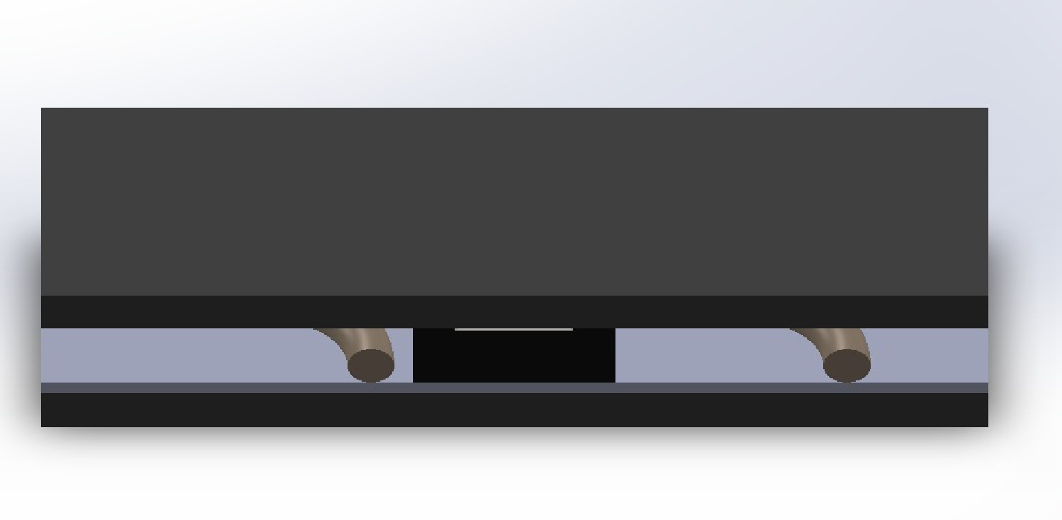
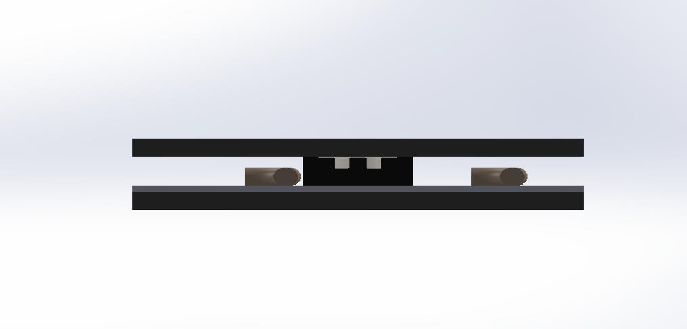
Project Demonstration
Design of Mat on Solidworks:
Isometric View
Front View

Slide 14

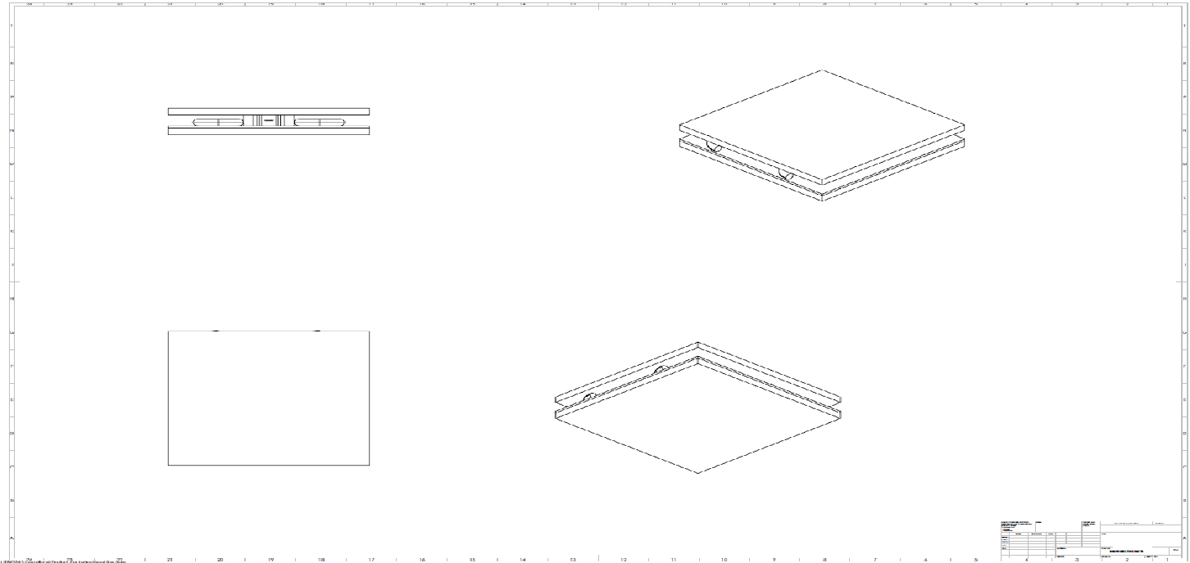
Project Demonstration
Design of Mat on Solidworks:
Side View
2D Views

Slide 15
Project Demonstration
Formulas Used:
Ɵ = R_{o} - R_{i}
R_{c} = 4ρ(Ro² - Ri²)/Ɵ²
P = V² ⁄ R_{c}
Standard Values:
Parameter | Value
Standard Voltage Supplied | 230 V
Resistivity of nichrome | 1.1 x 10⁻⁶ Ωm
Diameter of nichrome wire | 2 mm

Slide 16
Project Demonstration
Result values after Calculation:
Parameter | Value
Inner Radius of wire | 8 mm (Hit and Trial)
Outer Radius of wire | 10 mm (Hit and Trial)
Length of wire required | 7 m (Hit and Trial)
Resistivity of wire used | 69.3 Ω
Power Rating | 763.85 ~ 800W

Slide 17
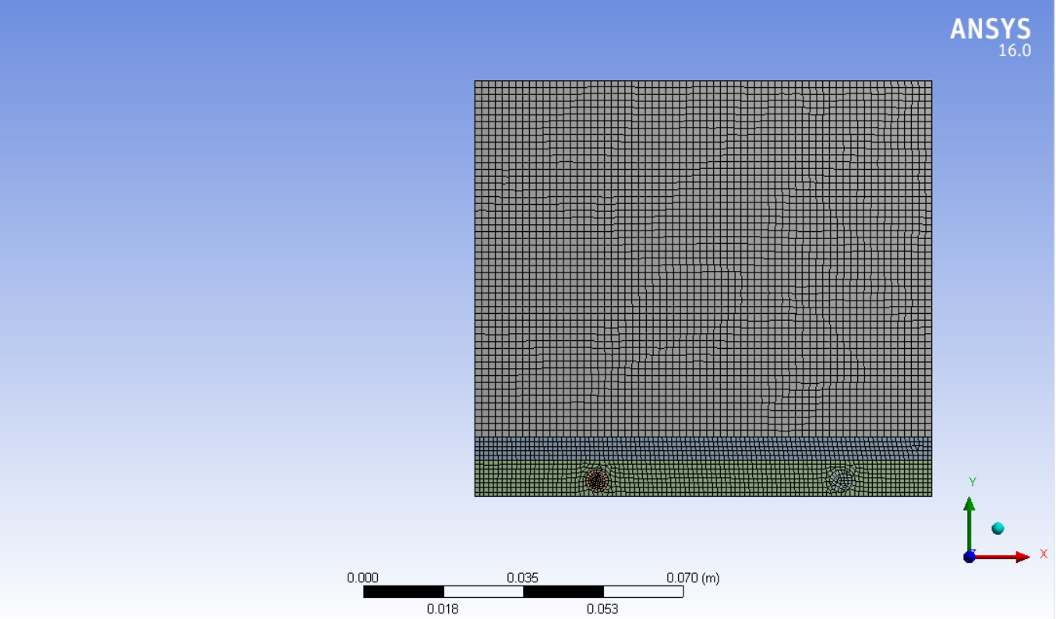
Project Demonstration
Simulation:
The simulation was set up in Ansys. The 2 D model was created using Solidworks and then imported to Ansys Workbench. A Transient thermal analysis system was used to simulate the process. Here we have considered 100mm*100mm of the mat which is used to melt 2.5 inches of snow spread throughout its geometry. The simulation tries to heat the snow until it reaches its vapour state. Meshing for all the cases is kept the same.

Slide 18
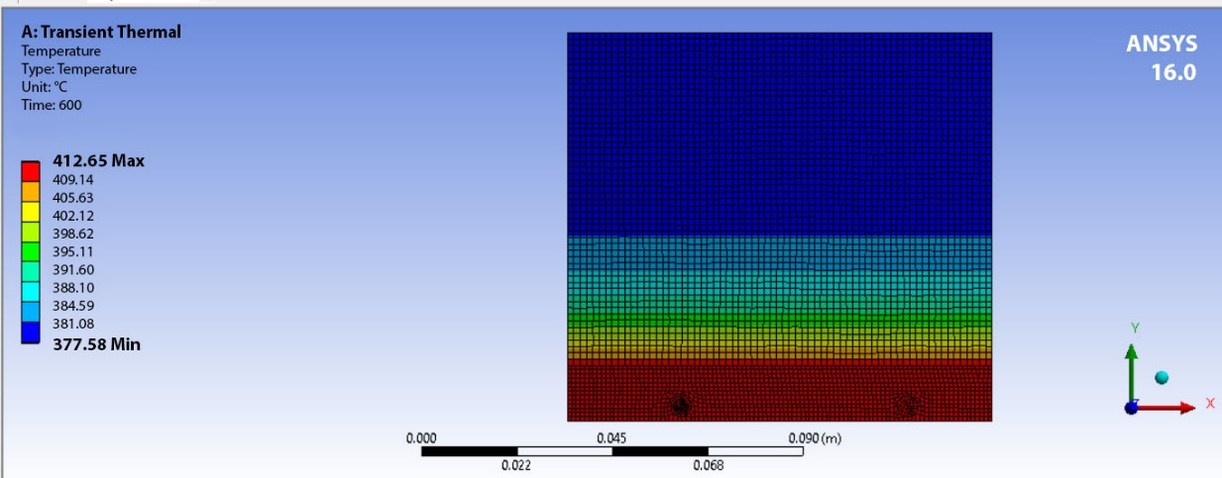
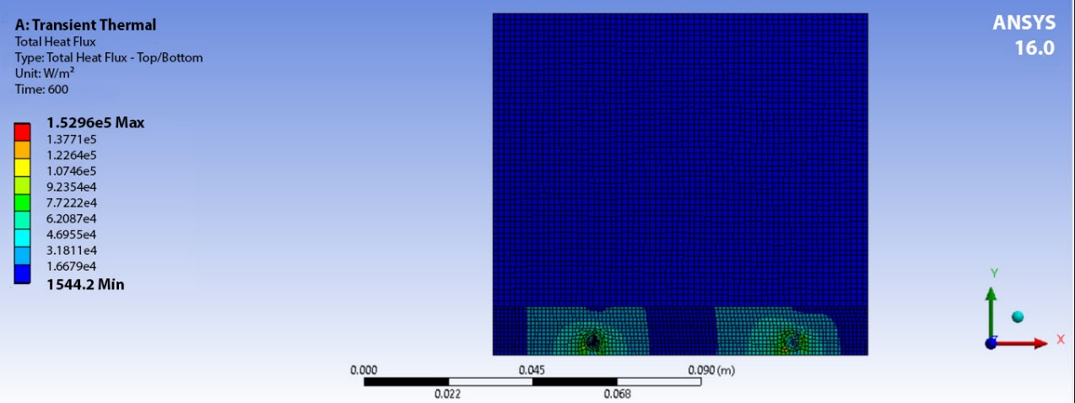
Project Demonstration
Analysis at -8℃:
Settled Snow

Slide 19
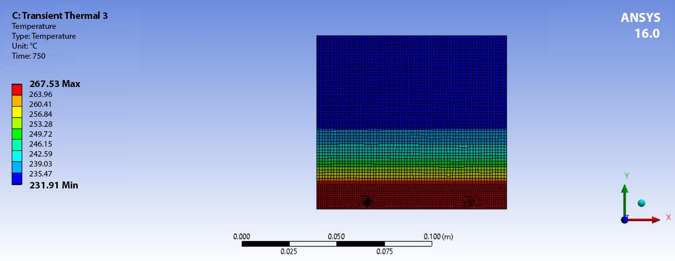
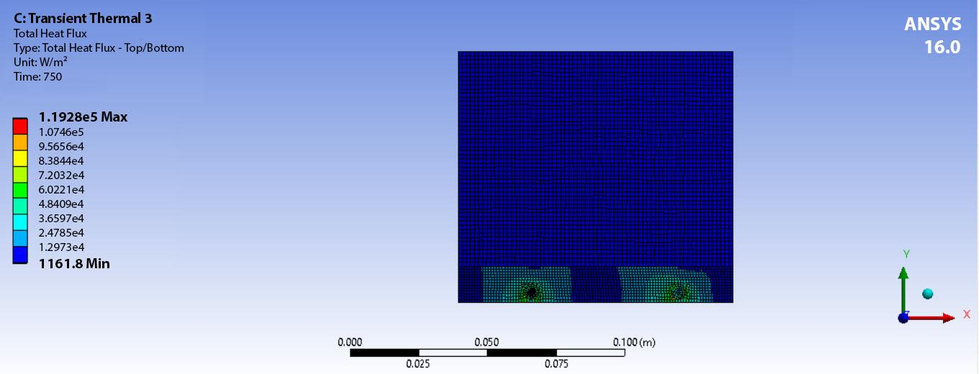
Project Demonstration
Depth Hoar

Slide 20
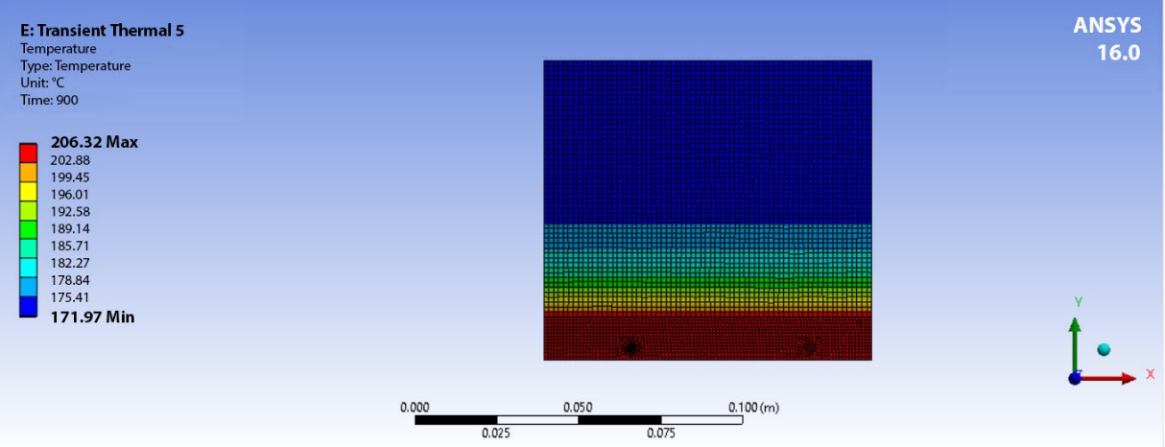
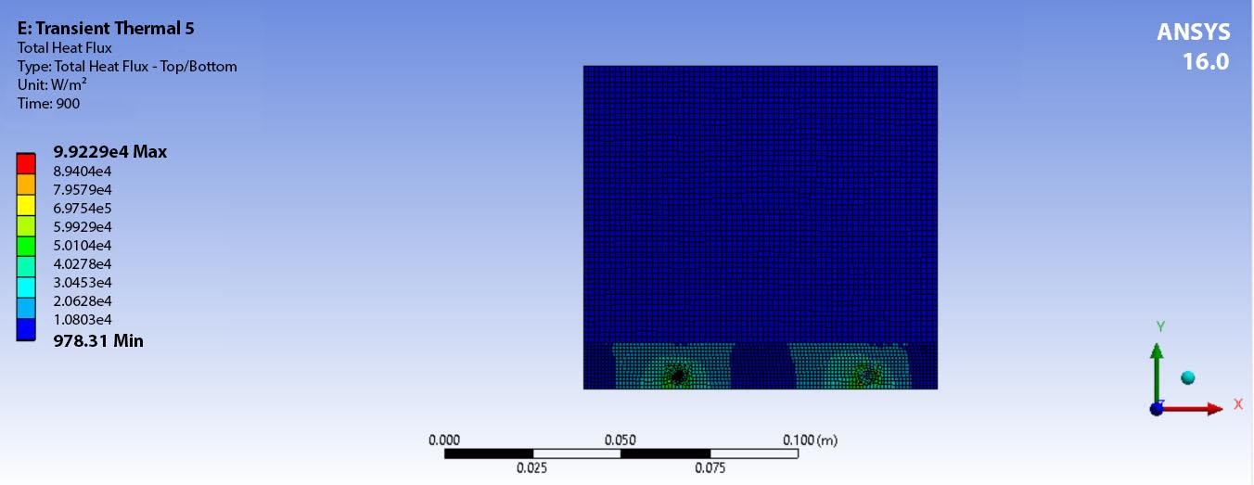
Project Demonstration
Wind Packed Snow

Slide 21
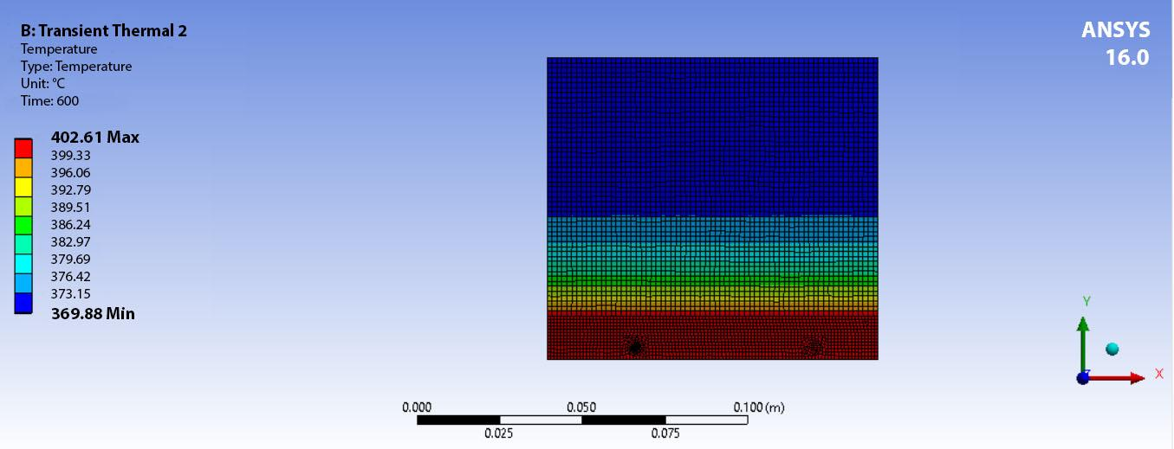
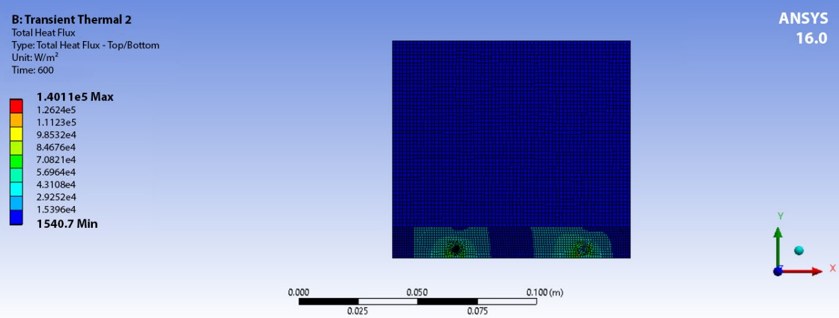
Project Demonstration
Analysis at -15℃:
Settled Snow

Slide 22
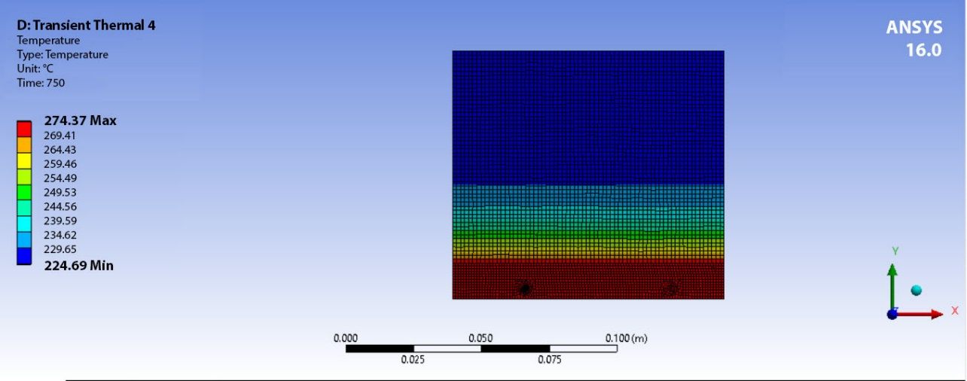
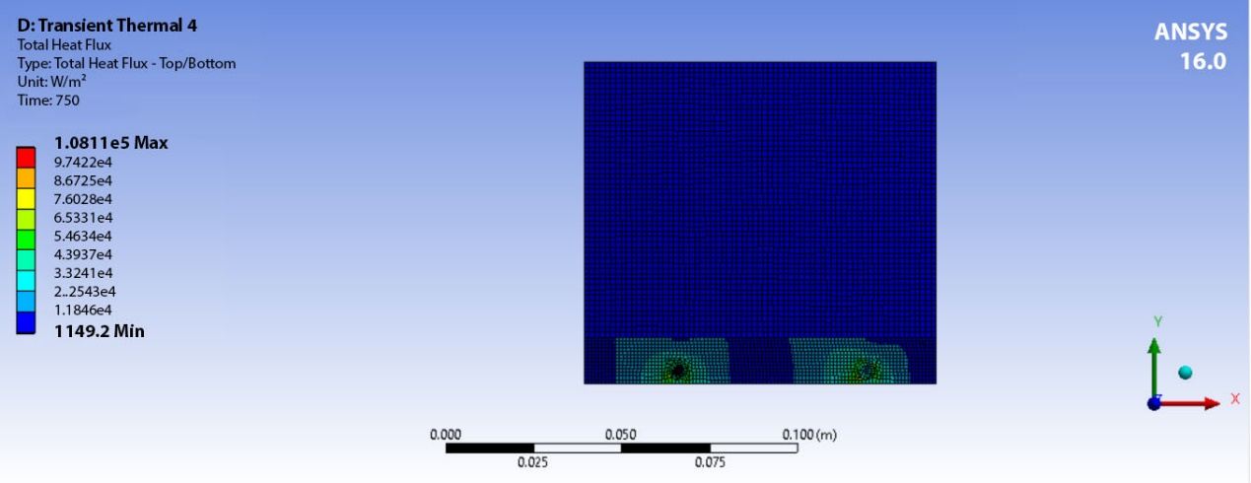
Project Demonstration
Depth Hoar

Slide 23


Project Demonstration
Wind Packed Snow

Slide 24
Conclusions
Our product uses a load cell to prevent energy wastage. In today’s day and age high energy consumption is a highly prevalent problem. To reduce that we have added the usage of microcontrollers to stop electricity supply when said task of melting the snow gets completed. This technology reads changes in load atop the mat surface to determine whether or not heat is required and in turn if electricity should be provided or not.
The mat is also made up of highly durable materials as the mat itself so that it lasts longer, and also the heat supplied from the heated wires does not damage. Due to the usage of flexible and lightweight materials it has easy portability.
Theoretical calculations suggested a power rating of 800 W over a 100x100 mm surface of the mat which was confirmed by the Heat Flux Gradient maping found through simulations on ANSYS.

Slide 25
Conclusions
To check the proper melting of snow, simulations were carried out on 3 different types of snow i.e Settled Snow, Depth Hoar and Wind Packed Snow each of 2.5 inches height.
Analysis was carried out on Settled Snow at -8ºC and -15ºC
Heat was supplied for about 600 seconds to the snow which started at -8ºC and the temperature of the top surface of the snow reached minimum temperatures of 377.58ºC, indicating that the snow was melted and removed by vaporising.
Heat was supplied for about 600 seconds to the snow which started at -15ºC and the temperature of the top surface of the snow reached minimum temperatures of 369.88ºC, indicating that the snow was melted and removed by vaporising.
Analysis was carried out on Depth Hoar at -8ºC and -15ºC
Heat was supplied for about 750 seconds to the snow which started at -8ºC and the temperature of the top surface of the snow reached minimum temperatures of 231.91ºC, indicating that the snow was melted and removed by vaporising
Heat was supplied for about 750 seconds to the snow which started at -15ºC and the temperature of the top surface of the snow reached minimum temperatures of 224.69ºC, indicating that the snow was melted and removed by vaporising.
Analysis was carried out on Wind Packed Snow at -8ºC and -15ºC
Heat was supplied for about 900 seconds to the snow which started at -8ºC and the temperature of the top surface of the snow reached minimum temperatures of 171.97ºC, indicating that the snow was melted and removed by vaporising
Heat was supplied for about 900 seconds to the snow which started at -15ºC and the temperature of the top surface of the snow reached minimum temperatures of 164.98ºC, indicating that the snow was melted and removed by vaporising.

Slide 26
Future Scope
The future scope for this product is quite broad. With better research and funds carbon polymers with a proper material blend can be used which has better conductivity and can spread the heat to melt the snow faster also. Construction of a heat reservoir to store excess heat so that even electricity is not supplied but snow melts would also vastly improve energy wastage.

Slide 27
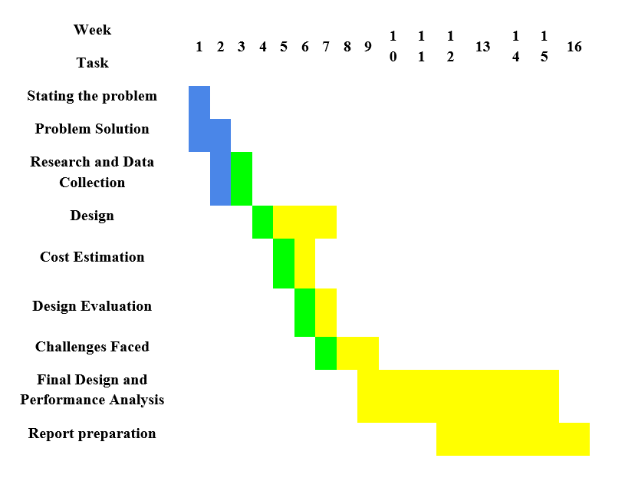
Time line

Slide 28
References
Taejin Kim, D.D.L. Chung : Carbon fiber mats as resistive heating elements (2002)
Abubakar Gambo Mohammed, Gokhan Ozgur, Ercan Sevkat : Electrical resistance heating for deicing and snow melting applications: Experimental study (2019)
Kwesi Mensah, Jong Min Choi : Review of technologies for snow melting systems (2015)
S. Enoki, K. Iwamoto, R. Harada, K. Tanaka, T. Katayama : Heating properties of carbon fibers by using direct resistance heating (2012)
Ronald E. Bayless, James M Havard : Snow Melting Heater Mats (1988)
Virginia Tech. "Student research team accelerates snow melt with 'Melt Mat': A student team discovered a solution for municipalities looking to save money and for homeowners hoping to avoid snow shovel duty." ScienceDaily. ScienceDaily, 15 February 2018. www.sciencedaily.com/releases/2018/02/180215180313.htm
Teboho Clement Mokhena, Mokgaotsa Jonas Mochane, Jeremia Shale Sefadia : Thermal Conductivity of Graphite-Based Poklymer(2018).
Wei Zhang, Abbas A, Dehghani-Sanij : Carbon based conductive polymer composites(2007).
https://www.linkedin.com/pulse/physics-snow-melting-gary-hilton
http://www.brysonics.com/heating-a-nichrome-wire-with-math
http://www.coilgun.eclipse.co.uk/coil_resistance_formula.html
https://www.jlcelectromet.com/nickel-chromium-heating-resistance-alloy-grades.html
https://patents.google.com/patent/US6049063A/en

