Slide 1
loan eligibility

Slide 2
Libraries imported/used
Pandas
Read_csv
Profiling -> ProfileReport : to create a report of the data
Numpy
Matplotib.pyplot
Seaborn
Plotly.express
Imblearn.over_sampling
RandomOverSampler :

Slide 3
Sklearn:
Metrices:
accuracy_score
confusion_matrix,
classification_report
r2_score
mean_absolute_error
mean_squared_error
roc_curve
roc_auc_score
model_selection
train_test_split
GridSearchCV
learning_curve
Ensemble
RandomForestClassifier

Slide 4
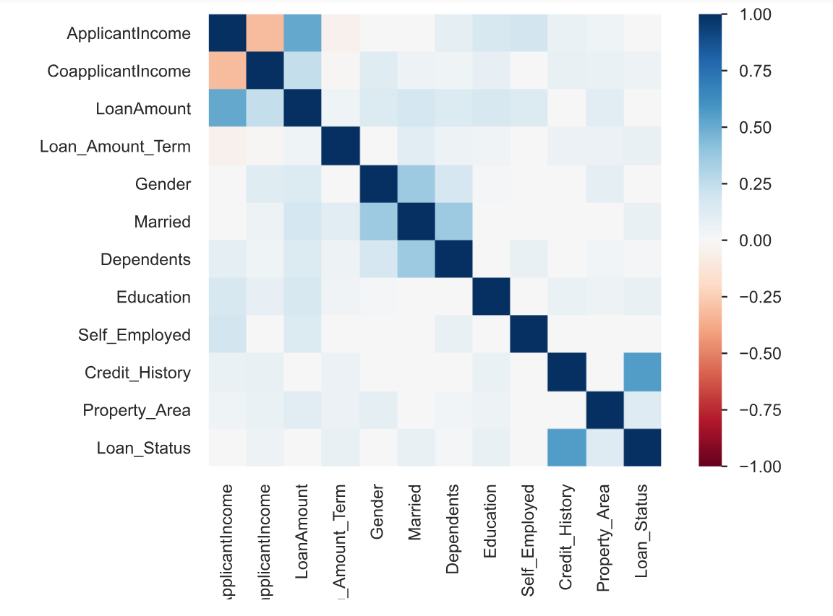
Correlations between variables

Slide 5
Preprocessing to the data
Null values
Fill gaps
Separate the output column
Step 1 description
Step 2 description
Step 3 description
Fill the null cells by :
Drop not required columns
Mode -> object
Mean -> numeric
Assign the output (y) to new variable
Calculate the number of null cells in each column

Slide 6
X, y = RandomOverSampler().fit_resample(X, y) ax = sns.countplot(x=y)
-The solution of class imbalance problem is to randomly resample the training dataset
One of the main approaches to randomly resampling an imbalanced dataset is oversampling that duplicates examples from the minority class
1- import imblearn
2- RandomOverSampler() method
3- fit.resample() to fit the oversample and apply it to the database
seaborn.countplot() : Show the counts of cells in each categorical bin using bars ,, to make sure there is no unbalancing problem

Slide 7
y = LabelEncoder().fit_transform(y)
Import preprocessing.LabelEncoder from sklearn
LabelEncoder is used to convert categorical columns into numerical ones so that they can be fitted by machine learning models which only take numerical data but it assigns a unique number(starting from 0) to each class of data. This may lead to the generation of priority issues during model training of data sets

Slide 8
Mapping To object columns
(Assign each possible value in a column to a unique number starting from 0 ) in a dictionary where key=value of cell , value = number assigned
gender_mapping = {'Male': 0, 'Female': 1}
…
…
np.vectorize() function is used to convert every element in the columns according to the dictionary
X[:, 0] → 1st column , all rows
X[:, 0] = np.vectorize(gender_mapping.get)(X[:,0])

Slide 9
GridSearchCV
GridSearchCV is a technique for finding the optimal hyperparameter values from a given set of parameters in a grid to be suitable for the model
estimator=sklearn model
param_grid= dictionary with parameter names as keys and lists of parameter values
cv= integer that is the number of folds for K-fold cross-validation
Scoring = performance measure
Best_parmas_ → combination of hyperparameters along with values that give the best performance

Slide 10
Model building
Split the dataset into training and testing sets
Initialize the Random Forest Classifier
Train the model using the training data & make predictions on the test data
Step 1 method
Step 2 method
Step 3 methods
train_test_split()
RandomForestClassifier(n_estimators=150, random_state=43)
clf.fit(X_train, y_train)
y_pred = clf.predict(X_test)

Slide 11
RandomForest:
supervised Machine learning algorithm
Random forests can be used for solving regression and classification problems
creates a set of decision trees from a randomly selected subset of the training set
Each decision tree is like an expert, providing its opinion on how to classify the data
Predictions are made by calculating the prediction for each decision tree
Take the most popular result

Slide 12
Evaluation compare y_true and y_predict
Model’s accuracy:
accuracy_score(y_test, y_pred)
Quality of the output:
confusion_matrix(y_test,y_pred)
Heatmap is a graphical representation of data using colors to visualize the value of the matrix

Slide 13
import roc_curve, roc_auc_score
Predict_proba used to predict the probability of occurrence of a sample belonging to a particular class in a classification problem.
ROC Curve is a graph displaying the performance of a classification model. It is a very popular method to measure the accuracy of a classification model.
Roc_auc() is a metric that computes the area under the Roc curve,, range of the AUC ROC curve score is between 0 and 1 & value of 1 is perfect prediction model
True Positive Rate is the proportion of observations that are correctly predicted to be positive.
False Positive Rate is the proportion of observations that are incorrectly predicted to be positive

Slide 14
--Import learning_curve learning curve is a plot that show changes in learning performance over time in terms of experience Learning curves of model performance on the train and validation datasets can be used to diagnose an underfit, overfit, or well-fit model
Calculate the mean and standard deviation of training and test scores: np.mean() & np.std()

Slide 15
User input and make loan eligibility prediction using Random Forest
1- take inputs from the user ,, convert needed ones to int or float
2- create dataframe and save the taken inputs in it
3-encode the object values using mapping and resave result in the dataframe
4-make prediction on the user input data using predict()
5-Interpret the prediction :
if prediction == 1 → approved ,, else → rejection

Slide 16


