Slide 1
Ctrl+Alt+Defeat Project 1
February 14, 2024

Slide 2
Group members
Chuchu Wang
Brian Quintero
Jennifer Tran
Sumain Hemani

Slide 3
Evaluation of Data Science Salaries from 2020-2023
Outline of Presentation:
Data cleaning process, job experience analysis
Salary Distribution across Jobs and Experience levels
Work Environment Analysis
Future Outlook
Notes:
We decided to exclude 2024 from the raw data and evaluation because there hasn’t been enough data in the year so far which can cause the analysis to be skewed

Slide 4
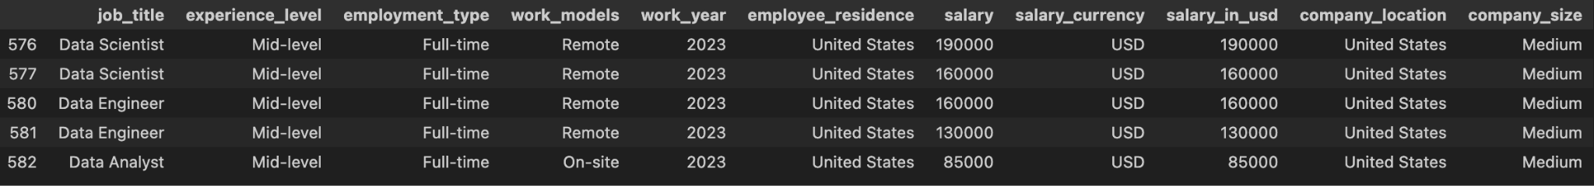
Data cleaning process
Remove irrelevant observations
Salary currency: USD only
Company location: United States
Remove year 2024 data
Replace and rename similar job title
Top 5 jobs
Data Scientist
Data Engineer
Data Analyst
Machine Learning Engineer
Analytics Engineer

Slide 5

Experience Level vs Average Salary
Prediction: expecting to see salary increase with work experience level goes up
Method:
Compare the average salary of the four work experience levels for top 5 jobs
Look details on the boxplot visually to compare each job title average salary on the experience level

Slide 6
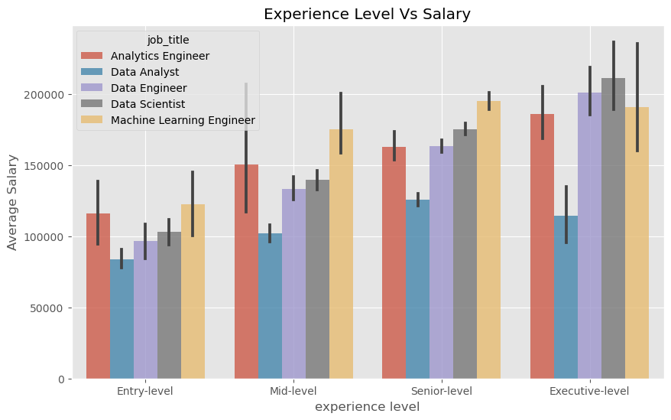
Experience Level vs Average Salary
Positive Salary increase over experience level
Data Scientist: doubled salary from Entry level to Executive level

Slide 7
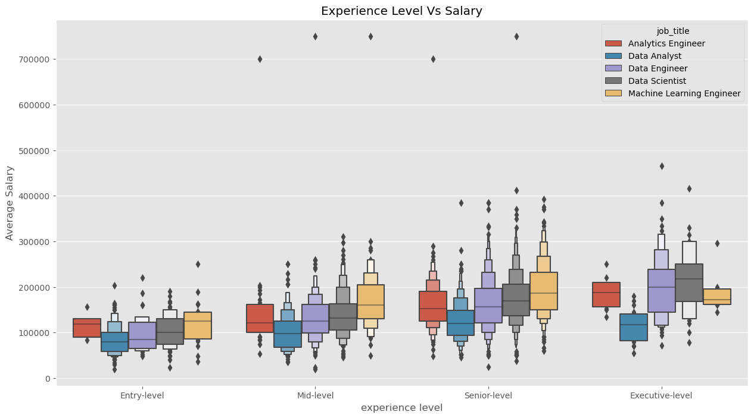
Experience Level vs Average Salary
Senior level: larger spread of data
Analytics Engineer: smaller spread of data
Data Analyst: lower average salary

Slide 8
Salary Distribution by Job Title and Experience Level
Deeper dive into Salary distribution among different job titles for four experience levels:
Entry-level
Mid-level
Senior-level
Executive-level
What is the salary distribution for each Job Title as you move from Entry-level experience to Executive Level?
Which Job Titles show the most potential for increasing

Slide 9
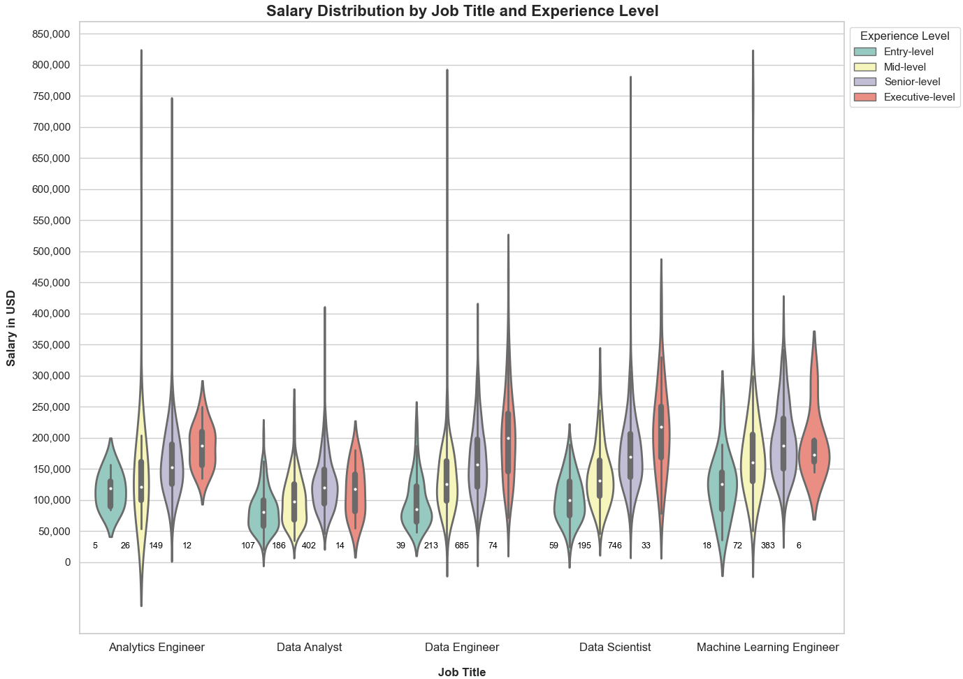
Salary Distribution based on Data for 2020 - 2024

Slide 10

Salary Difference in Work Environment
Work environment is important factor to consider when you are job searching.
Hybrid
On-Site
Remote
How does salary differ when it comes to work environments?

Slide 11
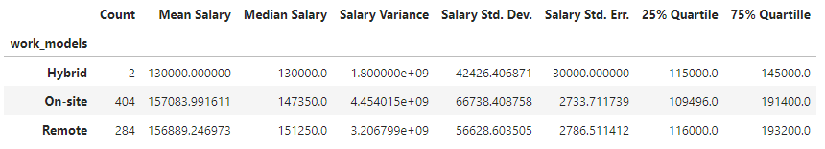
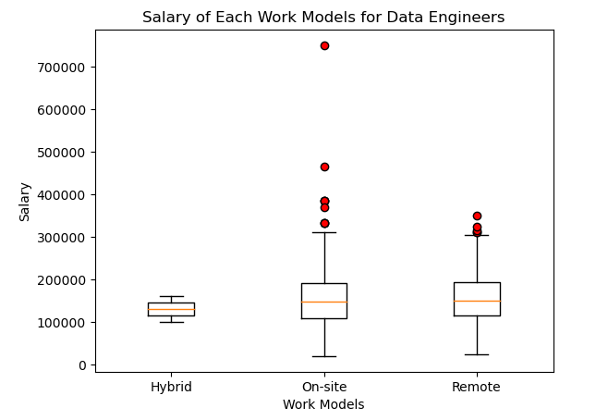
Data Engineer
There is no statistical difference in relation of work models to salary for a data engineer.

Slide 12
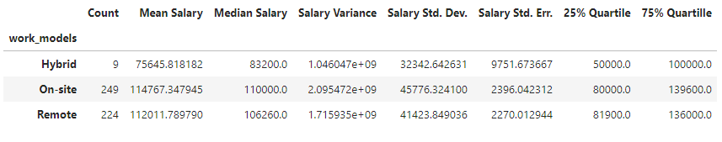
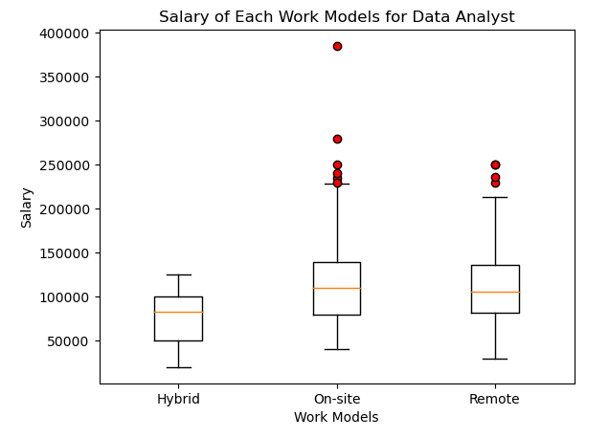
Data Analyst
There is no statistical difference in relation of work models to salary for a data analyst.

Slide 13
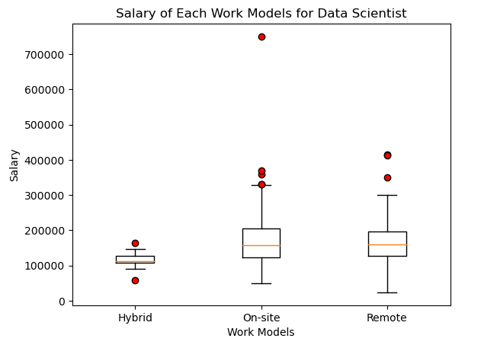
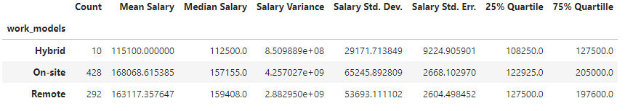
Data Scientist
There is no statistical difference in relation of work models to salary for a data scientist.

Slide 14
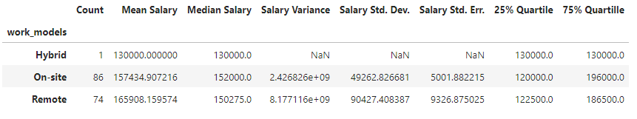
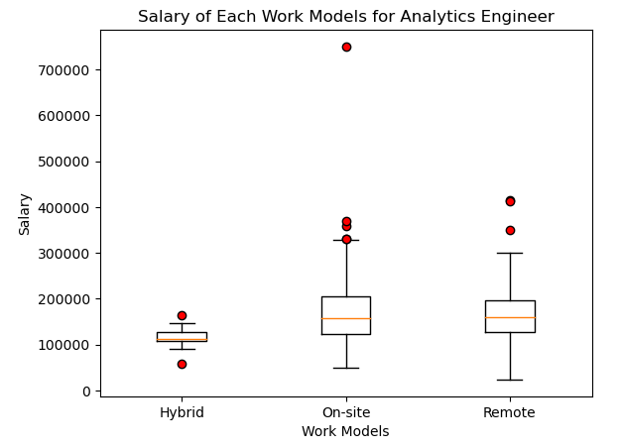
Analytics Engineer
There is no statistical difference in relation of work models to salary for a analytic engineer.

Slide 15
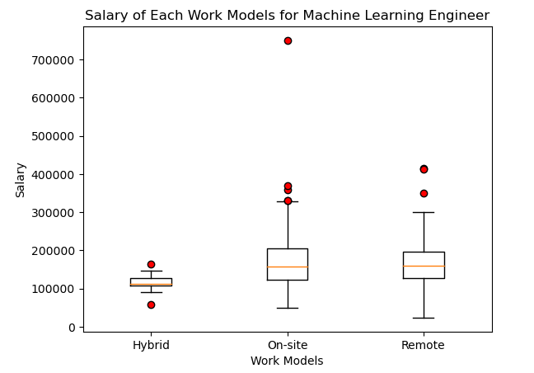
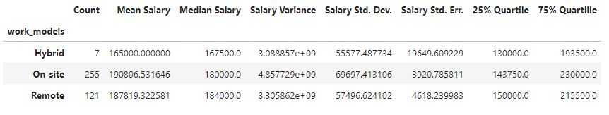
Machine Learning Engineer
There is no statistical difference in relation of work models to salary for a analytic engineer.

Slide 16
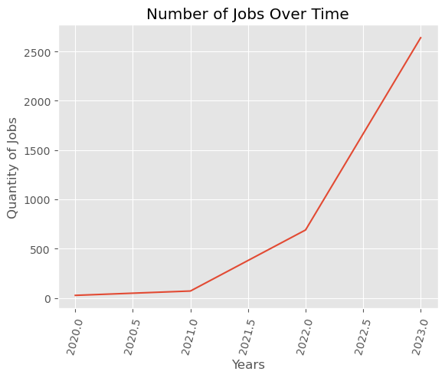
Trend of how a position has changes in demand over time and predicting their value for the future
Work Year Top Trending Job
----------- -------------------------
2020 Machine Learning Engineer
2021 Machine Learning Engineer
2022 Machine Learning Engineer
2023 Machine Learning Engineer
Notes:
When doing a comparison of the salaries, Machine Learning Engineer is the top sought after job each year.
‘Ggplot’ demonstrates rise in job quantity over time
First started with understanding the number of jobs over time. This graph is broken down into 6 month intervals starting in 2020 and ending in 2023.
The rising trend allows us to assume there will be a continuing incline in the number of jobs.
According to the Bureau of Labor Statistics, Employment of data scientists is projected to grow 35 percent from 2022 to 2032, much faster than the average for all occupations.
About 17,700 openings for data scientists are projected each year, on average, over the decade. Many of those openings are expected to result from the need to replace workers who transfer to different occupations or exit the labor force, such as to retire.
https://www.bls.gov/ooh/math/data-scientists.htm

Slide 17
Top 5 Jobs and Salaries Per Year
job_title | Analytics Engineer | Data Analyst | Data Engineer | Data Scientist | Machine Learning Engineer
2020 | 0.000000 | 95000.000000 | 110133.333333 | 158831.000000 | 179333.333333
2021 | 0.000000 | 100375.000000 | 140309.375000 | 145395.833333 | 161833.333333
2022 | 148310.975610 | 112619.839161 | 152188.520000 | 156070.048673 | 169167.518519
2023 | 165005.317881 | 113529.419890 | 159268.089947 | 168992.584735 | 192506.762019

Slide 18
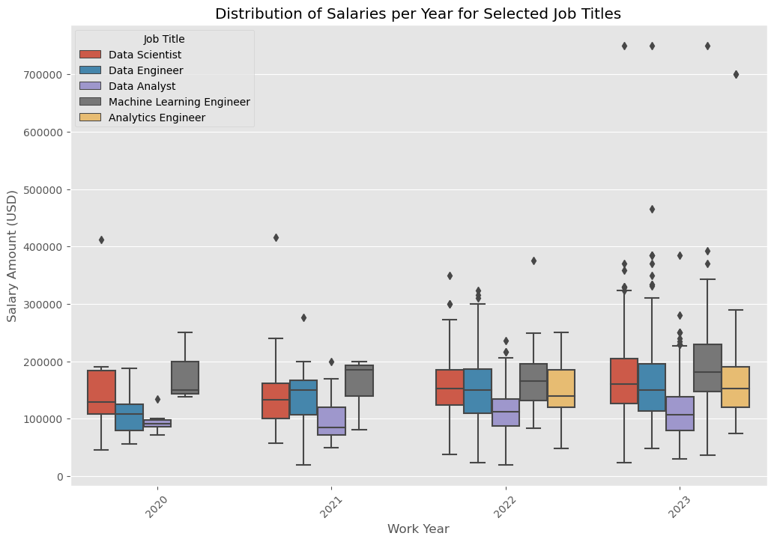
Different views of Distribution of Top 5 Job and Salaries Per Year
Notes:
The top 5 top titles we deduced in our analysis are: Analytics Engineer, Data Analyst, Data Engineer, Data Scientist, Machine Learning Engineer.

Slide 19
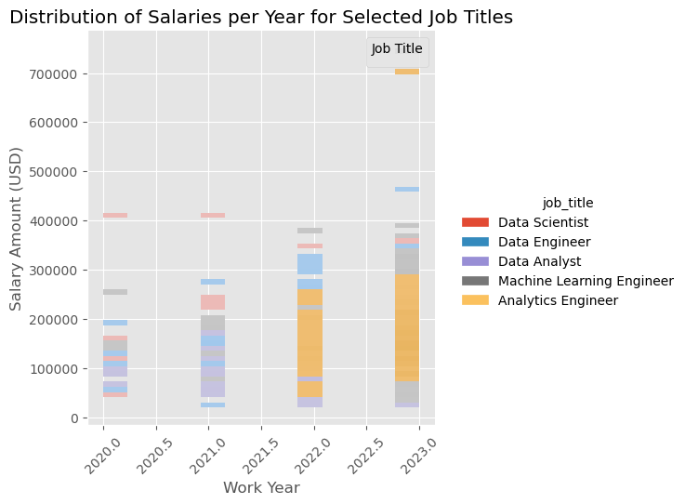

Slide 20
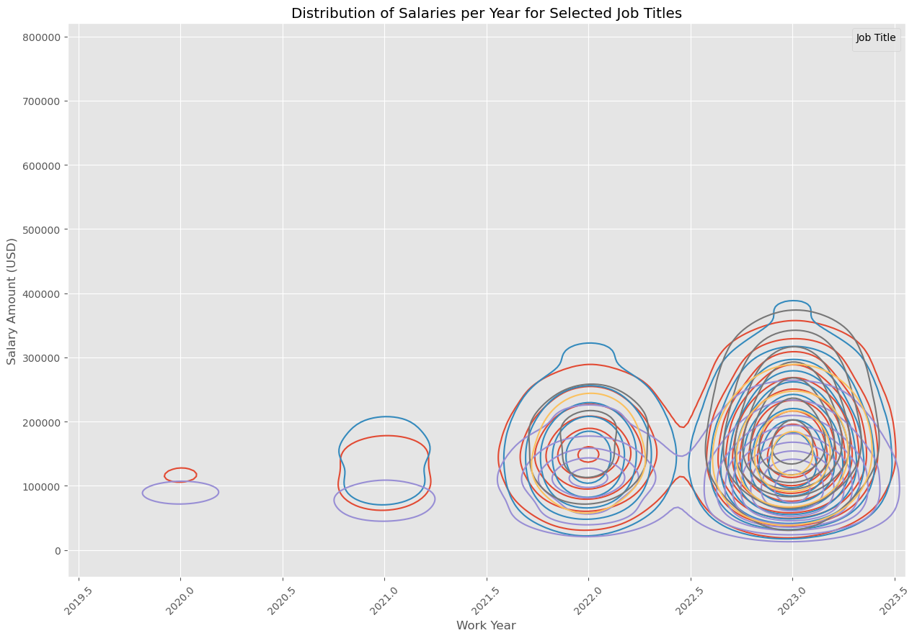
Growth and Prediction
Notes:
Same thing, different view which demonstrates the demand of jobs every year and how each job has grown interconnected.

