Slide 1

Calorease
Fitness and Dietary Tracking System
Submitted by:
Venkata Naveen Aduri
Devaki Tella
Sai Hemanth Mallam
Lokesh Chowdary Jasti
Sushma Sri Bujula
Santhoshini Goskula

Slide 2

Introduction
What is Calorease?
A fitness and dietary tracking application aimed at helping users maintain a healthy lifestyle.
Purpose:
Simplify fitness tracking by offering tools for logging workouts, meals, and weight trends.
Provide visual data insights for better decision-making.

Slide 3
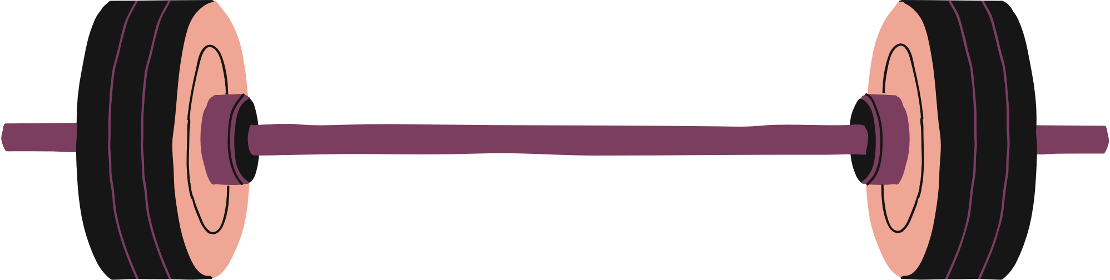

Project Goals
03
01
Deliver a seamless user experience through intuitive interfaces for logging, editing, and visualizing fitness and dietary data.
04
Provide users with an integrated platform to track workouts, dietary intake, and progress, encouraging a healthier lifestyle.
02
Implement robust validation, user authentication, and secure storage for personal and fitness-related information.
Allow users to easily log fitness and diet data, with visual tools to analyze trends over time.

Slide 4

Features Overview
User Registration and Login
Profile Management
Workout Tracking
Dietary Tracking
Visualization
Log and manage workouts with details like calories burned and workout type.
Update weight, change passwords, and delete accounts.
Record meals with nutritional details like calories, protein, and servings.
Graphs for workout trends, dietary patterns, and weight progress.
Create and manage user accounts.

Slide 5

User workflow
Signup
Login
Users register by entering their personal details (name, email, height, weight, etc.).
Users access the system with their email and password.
Navigation
Data Management
The Home Page provides options to go to User, Workout, Dietary, or Visualization pages.
Users can add, edit, or delete data in each section.

Slide 6
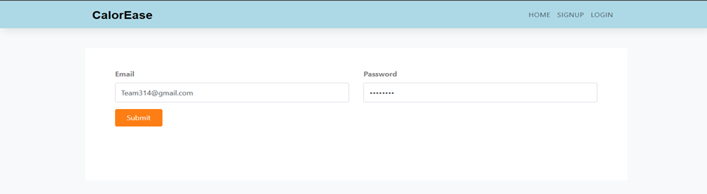
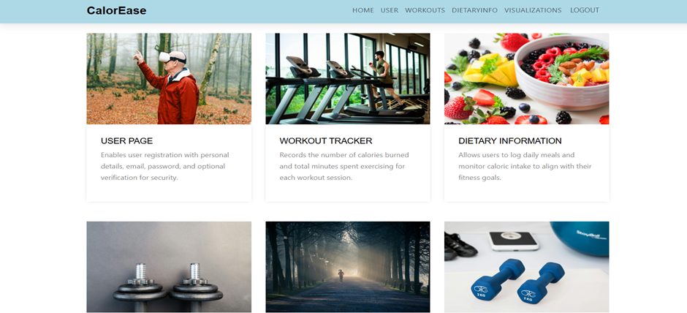
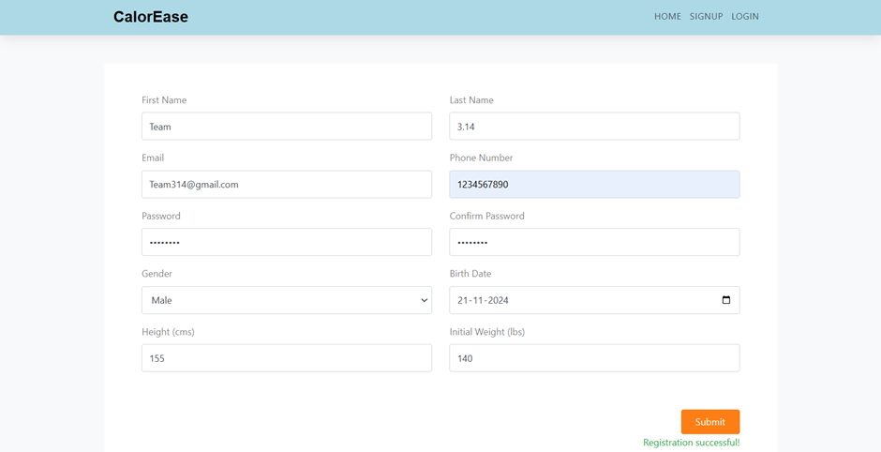
User interface
Login Page
Dashboard
Signup Page

Slide 7




User Page Features
EDIT PERSONAL
INFORMATION
MANAGE ACCOUNT
Eat nutritious foods such as fruits, vegetables, proteins, and whole grains.
Aim for 7-9 hours of sleep per night.
WEIGHT HISTORY
View and manage previously logged weights.
Add new weight entries or edit/delete existing ones.

Slide 8



Workout Page Features
LOG WORKOUTS
VIEW WORKOUTS
Enter details such as Workout Name, Duration, Calories Burned, and Description.
View logged workouts in a table format, filterable by date.
EDIT/DELETE WORKOUTS
Update or remove existing entries for accuracy and relevance

Slide 9

Dietary Page Features
LOG MEALS
VIEW MEALS
Enter details such as Meal Name, Calories, Protein, Serving Size, and Date.
See logged meal entries in a table format
EDIT/DELETE MEALS
Update meal information or delete irrelevant entries.

Slide 10


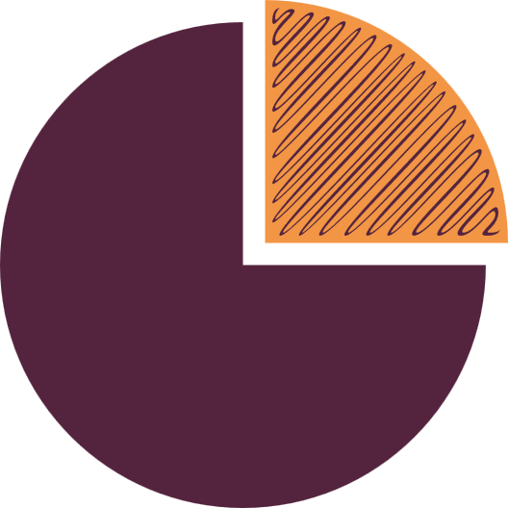

Visualization Page
WORKOUT TRENDS (BAR GRAPH)
DIETARY BREAKDOWN (PIE CHART)
Display calories burned over time based on workouts.
Show protein and calorie distribution for meals on a specific date.
WEIGHT PROGRESS (LINE GRAPH)
Visualize weight changes over time.

Slide 11
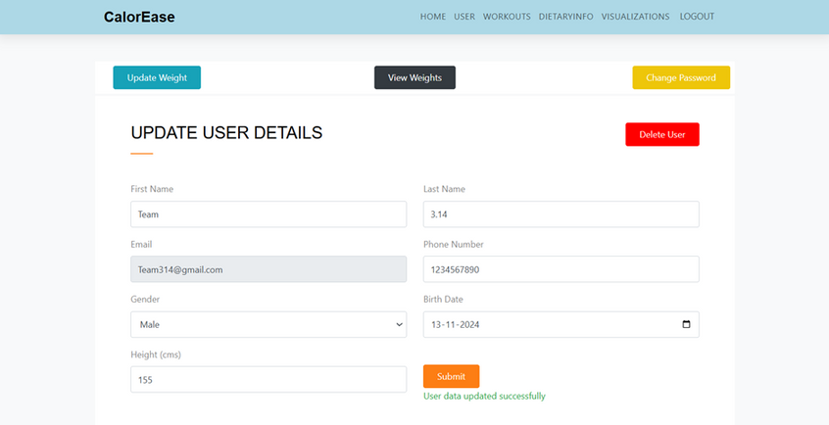
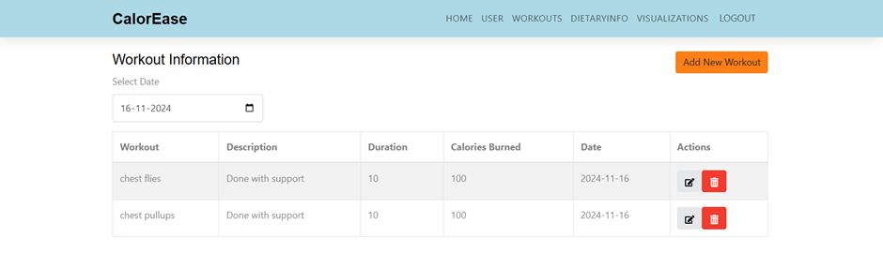
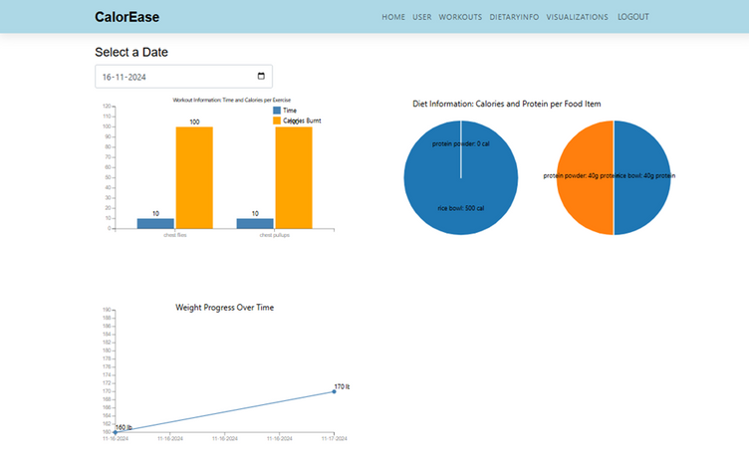
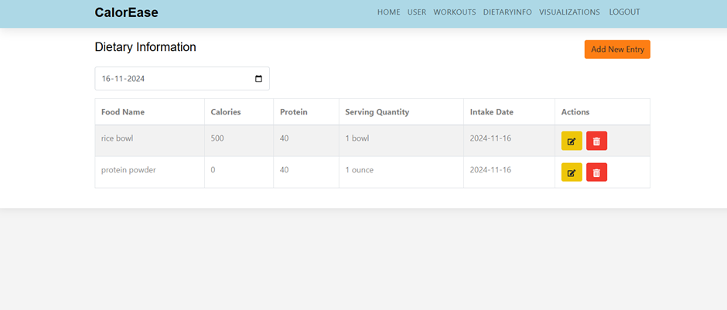
User interface
User Page
Workout Page
Visualization page
Dietary Info page

Slide 12


Additional Scenarios
Deleting Workouts
Changing Password
Users can delete specific workout entries after confirmation.
Requires the current password and confirmation of the new password.
Deleting Account
A confirmation ensures irreversible removal of user data.

Slide 13
Non-Functional Requirements
Performance: The program can manage a high volume of users and can execute with quick response times.
Usability: It's simple to navigate and easy to use the user interface.
Code quality : cleanliness and documentation are maintained.

Slide 14
Technology and software Requirements
Operating Systems: Windows 10/11 or macOS 13+ or Linux (Ubuntu 20.04+)
Frontend: React.js, Node.js (v14.0+)
Backend: Express.js with MySQL Database
Others: NPM (v6.0+), MySQL Workbench

Slide 15
Accomplishments
Implemented secure user registration and login with data validation.
Developed workout and dietary tracking tools with edit/delete options.
Created interactive graphs for tracking progress over time.
Enabled users to manage personal information and account settings.
Ensured secure session management with a reliable logout feature.
Designed a scalable framework for future enhancements.

Slide 16
Future Scope
Add Smart Meal Suggestions:
Use AI and user data (e.g., dietary preferences, fitness goals) to recommend meals tailored to calorie and nutrient requirements, helping users make healthier food choices.
Offer Better Health Insights:
Implement advanced analytics to provide users with detailed reports, trends, and predictions, such as workout effectiveness or expected progress toward weight and fitness goals.

Slide 17
Thank you!

