Slide 1
Multi-style Image Morphing System based on GANs and XDoG
Project Presentation
魏嘉威106061537 卓言9861811 王泓崴106061621
許凱碩105061578 林鉉博105061592 郭韋良105061521

Slide 2
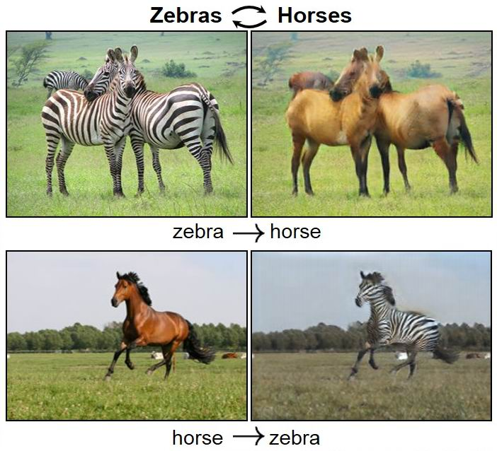
Introduction / Motivation
* CycleGAN is promising to transfer style from one image to another...
* But, how about such style transfer on 'video' ???
* Cameras are everywhere, to plan style ahead that matters.
* We have morphing to check transfer details, and
* We also include XDoG to compare pros & cons of cycleGAN
* Let's kick-off the journey of GREAT MOVIE DIRECTOR !!!

Slide 3
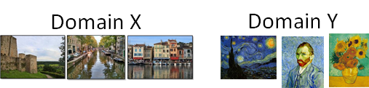
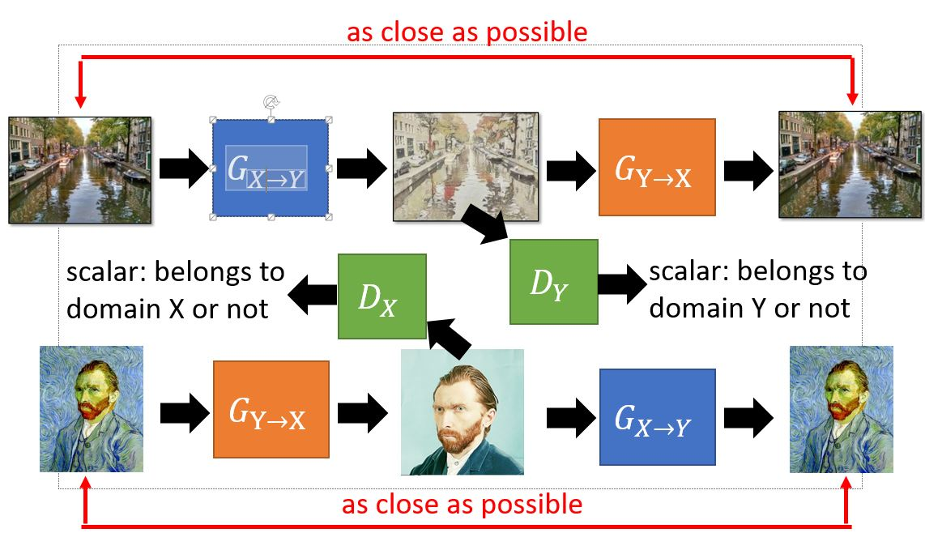
CycleGAN

Slide 4
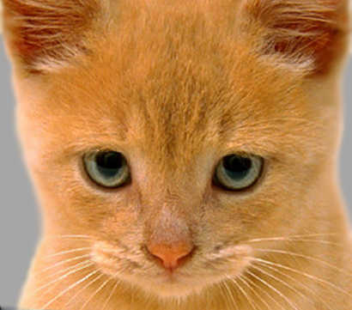
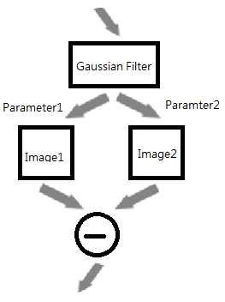
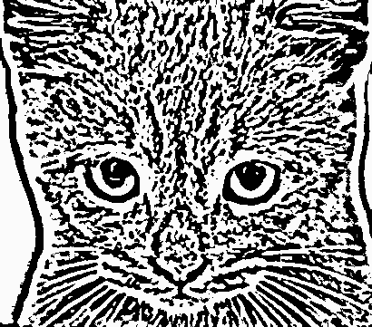
XDoG / Image Morphing

Slide 5
Experiment Steps
Take Few
Video
Video to Frame
CycleGAN
XDoG
Morphing
Pick Up
Frame to Video
1. Take few videos with different scenes. Ex:30 fps
2. Slice each video into several continuous still images.
3. Optimize parameters of CycleGAN or XDoG for each sliced still image, and transform then.
4. Set several morphing degree from original image to transformed image. Ex:30x10=300 images
5. Along time axis, pick up each still image with proper morphing degree to show continuous changes. Ex:300 pick up =30 images
6. Archive these images, and form back video again.

Slide 6
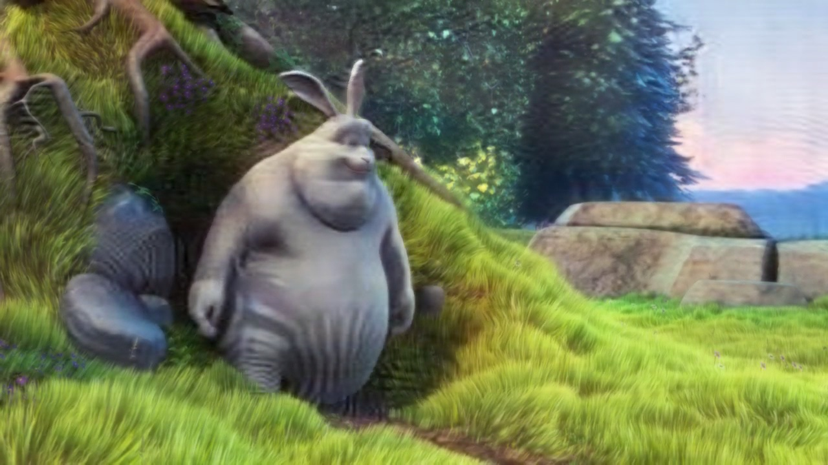
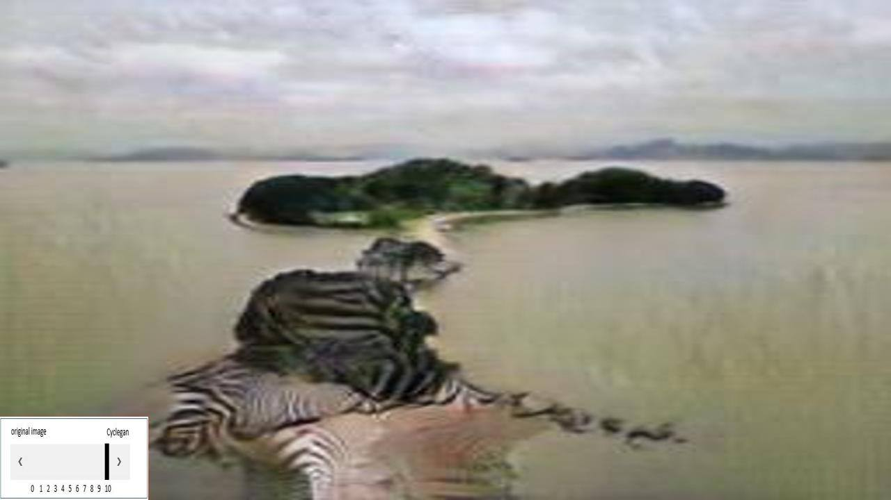
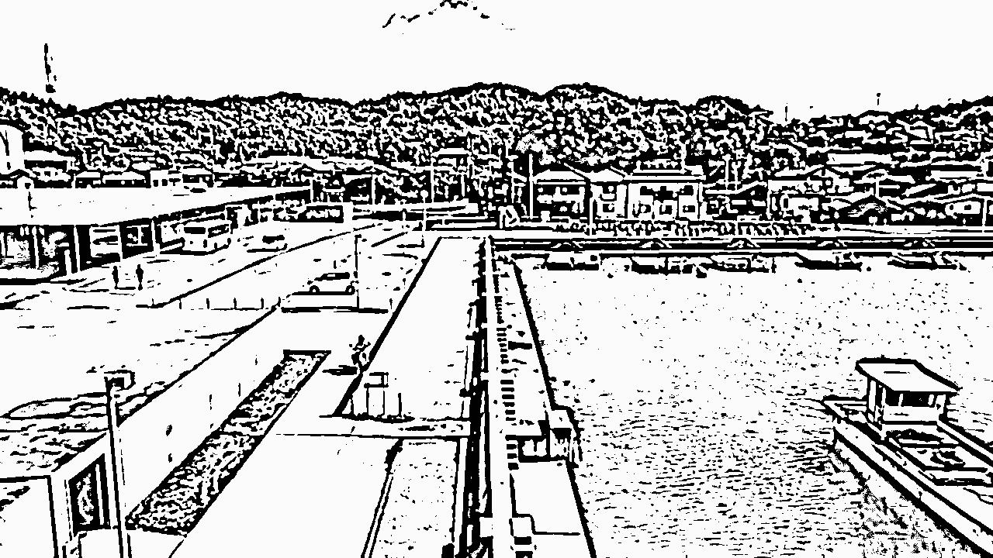
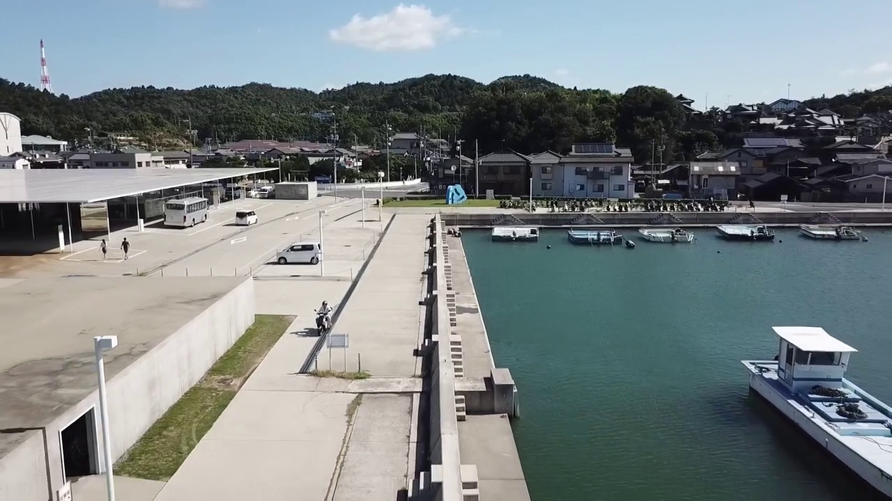
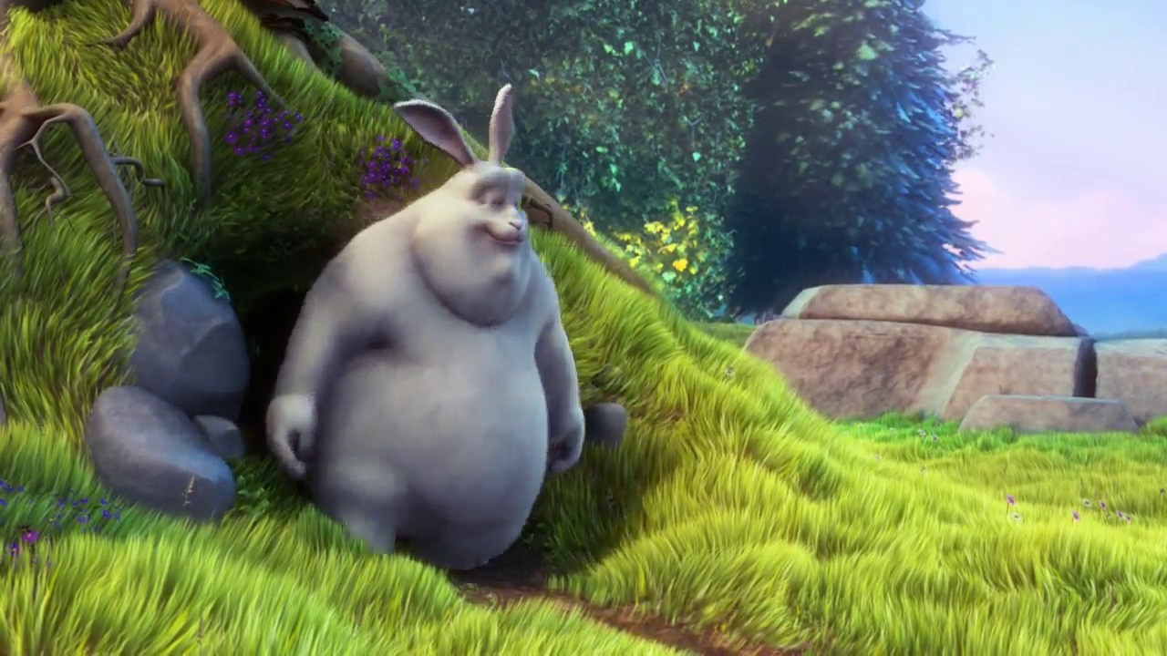
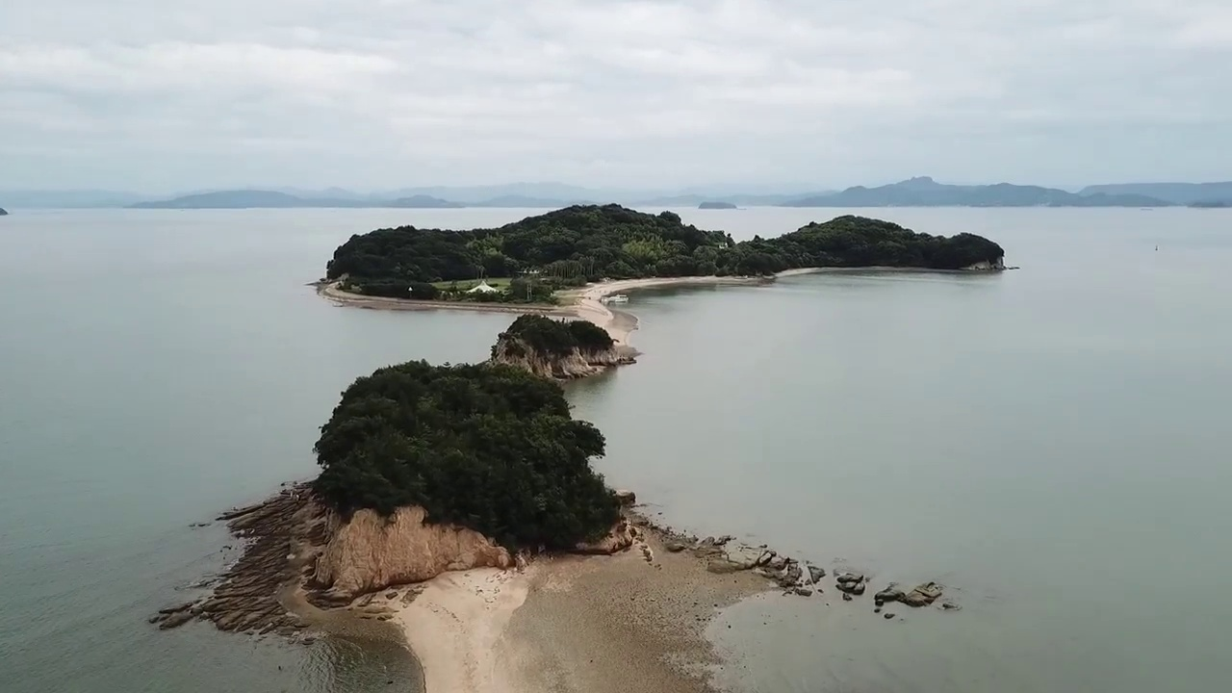
Result Discussion
Our model was trained on the wild horse and zebra synsets of ImageNet.
So may cause some problems when the testing data are not horses.
Variety of the testing data will make different results of better performance or not.
XDoG shows better performance while comparing to the result of CycleGAN.
CycleGAN of Rat
CycleGAN of Island
XDoG of Port
So mret 256x256
Original
Rat
Original
Island

Slide 7
Conclusion
With different morphing degree, movie style is easier to be inspired & planned ahead.
Though cycleGAN promises us unpaired image-to-image translation during training phase, in fact, similar to input stuffs in train pool is still necessary.
As reference, XDoG is simpler for preparation, yet the style is limited and transform proceeds irreversible.
Well-trained cycleGAN for video takes efforts to widely train, yet it deserves.

