Slide 1
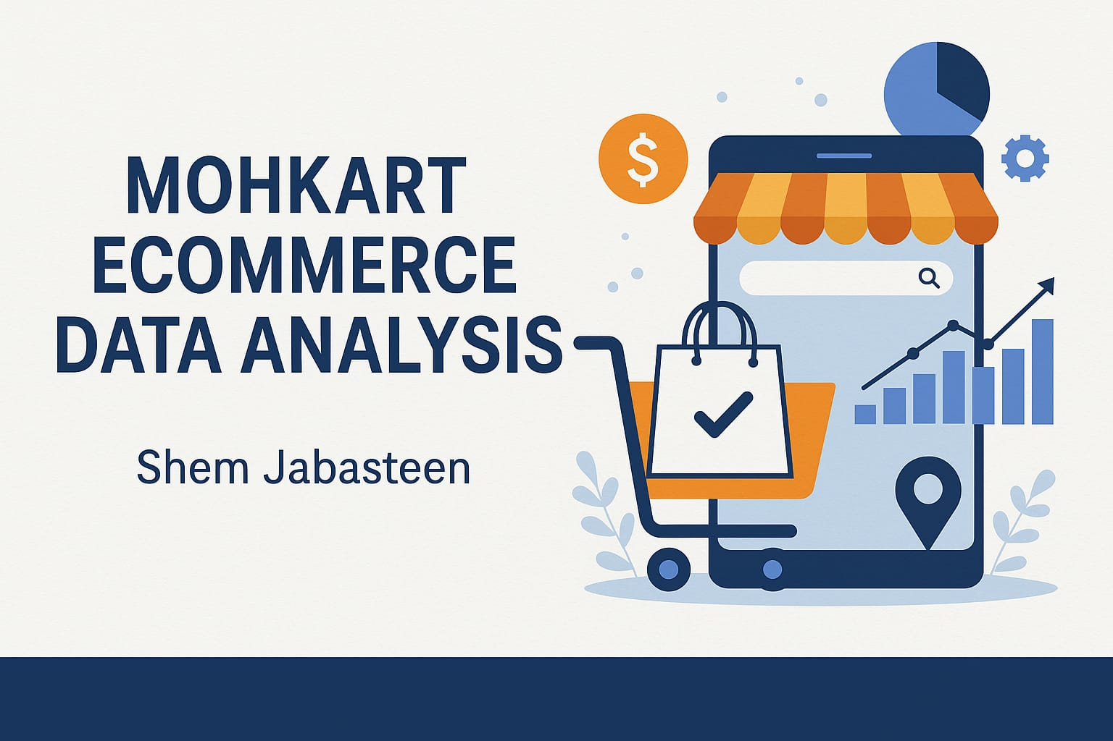

Slide 2
Executive Summary
Analyzed customer transactions and browsing behavior from Mohkart's e-commerce data.
Built a Tableau dashboard with 10 sheets covering city, time, product, device, and customer segment insights.
Key goal: Identify patterns to boost sales, improve engagement, and segment customers better.

Slide 3
Key Insights
Top Cities: Surat, Lucknow, and Gwalior are the top-performing cities in terms of total revenue, suggesting these regions have a strong e-commerce presence and should be prioritized for exclusive offers, loyalty programs, and premium delivery services.
Cities like Vijayawada, Tiruppur, and Faridabad fall in the mid-range of revenue but have room to grow. These could be strategic targets for regional expansion using influencer marketing or trust-building initiatives to increase conversion

Slide 4
Key Insights
1.Peak Performance Midweek:
Wednesday records the highest sales, highlighting midweek as a prime time for high-value campaigns, flash sales, or product launches.
2.Weekdays > Weekends:
Monday to Friday consistently outperform weekends, suggesting that users are more likely to browse and shop during the workweek—focus marketing spend and retargeting here.
3.Weekend Strategy Needed:
Saturday and Sunday show a dip, indicating a need to improve engagement—consider mobile-first content, gamification, or weekend-exclusive discounts to boost conversions.

Slide 5
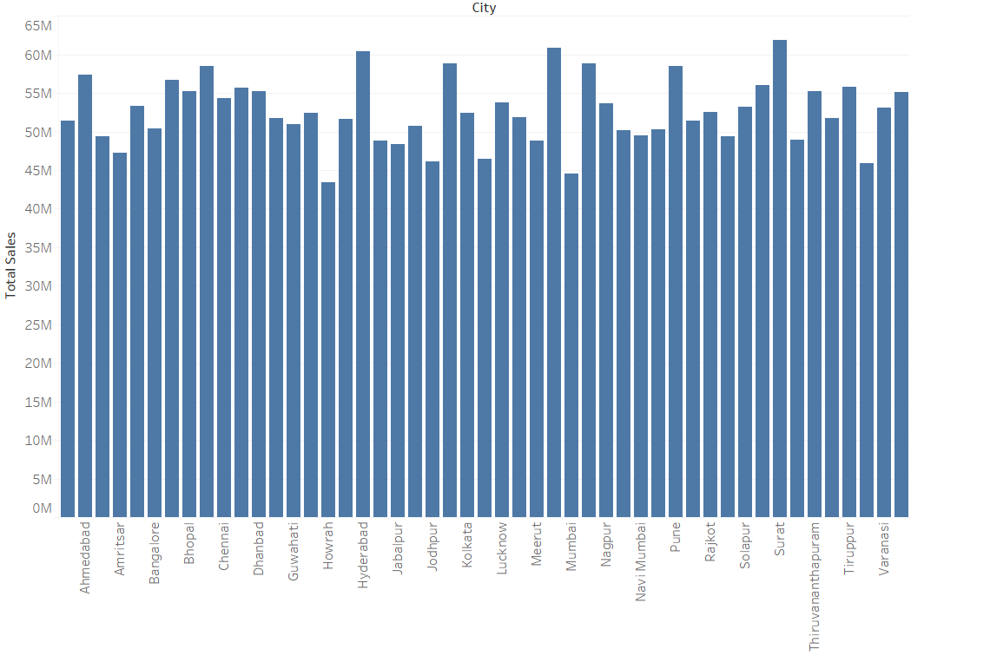
City Wise Sales

Slide 6
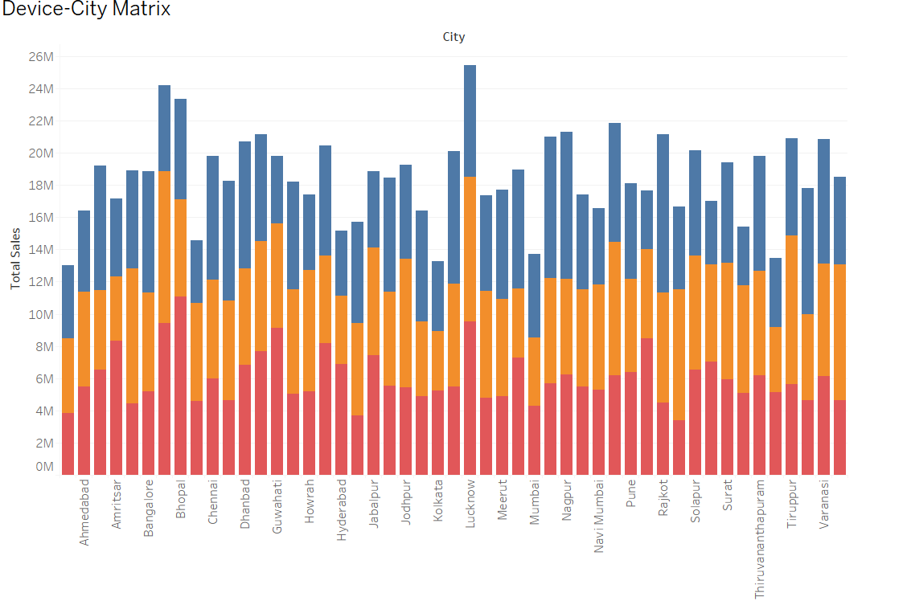

Slide 7
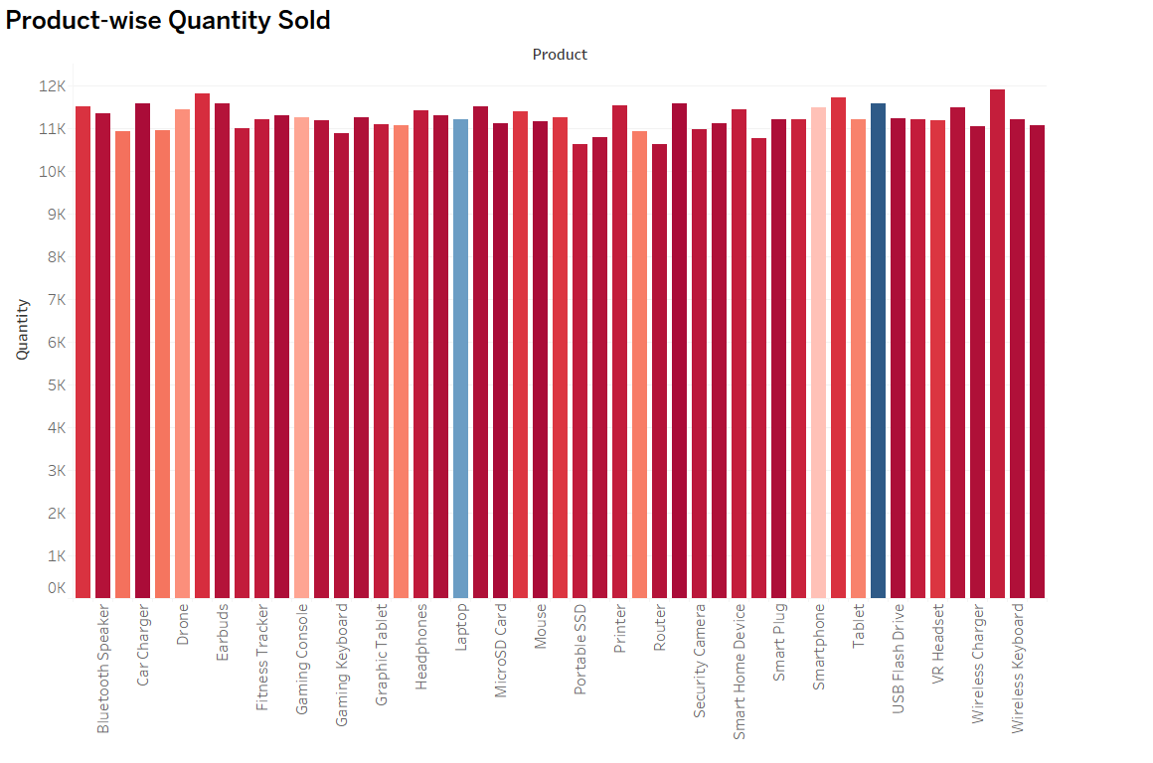

Slide 8
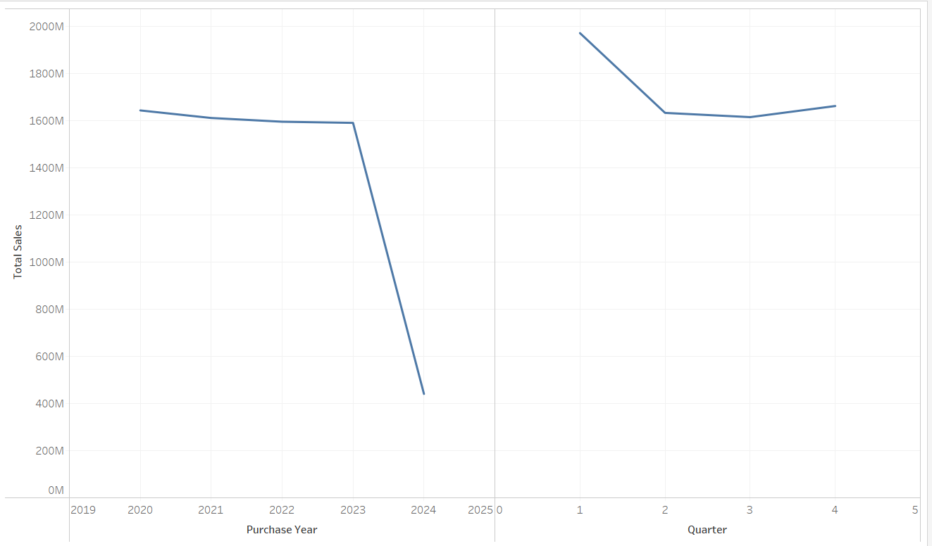
Purchase analysis over year

Slide 9
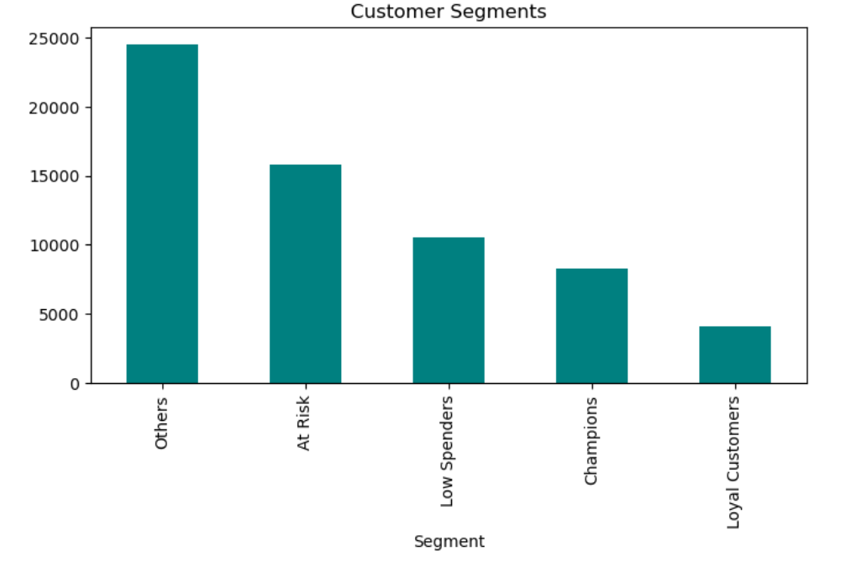
Customer Segmentation Strategy
Champions: High spenders; retain with loyalty perks.
Bargain Shoppers: High browsing, low spend; target with discounts.
Impulse Buyers: Low browse, high spend; target with flash deals.
Window Shoppers: Browse a lot, buy little; re-target with reminders.

Slide 10
Action Plan & Dashboard Demo
Targeted Campaigns: Focus on city-based and time-slot-specific offers.
Personalization: Segment-wise strategies to convert 'Others' to loyal users.
Demo: Dashboard highlights sales by city, device use, time slot patterns, and segment profiles.
Thank you!

