Slide 1
F1
Podium Prediction
Interpretable Machine Learning Project
By Sunny Shen

Slide 2
Problem & Dataset
Can we predict if a driver will finish on the podium using only pre-race data?
Target
Class balance
Binary classification — podium (1) if finish position ≤ 3, else 0
~15% podium rate — only 3 of ~20 drivers podium per race
Era
Train / Test
2010–2023, filtered to the modern era to keep regulations consistent
Temporal split: trained on 2010–2020, evaluated on 2021–2023
Source
Why temporal split?
Ergast API — results, qualifying, races, drivers, constructors
A random split would leak future race data into training, leading to an invalid evaluation

Slide 3
Feature Engineering
grid_position
Raw → kept as-is
Where the driver qualified. Ended up being the strongest predictor of race outcome.
rolling_pts_3
Engineered — needs .shift(1) to avoid leakage
Average points over the driver's last 3 races. Captures current form and momentum.
constructor_avg_pos
Engineered — rolling season average
Team's average finishing position this season - a proxy for car performance.
is_top3_grid
Engineered — derived from grid_position
Binary flag — whether the driver started P1, P2 or P3. Captures the pole position advantage non-linearly.
constructor_podium_rate
Engineered — mean encoding
Team's historical podium rate across all seasons. Encodes long-term constructor strength.

Slide 4
Models Used
Logistic Regression
Decision Tree
Random Forest
Linear baseline
Main interpretable model
Ensemble comparison
Models podium probability as a sigmoid function of the features — draws a linear decision boundary in feature space
Splits on the feature and threshold that best separates podium from non-podium at each node, using Gini impurity
Trains 100 trees on random bootstrap samples and feature subsets, then combines predictions by majority vote
Each learned coefficient shows a feature's direction and magnitude of effect on the log-odds
max_depth=4 and min_samples_leaf=20 keeps the tree readable and prevenst overfitting
Reduces variance through randomness
no single tree can be read, so individual predictions can't be explained
Used as a linear baseline
if a more complex model can't beat it, the added complexity isn't justified
Every prediction traces from root to leaf, so we can explain exactly why each driver was classified
Included as an upper-bound benchmark to quantify the accuracy cost of choosing the interpretable tree

Slide 5
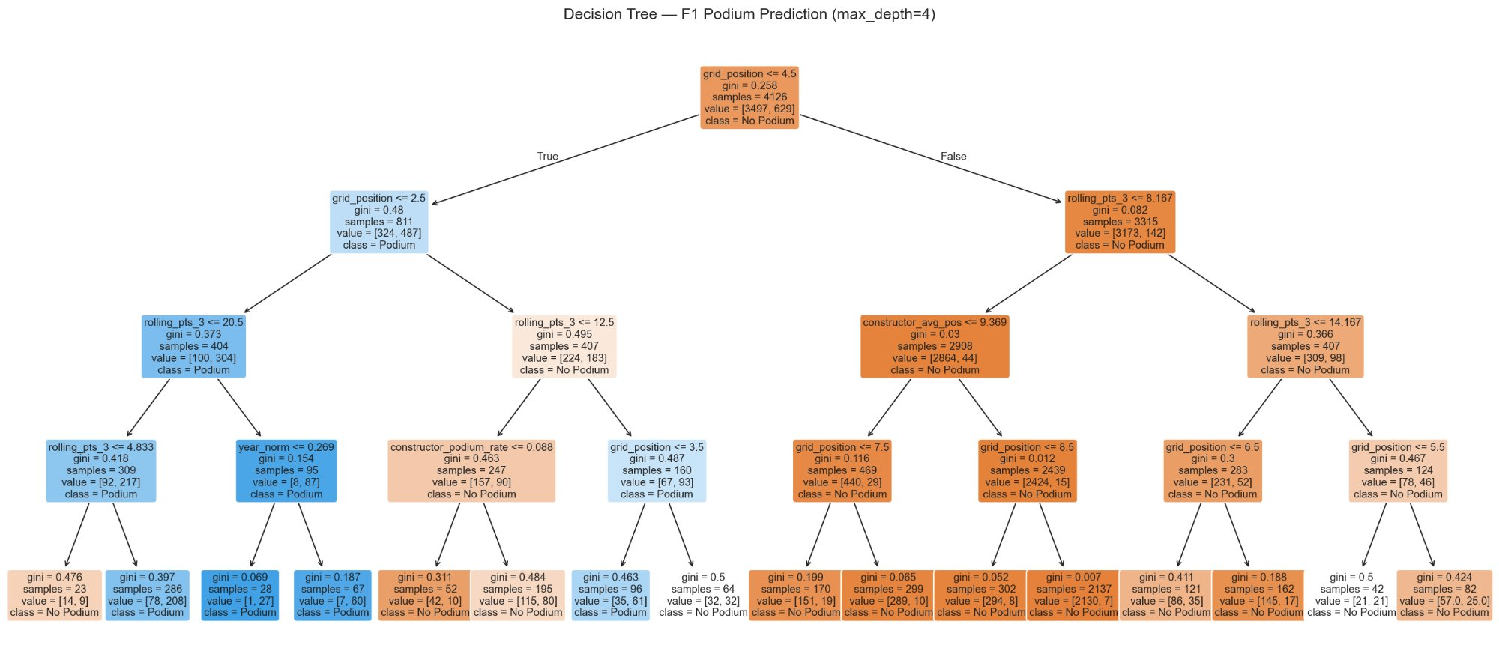
The Decision Tree
Root split: grid_position ≤ 4.5 — qualifying is the most important decision

Slide 6
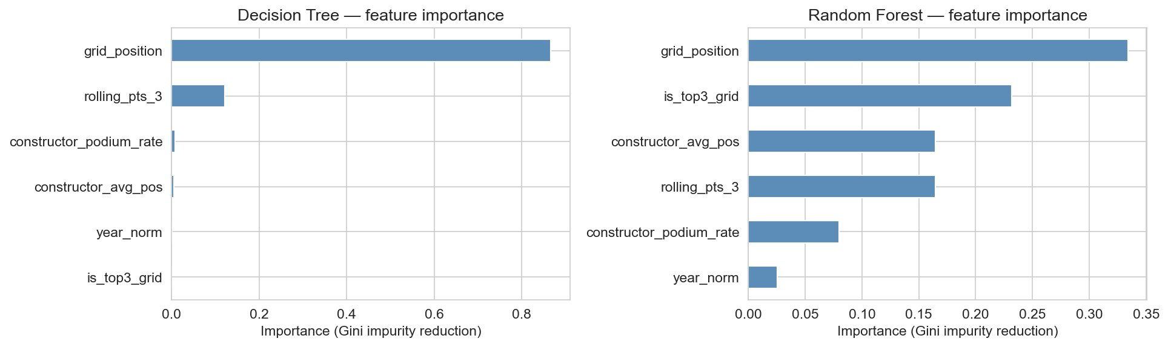
Feature Importance
Key insight: The single tree concentrates almost all importance on grid_position (>0.8). The random forest distributes weight more evenly, which likely explains why it generalizes better.

Slide 7
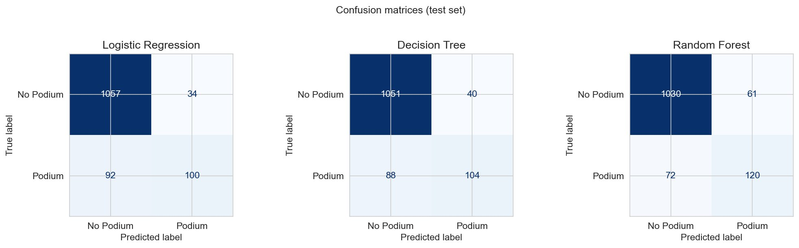
Confusion Matrices
100
104
120
LR caught — true podiums
DT caught — true podiums
RF caught — true podiums

Slide 8
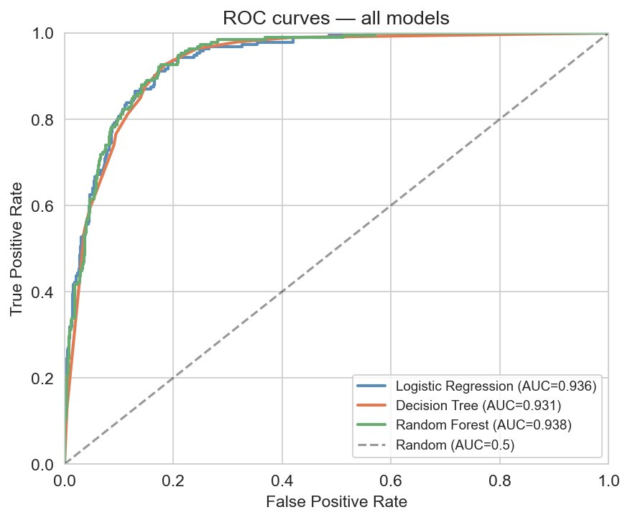
ROC Curves & AUC
0.936
Logistic Regression AUC
0.931
Decision Tree AUC
0.938
Random Forest AUC
All three models score ~0.93 AUC
Observation: the interpretable Decision Tree closes the gap to within 0.007 of the ensemble.

Slide 9
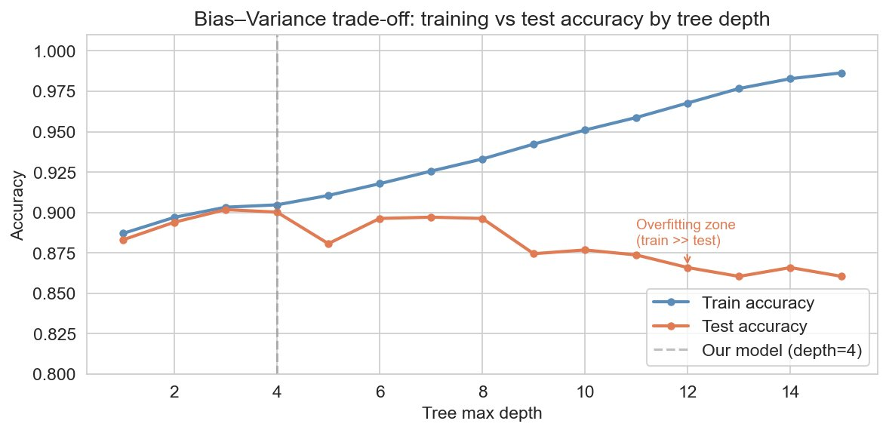
Overfitting Investigation
Depth 1–2
High bias. The model is too constrained to capture real patterns.
Depth 4 ← our model
Train and test accuracy converge. Optimal generalisation point.
Depth 8+
Training accuracy climbs but test accuracy drops. The model memorises training data.
Takeaway: As depth increases, training accuracy keeps climbing. Test accuracy peaks around depth 4 then falls. This is the bias–variance trade-off playing out in real data.

Slide 10
Key Insights
01
02
Qualifying dominates
Driver form adds predictive signal
grid_position was the strongest predictor by a wide margin. The tree's root split at ≤ 4.5 alone accounts for the majority of correct classifications.
rolling_pts_3 ranked second in importance. Recent points momentum meaningfully improves predictions beyond grid position alone.
03
04
Interpretability with minimal cost
The model can't predict chaos
The Decision Tree (AUC 0.931) trails the Random Forest (0.938) by only 0.007 while offering better transparency
False negatives tend to cluster in rain races, safety car periods, and DNFs ahead of the driver—events that no structured pre-race features or CSV data can fully capture.

Slide 11
What We Learned
Data preprocessing
We spent more time on data preparation than modelling. The Ergast dataset uses \N for nulls, had some qualifying rows are missing entirely, and we had to apply .shift(1) to our rolling features to prevent the model from seeing the current race's result when predicting it.
Feature engineering
Raw columns rarely feed straight into a model. Rolling averages, binary flags, and mean-encoding transformed the data into something useful.
Model evaluation
The initial accuracy of ~88% looked good until we realized a naive classifier that always predicts no podium would score ~85% due to class imbalance. AUC and F1-score gave a far more honest picture of model quality.
Interpretable ML
Being able to open the Decision Tree and trace exactly why it predicted a podium felt very useful. The Random Forest is only 0.007 AUC better, which isn’t enough to justify losing that level of explainability.

Slide 12
Thank You
Questions?

